Slide 1

An explicit OWL representation of ISO/OGC Observations and Measurements
Comparison with SSN ontology
Simon Cox | Research Scientist | Environmental Information Systems
17 October 2013
Land and water

Slide 2
Outline
Methodology for O&M in OWL
Challenges in converting from UML
Expressivity
Alignment

Slide 3
Observations and Measurements

Slide 4
ISO 19156 Observations and Measurements
OM_Observation
GF_PropertyType
GFI_Feature
+featureOfInterest
+
phenomenonTime
1
1
0..*
+
resultTime
+observedProperty
+
validTime [0..1]
+
resultQuality [0..*]
+
parameter [0..*]
0..*
Range
1
+procedure
+result
OM_Process
Any
An Observation is an action whose result is an estimate of the value
of some property of the feature-of-interest, obtained using a specified procedure
Cox, OGC Abstract Specification – Topic 20: Observations and Measurements 2.0
ISO 19156:2011 Geographic Information – Observations and measurements

Slide 5
ISO 19156 Sampling features
Domain feature type
+sampledFeature
GFI_Feature
SamplingFeatureComplex
0..*
Intention
+
role
SF_SamplingFeature
0..*
+relatedSamplingFeature
+
parameter [0..*]
+relatedObservation
OM_Observation
0..*
+
lineage [0..1]
+relatedObservation 0..*
0..*
SF_SpatialSamplingFeature
+shape
GM_Object
+
positionalAccuracy [0..2]
SF_Specimen
SF_SamplingPoint
SF_SamplingCurve
SF_SamplingSurface
SF_SamplingSolid
Station
Traverse
MineLevel
MapHorizon
Borehole
Section
Mine
Cox, OGC Abstract Specification – Topic 20: Observations and Measurements 2.0
ISO 19156:2011 Geographic Information – Observations and measurements

Slide 6
UML → OWL Conversion rules

Slide 7
ISO 19150-2 (2015?)
UML Package → OWL Ontology
UML Class → OWL Class
UML Attribute/Association role → RDF Property
UML Stereotype → OWL Class

Slide 8
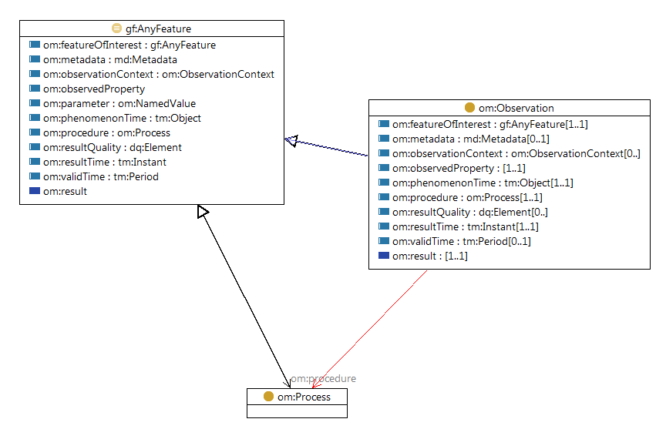
om:Observation class
(TopBraid diagram view)

Slide 9
UML-OWL mismatches
UML is frame-based
  Attributes owned by classes
  Association-roles owned by classes
  property redefinition/refinement uncommon and complicated
RDF is open-world
  Properties scoped to Ontology (namespace)
  Property re-use expected
  rdfs:subPropertyOf easy, commonly used

Slide 10
Options for defining properties
Frame-based
  Name scoped to class
  Narrow rdfs:domain
  Narrow rdfs:range
  Strict cardinality constraints
om:Observation.resultTime
a owl:ObjectProperty ;
rdfs:label "Result time"@en ;
rdfs:domain om:Observation ;
rdfs:range tm:Instant .
Open-world
  Name scoped to namespace
  Generic rdfs:domain
  Narrow rdfs:range
  Loose cardinality constraints
om:resultTime
a owl:ObjectProperty ;
rdfs:label "Result time"@en ;
rdfs:domain gf:AnyFeature ;
rdfs:range tm:Instant .

Slide 11
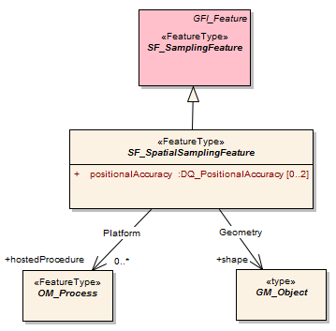
Complete example – lax form
sam:SF_SpatialSamplingFeature
a owl:Class ;
rdfs:label "Spatial sampling feature"@en ;
rdfs:subClassOf gf:AnyFeature , sam:SF_SamplingFeature ;
rdfs:subClassOf
[ a owl:Restriction ;
owl:cardinality "1"^^xsd:nonNegativeInteger ;
owl:onProperty sam:shape ] ;
rdfs:subClassOf
[ a owl:Restriction ;
owl:minCardinality "0"^^xsd:nonNegativeInteger ;
owl:onProperty sam:positionalAccuracy ] ;
rdfs:subClassOf
[ a owl:Restriction ;
owl:maxCardinality "2"^^xsd:nonNegativeInteger ;
owl:onProperty sam:positionalAccuracy ] ;
rdfs:subClassOf
[ a owl:Restriction ;
owl:minCardinality "0"^^xsd:nonNegativeInteger ;
owl:onProperty sam:hostedProcedure ] ;
skos:notation "SF_SpatialSamplingFeature"^^h2o:ISOClassName .

Slide 12
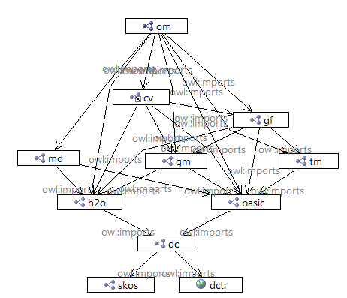
O&M integrated into ISO framework
Direct dependencies
  Feature ISO 19109
  Geometry ISO 19107
  Temporal ISO 19108
  Coverage (fields) ISO 19123
  Metadata (!) ISO 19115
  Meta-model ISO 19150-2
  Basic datatypes ISO 19103
No other alignment attempted at this time

Slide 13
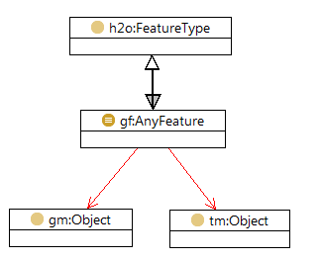
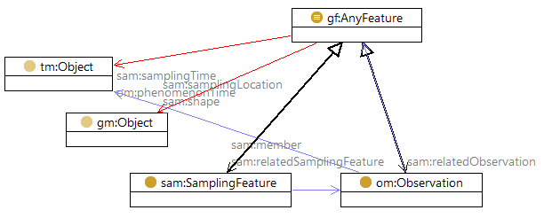
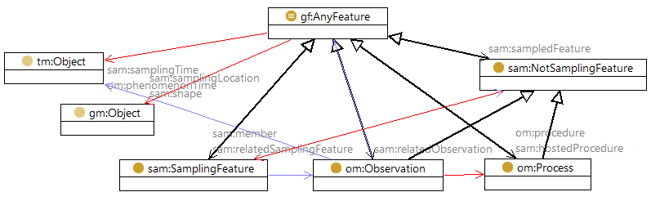
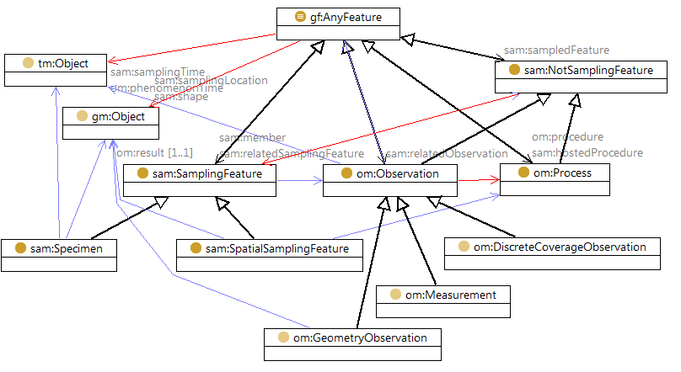
ISO/OGC Feature Model
Feature disjoint with Geometry
  feature is not geometry
  feature has geometry

Slide 14
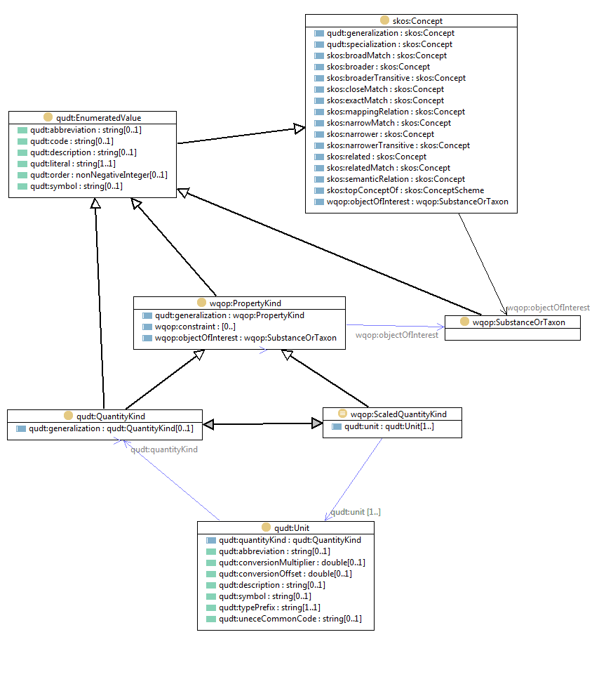
O&M linked to QUDT
OM_Observation
GF_PropertyType
GFI_Feature
+featureOfInterest
+
phenomenonTime
1
1
0..*
+
resultTime
+observedProperty
+
validTime [0..1]
+
resultQuality [0..*]
+
parameter [0..*]
0..*
Range
1
+procedure
+result
OM_Process
Any
om:observedProperty
a owl:ObjectProperty ;
rdfs:domain gf:AnyFeature ;
rdfs:label "Observed property"@en ;
skos:definition """The association Phenomenon shall link the OM_Observation to the GF_PropertyType for which the OM_Observation:result provides an estimate of its value."""^^xsd:string .

Slide 15
Compare with SSN

Slide 16
Side by side instances
p1:obsTest1
rdf:type om:Measurement ;
om:featureOfInterest <http://wfs...&featureid=fruit37f> ;
om:observedProperty <http://sweet.jpl.nasa.gov/2.0/phys.owl#Mass> ;
om:phenomenonTime p1:ot1t ;
om:procedure p1:Sscales1 ;
om:result
[ rdf:type basic:Measure ;
basic:uom <http://www.opengis.net/def/uom/UCUM/0/kg> ;
basic:value "0.28"^^basic:Number ] ;
om:resultTime p1:ot1t ;
om:parameter
[ rdf:type om:NamedValue ;
om:name <http://sweet.jpl.nasa.gov/2.0/physThermo.owl#Temperature> ;
om:value
[ rdf:type basic:Measure ;
basic:uom <http://www.opengis.net/def/uom/UCUM/0/Cel> ;
basic:value "22.3"^^basic:Number ] ] .
p1:Sscales1
rdf:type om:Process ;
rdfs:label "Salter scales"^^xsd:string .
p1:ot1t
rdf:type tm:Instant ;
tm:dateTimePosition "2005-01-11T16:22:25.00"^^xsd:dateTime .
p1:obsTest1
rdf:type ssn:Observation ;
ssn:featureOfInterest <http://wfs...&featureid=fruit37f> ;
ssn:observedProperty <http://qudt.org/vocab/quantity#Mass> ;
ssn:observationSamplingTime p1:ot1t ;
ssn:observedBy p1:Sscales1 ;
ssn:observationResult
[ rdf:type ssn:SensorOutput ;
ssn:hasValue
[ rdf:type DUL:Amount , ssn:ObservationValue ;
DUL:hasDataValue "0.28"^^xsd:float ;
DUL:isClassifiedBy <http://qudt.org/vocab/unit#Kilogram> ] ;
ssn:isProducedBy p1:Sscales1 ] ;
ssn:observationResultTime p1:ot1t ;
DUL:hasSetting p1:tempObsTest1 .
p1:tempObsTest1
a ssn:Observation ;
rdfs:comment "Observation of temperature context for measurement of fruit mass"^^xsd:string ;
...
DUL:isSettingFor p1:obsTest1 .
p1:Sscales1
rdf:type ssn:SensingDevice ;
rdfs:label "Salter scales"^^xsd:string .
p1:ot1t
rdf:type DUL:Amount ;
DUL:hasDataValue "2005-01-11T16:22:25.00"^^xsd:dateTime .

Slide 17
ISO 19156 Sampling features
+sampledFeature
GFI_Feature
SamplingFeatureComplex
0..*
Intention
+
role
SF_SamplingFeature
0..*
+relatedSamplingFeature
+
parameter [0..*]
+relatedObservation
OM_Observation
0..*
+
lineage [0..1]
+relatedObservation 0..*
0..*
SF_SpatialSamplingFeature
+shape
GM_Object
+
positionalAccuracy [0..2]
SF_Specimen
SF_SamplingPoint
SF_SamplingCurve
SF_SamplingSurface
SF_SamplingSolid
Cox, OGC Abstract Specification – Topic 20: Observations and Measurements 2.0
ISO 19156:2011 Geographic Information – Observations and measurements

Slide 18
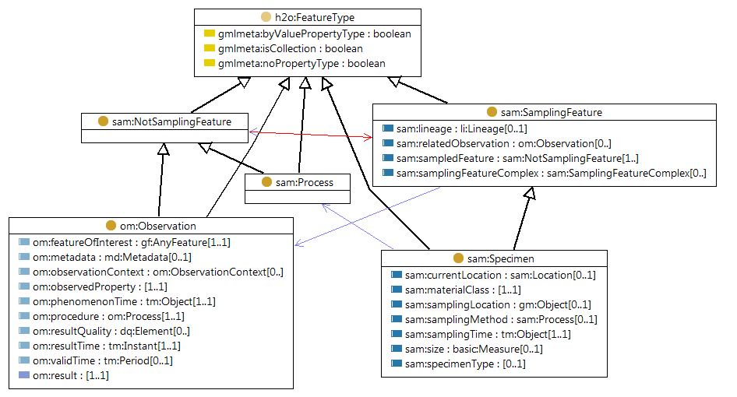
sam:Specimen

Slide 19
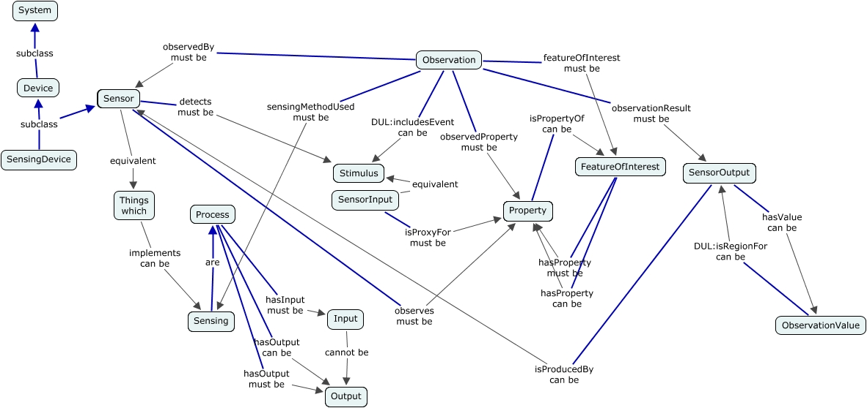
O&M vs SSN
OM_Observation
GF_PropertyType
GFI_Feature
+featureOfInterest
+
phenomenonTime
1
1
0..*
+
resultTime
+observedProperty
+
validTime [0..1]
+
resultQuality [0..*]
+
parameter [0..*]
0..*
Range
1
+procedure
+result
OM_Process
Any

Slide 20
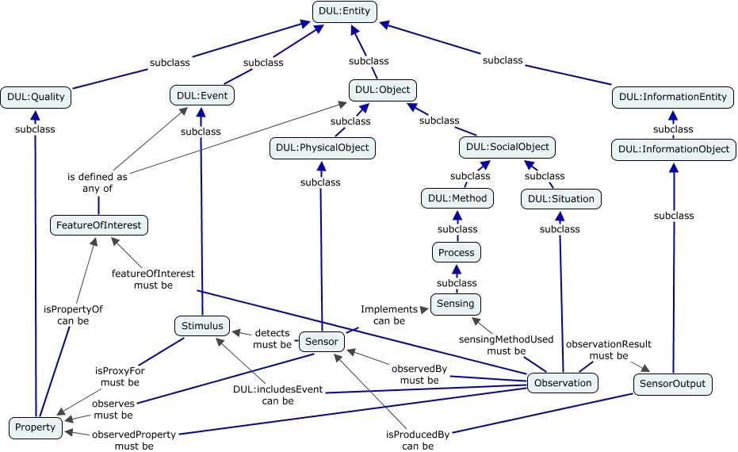
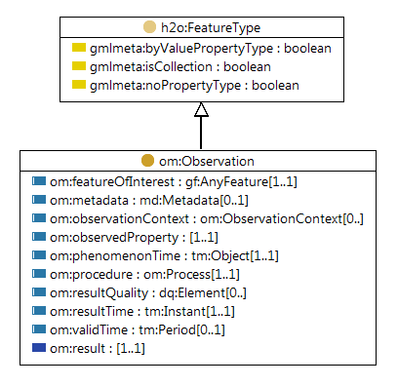
SSN alignment

Slide 21
Alignment strategy
SSN
  Syntactic/semantic alignment (UML→OWL/RDF+DUL) in one step
  Conflates concerns?
OM
  UML→OWL ‘syntactic’ alignment first
  Semantic alignment (various) in later steps, separate graphs
  rdfs:subClassOf
  owl:equivalentClass
  rdfs:subPropertyOf

Slide 22
Summary

Slide 23
Summary
Model
  Rule-based transformation from UML to OWL
  Dependencies on other ISO 19100 models
Expressivity
  SSN & O&M comparable
Alignment
  O&M 2.0 Observation is an Event
  SSN Observation is a DUL:SocialObject
  Separate syntactic and semantic alignment?

Slide 24
Additional credits
O&M: Fowler & O’Dea, OGC, ISO/TC 211,
Rob Atkinson (CLW), Rob Woodcock(CESRE)
OM Ontology: David Ratcliffe, Michael Compton,
Laurent Lefort (CCI), Jonathan Yu (CLW)
Projects: XMML, pmd*CRC, AuScope, WIRADA, IPBA, eREEFS

Slide 25
Thank you
CSIRO Land and Water
  Simon Cox
  Research Scientist
    t +61 3 9252 6342
    e simon.cox@csiro.au
    w www.csiro.au/people/simon.cox
Land and water

Slide 26

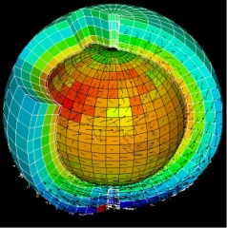


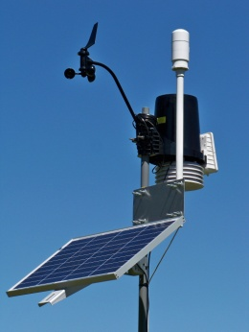
The need for standardisation
Remote sensing
Sensor
Value
Parameter
Scene
Integrated modelling is becoming the norm
  bioregional assessment
  eReefs
  When using heterogeneous (data) sources, discovery & integration is a major challenge
Standards make this easier
  Many private contracts
  →one public agreement
Earth science
Algorithm, code, simulator
Model, field
Variable
Volume, grid
Metrology
Instrument
Value
Measurand
Sample
Chemistry
Instrument, analytical process
Analysis
Analyte
Sample
Environmental monitoring
Gauge, sensor
Value, time-series
Parameter
Station
Observations & Measurements
procedure
result
observed property
feature of interest
Notes:
Different disciplines use different words for the same things
O&M provides a standard, domain-neutral terminology
Reduces ambiguity
Increases interoperability

Slide 27
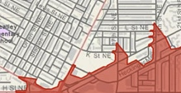


Views of data
  Features exist, have attributes and can be spatially described – ‘discrete’ or ‘vector’
Features
  Continuous phenomena, varying in space and time – ‘raster’.
  A function: spatial, temporal or spatio-temporal domain to attribute range
Coverages
  An act that results in the estimation of the value of a feature property, and involves application of a specified procedure, such as a sensor, instrument, algorithm or process chain
Observations

Slide 28
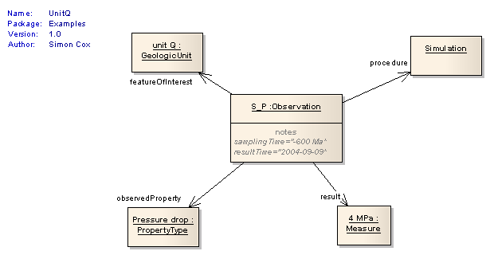
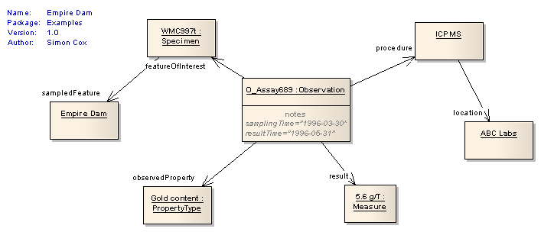
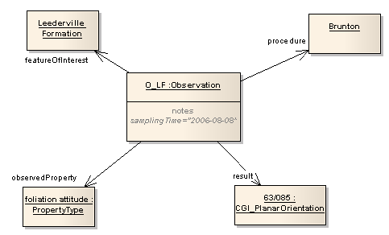
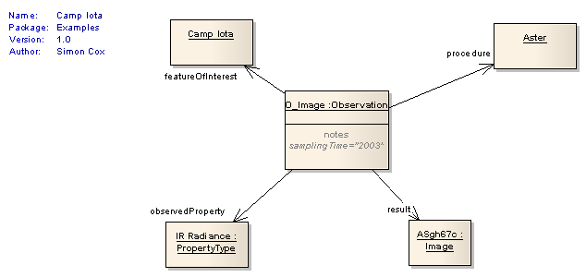
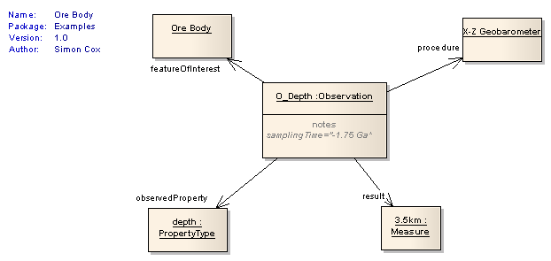
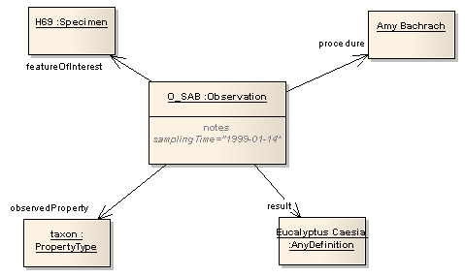
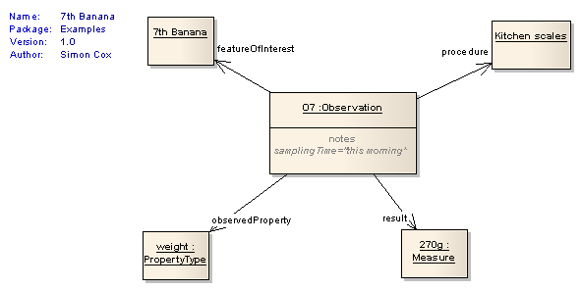
In “pictures”

Slide 29
ISO 19156 Observations and Measurements
OM_Observation
GF_PropertyType
GFI_Feature
+featureOfInterest
+
phenomenonTime
1
+propertyValueProvider
1
0..*
+
resultTime
+observedProperty
+
validTime [0..1]
+
resultQuality [0..*]
+
parameter [0..*]
+generatedObservation
0..*
Range
1
+procedure
+result
OM_Process
Any
An Observation is an action whose result is an estimate of the value
of some property of the feature-of-interest, obtained using a specified procedure
Cox, OGC Abstract Specification – Topic 20: Observations and Measurements 2.0
ISO 19156:2011 Geographic Information – Observations and measurements

Slide 30
Cross-domain model for observations
Standard terminology for cross-domain/interdisciplinary use
Broadly applicable
  In-situ observations, monitoring
  Remote sensing
  Sampling and ex-situ (lab) observations
  Simulations and forecasts
Adoption
  GeoSciML, AIXM, INSPIRE, D&I
  WMO, WaterML, ODIP, ANZSoilML,

Slide 31
Domain specific vocabularies required
observed property
  Related to feature-of-interest
OM_Observation
GFI_PropertyType
GFI_Feature
+featureOfInterest
+
phenomenonTime
1
+propertyValueProvider
1
0..*
+
resultTime
+observedProperty
+
validTime [0..1]
+
resultQuality [0..*]
+
parameter [0..*]
+generatedObservation
0..*
Range
1
+procedure
+result
GFI_DomainFeature
OM_Process
Any
feature of interest
  Feature-type
  Feature instances
procedure
  Standard procedures,
result
GML, SWE, netCDF

Slide 32
Applications

Slide 33
ANZSoilML - sampling
GFI_Feature
featureOfInterest
sampledFeature
relatedObservation
property
ValueProvider
SF_Sampling
Feature
OM_Observation
relatedSampling
Feature
parameter
lineage
related
Observation
phenomenonTime
parameter
resultQuality
resultTime
validTime
SF_Specimen
currentLocation
SF_SpatialSampling
Feature
materialClass
samplingLocation
positionalAccuracy
samplingMethod
samplingTime
Size
specimenType
Legend
Soil Sample features
O&M features
SoilSpecimen
archivedSample
SoilSample
coarseFragmentsPresent
0..*
depthRange
Simons, Wilson, Ritchie, Cox – ANZ SoilML – EGU 2013
Simons, Wilson, Ritchie – OZ SoilML – ANZ Soils Conference 2013

Slide 34
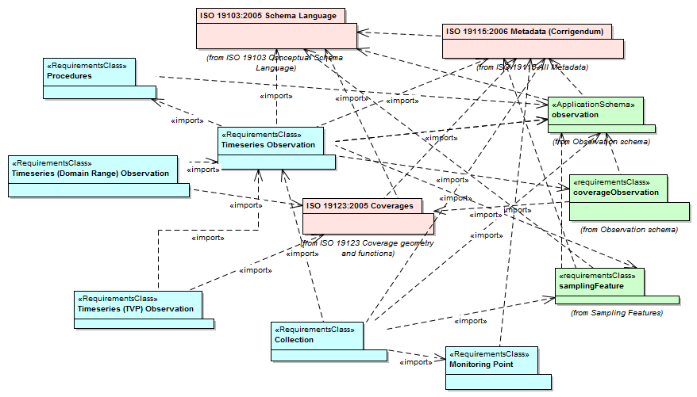
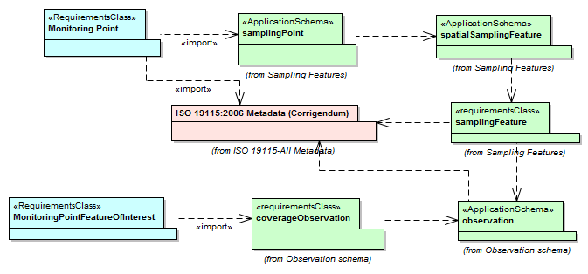
WaterML 2.0
Taylor, OGC Implementation Specification, WaterML 2.0 2012

Slide 35
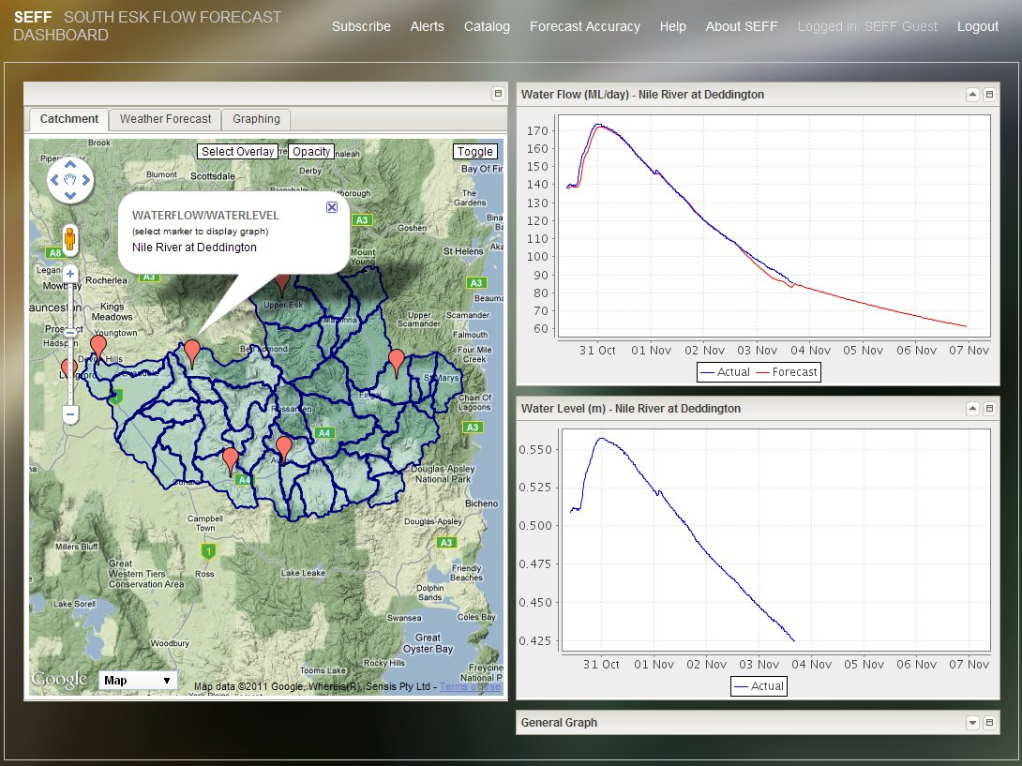
Notes:
South Esk flow forecasting dashboard

Slide 36
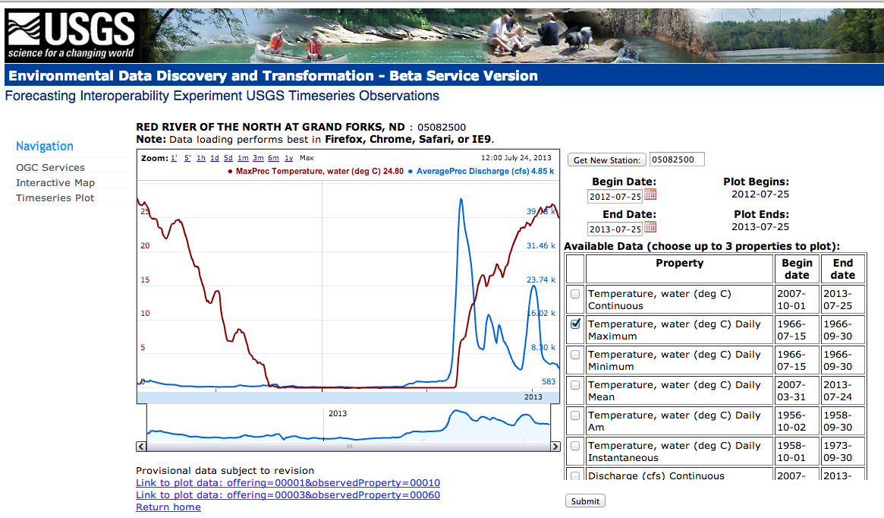
Notes:
USGS implementation using SOS and WaterML2.0

Slide 37
WQML
Simons, Cox – IPBA Report, 2013

Slide 38
Water quality observations model
The observation feature of interest must be
either a groundwater or geofabric feature
The observed property must be
a water-quality parameter
The units of measure must match
the water-quality parameter

Slide 39
Observed properties – water quality

Slide 40
WQ Properties model
Simons, Yu, Cox – IPBA Report 2013
Cox, Simons Yu – AGU Fall Meeting 2013

Slide 41
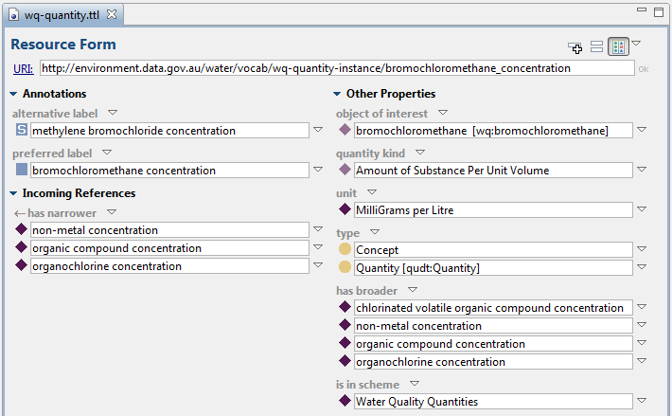
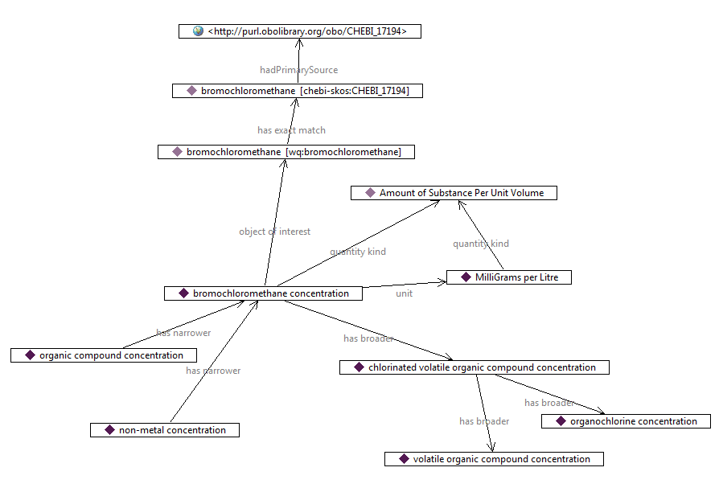
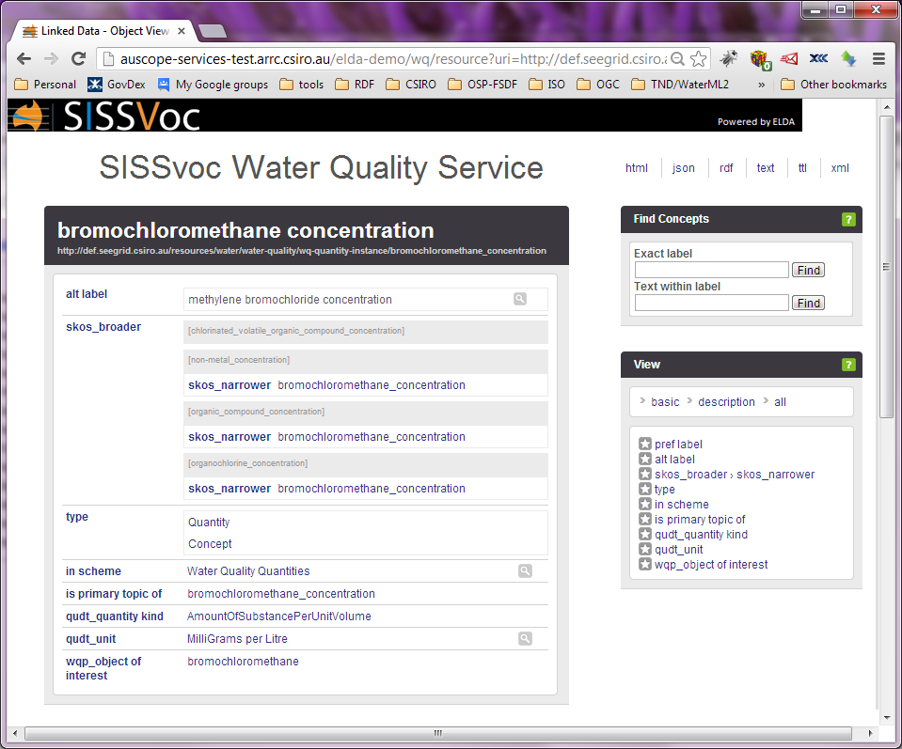

Slide 42
WQ Ontology
Immediate requirements
  IPBA, eReefs partners, BoM
Harmonization and alignment
  CUAHSI, EPA, USGS
  ChEBI - Chemical Entities of Biological Interest
  QUDT – NASA/TopBraid
Formalization
  Semantic Web technologies – RDF/OWL/SKOS
Publication
  SISSvoc

