Slide 1
Ontology and Geospatial Standards
Ontology Summit 2009
NIST Gaithersburg, MD
Josh Lieberman
April 6, 2009

Slide 2
What is the OGC?
Open Geospatial Consortium, Inc. (OGC)
Not-for-profit, international voluntary consensus standards organization
Founded in 1994, Incorporated in US, UK, Australia
360+ (up from 340 last year) industry, government, research and university members
OGC Mission
To lead in the development, promotion and harmonization of open spatial standards …

Slide 3
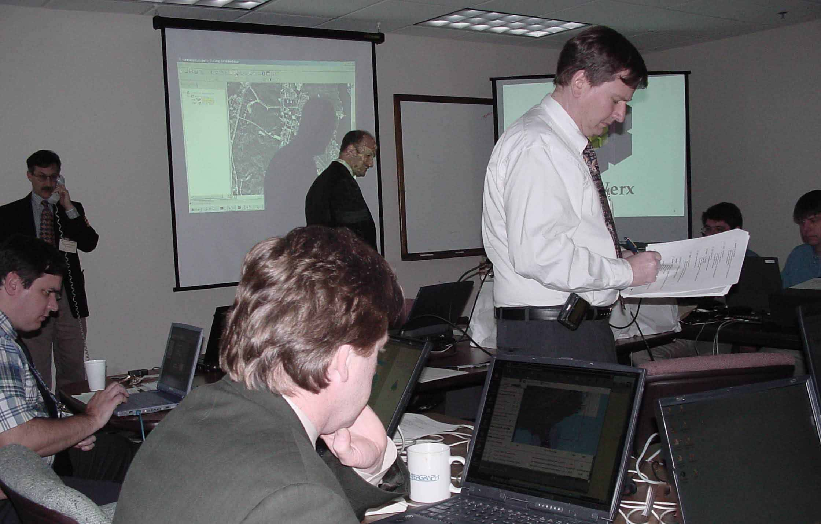
OGC’s Approach for Advancing Interoperability
Interoperability Program (IP) - a global, innovative, hands-on rapid prototyping and testing program designed to accelerate interface development and validation, and bring interoperability to the market
Specification Development Program –Consensus standards process similar to other Industry consortia (World Wide Web Consortium, OMA etc.).
Outreach and Community Adoption Program – education and training, encourage take up of OGC specifications, business development, communications programs
Notes:
As a response, the OpenGIS® concept and dream began due to:
1. The user’s need to integrate geographic information contained in heterogeneous data stores whose incompatible formats and data structures have prevented interoperability. This incompatibility has limited use of the technology in enterprise and Internet computing environments, and the time, cost, and expertise required for data conversion have slowed adoption of geoprocessing across all market segments.
2. The larger community’s need for improved access to public and private geodata sources, with preservation of the data’s semantics.
3. Agency and vendor needs to develop standardized approaches for specification of geoprocessing requirements for information system procurements.
4. The industry’s need to incorporate geodata and geoprocessing resources into national and enterprise information infrastructures, in order that these resources may be found and used as easily as any other network-resident data and processing resources.
5. Users’ need to preserve the value of their legacy geoprocessing systems and legacy geodata while incorporating new geoprocessing capabilities and geodata sources.

Slide 4
OGC Interoperability Program Policies
Running Code
Implementations from different developers to test draft interoperability specifications
Intellectual Property Rights
In accordance with OGC Intellectual Property Rights Policy
All information created in [most] initiatives must remain confidential until released through an OGC process. [Some pilots differ, e.g. GEOSS]
OGC Baseline Support
First consider OGC Adopted Document Baseline; then consider new specification development
Engineering Reports (ER’s) posted for consideration by the OGC Specification Program
Coordination through OGC Reference Model
OGC Interoperability Testbed Policies and Procedures (05-129r1)
http://www.opengeospatial.org/about/?page=ippp

Slide 5
Iterative Development Yielding Tested Specifications
Requirements
Prototype Implementations
Interoperability Program
Holes and Enhancements
Interoperability Program Reports
Outreach Program
Specification Program
Adopted Specifications
SCOTS Implementations

Slide 6
OGC Areas of specification
Fundamental
GI Science
ISO & Other Coordination
Abstract Specifications
(Best) Practices & Specification Improvement
Implementation per Member Requirements
Service Interface Definitions
Information Models / Encodings
Distribution of Capabilities
External Standards

Slide 7
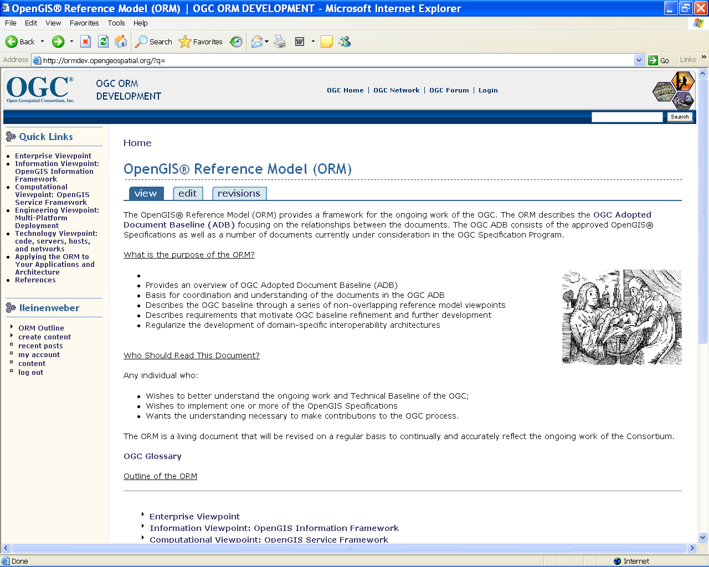
OGC Reference Model (ORM)

Slide 8
Ideas for Ontology Roles in OGC Standards
Domain ontologies used in practice for implementation of OGC standards
OGC implementation specifications which specify ontologies
OGC abstract or conceptual standards specified using ontologies
An ontology for the OGC standards process
Ontologizing lessons for OGC standards process

Slide 9
OGC Encounters with Ontologies
Geospatial Semantic Web Interoperability Experiment
W3C Geo 2007 ontology
Drexel OWL ontologies for OGC / ISO TC211 schemas
SWING Project semantic annotation
SWE - Oceans IE Semantic mediation between coastal atlases

Slide 10
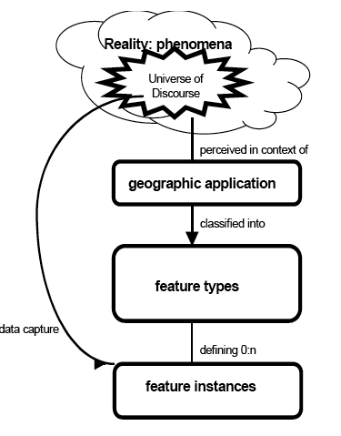
Geospatial Ontology Challenges
Geographic Representation
Feature discernment
Geometry attributes
Reference systems
Symbolization and visual grammar
Observational processes
Natural phenomena
Measurable properties
Observation event
Collection process
Feature of interest
Classification

Slide 11
GSW IE and Beyond
The OGC geospatial semantic web interoperability experiment tested initial architectures and technologies for cross-domain, distributed geospatial knowledge query, leading to multiple questions and follow-on activities.
GeoRSS geospatially enabled resource references
Geospatial Intelligence Query:
“Which airfields within 500 miles of Kandahar support C5A aircraft”
Query Domain
Ontology
Geospatial Ontologies workshops
(resource, process, service)
OWL-S
Description
OWL-S
Description
OWL-S
Description
W3C Geospatial
Semantic Activities
DAFIF
Ontology
AIXM
Ontology
Gazetteer
Ontology
Aero Data
(DAFIF) WFS
Aero Data
(AIXM) WFS
Geonames
Data Gazetteer
Service
Figure by Dave Kolas & Josh Lieberman

Slide 12
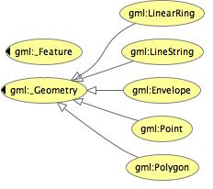
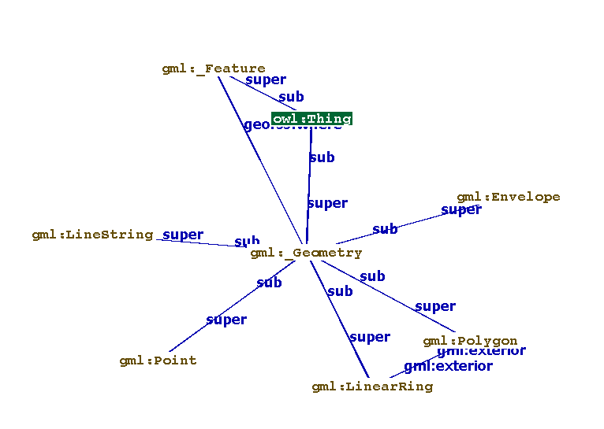
W3C Geo 2007
http://www.w3.org/2005/Incubator/geo/XGR-geo/
http://www.w3.org/2005/Incubator/geo/XGR-geo-ont/

Slide 13
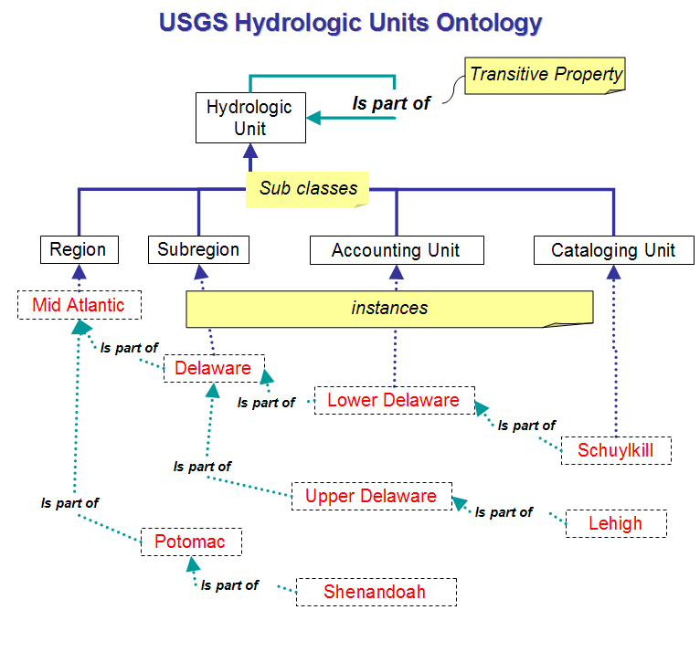
What Could a Geospatial Ontology Look Like?
Spatial Ontology - an explicit, partial description or vocabulary of representations which people use in geospatial/spatial domains
Example - USGS Hydrologic Units are organized in an ontology
From Hydrologic Ontologies Framework (HOW) by Michael Piasecki, Bora Beran & Luis Bermudez
Presented at 3rd GEON Annual Meeting San Diego, CA, May 5-6, 2005

Slide 14
Semantic Annotations in OGC Standards
Discussion Paper 08-167 - Patrick Maué, Philippe Duchesne, Sven Schade
Semantic Web services INteroperability for Geospatial decision making (EU-IST FP6 project (FP6-26514))
Development of ontology infrastructure to support:
Semantic annotation of service capabilities and service contents
Support the user in formulating goals
Discovery of geographic information and geoprocessing services
Specify workflows for service execution
Annotations at 3 levels
Keywords & Thesaurii, e.g. gmd:MD_Keywords
Application ontologies, e.g. schema annotation with sa-wsdl
Data domain ontologies, e.g. using sa:modelReference
Implications for a variety of OGC implementation standards

Slide 15
Geosemantic Roles Within GeoWeb
Trader
{within
Boston}
Query
Expansion
Related Concepts
Search Concepts
BBOX(42.357085,
-71.063089,
42.454085,
-71.173089)
Provider
Mediation
Resource Concepts
Consumer
Provider
Binding Concepts
Mediation (translation) between community concepts
Query expansion to add additional concepts
Inference simplification (e.g. coordinate -> topology) to support reasoning

Slide 16
Where Next with Ontologies in OGC Standards
Formal representation of rules and constraints in specifications
Opportunities for mediation between knowledge communities inside and outside of OGC
Proposed incorporation of ontologizing process as an activity thread in next OWS testbed - OWS-7
Testbed activity realization generally requires
Interest from OGC members
Financial sponsorship of the activity
(2) typically results from legal mandates, discernment of pain points, urgent bottlenecks, or strong potential for exciting new capabilities.

Slide 17
Geosemantic Web Challenges
Geosemantic agent architecture is under-developed and un-proven in operational systems (or very well hidden away).
Ontologies and formal encodings for geospatial knowledge are not yet established (chicken – egg problem)
Geosemantic knowledge is “hidden” in textual description and syntax specifications (substantial task to extract and make explicit)
Generalized geospatial inference is hard to design and harder to implement (spatial logic and tedious combinatorics)
Killer app to drive investment in the Geosemantic Web has not yet been discovered (could it be discovery mediation?)

Slide 18
The National Map
Data as web services
NLP and semantic demo solution
Scenario step by step:
User browse the site and click an event to view an observation.
User draw a polygon (or define a distance) that may be affected by the observation.
A list of land use data returned. And, a search function is provided to search certain land use.
User select one or few land use categories. NLP and semantic demo come here (or right after TNM).
The map interface displays the polygons/areas from the search, and may give a tabular report.
Feed land use and other data as ArcGIS Server data service
Map Interface
Google Map with ArcGIS Server Javascript
Data:
Ocean observation data from OpenIOONS
Land data from The National Map
1.
2.
User
3.
List of data sets and search.
4.
User
5.
Result
Feed Ocean Observation Data as KML service
Discussions:
Each green box is for one or few participating demos.
OpenIOONS is a perfect demo of semantic and ontological work. But it may be difficult to integrate the whole project onto our demo site. We could demo this part separately?
OpenIOONS can provide KML data in two ways: download and then published as KML service on the demo web site, or retrieved directly from OpenIOONS site as a KML data service (preferred).
Depending on the data by TNM, we could have other use cases.
Time commitment.
OpenIOONS Project
http://www.openioos.org/real_time_data/gm_sos.html
Demo project
Marine Metadata Interoperability Project
http://mmisw.org/
Naijun Zhou, University of Maryland, njzhou@umd.edu
With Input from Gary Berg-Cross SOCoP

