Slide 1
Improving OAGIS with Ontology Technology
David Connelly
CEO, Open Applications Group, Inc.
http://www.openapplications.org

Slide 2
Introduction
I am not an expert in Ontology
I build standards
We can always improve standards
So my context is how to use Ontology technology to do this
We have tried some research in past in partnership with NIST
I will discuss some plans moving forward

Slide 3
Open Applications Group
Who we are
OAGi is a not-for-profit, independent, open standards development organization.
It was formed to promote interoperability among business software applications and to create or endorse one or more standards for easier business software interoperability.
The primary technical standard produced by OAGi is OAGIS, the OAG Integration Standard.
www.openpplications.org
Notes:
Next I would like to say a couple of words about the OAGI in order to better explain the plans of the Group to adopt the various specifications within ebXML.
The Open Applications group focuses on an enterprise’s entire need for interoperability. They call this End to End integration. This includes B2B, A2A (Internal integration), and A2E (Applications to Execution systems such as Manufacturing Execution or Plant Data Collection systems).
The efforts of the OAGI are focused on a horizontal based solution with a strategy to work with the vertical industry groups.

Slide 4
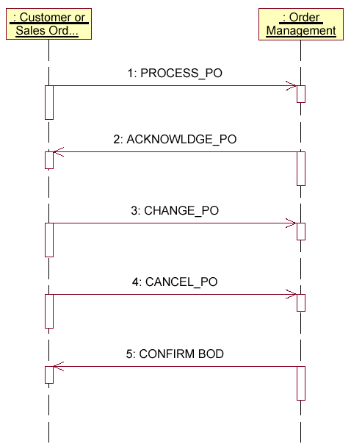
OAGIS is Process Definitions and Payloads
Scenario is process definition
Business Object Documents (BODs) are messages within the Collaboration
Freely downloadable at:
http://www.openapplications.org

Slide 5
Definitions of Ontology
(computer science) a rigorous and exhaustive organization of some knowledge domain that is usually hierarchical and contains all the relevant ...
the metaphysical study of the nature of being and existence
wordnet.princeton.edu/perl/webwn

Slide 6

Thoughts
Goal of OAGIS
Focus on end-user
Focus on Solution Provider
Save Money
Improve agility
Definition of Ontology
How can this improve OAGIS

Slide 7
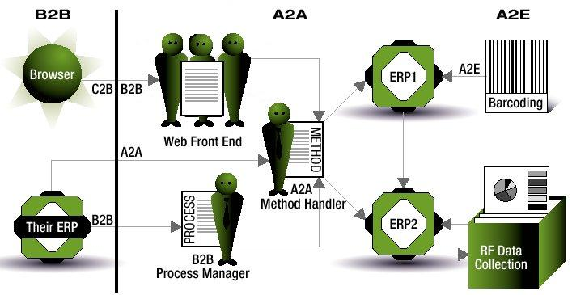
Open Applications Group Goal
E2E = B2B + A2A + A2ETM
Everywhere to Everywhere Integration
Notes:
Most efforts today are focused solely on B2B integration. We think this is not enough.
Organizations instead need to be looking at End to End integration which connects the B2B efforts with the Application to Application and Application to Execution software efforts.
Without connecting across this continuum, firms will be be missing key capabilities to execute their B2B as well well as getting stuck implementing multiple standards or doing their internal integration the old fashioned point to point way, costing them too much money, too much time, and limiting their ability to be responsive to business needs.

Slide 8
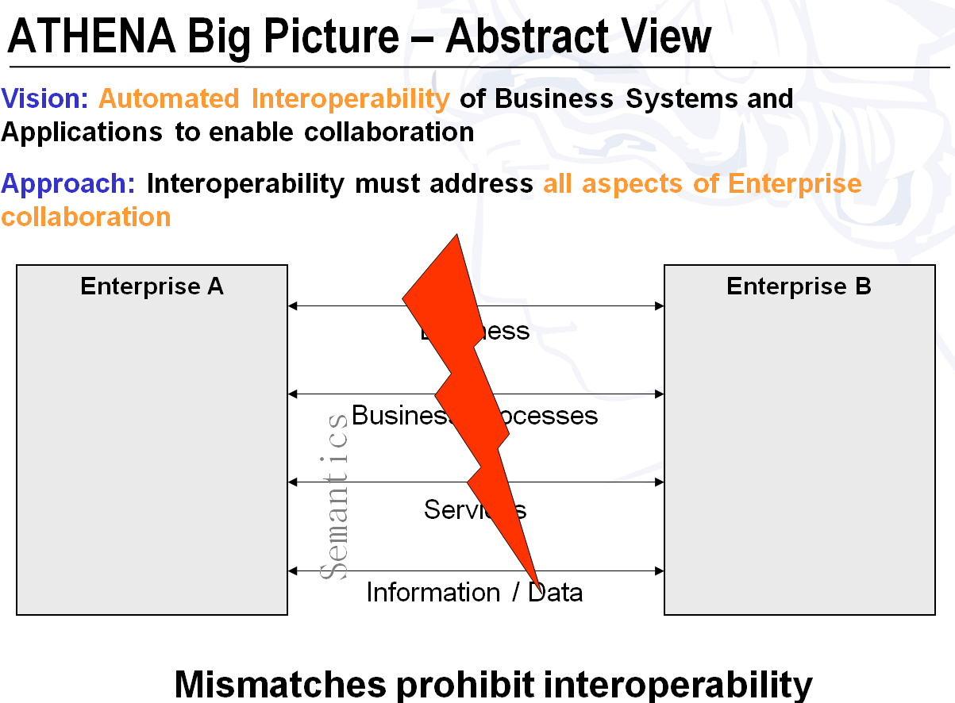
Problem Description

Slide 9

Industry Collaborations
UN/CEFACT – United Nations
ISO- International Standards Organization
MoU MG – Memorandum of Understanding Management Group
IEC TC57 WG14 – Electric Utility Standards
KIEC – Korean e-Commerce Consortium
NIST – National Institute of Standards & Technology
AIAG – Auto Supply Chain North America
Odette – Auto in Europe
ITA – Information Technology in Germany
STAR – Auto Retail North America
AAIA – Auto Aftermarket North America
RV Industry – North America
AIA – Aerospace North America
AECMA – Aerospace Europe
OSCRE – Facilities Management
VISION Industry
HR-XML – HR Content, world-wide
SP95 – Enterprise Controls
ARTS (Retail)
STEP – Engineering world-wide
IFX – Interactive Financial Exchange
SWIFT
TWIST
Comptia/EIDX – Electronics and Computer Industry
WS-I
OASIS
Tax-XML
UBL

Slide 10
OAGIS Convergence Initiatives
UN/CEFACT
MoU MG
Financial Harmonization
AIAG, STAR, Odette, JAMA/JAPIA
ISA SP95
HR-XML
ACORD
CIDX
ARTs
STEP
Others possible

Slide 11
Problem Description
OAGIS
  BOM
  Item Master
  ECO
STEP
  AP214
  OMG PLM Services
  OAGIS PLCS (later for Manufacturing)

Slide 12
NIST B2B Testbed Activity Update
Serm Kulvatunyou
Nenad Ivezic
Jungyub Woo

Slide 13
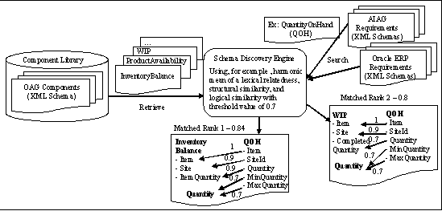
Problem Description
Notes:
- We expect that a user seeing the results from the schema discovery engine could make a better and more efficient judgment how to best reuse the existing standard schemas.

Slide 14
Research Findings
Three levels of similarity measures identified
  Lexical similarity measure – Words and terms similarity based on domain independent or specific knowledge
  Structural similarity measure – Words and terms similarity based on structural information (what a term contains and how)
  Logical similarity measure – Words and terms similarity based on associated formal models
Approach to measure the quality of the similarity measure preliminary defined

Slide 15
Activities with OAGIS
Looking at a Next –Gen Effort
Will Include UN/CEFACT Technologies
Improve Supply Chain Interoperability
Improve Cross-Supply Chain Interoperability

Slide 16


Core Components, The Idea
Sponsored by the United Nations
Defines the basis for building business languages.
Encourages all business languages to be based on same concepts.

Slide 17
Why Did OAGi Adopt Core Components?
Enables all business languages to be based on same concepts and building blocks.
Will increase interoperability within supply chains
Will increase interoperability across supply chains
Excellent base for OAGIS convergence initiatives

Slide 18
UN/CEFACT Technologies
Naming and Design Rules
CCTS
Data Types
Unified Context Methodology (UCM)

Slide 19











SDO Adoption of UN/CEFACT
Notes:
SAP TechEd ‘07

Slide 20

Software Vendors Adoption of UN/CEFACT
SAP – Solving the problem: CCTS
Core
Data Type
Party
An implementation of ISO 11179
Creates common re-usable building blocks
  Conceptual Data Constructs – Core Components
  Reusable logical/physical Data Constructs – called BIEs
  Core Data Types, i.e. for “Amount, Code, Measure, and Quantity”
Based on Semantic Definitions
  Clear rules on how to define semantics to explain what items mean
Uses a Context Mechanism that controls how data constructs vary depending on the context
  e.g. By business process, business process role, industry, country/region, etc.
Syntax neutral
  Can be used to define business documents OR business objects/databases
Provides the heavy lifting for syntax specific representations
Artifacts identified in a registry to maximize visibility and reuse
Identifier
Conceptual
Data Model:
Core
Components
Address
Person
Communication
Logical Data Models:
BIE’s
Context
Buyer_ Party
Seller_ Party
Buyer_ Identifier
Seller_ Identifier
Home_ Address
Legal_ Address
Primary_Person
Terciary_Person
Telephone_ Communication
Fax_ Communication
Notes:
SAP TechEd ‘07
The CCTS methodology is comparable with the syntax (grammar) rules of a human language. Language rules typically govern the way the words in a sentence are arranged. CCTS provides this for data names, but goes much further. CCTS not only provides the grammar rules, it also defines a methodology for creating unambiguous building blocks that can be understood and interpreted by humans and machines in the same way. The Core Component Technology achieves this by using the following key concepts for the development of business data:
Logical modeling of objects, which is comparable to the logical composition of paragraphs, business letters, articles or even books. This is based on that approaches like OO-approach, Codd’s rules for relational databases, normalization forms and structuring according to semantical logic.
Naming convention, which is a set of rules of grammar, based on ISO 11179 part 5, that govern the formulation of the names of business data elements. It maps pertinent aspects of the business context onto the names of the elements.
The context for giving the correct meaning of the business data, which is in relationship to the other parts and perceptions in which the communication of the data occurs. This so-called Context Driver Principle establishes predefined context categories, like geopolitical region, industry, business process etc., that identify and distinguish the usage of an element.
Syntax neutral semantic information that can seamlessly be transformed into various kinds of technical representations without any information loss. A natural language can be also used by different media: speech and writing.
Beyond these key concepts, the heart of CCTS is its building block system for creating data aggregations. This building block system is an approach to decomposing complex business data structures and business information into modular, unambiguous and reusable building blocks.

Slide 21

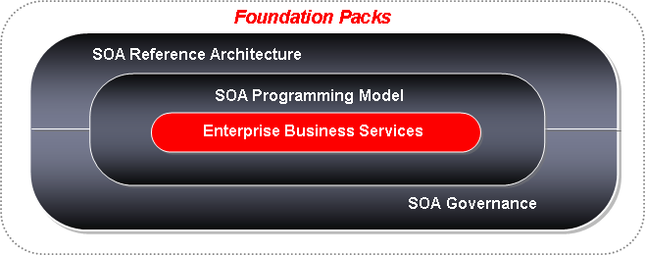





Software Vendors Adoption of UN/CEFACT
Oracle Enterprise Business Objects
Standardized Service Payloads
Based on semantics and open
standards
Create
SalesOrder
Update
SalesOrder
Query
Customer
Account
Query
Item
Utility
Services…
Based on Open Standards
  UN/CEFACT CCTS
  UN/CEFACT XML NDR
  OAGIS
  XACML
  WS-Addressing
Rationalized against Oracle Applications
Extensible and Upgradeable
Oracle Enterprise Business Messages
Oracle Enterprise Business Objects
UN/CEFACT XML NDR
Oracle Applications
(eBusiness Suite, Enterprise)
Industry Standards
(OAGIS, UN/CEFACT CCL)
UN/CEFACT CCTS

Slide 22
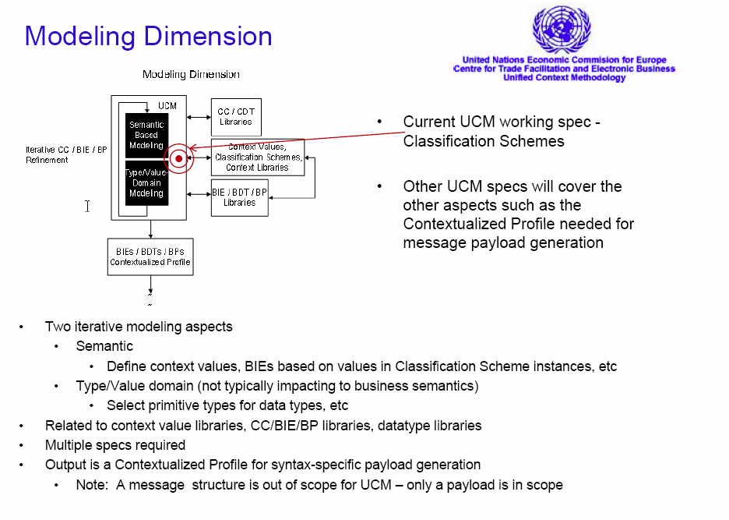
Unified Context Methodology

Slide 23
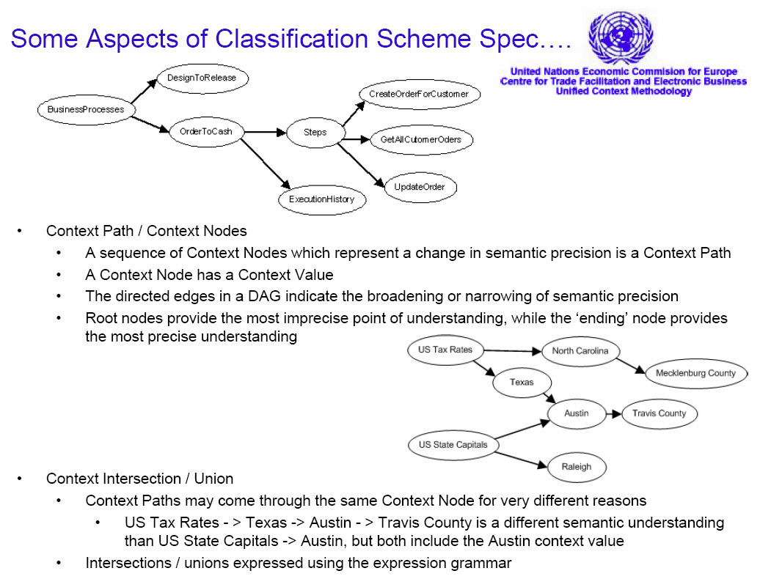
Unified Context Methodology

Slide 24
Final Thoughts
We have been active in semantic research for years
Continuously trying to improve the ambiguities in the standard
Thinking of a non-normative OWL version of OAGIS
Open to ideas

Slide 25
Questions?
www.oagi.org

