Slide 1

Content Intelligence and
Smart Applications
Innovative Query, Inc.
Greg Bardwell, Founder & CEO
Phone: +1-301-910-2199
Email: gregb@innovativequery.com
www.innovativequery.com
Notes:
Intro Self
Innovative Query, Inc. is an early stage company in the new rapidly growing field of exploratory search.
We use visualization & Work Flow on top of semantic analysis to make better use of unstructured information.
We offer a SaaS solution for research management and knowledge discovery.
We are seeking seed funding of $750k for product and market validation, and to help establish our sales process.

Slide 2
Introduction
What we Do
IQeXplore Platform Overview
Case 1: Quote My Source
Case 2:

Slide 3
Content Intelligence & Smart Applications
At the highest level Content Intelligence is the ability to generate insights to improve business outcomes with content.
Content Intelligence enables proactively serving up needed information. That is a powerful statement, "proactively serving up needed information." This drives:
    Improved search, discovery and collaboration
    Pushing the right information to the right users to do their job
    Improved information and content publishing
    Mashups of and with content for new classes of BI and publishing applications
    Unlocking information for actionable insights

Slide 4
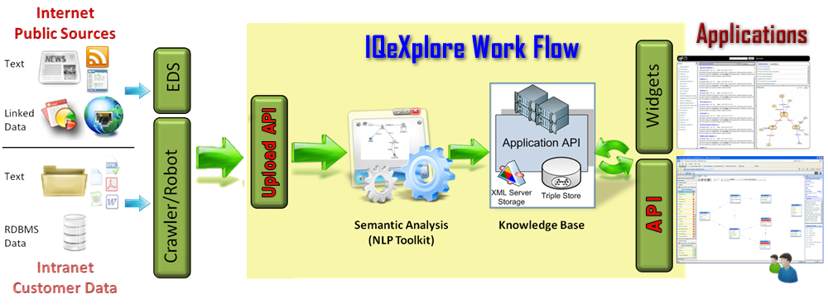
IQeXplore: Marketecture
Full Text for Search, Content Management
Extracted: Entities, Facts, Events, Profiles, Timeline
Semantic Triple Store
Search, Clustering, Text & Content Analysis, Navigation Methods & Semantic Web Endpoints (SPARQL)
Notes:
Ontology Driven NLP Semantic Processing

Slide 5
Semantic Ontology/
NLP Processing
Entity
Event or
Fact
Entity
Does Business With
Organization
Person A
Met With
eMailed
Person B
Company A
Owned By
Person C: Known Threat

Slide 6

End-to-End Process
Capture Wrappers
Search Engines
Applications
  Dashboard & Reports
  Visualizations
  Relationship Trees
  Document Viewer
  Geographic Displays
  Temporal Filters
Databases
Email & Desktop
IQeXplore
Connectors
  Localizes Search
  Translates Results
  Filters Input / Output
  Applies Ontologies
  Stores Configurations
Semantic Tools
Learning & User Models
  Ontology & Models
  SDK/API
  Filtering
  Collaboration
  Scenario Analysis
Entity Extraction
Knowledge Base
  Entities & Facts
  Relationships
  Open Standards
  Extensible
  Statistical lexicon
  Rules-based methods
  Modular component
  Custom/Optimized
© Copyright 2010

Slide 7

The Whole Picture for Data
IQeXplore
Business Intelligence
Keyword Search &
Text-mining
Semantic Applications
Semantic Discovery
API
Other Applications
Search
Data Warehouse
ECM
Cross-Domain
RDF Store (XML)
ETL
Crawlers & Connectors
Entity Extraction
NLP, Metadata,
& Ontology
Enterprise Content Mgt
(ECM)
Structured Data in Tables
Unstructured Data/Text
(80% of all information)

Slide 8
Case 1: Semantic BI for Blogging
Marketing Company
Challenge
  Utilize data obtained from news, social media, and internal sources
  Optimize and personalize search
  Work with open sources
  Respond quickly to chatter
Results
Save time on analysis of content
More complete intel from text sources
Quicker and more precise responses to social media
Better and faster content creation
Solution
  NLP and Semantic index for unstructured sources
  Custom scoring/alerts for results
  Authoring tools to expedite content creation and analysis tasks
Notes:
Half the time writing blog articles rich with links to sources is lost to the cumbersome process of accumulating quotes, tracking attribution, and incorporating those quotes into your own content, complete with links back to the originals.
Quote My Source is an automated research and content creation tool for writers and bloggers. It provides the content author with targeted and highly relevant source materials drawn from a variety of feeds and web searches using semantic analysis and user defined criteria to both find and select content automatically. Authors can then easily identify and organize quotable content, complete with attribution and source URL. Then, they can easily export selected quotes directly into their content management system or blogging tool, already formatted for appropriate display.

Slide 9
Case 2:
Augmented Governance
Supporting UCDMO in Augmented Governance Lab to enable cross domain audits
  Paradigm shift from defined architectures to defined data/metadata relationships
  Neither centralization nor normalization is required
  Web-scale approach to leveraging ROA-based approaches for linked audit data analysis
Au-G connects atomic audit data with graph based dynamic schemas
Data and metadata (including audit data) are managed in compliance with EO 13526

Slide 10
Zero Day Event Detection
PROCESS WEB LOGS – Ontology Driven processing on cross-domain message traffic
CONTEXT – Identify suspicious relationships & events from multiple sources
MATCH TO THREAT ONTOLOGIES – Use semantic web reasoner to match multi-source patterns to Ontology
ALERTS – If match with Ontology match to threat database and send alert
ANALYST – Pull the original sources of the relationships & events that match the threat patterns

Slide 11
Process Overview

Slide 12
TECH Backup Slides

Slide 13
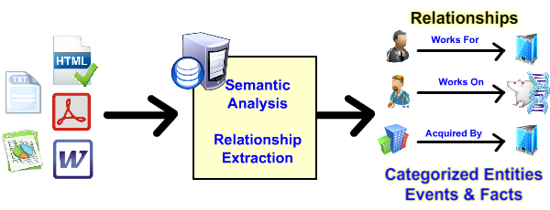
Stage 1: Document Analysis
In stage 1, documents are semantically analyzed using natural language processing for entities, facts and events and their relationships. All the document attributes are captured and all the metadata possible is extracted. Entities, events and facts are extracted based upon contextual analysis, not just keyword searching and they are categorized and relevancy values are assigned to them based upon context.

Slide 14
Semantic Relationships
Event or
Fact
Entity
Entity
Does Business With
DoD
IQI
Partners With
Is CEO
Mark Logic
Greg
Is A
Knowledge
Expert
Semantic relationships simply relate one entity to another. The examples below include Greg is CEO of Innovative Query, Inc. (IQI), Greg is a knowledge expert and IQI does business with the DoD..

Slide 15
From One Document
Entities Extracted
  38 Categories Out of Box
Facts & Events Discovered
  50 Categories Out of Box

Slide 16
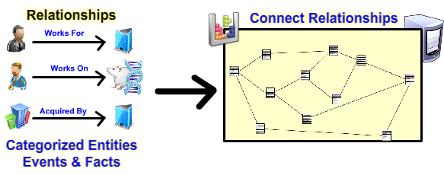
Stage 2: Building Connections
IQeXplore uses these relationships to generate knowledge maps – connecting one relationship to another to another and so on. It matches entities and relationships and can connect them and display them in various visual graphs and diagrams.

Slide 17
Multiple Documents
Yields Huge Fact Trees

Slide 18
Facts & Relationships
UNUSABLE! Normally.
Except with IQeXplore

Slide 19
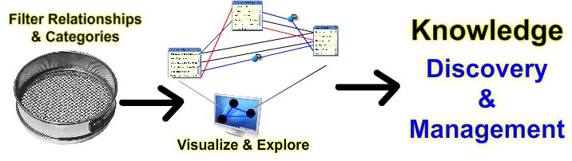
Stage 3: Exploring
Rules & Filters to Link Data Documents, Triples
IQeXplore has many tools for exploring and filtering to help you turn complex knowledge relationship webs into useful knowledge maps.

