Slide 1
Introduction to

Slide 2








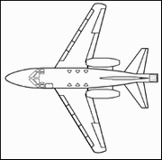












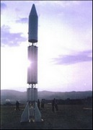


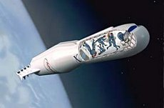






Ansari X PRIZE
$10M to first privately-financed team to fly a spaceship capable of carrying 3 people to 100km twice in 2 weeks
26 Teams from 7 Nations spent over $100M

Slide 3





>$1 billion
private
space industry
Highly leveraged
Efficient
Sparks industry
$100 million
spent in pursuit
$10 million
prize
$2.5 million
seed money

Slide 4

It’s not just about space. It never was. It’s about transforming the way we solve humanity’s greatest challenges.

Slide 5





Prize Groups
Life Sciences
Exploration
Energy & Environment
Education &
Global Development

Slide 6
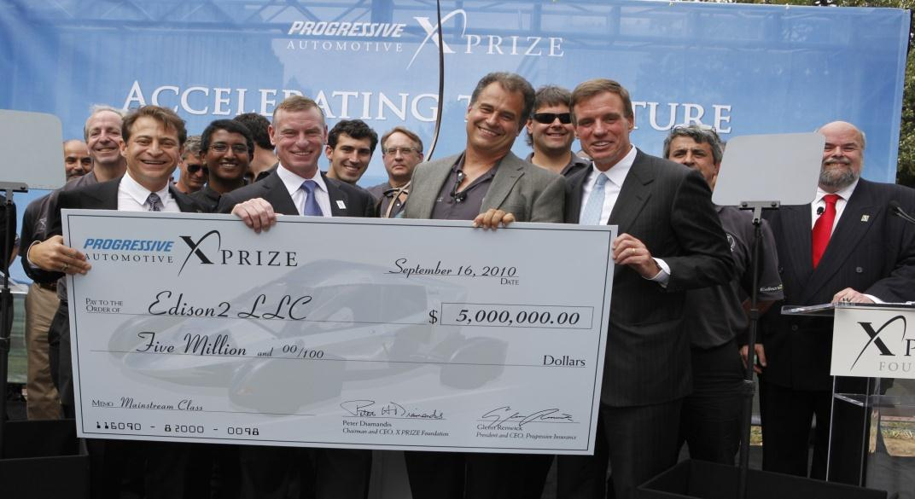
The $10MM Progressive Automotive X PRIZE: First team to build a fast, affordable, manufactureable car with >100 MPGe:
Won on September 16th, 2010
136 Teams from 11 nations spent $100 Million+
Generated 6 BILLION+ consumer impressions worldwide
Page | 6

Slide 7


Sequence 100 human genomes in 10 days or less.
Ushering an era of personalized medicine.
$10 million

Slide 8


Send a robot to the moon, travel 500 meters and transmit video, images and data back to the Earth.
Reduce cost of planetary exploration & stimulate interest in science and technology.
$30 million

Slide 9
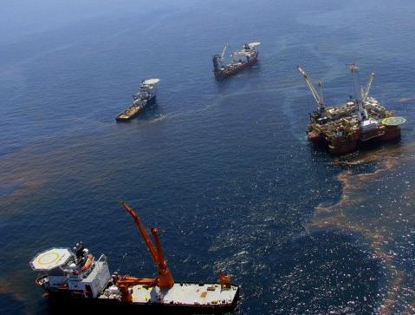

Inspire a new generation of innovative solutions that will speed the pace of cleaning up seawater surface oil
$1.4 million

Slide 10
Why Prizes

Slide 11
There’s been a surge in prize capital since 1970
Aggregate prize purse, prizes over $100,000
U.S. $ Millions
Recent large-purse prizes
  Ansari X PRIZE (1996); $10M
  MPrize (Methuselah Mouse) (2003); $4M
  NASA Centennial Challenges (2003); $2M
  Netflix Prize (2006); $1M
  Google Lunar X PRIZE (2007); $30M
  Mo Ibrahim Prize for Achievement in African Leadership (2007); $5M
  Progressive Auto X PRIZE (2007); $10M
  Saltire Prize (2007); £10M
  Virgin Earth Challenge (2007); $25M
  Energy Free Home Challenge (2008); $20M
400
350
300
250
200
150
100
50
0
1970
1975
1980
1985
1990
1995
2000
2005
2010
Source: McKinsey & Co. “And the winner is…,” 2009

Slide 12
This growth has been driven by new sponsors and fields
Sources of prize capital since 2000
Percent of prize capital
Large prize purses by sector
U.S. $ Millions
315
Foundation/non-profit est. 1995 or later
47%
Aviation & Space
88
Corporation
27%
88
Science & Engineering
Government
17%
77
Climate & Environment
Foundation/non profit est. before 1995
74
5%
12
18
6
30
Arts
27
33
Other
12
Other
5%
1997
2008
Source: McKinsey dataset of 219 prizes worth $100,000 or more
Notes:
Before 1991, 97% of big prizes were recognition of prior achievement. Since 1991, 78% of new prize money has been dedicated to inducement style prizes that focus on a specific type of goal.
Corporations and new philanthropists have provided more than 2/3 of total prize capital since 2000 and are pursuing areas linked to their commercial interests or individual philanthropic passions.
Prizes are shifting from traditional areas such as the arts, which ten years ago claimed 1/3 of large prize purses. Today, arts and humanities make up less than 10% of total. But science /climate/ aviation have increased seven-fold. And most of that new money goes towards those who solve defined problems

Slide 13
Prizes’ distinctive attributes are reinforced by broader social trends to encourage use and experimentation
  Expressiveness
  Flexibility
  Openness
  Success-
  contingent
  rewards
  New wealth
  Frustration with conventional approaches
  Internet as driver
  of access and collaboration
  Low-cost, distributed computing power
  Multi-media intensive society
Notes:
In sum, a broader range of sponsors is using larger prizes more often—and in more innovative ways—to address a wider array of objectives. Many factors have contributed to this change, including the arrival of new wealth outside of established philanthropic channels, a frustration with conventional approaches to change, different approaches to allocating risk in the development of new ideas and technologies, greater global interconnectedness through the Internet, and an increasingly multi-media and technology intensive world. Prizes have several distinctive attributes allowing them to take advantage of all these trends:
Expressiveness: Prizes embody aspirations, priorities, values, and a commitment to desired changes. Well designed prizes carry a strong element of theater that makes them newsworthy and media friendly. This messaging and brand-building potential is attractive to corporations looking to burnish their image or wealthy donors seeking to signal their arrival. Competitors for the prize benefit, too—even those who don’t win. A high profile competition helps participants attract sponsors willing to finance their efforts, and stimulates investment in the field.
Flexibility: At their best, prizes inspire people and teams to push their efforts beyond conventional limits. Freed from an overreliance on narrowly commercial incentives, competitors
can turn their efforts to addressing issues that the market may overlook. Prizes also add additional layers of motivation beyond money, such as prestige and intellectual curiosity. In an era when more and more people want to see solutions to societal problems that have proved resistant to pure market solutions, prizes—and their flexibility to address a range of issues— are increasingly valuable for the social entrepreneurs who benefit from prize money and for prize sponsors seeking change.
Openness: Prizes attract diverse groups of experts, practitioners, and laypeople—regardless of formal credentials—to attempt to solve difficult problems. The citizen-inventor working out of a garage is a cherished part of prize lore. Technology may make this iconic figure more common. Low-cost computing power, the research capabilities of the Internet, and the many ways the information technology enables cheap and easy collaboration are working together to dramatically expand the pool of potential solvers and lower the cost of attempting or
recognizing solutions.
Success-contingent rewards: Prizes shift risk from prize sponsors to competitors (or their sponsors) by only paying for successful achievement of a defined goal. No success, no prize. We call this the “efficiency” of prizes: in a way, they are “fixed cost science or engineering.”16 For philanthropists, government departments or corporations looking to improve return on investment, in many situations this contingent rather than guaranteed payout can be a much more attractive proposition than a conventional grant or contract.
Likewise, for competitors, success-contingent rewards combine with the theater of a wellstaged competition to create an urgency that delivers previously unachievable levels of focus
and creativity, with real innovation as the ultimate result.
These distinctive attributes of prizes and the external trends that reinforce them help explain why prizes are becoming so popular. But their intrinsic value is only part of the story. More
valuable still is the way these attributes combine to form powerful change levers that can transform people’s actions and perceptions. This renewed and strengthened ability to affect positive change is perhaps the fundamental reason for the prize renaissance of recent years.

Slide 14
Seven ways that prizes deliver change
Identify
excellence
Focus a
community
Influence public
perception
1
2
3
Community
Public
4
Identify
and mobilize
new talent
Focus
Topic/
problem
Influence
5
6
7
Strengthen
community
Educate and
improve skills
Mobilize capital
Source: McKinsey dataset of 219 prizes worth $100,000 or more
Notes:
1 Identifying excellence
Identifying excellence is one of the oldest and most recognized functions of prizes. Indeed, the ancient Greeks identified the celebration and cultivation of arête (“virtue” or “excellence”) as the essential purpose of the Olympic Games. Prizes highlight and elevate superlative behaviors, ideas, and achievements in order to motivate, guide, and inspire others. Identifying excellence remains the cornerstone of many prizes—the essence of their power to produce change. In our survey of 48 large-prize sponsors, out of all the change levers “identifying excellence” was cited most often—by nearly 80% of respondents—as an essential attribute of their prizes.
2 Focus a community
Prizes can be particularly effective at shaping the agendas and behavior of groups and guiding (directly or indirectly) the activity of individuals, institutions, and even whole disciplines. The most obvious manifestation is when a prize focuses a problem-solving community on a specific, well-defined challenge. This was the core intent of historic prizes like France’s Food Preservation Prize and Britain’s Longitude Prize, but there are many more recent examples. The $1 million Netflix Prize, for instance, challenges data mining programmers to improve the company’s online movie recommendation algorithm by 10%. Partly by releasing proprietary data of interest to data miners, Netflix has attracted more than 34,000 entrants (many of whom have spent significant hours on the task) and is now within reach of its target. Ashoka’s Changemakers program seeks a similar objective in a different way, using an open source “discovery framework” to frame a set of social problems, such as access to water or sanitation, focusing the problem-solving efforts of a growing community of social entrepreneurs.
3 Influencing public perception
Prizes offer sponsors a powerful loudspeaker. As Kevin Bolduc of the Center for Effective Philanthropy has noted, prizes can be “successful in part because they are big and loud.”18 For many philanthropists, the ability of prizes to grab attention and influence public perception of a topic or discipline is deeply attractive. There are many examples of well-crafted prizes, backed by a relatively small amount of capital, establishing the importance of a field, catalyzing market demand, shaping public debate, and even changing the image of sponsors.
4 Identify and mobilize new talent
A core power of prizes derives from their openness: their ability to attract diverse talent, generate unexpected approaches, and reveal unusual perspectives in the face of a problem or challenge. This can take the form of “cross-disciplinary solutions” that involve collaboration among unlikely partners, or even of “crowd-sourcing genius,” the attraction of talented individuals who are outside established systems of innovation. Compared with other incentive instruments such as grants and scholarships, prizes reduce bureaucratic barriers
to entry for participants and need not screen for conventional qualifications. In the words of Thomas Kalil, a former Deputy Assistant to President Clinton for Technology and Economic Policy, prizes allow sponsors, “to engage a set of innovators [that they] would not get to through a traditional grant-making or procurement process.”
5 Strengthen community
It is easy to focus excessively on the competitive element of prizes—on who wins the award—and ignore their ability to bring together powerful networks that enable members to share ideas, approaches, and best practices. More than two-thirds of the prize sponsors we surveyed see prizes as means for strengthening the problem-solving community—not only to help solve a specific problem, but also to bring ideas and people together to encourage future collaboration and innovation. In many cases, prizes’ greatest societal benefit derives not from the specific achievements that win the awards but rather from the conferences, judging panels, and competitor networks that follow as an integral part of the prize process.
6 Educate and improve skills
Prizes often educate the public and improve the skills of participants, welcome byproducts of the competitive process. Some sponsors harness this power to design prizes for which the process is at least as important as the outcome; for these prizes, developing skills is itself a principal goal of the program. This is an under-utilized lever: although many prizes have learning or skill-building elements, few prize sponsors see this as an area of focus. Indeed, only 35% of prize sponsors we surveyed actively sought to educate and improve skills through their program. Nonetheless, our review found good examples of prizes oriented around educating and
7 Mobilize capital
Finally, prizes can provide valuable leverage for a sponsor’s investment by mobilizing further financial or intellectual capital in support of a solution. This leverage takes two principal
forms. First, by shifting risk from sponsors to participants, prizes attract investments of capital and time from motivated competitors. Second, when prizes produce vetted solutions they can attract further investment in a particular field.

Slide 15
What are the disadvantages of prizes?
Prizes, as “zero-sum games,” can make contestants duplicate efforts.
Prizes may not offer incentive for incremental improvements.
Prizes can require expensive investment by teams.
Prizes may fail to provide info about “close successes.”
Prizes may fail to attract contestants without a market opportunity beyond the prize (e.g. basic science).

Slide 16
Designing an Effective Prize

Slide 17
Effective prize development and delivery includes five steps
Design
elements
Goal
setting
Prize
strategy
Post prize
Build legacy
Broad aspirations
Stake-holder needs
Prize
types
IMPACT
Reinforce impact
Measure
and improve
Specific objectives
Prize
ops & marketing
Phase I
II
III
Source: McKinsey dataset of 219 prizes worth $100,000 or more
Notes:
Goal Setting: As recent activity shows, prizes can be used to produce or encourage a broad array of benefits for society. However, worthy aspirations only count for so much. Effective prizes work because they have sharply-defined, achievable goals. Formulating those goals well is not easy: our survey of prize administrators found that they consider “specifying the goal or mission” to be one of the most difficult aspects of effective prize-giving. Clarifying a prize’s goals is a two-part process. First, sponsors must define a broad and compelling aspiration (e.g., encouraging lunar exploration). Second, they must identify specific objectives that would advance the achievement of that aspiration and that a prize would help to fulfil (e.g., stimulating the emergence of innovative companies in the field).
PRIZE STRATEGY
Philanthropy can sometimes suffer from too narrow a strategy: as one analyst said, “foundations don’t think outside the box, they think about the common strategies within
circumscribed areas.” Because of this narrow thinking, philanthropic prizes tend to be under-used, and even when used, sponsors often fail to take full advantage of their unique strengths. The challenge for philanthropists is not to develop more and better ways to recognize excellence, but to find ways to make prizes more effective in achieving a societal objective. That, in turn, principally means increasing the number of change levers that a given prize utilizes. Determining a prize’s size and frequency—often the first topics sponsors want to think through—are really secondary concerns, best left for the end of the development process. Far more important is overall strategy. Intelligent sponsors start by developing a deep understanding of their prize’s potential problem-solvers and other constituents; then they move on to consider (and possibly invent) the prize type that will best address their motivations. Without a strategy based on such thinking, it is very difficult to make good decisions about award size, frequency, criteria, or follow-up.
DESIGNING A PRIZE
Once a strategy has been developed and an archetype identified, the work of designing a prize in detail can begin. Four major tasks—determining the participants, defining participant rights, creating the competitions rules, and setting the awards—constitute prize design, and each of these encompasses a longer list of specific design elements and tradeoffs. The high number of choices to be made, and the way each choice affects so many others, makes prize design difficult. It can easily take many months or even multiple award cycles to get the design of a prize right.
Determining participants entails devising qualifications, setting the framework for teams, and determining the number of competitors. Defining participant rights addresses the ability of participants to fund and benefit from the prize experience, and of the sponsor to control how the prize is presented to the public. Creating the rules focuses on choices about timing and stages, criteria for winning, and allowable participant interaction. And setting the awards includes choices about the number, nature, and value of rewards conferred to the winners. The change levers that a prize employs will strongly influence many of these decisions, such as the size of the prize. For example, prizes focused on educating and strengthening a community can make the size of the prize relatively small, and potentially non-monetary. But prizes focused on identifying excellence or influencing public perception may often need to create a higher-value award to attract the necessary media attention.
PRIZE PROCESS
Creating and executing an effective prize process Prizes derive much of their power from their theatricality. A prize is an easy-to-understand concept that maximizes and focuses excitement, giving visibility to ideas and providing emotional access to the public and potential participants. In the words of innovation author and business consultant Geoffrey Moore, prizes are “an ‘Arthurian romance’ that makes people feel that they can participate in the quest for a solution.”85 Making the most out of this theatrical dimension is often a key task of a prize’s process. A well-designed and well-run process will attract quality participants, capture attention, passion, and innovation through competition, celebrate winners within a community and in the public eye, and ensure that the prize maximizes its potential impact. For some prizes, such as participation and network prizes, some or all of the desired impact occurs during the prize process, making that process arguably more important than the actual award. In our research, we came across too few examples of prizes that do an outstanding job of managing the theatrical element.
POST PRIZE
Post prize: Driving impact, legacy, and improvement A prize’s life cycle does not end the day the award is bestowed. On the contrary, much of a prize’s impact can only be generated after the award is given. Further investment can reinforce winning ideas or take them to scale. The prize’s community of problem solvers can disseminate ideas and use them to solve other problems. And the sponsor can learn and apply lessons from the prize’s design and delivery that will improve its own impact in future competitions, or the impact of other prizes. Prizes not structured to reinforce impact in these ways may exert a positive effect on their own winners, but nonetheless fail or fall short of their sponsor’s ultimate aspiration for change. We were consistently impressed by prizes that devote resources to the “life after the prize” phase but also discouraged to hear how few sponsors make a concerted effort in this area.

Slide 18
We’ve observed six major prize models…
Type
Examples
Type
Examples
Participation
  FIRST Robotics Competition
  Odyssey of the Mind
Exposition
  Green Challenge
  Changemakers
Incentive Prizes
Exemplar
  Nobel Prize
  Man Booker Prize
Point solution
  Netflix Prize
  Innocentive (select)
Network
  El Pomar Awards
  Milken Educator Awards
Market stimulation
  Ansari X PRIZE
  Progressive Auto X PRIZE
Source: McKinsey & Co. “And the winner is…,” 2009
Notes:
Participation prizes: inspire participants to change behaviors and even life trajectories (Biggest loser)
Exemplar prizes define excellence within an arena. Used to publicize endeavors, legitimize pursuits and influence public opinion
Network prizes identify, celebrate, empower and invest in prize participants and the broader stakeholder ecosystem. The goal is to build networks and strengthen communities by creating forum for interaction.
Exposition prizes are designed as much to highlight a broad list of promising ideas as to choose winners among them (think of World’s Fair)
Point Solution prizes: Focus a community and mobilize talent and capital to solve well defined problems with no clear path to solution (e.g. “open innovation platforms” like InnoCentive and NineSigma.
Market Stimulation prizes: originate form some sort of market failure that prevents achievement of desireable social outcome (e.g. lack of investment, limited supply base, poor consumer understanding/awareness)

Slide 19
…utilizing a number of prize structures
Prize Type
Date Certain
Date Certain, Repeating
Past the post
First to Achieve
Standing contest
Description
All teams must compete on a certain day or time-window
If the prize is not won the first attempt, it can be repeated
First team to meet/beat a specific metric, can be backed by a specific deadline
First team to solve the challenge wins
Any team to meet/beat a specific metric, consistent challenge
Example
Progressive Insurance Automotive X PRIZE
Northrop Grumman Lunar Lander Challenge
Netflix Prize
Goldcorp Challenge
Internal employee safety “contests”

Slide 20
Myths about prize design and delivery
Common myths
Research findings
There are only two types of prizes
  The ‘recognition’ and ‘inducement’ division is limiting
  Prizes can use many other levers for driving change
Bigger purses are necessary to break through the noise
  Publicity doesn't necessarily match purse size
  Prize power actually results from effective strategy and execution
It’s all about competition
  Competition does motivate participant behavior, but many prizes are also using collaboration to drive change
It’s all about the winner
  Sponsors report that some of the best innovations don’t win the prize
  In many prizes, the benefit is delivered by broad participation, not winning
Prizes are easy
  Good prizes can take months to develop and refine
  Prize development is a multi-step process, with each step important
  to capturing the desired outcome

Slide 21
Crafting Your Incentive Prize
Part 1: What’s The Target?:
Target Market Failure? Have you targeted a problem where a market failure exists? Where the normal forces of capitalism will not solve the problem? Does your prize address the underlying market failure?
What Metric Measuring? What parameter(s) are you measuring in your competition? If you can’t measure it, you can’t improve it?
Measureable, Objective Goal? Without a target you’ll miss it ever time. Are you able to describe a clear and measureable goal that is easy to understand?
Audacious & Achievable? Is your goal Bold, Visionary, Emotionally charged, inspirational… but still achievable? Can you “dial” the competition parameters to make it audacious but achievable?

Slide 22
Crafting Your Incentive Prize
Part 2: Prize Components
Name: What is the competition name?
One-Sentence Descriptor: This is your elevator pitch that conveys the bold and inspired vision, at the same time you’re clear about what you’re measuring.
Purse Amount: Purse is set depending on difficulty and length. What is the minimum amount you think a team will need to spend to achieve the goal? What will attract entrepreneurs?
Competition structure: Date certain event? Past the post? First to achieve? Repeating?
Guidelines: Can you convey in a simple set of rules the key objective achievements that the team must hit to win. Remember – Clear, measurable and objective.
New Paradigm : What is the new paradigm you wish to create when the competition is finished? You can express this as a “New York Times Headline”.

Slide 23
Crafting Your Incentive Prize
Part 3: Fine Tuning and Testing the Impact of The Competition
Define Problem, NOT Solution: Are you defining the problem, but not specifying the solution?
Back-end Business Model? Will teams be inspired by the business they can create if they win the competition. Will they be excited to invest far more than the purse?
Telegenic Finish? Do you have a telegenic finish that will grab the public attention and drive team to compete?
Operations Cost: How expensive will this be to operate? Can you design it so that the teams need to demonstrate their results in a fashion which is obvious and non-controversial, and therefore easy to judge?

Slide 24
An Example: The Ansari X PRIZE
Prize Name: The “X” Prize for private spaceflight (X to be replaced by name of donor)
Market Failure/Paradigm Change?:
There is no money being invested in private human spaceflight; Everyone thinks it is solely the province of government.
No bucks, no buck rogers… No viable start-ups are even trying.
Because there is no business, there are no regulations.
One-Line Descriptor: A $10 million competition for the first team to build a privately funded spaceship, able to carry 3 adults to 100 kilometers altitude, land safely, and fly the same ship into space again within two weeks.
Prize Amount: $10M Competition Timeline: Up to 8 years from launch
General Guidelines:
Teams must be privately financed (>90% private financing)
The Spaceship must be able to carry 3 adults
Spaceship must reach a minimum altitude of 100 kilometers
Must land safely and fly again within 14 days
Passengers must land in good health after second flight
No more than 10% of the dry mass can be replaced between flights
Headline: “Spaceflight for all, now a reality.”

Slide 25
Thank You
Chris Frangione
Sr. Director, Prize Development
Christopher.Frangione@xprize.org
919-247-7933
Eileen Bartholomew
Sr. Director, Prize Development
Eileen.Bartholomew@xprize.org
310-741-4894

