Slide 1
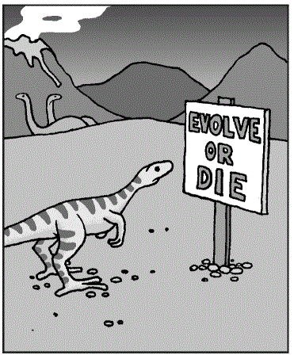
Ontology for Big Systems & Systems Engineering
Ontology Summit 2012
Session-04
Thu 2012.02.02

Slide 2
topics
Systems engineering practice – an issue (in my experience):
Nested hierarchy of system of systems – is this complex enough?
Systems engineering (IT) issues ontology can help to solve:
Semantic interoperability (Giancarlo)
Semantic legacy modernisation – inheriting complexity

Slide 3
Are complex systems of systems naturally nested?
Clarification:
By ‘big’ systems, do we mean ‘complex’ systems?
A simple system can be ‘big’ – in size, a complex system can be ‘small’ – in size
Is size then the issue?
I shall assume not.
(In my experience) it is common for systems engineering projects to:
take a systems of systems approach to reduce (divide) complexity
assume the systems are (to a large extent) nested.
what if complex systems of systems need to be massively overlapping (interconnection-ally complex)?
i.e. there is no natural nesting

Slide 4
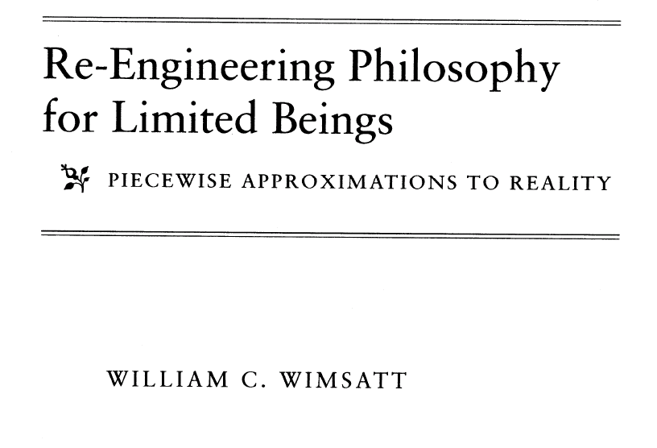
A good source

Slide 5
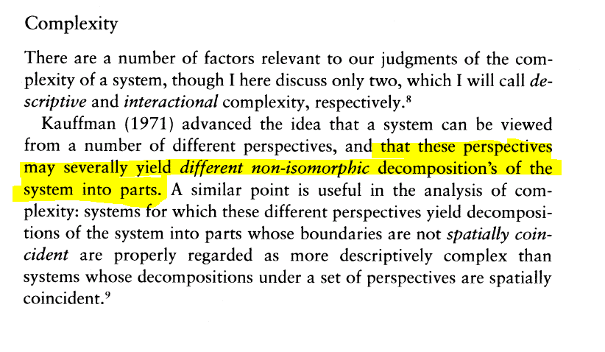
Different decompositions

Slide 6
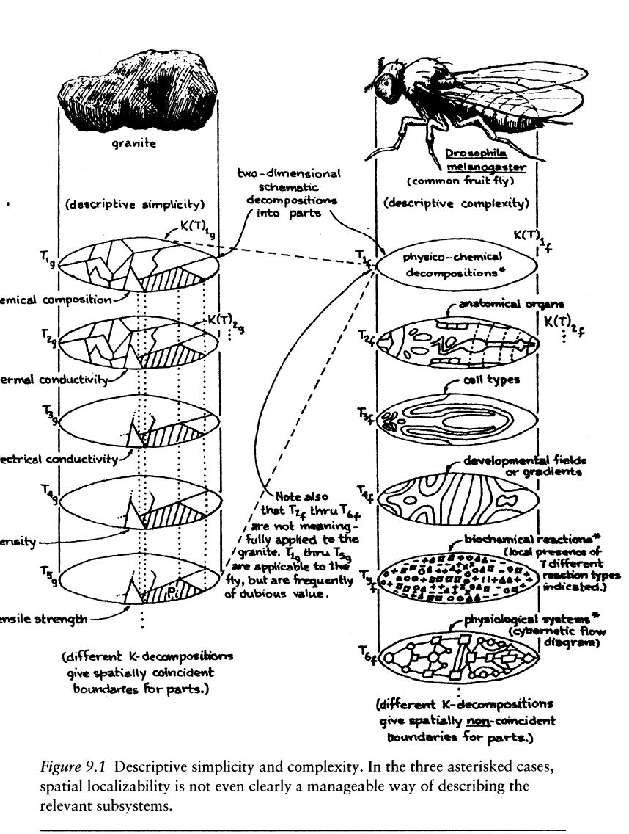
Nested versus non-nested decomposability

Slide 7
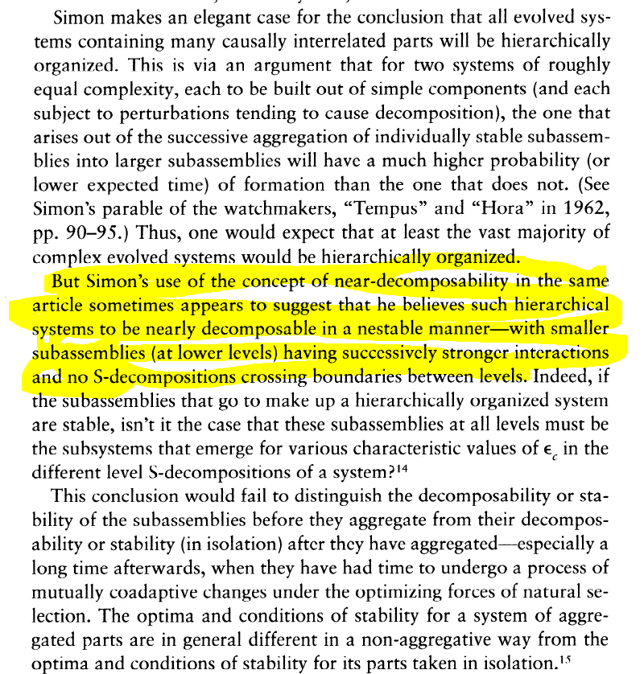
Nested hierarchies of systems

Slide 8
What if systems of systems are not naturally nested?
Then the system engineering practice of nesting systems may reduce the complexity of the design framework below what is required for the artefact.
(In my experience) The discipline of ontology can help to manage the (interconnection) complexity that is required.

Slide 9
Systems engineering (IT) issues to solve
Why IT?
Systems engineering not (originally) designed for IT/semantics
Two key areas:
Semantic interoperability (Giancarlo)
Semantic legacy modernisation – inheriting complexity

Slide 10
From greenfield to brownfield
Greenfield
Brownfield
A problem space needing the development and deployment of new software systems where there are NO existing (legacy) software applications/systems.
These can assume a "clean sheet of paper" target environment throughout the design and implementation phases of software development.
A problem space needing the development and deployment of new software systems in the immediate presence of existing (legacy) software applications/systems.
The context (local landscape) of the system being created be factored into any development exercise. This requires a detailed knowledge of the systems, services and data in the immediate vicinity of the solution under construction.

Slide 11
Semantic legacy modernisation
In IT as in other areas, the next generation system is often re-built from scratch (green-field mentality)
For large (i.e. complex) systems the cost is becoming prohibitive
Not just the cost of development
Operation of the systems is a form of investment
Quality assurance – that the system works (in places)
Guiding development – clear what is required
Need to find a way of reducing the cost
One option: recouping the investment in the legacy application

Slide 12
Questions?

Slide 13
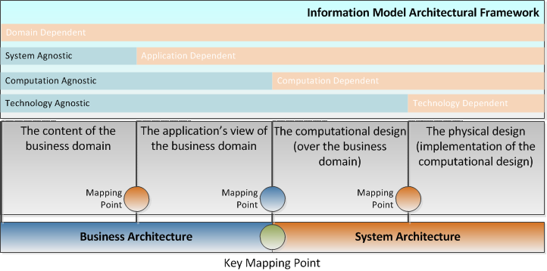
Information (architecture) Framework
Based upon a separation of concerns (similar to OMG’s MDA divisions)
Layered concerns, where each concern builds upon all previous concerns.

Slide 14
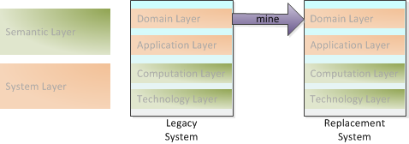
Opportunity for migration
An application modernisation opportunity

Slide 15
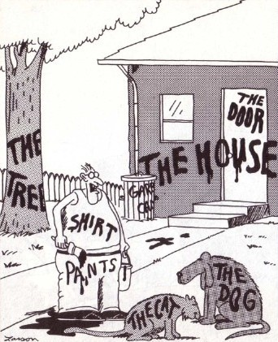
Transparent vision?
Everyone knows that if you put 10 data modellers to work on the model for a fixed domain, you will end up with 12 different models.
And none of these will really be a model of the real world. Certainly the modellers will not agree which one is.
Now... that should clear up a few things around here
In one case, it is transparent, in the other plainly not
Notes:
There is a problem I encounter when trying to discuss this context.
There is a background assumption that we take for granted – and it is so deeply embedded that we find it difficult to see we are making it.
Helpful to rope in other people who have had addressed the same problem.
Also, easier to see this problem if I show you it in a more general context.
Far Side cartoonist Gary Larson is mocking the Image of God doctrine’s ‘Insight Ideal’ here.
In theory:
one can list all the real world objects that the information in a system refers to.
In practice:
it is very difficult – just try.
Not because there are so many, just because it is difficult to agree what they actually are.
May be an question of ‘good enough’ for what?
Maybe good enough for conversation such as ‘pass the salt’, is not good enough for building information model (clearly).

Slide 16
Transparent vision is constructed
Look in the literature, we find the answer.
Transparent vision is constructed.
When we get used to it, it feels natural – but it is constructed.
Default assumption (in the ontological community?) is that it is natural.
Classic counter-example is conquistadors and Incas
Thought horse and man were a single animal
Different visions for different purposes:
E.g. Medical transparent vision – it would look obvious to a trained doctor
Ontological (modeller) vision?
Modern discussion:
(E.g.) Goodwin, Charles (1996). Transparent Vision. Interaction and Grammar. E. Ochs, E. A. Schegloff and S. Thompson. Cambridge, Cambridge University Press: 370-404.
Not a new issue
Modern discussion of the history of this topic.
Edward Craig, The Mind of God and The Works of Man (1987)
Often assumed that it is natural – this is often challenged.
For example, David Hume, A Treatise of Human Nature (1740) challenges it
The ‘Image of God’ Doctrine:
Man is made in God’s image, and that although human beings are far less perfect than God, human minds and God’s mind are the same kinds of thing.
‘The Insight Ideal’ is derived from the ‘Image of God’ Doctrine:
God in his goodness endowed human beings with faculties that enable them, in principle, to gain knowledge of the world he created for them.
It is totally taken for granted that ‘the universe was in principle intellectually transparent …’ (Craig 1987, 38)
Notes:
Professional Vision
Charles Goodwin,
American Anthropologist
Volume 96, Issue 3, pages 606–633, September 1994
DOI: 10.1525/aa.1994.96.3.02a00100
“Hume is attacking an overly inflated view of our intellectual capacities but he’s not out to destroy our knowledge completely.
Edward Craig’s book The Mind of God and The Works of Man (1987) paints a picture of this overly inflated view of our intellectual capacities: intellectual life in the early modern period
was in the grip of what he calls ‘The Image of God’ doctrine. This doctrine, a background assumption in much philosophical and theological thinking at the time, held that man is made
in God’s image, and that although human beings are far less perfect than God, human minds and God’s mind are the same kinds of thing. Human beings come closest to resembling God in
their capacity for a priori knowledge: they seem to know mathematical and logical truths independently of experience and knowledge of these areas seems certain and infallible. It was
also assumed that we could have such knowledge of the causal structure of the world. The Image of God doctrine embodied, as Craig points out, an epistemological assumption too, an
assumption he labels ‘The Insight Ideal’. The Insight Ideal assumed that the universe is, in principle, intelligible: God in his goodness endowed human beings with faculties that enable
them, in principle, to gain knowledge of the world he created for them. In this intellectual climate, Craig argues, it was totally taken for granted that ‘the universe was in principle
intellectually transparent, even though quantitative considerations put complete insight beyond human grasp’ (Craig 1987, 38)”

Slide 17
Transparent ontological vision?
Looks like vision (perception) in general is not transparent
Though this seems to be the naïve assumption
Professional vision can be transparent to members of the profession – e.g. doctor’s may see the same things.
Is the ‘professional ontologist’s’ vision transparent?
If we take the data modellers case seriously, then plainly not
What does this mean for ontological domain modelling?
We need to work out how to:
construct the transparent vision
first stage, make people realise that their vision is not transparent

