Slide 1
Ontologies and engineering analysis
David Leal
Ontology Summit 2012
2nd February 2012

Slide 2
What is engineering analysis?
Analysts look at the physics
systems engineers – want something to do X
designers – propose a way of doing X
analysts – predict whether or not it will do X
There is a design analysis loop
design optimisation is part of analysis
Certification is increasingly based on analysis
there are many things that are to expensive to make and break
maybe the demarcation line between what analysts do and what systems engineers do is whether or not physical laws are involved

Slide 3
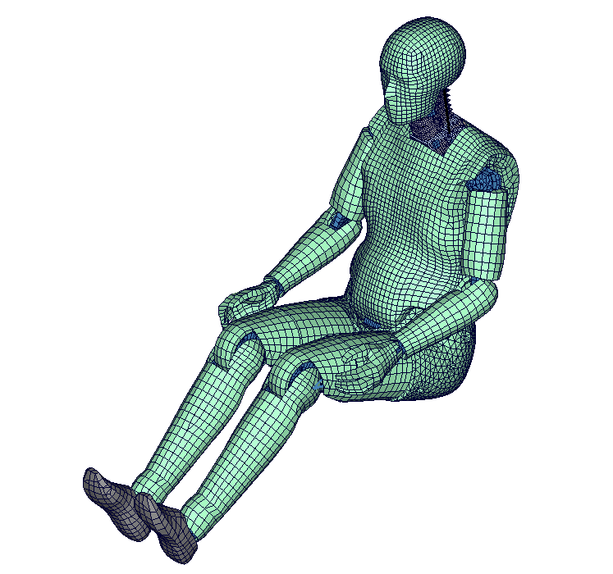
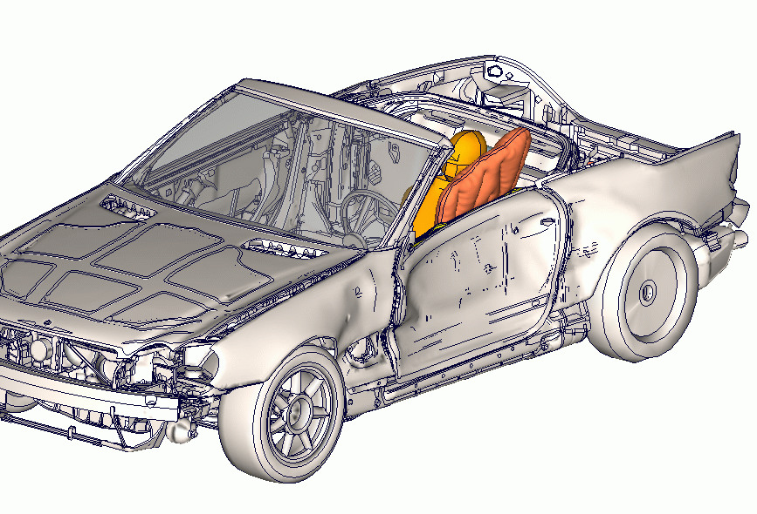
e.g. crash test simulation
Non-linear geometry, non-linear material behaviour, fluid flow, contact
Decisions about the level of idealisation

Slide 4
Distinctive problems of engineering analysis
Lots of data
gigabytes of data in a single analysis
terabytes within a sequence of analyses for a particular objective
Safety critical
you may be asserting that a product will not break in an event that you cannot replicate in a test rig
some accidents you don t want to replicate
replicating 50 years of life takes a long time
You get asked “how do you know the answers are right”
Ultimately there is an audit trail back to tests
material tests
validation of analysis methodologies

Slide 5
Engineering analysis is a “cottage industry”
Much of it is not routine
you do not necessarily know the analysis steps you will need to carry out before you start
Done by small teams of opinionated people who do not take kindly to PLM (Product Lifecycle Management) systems
a wide range of different disciplines – fatigue, thermal, fluid dynamics, high strain rates, creep, radiation
Work can be subcontracted
analyses of components may be carried out to OEM requirement by the component supplier
Standardisation of analysis data has not taken off
data is much more complicated than geometry
much of the interesting information is about the processes

Slide 6
Engineering analysis is a “cottage industry”
Much of it is not routine
you do not necessarily know the analysis steps you will need to carry out before you start
Done by small teams of opinionated people who do not take kindly to PLM (Product Lifecycle Management) systems
a wide range of different disciplines – fatigue, thermal, fluid dynamics, high strain rates, creep, radiation
Work can be subcontracted
analyses of components may be carried out to OEM requirement by the component supplier
Standardisation of analysis data has not taken off
data is much more complicated than geometry
much of the interesting information is about the processes

Slide 7
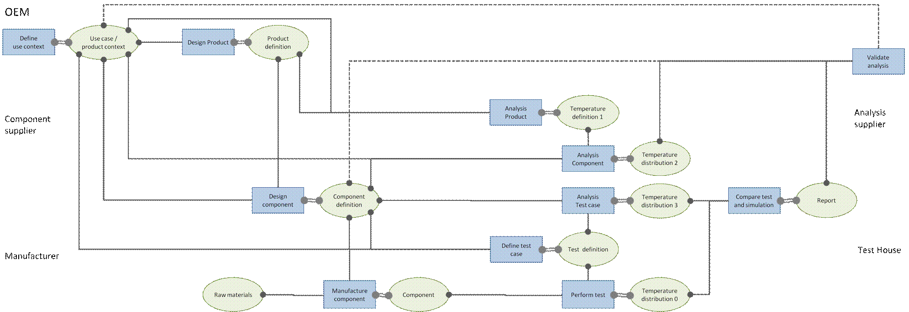
Lots of activities, lots of players

Slide 8
International Association for the engineering analysis community
NAFEMS North American Work Session on the Management of Simulation Data "Take Control of Your Analysis and Simulation Data", 27th September 2007, Troy, Michigan (USA).
This session lead to the formation of the North America based NAFEMS Simulation Data Management Working Group.
NAFEMS European Conference on “Simulation Process and Data Management” (SDM), 15th and 16th November 2011, Munich, Germany.

Slide 9
Problems
An engineering analysis ends with:
a text analysis report containing conclusions
some pretty pictures in the report
terabytes of data scattered here and there across servers, which theoretically justify the conclusions
What data is archived with the report?
How do you check the quality of the analysis process?
Hw do you do another analysis of the same component?
often you start again from the product geometry in the PLM system
Has anybody ever done a similar analysis before?
who was it, can the do it again, how long did it take?
did they get the right answer?

Slide 10
Doing better is not difficult
The big files are 99.99% “images” of fields, and 0.01% semantics
Inside the files there are scraps of text that identify parts, features, materials, states, etc.
Inside the files there is limited information about, when, who, and what software (but nothing about why the file was created)
Create a ontology for analysis
parts, features, materials, states, etc.
analysis is 4D
fields are objects
Make the semantics inside the files visible as RDF
the big files are mostly descriptions of the fields
Record the analysis activities
the files are inputs and outputs

Slide 11
Metrics
Quality metrics
mesh shapes, field discontinuities, etc.
Ranges of values in fields
are displacements consistent with a geometrically linear analysis?
are stresses consistent with a linear elastic analysis?
An ontology of metrics will enable them to be recorded
metrics become annotation of the files, and are then readily accessible

Slide 12
Decisions
Decisions are based on statements not “images”
e.g. the maximum surface stress on a weld
e.g. the limit state load
the statements should be explicit and linked to the data files from which they are derived
Decisions are activities
analysis involves many decisions
that a mesh is good enough
that a boundary can be regarded as rigid
that the temperature difference across this wall can’t be more that X
record the analysis decision as a statement
record the activity of making the decision
who was responsible and when

Slide 13
What we should be able to do
Automate the generation of analysis reports
Know which data was involved in reaching the conclusion
implement an archiving policy – a decision can be taken that some data will always be recalculated
Evaluate the quality of an analysis
quality metrics on the data
sources for the data
was the analysis process consistent with best practice

