Slide 1
Driving Innovation with Open Data
Chris Musialek in place for Jeanne Holm
Data.gov
February 9, 2012

Slide 2
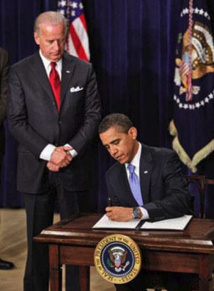
Creating a Data Ecosystem
Gather data
from many places and give it freely to developers, scientists, and citizens
Connect the community
in finding solutions to allow collaboration through social media, events, platforms
Provide an infrastructure
built on standards
Encourage technology developers
to create apps, maps, and visualizations of data that empower people’s choices
Gather more data
and connect more people
“A Strategy for American Innovation” published September 2009

Slide 3
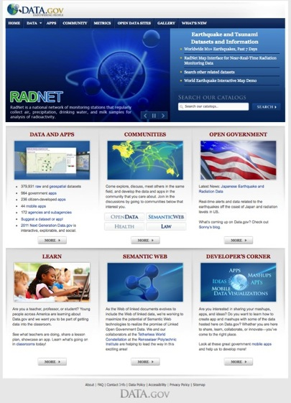
Data.gov
Provides instant access to over 400,000 datasets in easy to use formats
Contributions from UN, World Bank, and 185 agencies
Encourage development of innovative applications
Drive innovation and knowledge use across the globe

Slide 4
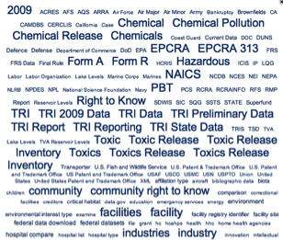
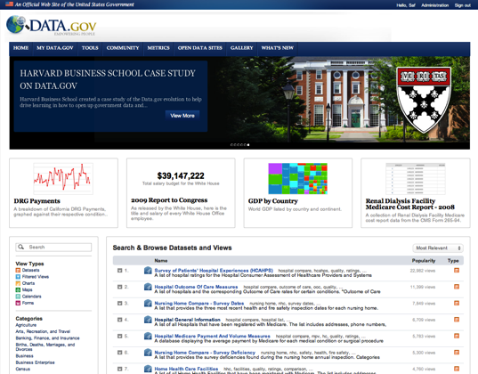
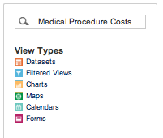
Easy to Find Data
Notes:
Most popular types of datasets: geography and environment, health and nutrition, and national security and veterans affairs

Slide 5
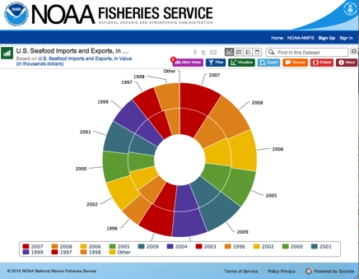
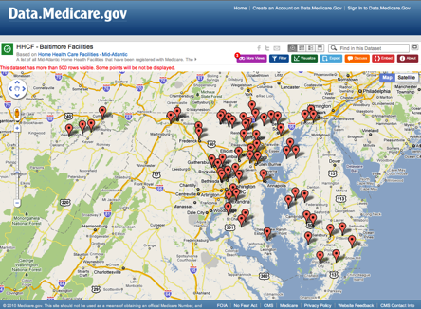
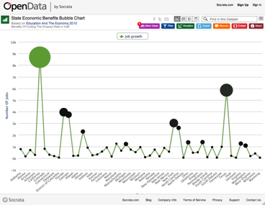
The Power of Visualizations

Slide 6
Powered Through Advanced Technologies
Provides developers the tools and raw data formats to develop new capabilities
Partnership with W3C (eGov Interest Group) and with RPI for research in semantic web
Connected to other open data efforts across the world
Data hosted in the cloud
Open source platform
Builds on ontologies developed in specific areas

Slide 7
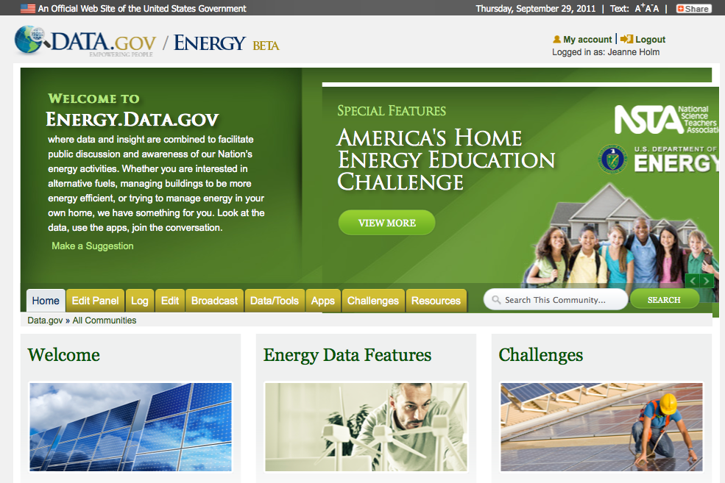
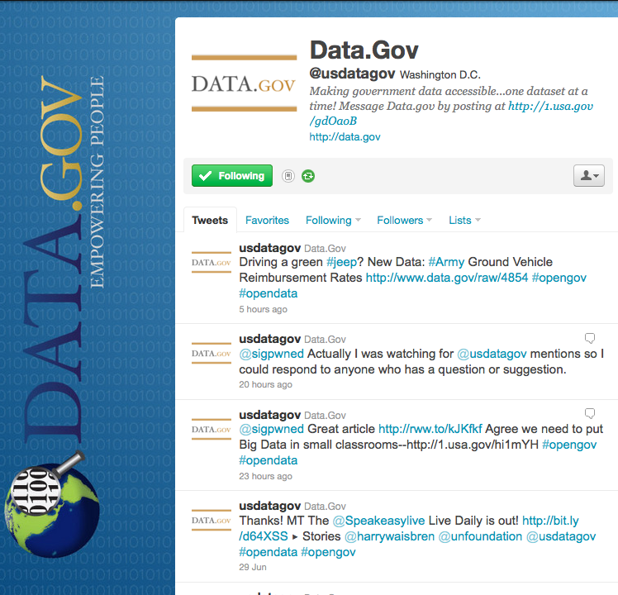
Open Communities
Community
Restore the Gulf | ✓
Open Data | ✓
Semantic Web | ✓
Health | ✓
Law | ✓
Energy | ✓
Education
Ocean
Research and Development
Public Safety
Human rights
+ many more…

Slide 8
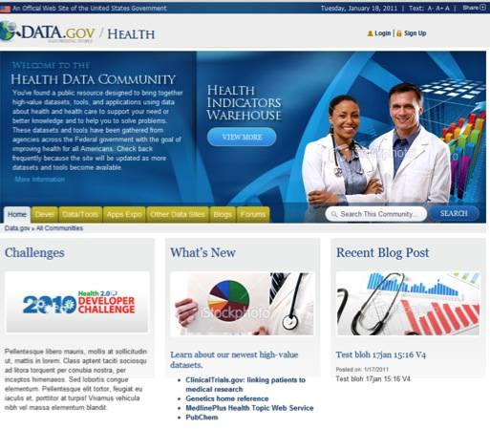
Health.Data.gov
Champion: Todd Park
Chief Technology Officer
US Dept. of Health and Human Services
Apps
Forums
Blogs
Challenges

Slide 9
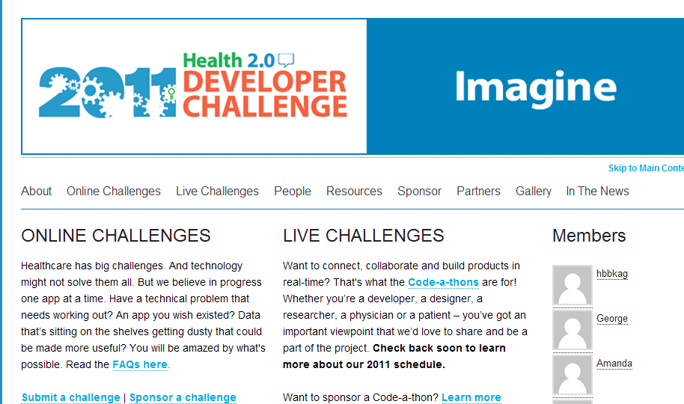
Publicizing Data to Innovators
Challenges and code‐a-thons (health2challenge.org)
Many innovator “meetups” and conferences
Annual health data-paloozas
Over 139 applications
50 new businesses
Thousands of lives improved each day

Slide 10
Creating Apps That Improve Lives: Asthmapolis
Notes:
Uses asthma patients aggregated GPS notations to create hot spots in communities where there are asthma issues
Changes individual behavior
From 65% daily incidence to 25% daily incidence of inhaler uses over a six month study

Slide 11
Think Big, Start Small, Innovate
Data.gov Quick Facts | May 2009 | October 2011
Total datasets available | 47 | >400,000
Hits to Data.gov | 0 | >200 million
Apps and mash-ups by citizens and government | 0 | 372 + 1113
RDF triples for semantic applications | 0 | 6.7 billion
Dataset downloads | 0 | >2.0 million
Nations establishing open data sites | 0 | 28
States offering open data sites | 0 | 31
Cities in North America with open data sites | 0 | 13
Open data contacts in Federal agencies | 24 | 396
Agencies and subagencies participating | 7 | 185
Communities | 0 | 7
Community challenges | 0 | 23

Slide 12
Energy Drives Innovation
Energy.Data.gov connects innovators, industry, academia, and government at federal, state, and local levels

Slide 13
Challenges Spark Ideas
Energy.Data.gov connects works with challenges across the nation to integrate federal data and bring government personnel to code-a-thons

Slide 14
Data Drives Decisions
Apps transform data in understandable ways to help people make decisions

Slide 15
The Path Ahead
Bring data up and out of government to the public ★
Make data accessible and linked ★★★★★
Provide simple ways to visualize the data
Create communities to understand and apply data
Connect and collaborate with small businesses, industry, and academia to drive innovation
Develop open source open government data platform with India for global use and further community development
Share with others to understand global issues
Be the change you want to see in the world
Ghandi

Slide 16
US Open Government Action Plan
On 20 September 2011, President Obama announced at the UN General Assembly…
Contribute Data.gov as a platform
India and the U.S. creating open source platform
Will allow any country to create open data site
Foster communities on Data.gov
Health, energy, and law plus new communities in education, research and development, and public safety
Launch International Space Apps Competition
NASA and other space agencies will gather scientists and citizens
Use data for global challenges: weather impacts on global economy and depletion of ocean resources
A collaboration website will be created to facilitate citizen participation

Slide 17
Open Data at Cities, Counties, and States

Slide 18
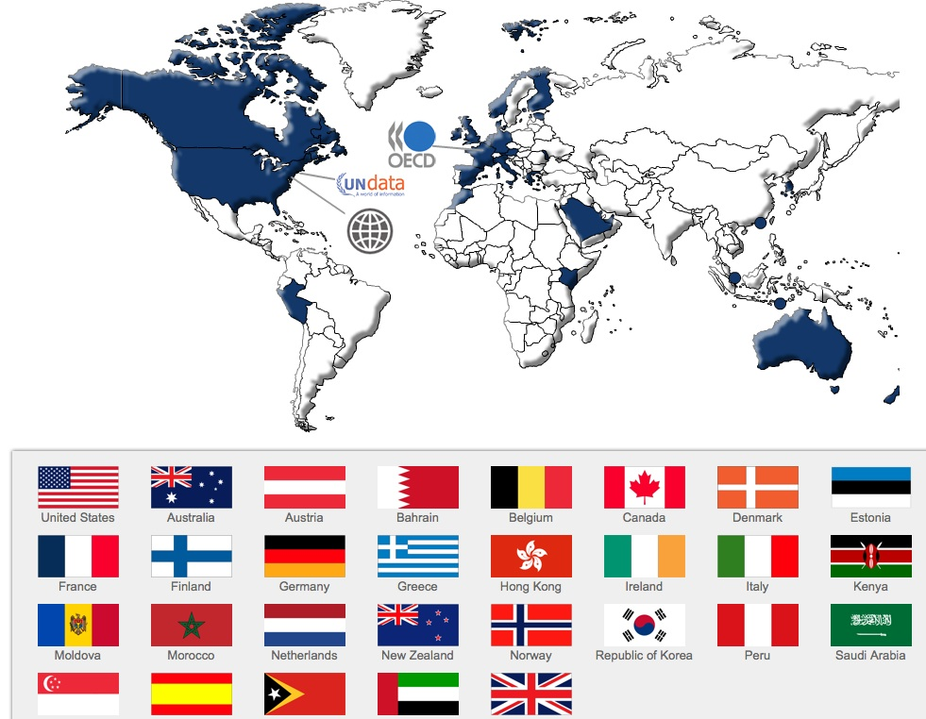
A Global Movement Has Begun to Provide Transparency and Democratization of Data
Don’t see your site? Update via @usdatagov

Slide 19
Let’s work together to set the data free! www.Data.Gov @usdatagov christopher.musialek@gsa.gov jholm@jpl.nasa.gov @JeanneHolm, @cmoose

