Slide 1
Separating Semantics and Implementation
From a Single Ontologically Sound Conceptual Model to Multiple Physical Schema Languages
Bruce T. Bauman, U.S. DoD

Slide 2
Agenda
Motivation
Challenge
OntoUML
Compiling
RDFS
XSD
SQL
Summary
Further Work
Conclusion

Slide 3
Model Types
Perspective
Greater Reuse
Enterprise
Fewer Models
Conceptual
Greater Detail
Reflects Semantics
Project
Greater Complexity
Logical
System
Physical
Optimized Physical
Representation
Neutral
Technology
Specific
Product
Specific
Implementation
Notes:
Traditional Data modeling starts in the Technology Specific Column.
Typical project practice in my organization is to jump straight to physical design.
Greater Complexity:
In order to support reuse two mechanisms that are often used to simplify a model cannot be used.
(Physical Optimization) If implementation narrowed to one technology, details that cannot be implemented in that technology are often omitted.
(Semantic Optimization) The full representation of the semantics of some concepts (e.g. material relationships) can be complex. As its likely that only a part of the full representation will be used in implementation, the other aspects of it are almost always omitted. After all we are creating models, and for models to be useful the detail they choose to omit is very important.

Slide 4
Model Types - Languages
Perspective
OntoUML
Enterprise
Conceptual
OntoUML with limited encoding annotations
Project
Logical
Full use of encoding annotations
System
Technology specific tooling
Physical
Optimized Physical
Neutral
Technology
Product
Implementation
Notes:
Limited Encoding Annotations are skip and absorb.

Slide 5
Why existing languages don’t cut it
Languages pitched at analysis and design (e.g., UML, ERD)
Optimized for design targeting specific technologies
Don’t have a well defined semantic mapping
Implementation languages (e.g., XML Schema, DDL, OWL, RDFS)
Clearly they have made implementation trades.
Natural Language
Not precise enough.
Notes:
So a natural question, is why use a new relatively unknown, unsupported modeling language. The short answer is that non of the existing modeling languages meet our requirements. The most important area in which they fail is that they are all design / implementation languages. Their constructs don’t have well defined semantic meanings leading to construct variability (i.e. different modeling constructs can be used to represent the same semantic).
Well, how about natural language. At the conceptual layer effective use of natural language is essential. After all the target for that model is a human. Only natural language has the expression and nuance to reflect a domain’s semantics. As such, its importance can not be understated, and the lack of attention to it in many projects is telling. That aside, natural language alone doesn’t meet the requirements of precision and semi-automatic translation to machine languages.
So if your not going to use a mainstream modeling language, you’re left with some very difficult problems.
Your not going to find tool support.
If you’re not using a design language, how do you know you have a good / sound model?

Slide 6
Unified Foundational Ontology (UFO)
Created by Giancarlo Guizzardi
For Conceptual / Analysis modeling
Ontologically Based
UML class diagram notation
Notes:
Based on current research, papers make numerous citations to existing ontologies, as well as papers in other disciplines including cognitive psychology, neuroscience etc.
It is NOT being put forward as the only appropriate modeling language to meet the requirements. What is being put forward is the following:
We need an appropriate modeling language for analysis, and stop trying to appropriated languages well designed for other purposes. This language is a good starting point.

Slide 7
Our subset of OntoUML
Classes
<<kind>> <<category>>
<<role>> <<roleCategory>>
<<dependent>> <<associative>>
<<event>>
Associations
<<non-dependency>> <<dependency>>
<<composition>> <<aggregation>> (merelogical relations)
Attributes
Datatypes
<<primitive>> <<domain>>3 <<enumeration>>
<<structure>> <<union>>3

Slide 8
Classes
Concept | Rigidity | Identity | Existential Dependence | Example
<<kind>> | Rigid | Unified | Independent | Person
<<role>> | Anti-Rigid | Unified | Independent | Spouse
<<dependent>> | Rigid | Unified | Dependent | Mental State
<<associative>> | Rigid | Unified | Dependent | Marriage
<<category>> | Rigid | Dispersive | Independent | Party
<<roleCategory>> | Anti-Rigid | Dispersive | Independent | Customer
Notes:
Meta-Properties
Basically the onto-clean distinctions

Slide 9
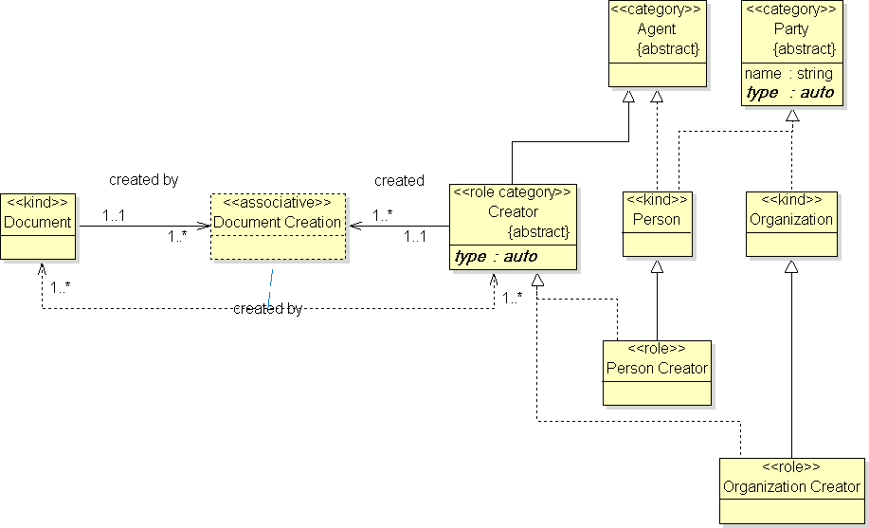
The finished product

Slide 10
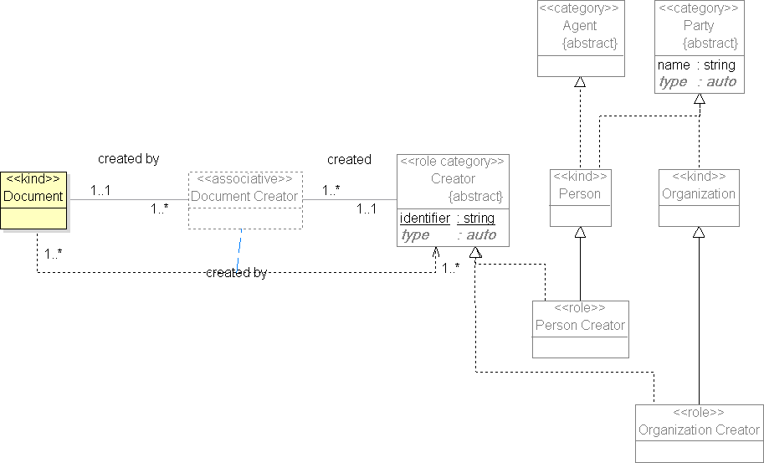
XSD – key assignment
Notes:
Anything can be given a key in a physical model, the question is what is the best place.

Slide 11
Association Encoding - embed
Source
A
B
Target
association
id : string
attrib : integer
1..*
1..*
id : string
attrib : integer
Include Association: true ◻ false ☒ Global ◻
A N/A | B Navigable ☒ Include Endpoint true ◻ false ☒ Encoding : embed
<Source>
<Id>Value</Id>
<Attrib>Value</Attrib>
<Target>
<Id>Value</Id>
<Attrib>Value</Attrib>
</Target>
</Source>

Slide 12
Association Encoding - reference
Source
A
B
Target
association
id : string
attrib : integer
1..*
1..*
id : string
attrib : integer
Include Association: true ◻ false ☒ Global ◻
A N/A | B Navigable ☒ Include Endpoint true ☒ false ◻ Encoding : reference
<Source>
<Target>
<Id>FK Value</Id>
</Target>
</Source>

Slide 13
Association Encoding - link
Source
A
B
Target
association
id : string
attrib : integer
1..*
1..*
id : string
attrib : integer
Include Association: true ◻ false ☒ Global ◻
A N/A | B Navigable ☒ Include Endpoint true ☒ false ◻ Encoding : link
<Source>
<Target href=“”/>
</Source>

Slide 14
Association Encoding - parts
Source
A
B
Target
association
id : string
attrib : integer
1..*
1..*
id : string
attrib : integer
Include Association: true ◻ false ☒ Global ◻
A N/A | B Navigable ☒ Include Endpoint true ◻ false ☒ Encoding : reference
<Source>
<Target>FK Value</Target>
</Source>

Slide 15
Association Encoding - parts
Source
A
B
Target
association
id : string
attrib : integer
1..*
1..*
id : string
attrib : integer
Include Association: true ☒ false ◻ Global ◻
A N/A | B Navigable ☒ Include Endpoint true ☒ false ◻ Encoding : reference
<Source>
<Association>
<Target>
<Id>FK Value</Id>
</Target>
</Association>
</Source>

Slide 16
Association Encoding - parts
Source
A
B
Target
association
id : string
attrib : integer
1..*
1..*
id : string
attrib : integer
Include Association: true ☒ false ◻ Global ☒
A N/A | B Navigable ☒ Include Endpoint true ◻ false ☒ Encoding : reference
<Association>
<Source>FK Value</Source>
<Target>FK Value</Target>
</Association>

Slide 17
Successes / Observations
It actually does work
Used on many projects
Model reuse is occurring
Encoding rules are sufficient however new encoding patterns are still being discovered
Projects select very different encodings
Notes:
Four Projects
Two encoded exactly the same domain in two entirely different ways.
One created a schema that constraint documents that were also compliant with the GML schema.
Projects select very different encodings with the one common denominator, they make heavy use of skip and collapse operations.

Slide 18
Challenges
Hard but not too hard
Physical Model Duality (encoding can seem like magic)
Tools
Really Hard
Talent
Culture
Things to consider
Return on Investment
Notes:
A physical model is pulled in to often contradictory directions. Does it firstly reflect its semantic origin, and only secondarily the data structures it will generate, or is it the opposite, or is there some happy middle ground?
Talent
ROI

Slide 19
Future Work
Better visualization
Change management
Continue to improve documentation
Prototype other implementations
Explore semi-automatic translation

Slide 20
Questions
Bruce Bauman
Senior System Architect
U.S. Department of Defense
btbauma@gmail.com

