Slide 1
Ontology for Federation and Integration of Systems
Ontology Summit 2012
Cross-track A2 Summary
Anatoly Levenchuk & Cory Casanave Co-chairs
http://ontolog.cim3.net/cgi-bin/wiki.pl?OntologySummit2012_SystemsFederationIntegration_Synthesis

Slide 2
Panelists
Dr. Tommi Karhela (VTT Technical Research Centre, FI) - "Ontology based Integration Platform for Modelling and Simulation - Simantics"
Mr. Anatoly Levenchuk (TechInvestLab, RU) - "Ontology-based Systems Federation"
Mr. Dennis Wisnosky (DoD, US) - " Leveraging Semantic Technology across systems to meet the goal of having an 'executable, integrated, consumable, solution architecture' "
Mr. Cory Casanave (Model Driven Solutions, US) - "Semantic Information Modeling for Federation“ (SIMF)

Slide 3
What is Federation and Integration?
Federation
Combining multiple independently conceived data sources, services and/or systems and using them together for analytics, information sharing and other purposes
Applies to system of systems engineering
Systems Federation (bus) – a kind of network with interoperability
WIKIPEDIA: A Federation is multiple computing and/or network providers agreeing upon standards of operation in a collective fashion
Integration:
Implies (but does not require) more control over the interacting components than does federation to achieve a composite system
Applies to systems engineering
Wikipedia: Systems integration, the engineering practices and procedures for assembling large and complicated systems from less-complicated units, especially subsystems

Slide 4
Business Case
The ability to federate and integrate data, processes, services and systems components is at the foundation of the modern enterprise, business eco-system and open, collaborative government
The cost of non-semantic approaches, that are largely coded transformations between fixed data structures, is high and introduces errors, inflexibility and risks
Incremental improvements in our ability to integrate and federate with semantics can mean bottom-line profits for the enterprise and improved service to citizens for government at lower cost and reduced timeframes

Slide 5
Federation Semantics
Federation and integration always involves semantic analysis, even if done informally
Ontologies provide methodologies and tools for capturing and leveraging semantic analysis to reduce the cost, time, errors and risk associated with manual federation and integration
Ontologies can help directly drive federation and integration solutions using inference, rules and model driven architecture

Slide 6
Primary Architectures
Structure
Point-point
Via a reference ontology (e.g. conceptual model)
Runtime
Extract Transform Load (ETL)
Semantic Bridges (Dynamic)
Ontologies assist with any combination, but are particularly effective in avoiding point-point static integration. Semantic federation can be implemented as ETL or dynamic translation

Slide 7
Reference Ontologies
Represent the semantics of a domain
Can map to multiple representations/systems/structures
A lattice of reference ontologies avoids the “universal ontology” problems
System A
Semantic
Bridge
Reference Ontologies
A.K.A. Conceptual Models
Semantic
Bridge
System B
Semantic
Bridge
Semantic
Bridge
System C
Semantic
Bridge
Semantic
Bridge
7

Slide 8
Federation at all levels
Federation and integration is required
At the “instance” level: data-data
At the model or ontology level: concept-concept
At the language or meta-model level: language-language
To be most effective, ontologies are applied at all levels

Slide 9
Service Federation
Service federation (SOA) encompasses information exchange, interacting roles, choreography, security & privacy
Service viewpoints can also be modeled using ontologies
Services utilize “information centric” ontologies
Service and domain ontologies are required to support the full life-cycle of integration and federation

Slide 10
Standards targeted at federation
ISO 15926, HDQM, Gellish, IDEAS, RDF/OWL, SIMF (in progress)
Important capabilities of federation standards and languages
The broadest possible context
Extensible
Enable anything to be said that is valid (i.e. no artificial restrictions)
Explicit ontological commitments that are followed consistently
Strong methodology so that the same thing is represented in the same way by different analysts, including,
Choice of alternative approaches left open by ontological commitments,
Consistent representation so the same thing would get pretty much the same representation from different analysts.
FOL (Minimum), HOL is actually needed
General languages for specifying federation & conceptual models as well as the general programming languages used for federation
Stakeholder (business) friendly

Slide 11
Semantic Web
Includes: Linked Data, RDF & OWL
Seen as mainstream for web data representation and “lite” semantics
Is being used in production (e.g. DoD BTA)
There are questions about representational capability and suitability for widespread federation and integration

Slide 12
Federation/Integration Examples
Product Lifecycle Management (PLM)
Financial systems integration
Federation of simulation systems
Federation of modeling languages
Space systems integration
Enterprise architecture
Federation of medical records
Supply chains
Information sharing to prevent terrorism

Slide 13
Difficulties
Absence of authoritative reference ontologies
Limited support for distributed ontology development: Versioning, granularity, provenance, etc.
Performance issues, particular when using federated ontologies and advanced logics
Different tools, languages and methodologies used by different practitioners
No ontology of system federation/integration - leads to fragmentation of methods, models, tools & frameworks

Slide 14
Dr. Tommi Karhela

Slide 15
Anatoly Levenchuk

Slide 16
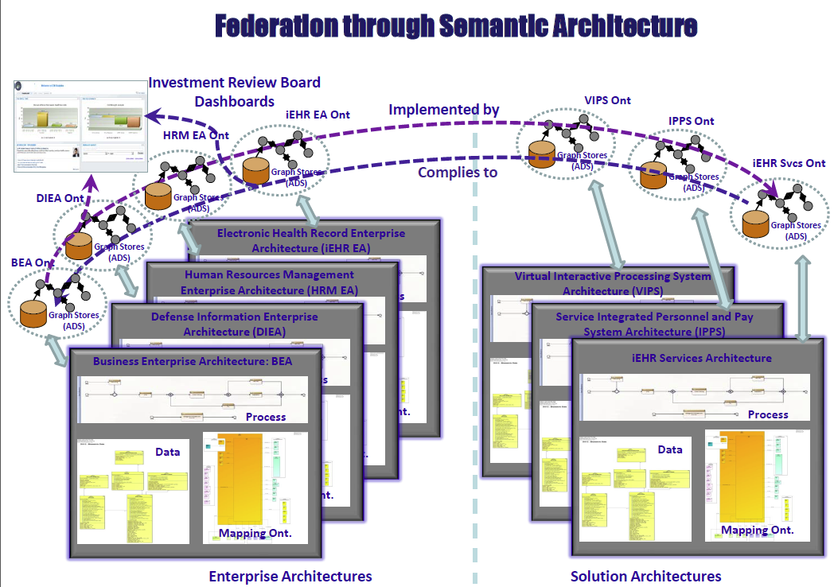
Dennis Wisnosky

Slide 17
Semantic Information Modeling for Federation (SIMF) Architecture (OMG Standard in progress)
Subject focused conceptual models define the concepts, predicates, integrity rules and terms of a domain that can be related to each other
Kernel
Conceptual Domain Models
Model Bridging Relations
SIMF Scope
Solution focused logical information elements represent information structures and integrity rules that can use and extend other information
Logical Information
Models
Technology focused physical data schema are grounded in logical data models which define their context and semantics
Physical Data Schema
Cory Casanave

Slide 18
Summary
Ontologies are an emerging best practice for federation and integration
Ontologies are part of a model driven architecture solution scenario – ontologies are models
Standards and agreement on languages and reference ontologies are still emerging
Semantic federation and integration improves agility while reducing time, cost and risk
Current ontological tools and methods are sufficiently mature for use in production federation and integration projects

