Slide 1
Ontology Summit 2012
Track 3 Summary Report Challenge: Ontology and Big Data
Co-Chairs
Mary Brady
Ernie Lucier
Thursday, April 12, 2012

Slide 2
Track 3 – Challenge Ontology and Big Data
Mission:
Identify appropriate objectives for an Ontology and Big Data challenge
Prepare problem statements, identify the organizations and people to be advocates, and identify the resources necessary to complete a challenge
Engage the community in designing ontology solutions to benefit BIG DATA applications

Slide 3
Track 3 Challenge Ontology and Big Data
Goal:
Meet Big Data Challenges via Ontology
Advance ontology and semantic web technologies
Identify challenges that will increase applications and accelerate adoption

Slide 4
Session 1: Panelists
Presenter | Organization | Topic
Dr. Barry Smith | University of Buffalo, SUNY | How BIG DATA might benefit from Ontology and why it usually fails
Chris Musialek (for Dr. Jeanne Holm) | Data.gov | Data.gov datasets (>400,000) that could benefit from ontology
Bryan Thompson, Mike Personick | SYSTAP, LLC | Managing scale in ontological systems
James Kirby | Naval Research Lab | Ontology for Software Production

Slide 5
Session 2: Panelists
Panelist | Organization | Topic
Dr. Tim Finin, Dr. Anupam Yoshi | UMBC | Making the Semantic Web Easier to Use
Kyoung-Sook Kim | NICT | Use Cases of Cyber Physical Data Cloud
Mike Folk |  | HDF5
Mario Paolucci | FuturICT | Global Participatory Computing for Our Complex World
Dr. Ursula R. Kattner | NIST | Materials Genome: Data Standards
Edin Muharemagic | LexisNexis | HPCC, Machine Learning

Slide 6
Current State (Ontology)
Ontology may tame big data, drive innovation, facilitate the rapid exploitation of information, contribute to long-lived and sustainable software, and improve Complicated Systems Modeling.
Ontology promises to:
Achieve global data standards, meanings, knowledge representation
Reduce complexity and costs
Improve agility
Allow reasoning and inferencing capabilities
But, there is a growing ontology base to choose from…without much regard for standardization.
Recommendation: Develop ontologies in the same field in a coordinated fashion to ensure that there is exactly one ontology for each subdomain, e.g., the Gene Ontology

Slide 7
Current State (BIG DATA)
BIG DATA – Data Drives Decisions
Commerce, Financial, and Homeland Security success stories in mining BIG DATA.
Amazon => suggest possible purchases
Credit card companies differentiate between fraudulent and legitimate purchases
Financial Analysts predict investments
Homeland Security monitors is constantly analyzing purchases to predict individual’s future buying habits
BIG DATA environments vary => Google Map/Reduce, HADOOP, LexisNexis HPCC, machine learning, appearance of higher-order languages
Important to consider entire “big data stack” and consider use of ontology at multiple levels (storage, feature identification and correlation, large-scale data integration, etc.)
Large-scale, national priority applications could learn from these applications areas; all could benefit from integrated ontology and machine learning approaches to provide global standards, meaning, knowledge representation

Slide 8
BIG DATA Applications
DATA.GOV
FuturICT
Materials Genome: Data Standards
Cyber-Physical Systems

Slide 9
Data.gov
Data.gov is Driving Innovation by Creating a Data Ecosystem
Gather data from many places and give it freely to developers, scientists, and citizens
Bring data up and out of government to the public
Make data accessible and linked
Connect the community by finding solutions to allow collaboration through social media, events, platforms
Create communities to understand and apply data
Provide an infrastructure built on standards
Encourage technology developers to create apps, maps, and visualizations of data that empower people’s choices
Provide simple ways to visualize the data
Connect and collaborate with small businesses, industry, and academia to drive innovation
Gather more data and connect more people

Slide 11
Materials Genome Initiative
Materials Properties
Physical Properties
Mechanical Properties
Magnetic Properties
Electrical Properties
Physics based models
Structure
Microscale
(e.g. voids, precipitates, defects, interfaces)
Macro scale
(e.g grain structure)
Nanostructure
(e.g. precipitates, interfaces)
Quantum Design (e.g. Grain boundary cohession
Micromechanics design
Phase transformation design
Macro scale (Continuum )FEM
Models integrated to predict structure and properties.
Models
Molecular
MD, KMC
Microscale
Phase Field
Quantum
Databases
Thermodynamics
Molar Volume/
Lattice parameter
Bulk Moduli
Diffusion
Mobilities
Thermal Conductivity
Interfacial Energies
Atomic-Scale Models:
First-principles (DFT,MC) , EAM, MD, KMC
Experimental Data
(e.g. Crystal Structure, thermochemical, D* )
Notes:
A different perspective on how the models and data are integrated in the design process. Note in general the goal is model a structure/property relationship

Slide 12
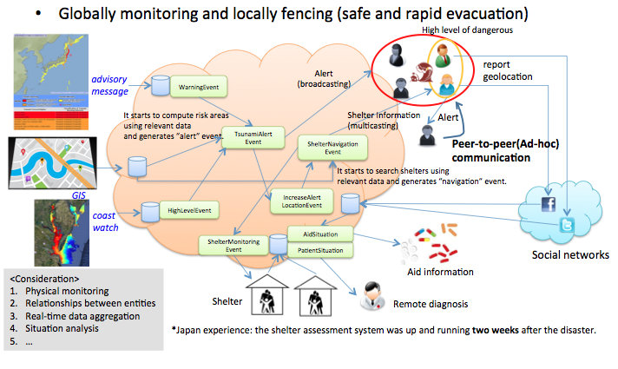
Cyber-Physical and the Cloud

Slide 13
BIG DATA Challenge: Considerations
Ontology has great promise for BIG DATA, but must have concerted standard efforts, similar to Gene Ontology, to be successful at a large scale.
Promising technology at each layer that should be considered for ontology use – storage, domain ontology, linked data, integration between domains, etc.
Methods to build on existing infrastructure rather than re-vamping?
Methods to address learning curve:
Education of future ontologists – topic of last year’s summit
What can we learn from other efforts?
Security, sysadm – over time, moved from system internals => certificate programs
BIG DATA platforms – emphasis on creating high-order languages that remove complexity of underlying hw/sw stack from user
Similar paradigm for ontologists?

Slide 14
BIG DATA Challenge: Goals
Increase:
Awareness of ontology technology among programmers/database managers
Number of qualified personnel to facilitate the growth of the ontology technologies
Accelerate agencies’ adoption of semantic and ontology capabilities through improved implementation methodologies
Create a cross-culture of domain scientists, engineers, computer scientists, solution providers to:
Ameliorate any mismatch between those with data and those with the skills to analyze it
Enable scientists and engineers to make maximum use of big data
Enable scientists and engineers to understand the potential of ontology-based systems integration
Enable ontologists to understand scientists and engineers needs

Slide 15
Big Data Challenge: Basic Principles
Heterogeneous collections of data to become more homogeneous and searchable “on the fly” or “at first presentation”
Involves more than one agency (could specify the agencies) and the resulting application/tool could be easily generalized for use by multiple agencies.
Incorporates agency mission statements
Involves more than one data set, of which:
At least one must be a “big data” data set (as defined… see data set summary)
At least one must be an active or streaming data set (this could be a requirement, or an option)
Promotes Data to Knowledge to Action

