Slide 1
Modeling Benchmark Challenge Project
http://ontolog.cim3.net/cgi-bin/wiki.pl?ModelingBenchmarkChallenge
mailto:model-challenge@ontolog.cim3.net
Henson Graves
April 26, 2012
Notes:
Abstract
Background1
I assembled these charts yesterday, based on charts 6 years old.
Background2
based on 7 years of personal experience as the architect of an information system for a very large multinational program
Before that I had 5 years building workbenches and federating systems
Technology has come a long way, yet the problems remain – at great cost
Yet the critical problem remains as its root cause is not generally understood
During the Summit
Matthew West’s example of the distillation unit system and some of the discussion helped me figure out a conceptualization problem that has been on my mind since the experience

Slide 2
Project Mission/Charter
Contribute to the evolution of modeling languages and development of formal semantics
Develop modeling examples
Express examples in multiple languages
Do analysis of language constructions and semantics

Slide 3
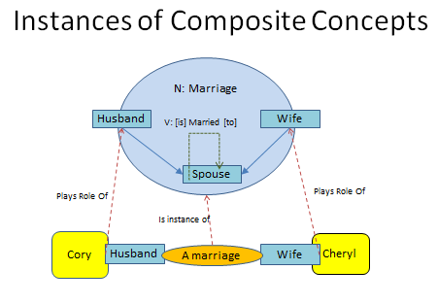
Marriage Example (Cory Casanave)
Features
Composite structure
Temporal aspect
Constraints/integrity rules both within a marriage and between marriages
Variants of pattern
Marriage Instance of composite structure
Focus is on language expressing ontology, not ontology

Slide 4
Distillation Unit Example (Matthew West)
Language Features
Distinction between parts and components is useful
Spatial-temporal aspects are important
Distinctions of kinds of relations are useful
Notion of identity is extremely important

Slide 5
Some Near Term Tasks
Create a metadata ontology to describe and manage the examples
Name: <text>
Author: <text> - perhaps this could be filled out automatically
Related examples: <list of internal urls>
Description: <text>
Features: <text list>
References: <list of urls>
Start entering examples documenting with fields above

Slide 6
Questions or Comments?

