Slide 1
Ontological realism as a strategy for integrating ontologies
Ontology Summit February 7, 2013
Barry Smith
http://ontology.buffalo.edu/smith

Slide 2
Scientific data is stored in databases
There are very few constraints on the creation of new databases
Scientific data becomes ever more siloed
Proposal to counteract this silo-formation: create a common non-redundant suite of ontologies covering all scientific domains to annotate scientific data
Question: What strategy shall we use to build this suite of ontologies

Slide 3
More precisely:
How shall we build a common ontology = an ontology that will integrate well with ontologies built for neighboring domains?
This question arises in science, but it arises also in other domains, such as commerce, government and the military

Slide 4
The Semantic Web provides only a small part of the solution
html demonstrated the power of the Web to allow sharing of information
can we use semantic technology to create a Web 2.0 which would allow algorithmic reasoning with online information based on XLM, RDF and above all OWL (Web Ontology Language)?
can we use RDF and OWL to break down silos, and create useful integration of on-line data and information

Slide 5
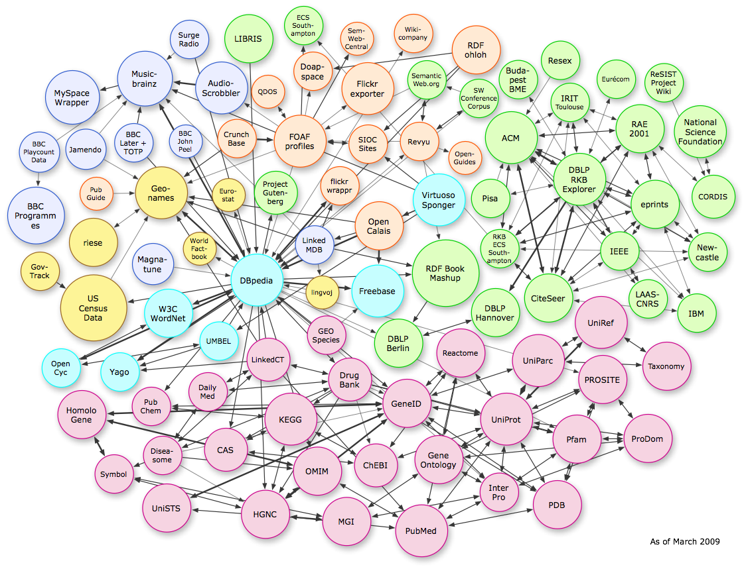
Ontology success stories, and some reasons for failure
Not all of the links here are what they seem
A fragment of the “Linked Open Data” in the biomedical domain
Notes:
http://dbpedia.org/fct/images/lod-datasets_2009-03-27_colored.png

Slide 6
The more Semantic Technology is successful, they more it fails to solve the problem of silos
Indeed it leads to the creation of multiple, new, semantic silos – because multiple ontologies are being created in ad hoc ways

Slide 7
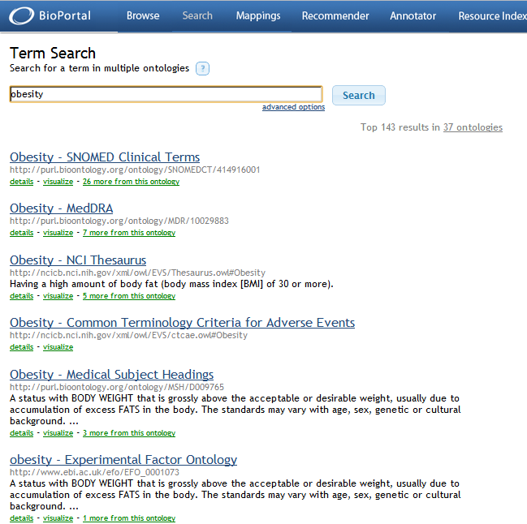

Slide 8
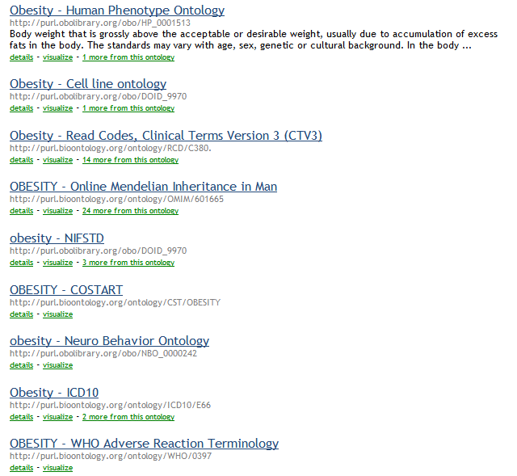

Slide 9
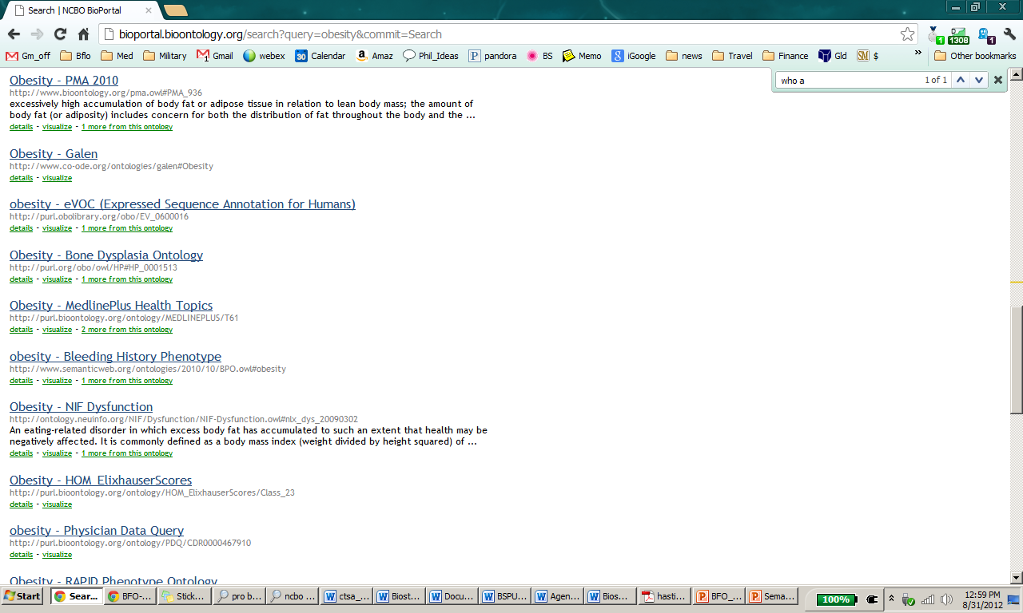

Slide 10
There are many ways to create ontologies
How do we build ontologies so that they converge? (The problem of ‘knowledge representation’)

Slide 11
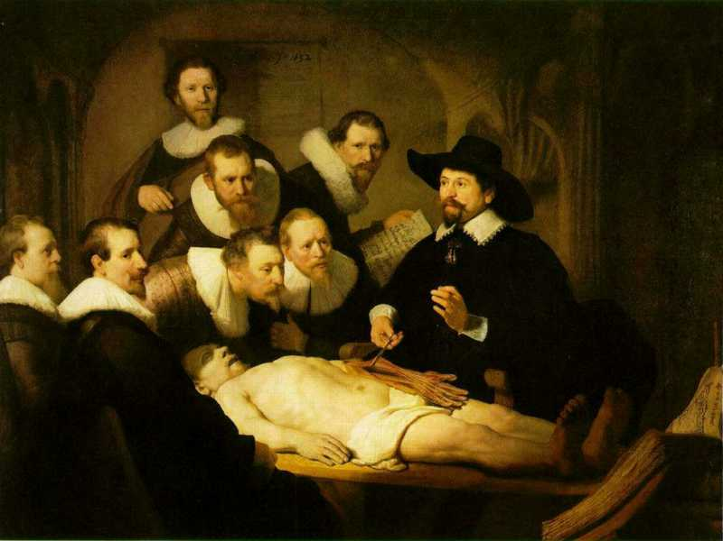
What is going on here ?
ah sh uqwu ja ?
ywye has
uw has!

Slide 12
There are many ways to create ontologies

Slide 13
Evidence-based ontology development
Q: What is to serve as constraint?
A1: Authority (I tell you what to do)
A2: Homesteading (Founder effect)
A3: Best candidate terminology
But what does ‘best’ mean?
A4: Voting ?
But then on what grounds should people vote?

Slide 14
A5: Reality, as revealed, incrementally, by which results of experimentation become incorporated into textbook science

Slide 15
Three Levels to Keep Straight
Level 1: the entities in reality, both instances and universals
Level 2: cognitive representations of this reality, e.g. on the part of scientists ...
Level 3: publicly accessible concretizations of these cognitive representations in textual and graphical artifacts

Slide 16
What is going on here ?
L3
ywye has
uw has!
ah sh uqwu ja ?
L2
L1

Slide 17
The realist approach
provides the basis for coordination (consistency) at the level of specific domains – reflecting the consistency of textbook science
But integration requires more than consistency – it requires also a common realist methodology for ontology development
Smith and Ceusters, “Ontological Realism as a Methodology for Coordinated Evolution of Scientific Ontologies”, Applied Ontology, 5 (2010), 139–188.

Slide 18
Benefits of common methodology
No need to reinvent the wheel for each new domain
Can profit from storehouse of lessons learned
Can more easily reuse what is made by others
Can more easily reuse training
Can more easily inspect and criticize results of others’ work
Leads to innovations (e.g. Mireot, Ontofox) in strategies for combining ontologies

Slide 19
Candidate Upper Level Ontologies
  Domain Ontology for Linguistic and Cognitive Engineering (DOLCE)
  Suggested Upper Merged Ontology (SUMO)
  Upper Cyc Ontology
  Basic Formal Ontology
  – all reflections of recognized need for semantic standardization via upper level ontology

Slide 20
Why choose BFO
Very small
Designed to support the consistent representation of different domains of reality in support of scientific research
– integration of data via ontologies presupposes consistent ontologies
Associated with aggressive program of project-based testing, feedback and training

Slide 21
Main reason to use BFO
BFO has the largest body of scientist users
(compare: This telephone network has the largest number of subscribers)
Snowballing network effects:
data annotated using BFO-conformant ontologies becomes more valuable
numbers of people with expertise in building BFO-conformant ontologies increases

Slide 22
Basic Formal Ontology
No fictions
No non-existents
No ‘possible worlds’
BFO is designed to support scientific research
Science is distinct from story-telling
There is no science of unicorns (though they may be a branch of psychiatry which deals with unicorn-obsessions or unicorn-delusions)

Slide 23
Basic Formal Ontology
a true upper level ontology
no interference with domain ontologies
no interference with issues of cognition
∼ a small subset of DOLCE but with a clearer treatment of instances, universals, relations and qualities, time

Slide 24
RELATION TO TIME GRANULARITY | CONTINUANT |  |  |  | OCCURRENT
 | INDEPENDENT |  | DEPENDENT
ORGAN AND ORGANISM | Organism (NCBI Taxonomy) | Anatomical Entity (FMA, CARO) | Organ Function (FMP, CPRO) | Phenotypic Quality (PaTO) | Biological Process (GO)
CELL AND CELLULAR COMPONENT | Cell (CL) | Cellular Component (FMA, GO) | Cellular Function (GO)
MOLECULE | Molecule (ChEBI, SO, RnaO, PrO) |  | Molecular Function (GO) |  | Molecular Process (GO)
The Open Biomedical Ontologies (OBO) Foundry

Slide 25
 | CONTINUANT |  |  |  | OCCURRENT
 | INDEPENDENT |  | DEPENDENT
ORGAN AND ORGANISM | Organism (NCBI Taxonomy) | Anatomical Entity (FMA, CARO) | Organ Function (FMP, CPRO) | Phenotypic Quality (PaTO) | Organism-Level Process (GO)
CELL AND CELLULAR COMPONENT | Cell (CL) | Cellular Component (FMA, GO) | Cellular Function (GO) |  | Cellular Process (GO)
MOLECULE | Molecule (ChEBI, SO, RNAO, PRO) |  | Molecular Function (GO) |  | Molecular Process (GO)
RELATION TO TIME
GRANULARITY
rationale of OBO Foundry coverage (homesteading principle)

Slide 26
Users of BFO (Consortia)
NIF Standard | Neuroscience Information Framework
eagle-I Ontologies | used by VIVO and CTSAconnect
IDO Consortium | Infectious Disease Ontology
CROP | Common Reference Ontologies for Plants

Slide 27
The OBO Foundry
  GO Gene Ontology
  CL Cell Ontology
  ChEBI Chemical Ontology
  PRO Protein Ontology
  OBI Ontology for Biomedical Investigations
  OGMS Ontology for General Medical Science
  PATO Phenotype (Quality) Ontology
  IDO Infectious Disease Ontology
  PO Plant Ontology
  SO Sequence Ontology
  FMA Foundational Model of Anatomy
  CARO Common Anatomy Reference Ontology
  EnvO Environment Ontology
  Disease Ontology

Slide 28
http://www.ifomis.org/bfo/users
Neurological Disease Ontologies (ND)
Interdisciplinary Prostate Ontology (IPO)
Nanoparticle Ontology (NPO): Ontology for Cancer Nanotechnology Research
Neural Electromagnetic Ontologies (NEMO)
ChemAxiom – Ontology for Chemistry
Ontology for Risks Against Patient Safety (RAPS/REMINE) (EU FP7)
Petrochemicla Ontology
US Army (I2WD)
…

Slide 29
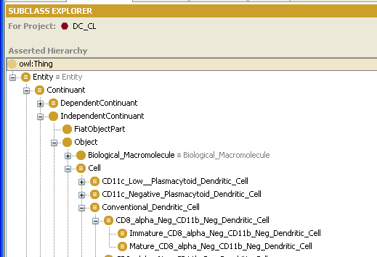
Example: The Cell Ontology

