Slide 1
A biologists' perspective on ontology utility
Melissa Haendel
Ontology Summit 2013
3.7.13

Slide 2
What do biologists need from an ontology?
Need it to communicate with each other and computers

Slide 3
What do biologists need from an ontology?
Need to apply ontologies to data:
Annotation
Structuring
Mapping
IN A CONSISTENT MANNER
Name | Type | Strain
CD4 knockout | Mouse | C57BL/6
OTI | Mouse | C57BL/6
CD4 knockout | Rat | Wistar
Search and classify data:
Query:
Find organisms on C57BL/6 background
Name | Type | Strain
CD4 knockout | Mouse | C57BL/6
OTI | Mouse | C57BL/6

Slide 4
Biologists have issues
Biology is particularly challenging due to moving conceptual targets (e.g. gene, allele)
Biologists like to re-use the same labels left and right
Biologists often don’t agree on how to define key concepts!

Slide 5
How to achieve these goals and address these issues?

Slide 6
Quality textual documentation and definitions
Seems simple . . .

Slide 7
Quality textual documentation and definitions
Definitions must not only describe a concept, but allow determination of real instances
Requires consideration of specific and precise concepts to be defined
This is where listing out properties and their use for definition are very helpful
=> Need a ‘concept first approach’ to definition creation

Slide 8
A ‘Concept-First Approach’ Example
Terminology of molecular labels is inconsistent: ‘probe’, ‘tracer’, ‘detector’, ‘reporter’, used variably to describe reagents with different characteristics
Conformance to varied label conventions has led to confusion, ambiguity, and inconsistency in different ontologies
Throw out the labels and consider the biologically important axes:
Axis 1 = Targeting: ability to specifically associate with a molecular target
Axis 2 = Detectability: ability to emit or produce some detectable signal
Notes:
We like to call this a concept first approach . . . . here is an example of modeling ‘molecular labels’, an area where the terminology is varied and imconsistent

Slide 9
A ‘Concept-First Approach’ Example
Axes applied to yield a set of principled subclasses,
and a more descriptive labeling scheme is applied
AXIS 2: DETECTABILITY
YES
NO
COVALENT
REPORTER
COVALENT
TRACKER
NO
(Alexafluors,
radioactive nucleotides)
(biotin,
digoxygenin)
AXIS : TARGETING
TARGETED
REPORTER
TARGETED
TRACKER
YES
(DAPI, coomassie,
labeled oligo probes)
(unlabeled antibodies,
oligo probes)
Results vetted by members of different stakeholder communities
Notes:
We like to call this a concept first approach . . . .

Slide 10
Label Bias
A common source of problems is developers imposing assumptions about the semantic content of a label.
Best to avoid using terms with varied and ambiguous meaning as primary labels . . .
e.g. ‘molecular probe’, ‘cell line’,
. . . or be careful to document this ambiguity, and give a precise definition that is clear about its specific view
OBO Foundry principle suggests use of numeric URIs which helps avoid label bias.
e.g. URIs not like http://xyzweb.org/ont/core#Position
But instead like: http://xyzweb.org/ont/core_43888887

Slide 11
Evaluating text definitions
Are all classes and properties defined? Do they avoid use of figurative or obscure language? Are there citations?
Are essential features for distinguishing from other classes included?
Aristotelian/genus-differentia structure is good for this
Especially important for imported classes
Is circularity avoided?
e.g. ‘specimen collection objective’ defined as the ‘objective to collect a specimen’
Are there clear instances in reality? Test against a set of candidate instances

Slide 12
Testing Definitions Against Instances
Example: ‘genetic material’
complex and nuanced concept, subject to varied interpretations
precise definition needed for use in diverse research communities (genomics, experimental biology, model organisms)
many definitions found on web are correct but vague and insufficient (not precise enough to delineate instances in reality)
e.g. “material of plant, animal, microbial or other origin containing functional units of heredity”
Notes:
MHB will make slide for #4 about capturing the correct extension from evaluating ‘genetic material’ - the test example of a cloning vector in a bacteria highlighted a problem with our definition and our structure of putting ‘genomic material’ as child of ‘genetic material’

Slide 13
Testing Definitions Against Instances
A more precise definition
“a nucleic acid macromolecule that is part of a cell or virion and has the disposition to be replicated and inherited by descendants.”
Start testing against instances
chromosomal DNA in dividing cells
chromosomal DNA in post-mitotic cells
Problem encountered already: a disposition for replication is not relevant in post-mitotic cells
Solution: Refine Definition
“a nucleic acid macromolecule that is part of a cell or virion and is inherited from an immediate ancestor, or incorporated in a manner that it has the disposition to be replicated and inherited by descendants.”
Notes:
“a nucleic acid macromolecule that is part of a cell or virion and is inherited from an immediate ancestor, or incorporated in a manner that it has the disposition to be replicated and inherited by descendants.”

Slide 14
Testing Definitions Against Instances
Continue testing against instances
3. a gene targeting DNA construct transfected into a cell
4. a transiently transfected DNA expression construct
5. a microinjected siRNA oligo in a cell
Problem: some instances expected to be grouped with genetic material, but don’t meet our strict definition
Solution:
Rename original class with more descriptive label ‘hereditary genetic material’, and
Implement new ‘genetic material’ as a more inclusive parent class
Notes:
- Original class renamed more precisely as ‘hereditary genetic material’
- Subclassed under a new, more inclusive ‘genetic material’ class that covers any expressed nucleic acid in a cell/virion

Slide 15
Other Textual Documentation
Does the ontology include extensive synonyms?
Does the ontology include other internal documentation such as edit history? Creator/editor? Status? Modeling notes?
Are there examples of usage? Counter examples?
Sometimes a concept is so complex that a definition cannot disambiguate exclusion or inclusion.

Slide 16
Example of a difficult to define entity
Reagent:
a material entity that bears a reagent role by virtue of it being intended for application in a scientific technique to participate in (or have molecular parts that participate in) a chemical reaction that facilitates the generation of data about some distinct entity, or the generation of some distinct material specified output
A ph meter probe fits our best definition, but is not considered a reagent by biologists =>> document!

Slide 17
Is there complete metadata?
Can use scripts to check ontology for a number of important metadata bits
missing definitions, labels, source, example of usage
duplicate labels
mismatched synonyms
Inclusion of some sort of curation status or metadata complete annotation to indicate readiness of entities

Slide 18
2. Quality logical expressions
No true path violations
Common mistakes are to forget that the distant ancestors definitions apply, and misunderstandings about transitive properties. These are not always caught by reasoners.
A balance of realism and practicality
Are the concepts as expressed in the text definition aligned with the logical expressions?
Are there many concepts used in logical expressions for which there would be no instances collected?
Does the inferred classification makes sense biologically?

Slide 19
3. Ontology reuse
Is the ontology orthogonal to others (an OBO priniciple)?
Does the ontology reuse entities from other ontologies at key intersection points?
Does the ontology include a subset of external entities with the closure, or import entire external ontologies?

Slide 20
Testing the ontology against data
It is important to validate the ontology against real data. But this is the intrinsic talk, you might say…..
Data often tells you that your ontology has errors.

Slide 21
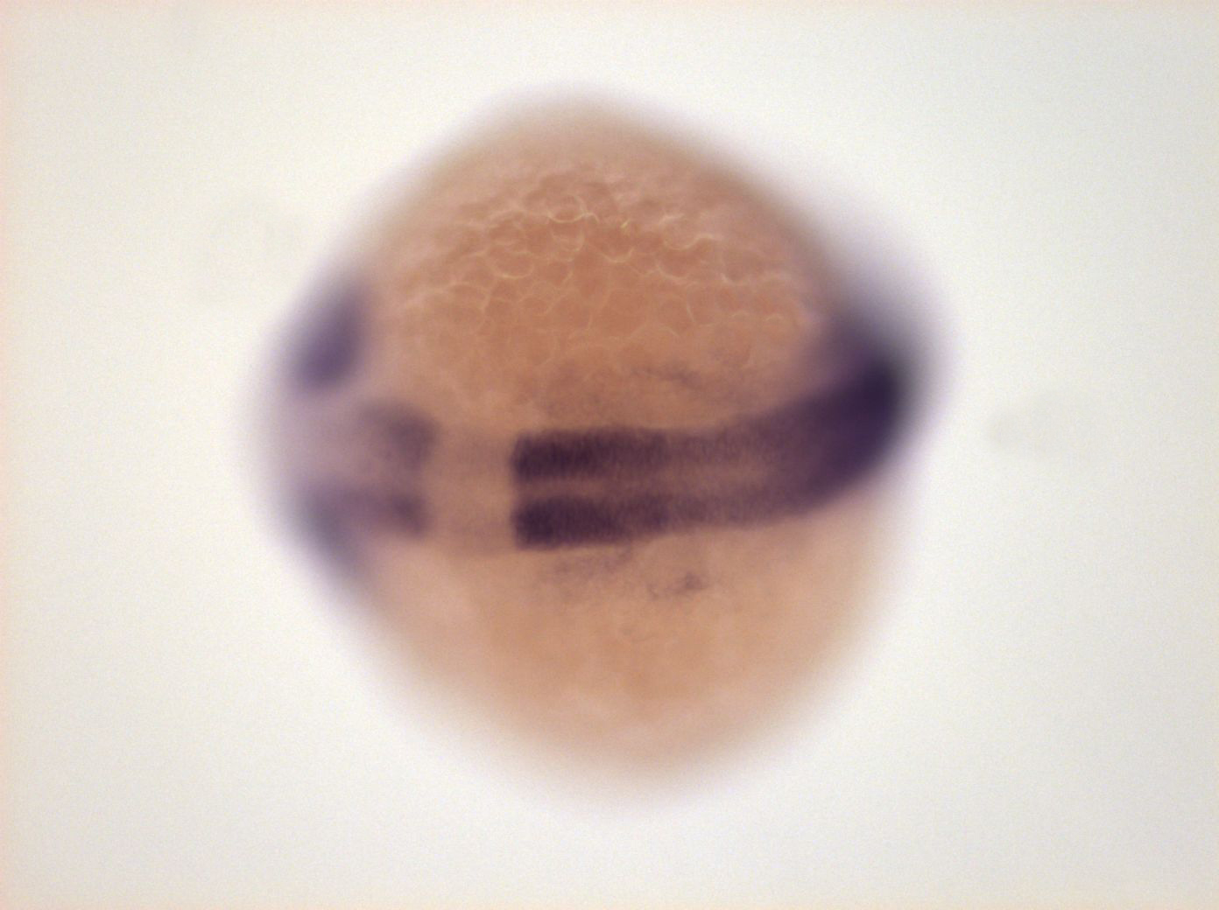
Iterative data-ontology evaluation
Ontology classes:
Neural plate
Neural tube
Ontology stage class definitions:
5-9 somites->10-13 somites
10-13 somites->prim5
Neural tube
Instance data:
9 somites
Neural plate or neural tube?

Slide 22
Ongoing intrinsic issues for development of biological ontologies
Lacking tools to enable visualization/editing via other transitive relations
Better ability to synchronize pieces of ontologies reused in another ontology
Standards for documentation, annotation properties and layering/import approaches for documenting in ontologies themselves, mechanisms for linking out to trackers/lists, wikis
Better ways to roll together text definitions from dependent classes

Slide 23
Special Thanks
Matt Brush
Scott Hoffman
Pioneers in our group to make all ontologies usable by more people.

