Slide 1
The General Ontology Evaluation Framework (GOEF) & the I-Choose Use Case A Proposed Infrastructure for the Ontology Development Lifecycle
Joanne S. Luciano, James Michaelis
[Tetherless World Constellation Rensselaer Polytechnic Institute]
Nicolau F Depaula, Djoko Sigit Sayogo
[Center for Technology in Government, SUNY Albany]

Slide 2
What is an elephant, exactly?

Slide 3
General Ontology Evaluation Framework (GOEF)

Slide 4
GOEF Approach
Novel
Approach
Two stages:
Recast use case into its components:
Functional objective
Design objective and requirements specification
Semantic components required to achieve above
Evaluate components using objective metrics
Place existing evaluation methods in context by utility

Slide 5
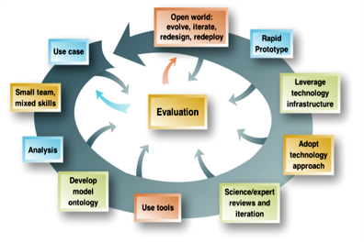
Semantic Web
Development Methodology

Slide 6
Function Level
Represents the top level of the use case.
i.e. the function of the intended use (for search, for integration, for gene annotation)
Additionally, the primary characteristics that define the classification of the domain of the ontology (organism, aircraft, instrumentation, etc.).
6
Notes:
6

Slide 7
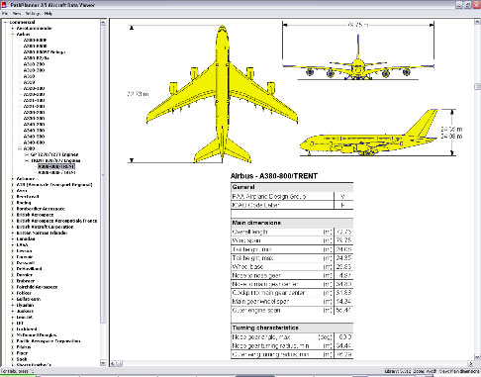
Standard Level
Represents the quality or standard that has to be met by the application (e.g. for legal, interoperability, function, compliance, etc.)
Further specifies the domain characteristics.
7
Notes:
For example, if the ontology is intended to represent a elephant for biological research, then accurate anatomical representations might be required, where as if the ontology is intended for use in amusement park rides, the requirements might be in safety and engineering.
7

Slide 8
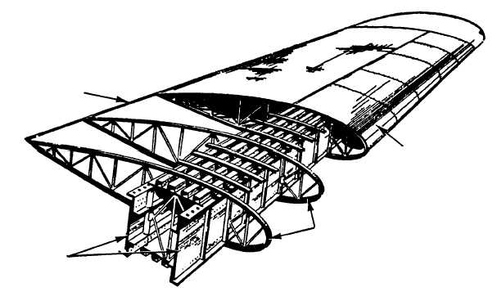
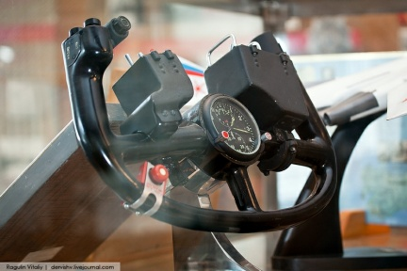
Component Level
Identifies ontology fragments that are needed in order to achieve compliance with the standard and fulfill the function.
8
Notes:
For example, a semantic component for a biological representation of elephant would require a trunk, legs, ears, etc., whereas for fish, components needed would include gills but no trunk. Both would include eyes, in this simplified conceptual example.
8

Slide 9
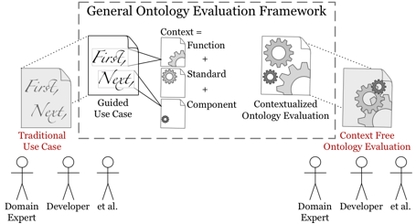
Three Levels of Evaluation
These combine to form the context for evaluation.
9

Slide 10
Formalizing Use Cases
Methodology for formalizing use cases still needed.
Development – based around 3 level evaluation.
10

Slide 11
Evaluation Metrics
Development of metrics (to be developed or used) will follow from formalization of use case design.
11

Slide 12
Overview of I-Choose & I-Choose Use Case

Slide 13
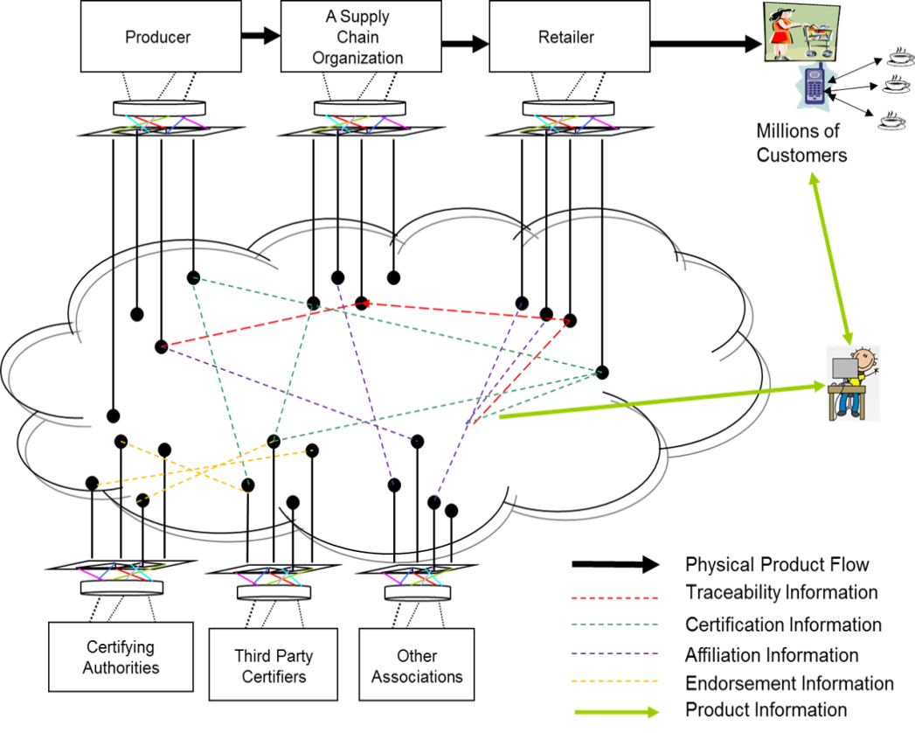
What is I-Choose
I-Choose is a transnational project funded by NSF Interop program and CONACYT in Mexico
It’s objective is to build an interoperable data architecture to support ethical consumption
Focus on sustainable coffee products produced in Mexico and consumed and distributed in Canada and in the US.
Components of I-Choose System:
A set of data standards to share information across sustainable supply-chain
A governance system

Slide 14
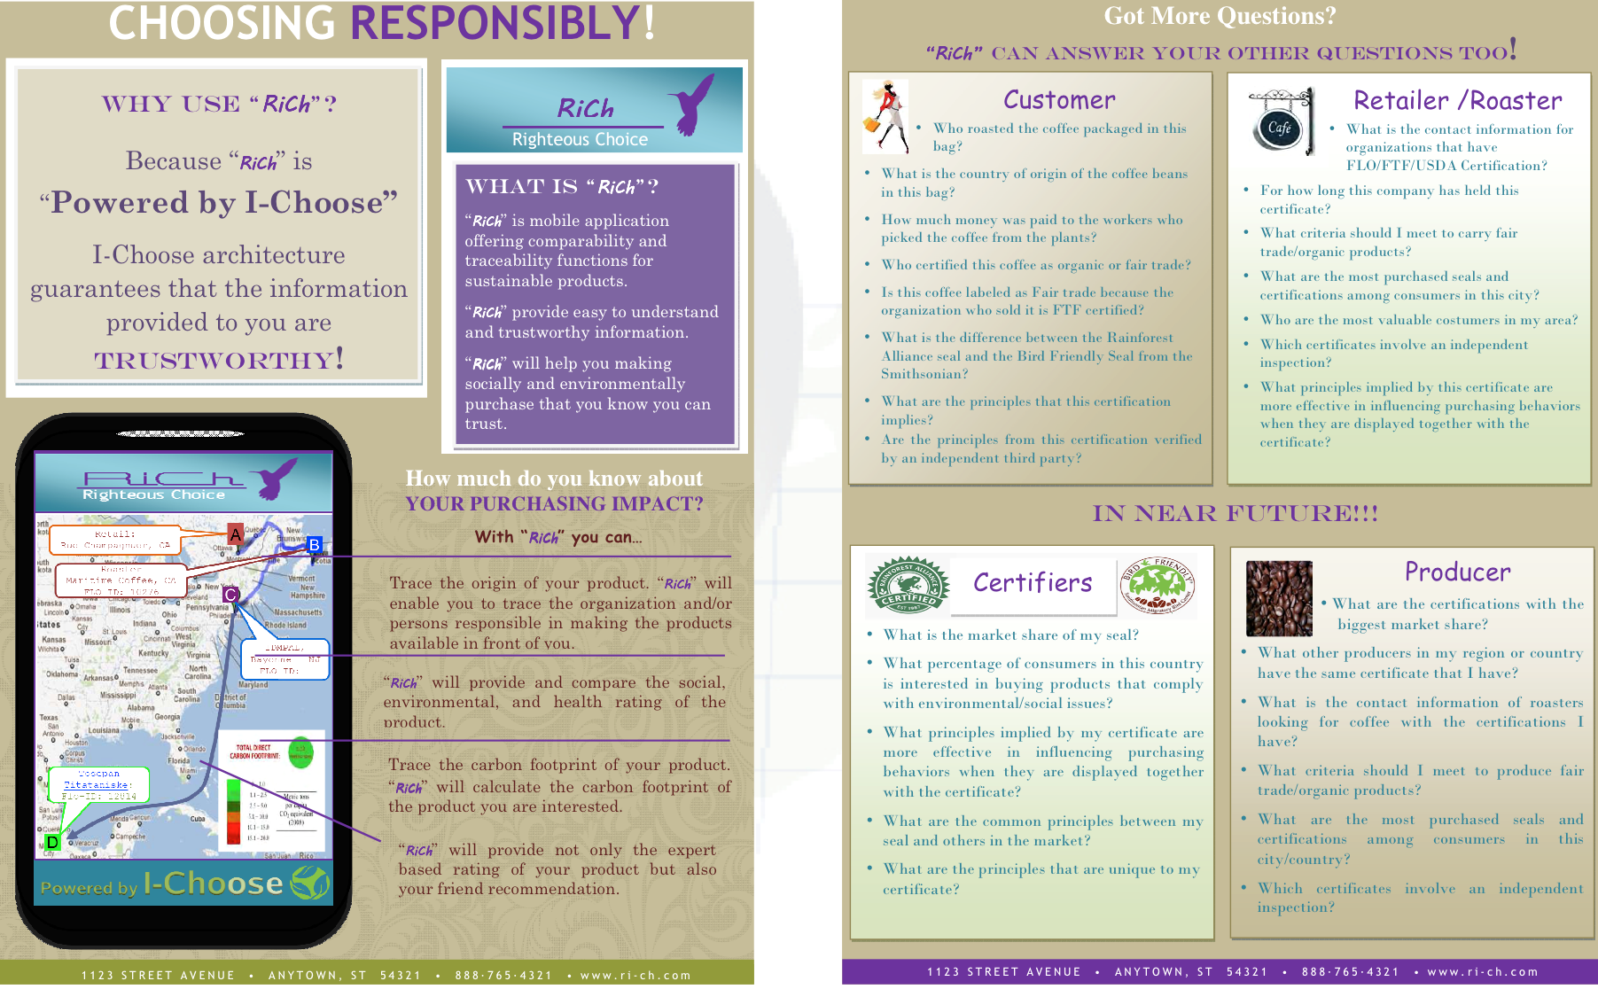
Envision Application Powered by I-Choose
14
Notes:
The image above shows a mock up application leveraged on a proposed I-Choose architecture. In this application, a user would be able to retrieve “extra” information about a product not provided in its package. The I-Choose project had thus set out to map the entire domain of coffee production, distribution, and consumption. This would have enabled the consumer or consumer advocate to retrieve a number of data points on characteristics of the particular product he/she would be interested in purchasing. To enable this envisioned application, I-Choose architecture would need to gather data from 3rd party certifiers and supply chain companies.
Preliminary research by I-Choose ontology team has shifted the focus of the I-Choose project to target data obtained through inspection/certification processes for sustainable certified coffee as a starting point.
14

Slide 15
Motivating Example: I-Choose Use Case - Child Labor & Child Protection
Description: Consumer advocate decides to verify compliance to child labor & child protection criteria pertinent to the core criteria of Fairtrade in conjunction to ILO minimum age convention
Step-by-step description: Consumer Advocate: request information that satisfy child labor and child protection criteria complying to ILO minimum age convention I-Choose: the system returns the information about all relevant child labor & child protection criteria pertinent to core criteria, applicable to Organization only and age minimum 18 years old

Slide 16
Motivating Example:
I-Choose sustainable consumer choice
Function:
Enable retrieval of specific criteria evaluations that occurred during an evaluation process of a particular product.
Design objective:
Initial system: Satisfy user criteria by generally accepted convention
Semantic components:
Compliance Criteria
a) Minimum age under 15
b) Minimum age under 18
c) Ensure school attendance
d) Ensure safety work environment
e) Legal guardian supervision
Certification Body
a) Flo-Cert
Standard
a) FairTrade International
b) ILO convention on Child Labor
c) ISO 65, 14000, 24000
Product
a) Coffee
16
Notes:
16

Slide 17
Motivating Example:
I-Choose sustainable consumer choice
Correctness:
General logical/syntactical validation
Match information provided in the ontology to general accepted definition:
ILO convention no. 138 (minimum age convention)
ILO convention no. 182 (worst form of child labor)
Completeness:
All child work criteria, and necessary characteristics included
Ability of ontology to distinguish compliant vs. non-compliant criteria
Utility:
Consumer/Consumer Advocate Questions Satisfied
17
Notes:
Utility: Challenge Question
Can user find enough information to satisfy her needs?
[3/13/13 9:14:05 PM] Joanne S. Luciano: M=Member, C=CORE criteria (required) all core with Rank 3, all others with an average grade of 3. grade is assigned based on even more detailed criteria the inspector has to match.
Time = iteration (they go back, some criteria are investegated in different years)
Rank = 1=5, 3 is passing, 1 and 2 not passing.
17

Slide 18
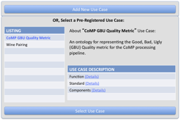
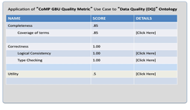
Use Case Management in GOEF
Add a New Use Case
Or, Select a Pre Registered Use Case
About “Child Labor Compliance Criteria 3.3.7
An ontology representing the FLO-CERT compliance criteria.
Flo-Cert
Small Farmers Organization (SPO)
Function [Details]
Standard [Details]
Components [Details]
Notes:
In GOEF, it is expected that encodings of use cases, along with metrics for evaluation, will be made available to consuming parties. At the top, we have a current architecture diagram, which highlights usage of both use cases and context-free evaluation metrics to guide ontology evaluation.
Below are two screenshots of an GOEF mockup, which allows end-users to select use cases from a registry, and establish appropriate ontology pairings based on available metrics (e.g., coverage of needed terms).
18

Slide 19
Suggestions from Hackathon Clinic
Outside participants:
Ken Baclawski, Leo Obrst, Peter Yim and Mike Dean
Comments:
Check “ontology of use case”
Participants (Ken) explained how the OOR use case ontology functions and may be useful for goals of GOEF
19
Notes:
Utility: Challenge Question
Can user find enough information to satisfy her needs?
[3/13/13 9:14:05 PM] Joanne S. Luciano: M=Member, C=CORE criteria (required) all core with Rank 3, all others with an average grade of 3. grade is assigned based on even more detailed criteria the inspector has to match.
Time = iteration (they go back, some criteria are investegated in different years)
Rank = 1=5, 3 is passing, 1 and 2 not passing.
19

Slide 20
Suggestions from Hackathon Clinic
Comments:
Leo suggested that a focus here may be on formalized “attributes” that an ontology evaluation method may recur to.
Leo also commented on the issue of domain vs. application. Same domain may have different applications, which generate different use cases.
20
Notes:
Utility: Challenge Question
Can user find enough information to satisfy her needs?
[3/13/13 9:14:05 PM] Joanne S. Luciano: M=Member, C=CORE criteria (required) all core with Rank 3, all others with an average grade of 3. grade is assigned based on even more detailed criteria the inspector has to match.
Time = iteration (they go back, some criteria are investegated in different years)
Rank = 1=5, 3 is passing, 1 and 2 not passing.
20

Slide 21
Acknowledgement
To the I-Choose project team for permission to use the project’s data and information
To Ken Baclawski, Leo Obrst, Peter Yim and Mike Dean for their comments and inputs during the Hackathon Clinics
21
Notes:
Utility: Challenge Question
Can user find enough information to satisfy her needs?
[3/13/13 9:14:05 PM] Joanne S. Luciano: M=Member, C=CORE criteria (required) all core with Rank 3, all others with an average grade of 3. grade is assigned based on even more detailed criteria the inspector has to match.
Time = iteration (they go back, some criteria are investegated in different years)
Rank = 1=5, 3 is passing, 1 and 2 not passing.
21

Slide 22
The General Ontology Evaluation Framework (GOEF) & the I-Choose Use Case A Proposed Infrastructure for the Ontology Development Lifecycle
Joanne S. Luciano, James Michaelis
[Tetherless World Constellation Rensselaer Polytechnic Institute]
Nicolau F Depaula, Djoko Sigit Sayogo
[Center for Technology in Government, SUNY Albany]

