Slide 1
Ontology Summit 2015 Internet of Things
Toward Smart Networked Systems and Societies
Track D: Related standards & synergies for emerging iot ontologies

Slide 2
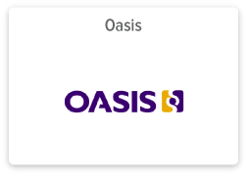
Geoff Brown
OASIS MQTT – Secretary, Founding Member & Sponsor OASIS MQTT Cyber security – Chair Founder & CEO of Machine-To-Machine Intelligence (M2Mi) Corporation
Member of Industrial Internet Consortium Member IoT World Forum Steering Committee Member of Smart Grid Interoperability Panel
Email: geoff.brown@m2mi.com Twitter (Corporate) : @M2MiCorp Twitter (Personal) : @GeoffreyBrown
Linkedin: www.linkedin.com/in/mrgeoffbrown

