Slide 1
Ontology Summit 2015 Internet of Thingssynthesis I
Toward Smart Networked Systems and Societies – Synthesis I
Track D: Related standards & synergies for emerging iot ontologies

Slide 2
Track D Session 1 Participants
*William Miller, Chair ISO/IEC/IEEE 21451-1-4
*Geoff Brown (Oasis MQTT Chair, Sec’y)

Slide 3
“The nice thing about standards is that there are so many to choose from.”
--Andrew tanenbaum

Slide 4
Reasons to Standardize (Session 2)
Avoid technological dead-ends*
Reduce dependence on vendors* or foreign countries
Promote universality*
Develop competitive edge or partnership, or respond to same
Solve a technical, enterprise or social problem
Bridge previously disparate technologies or disciplines
Incorporate elements from a related, entrenched standard
Lower cost by market-broadening
* Adapted from K. Jakobs, “Information Technology Standards, Standards Setting and Standards Research.”

Slide 5
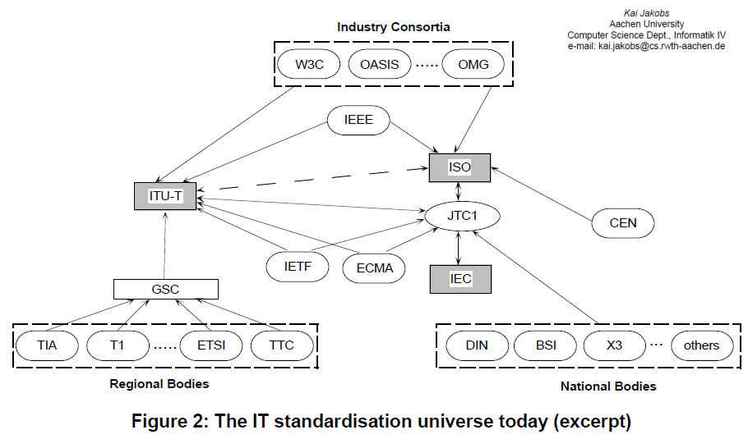
The Standards Semi-verse

Slide 6
The Standards Influence Maze

Slide 7
Mission Statement*
The existence of standards – both official and de facto – can dramatically influence the software development life cycle for ontology projects. This is especially for greenfield efforts, which can peg existing vocabulary, interoperability settings, test harnesses and verification processes to new projects. Standards may be essential for domain-specific data quality assurance. Standards also have a sociotechnical purpose. Communities of Interest (CoI) behind a standards effort can supersede a standard by concentrating expertise and collecting artifacts related to the standard. Because the world of “things” is by definition vast, standards can facilitate connecting software to devices by offering abstractions that impact domain-specific knowledge of the devices. This is helpful for building ontologies. That said, software development is a deregulated engineering process, and many successful software ventures have succeeded by ignoring or incorporating bits and pieces of unacknowledged standards work – sometimes creating new de facto standards in the process. The purpose of this track is to help potential IoT ontology developers understand the standards landscape – both official and de facto.
*Also appears as Abstract

Slide 8
Approachupdated
►Survey “official” IoT standards
►Identify de facto standards
►Identify related standards, projects, bodies not officially designed as IoT or WoT
►Highlight domains where ontology efforts:
(1) are most needed; (2) have harmonious partnership opportunities; (3) available subcomponents
►Discuss Challenges: Power mgmt., security, signal post-processing, provenance, signal quality, discovery, metadata, network issues, Big Data
►Related work: Modsim (e.g., Yang Song, et al. 2012, Sensor Fusion, Linked Open Data, augmented reality, Software Defined Networks (SDN), Named Data Networks
►Lessons from history: middleware, intelligent agents, CEP, embedded systems, DoD fusion
►Retrospective: Related Lessons from Ontology Big Data 2014 (G. Berg-Cross)

Slide 9
Track D Agendaupdated
Two Sessions (January 22, February 26)
Session 1
Speaker Background & Introduction
Standards Overview
“Official” | De Facto
Current IoT standards state of affairs
Strengths, weaknesses, trends
IoT standards “Semi-verse”
Influencers
Panel Q & A
Session 2
Low-hanging Ontology Fruit (=> XMPP, SSN, per various)
Speakers’ Favorite Use Cases
Moderator’s Puzzles
Panel Q & A

Slide 10
Add’l Standards / “Models” CitedNEW
Process Specification Language (Gruninger)
Constrained Application Protocol CoAP (Miller)
CEP
Decentralized (edge aggregation or preprocessing)
Abstract Services (from XMPP): Federation, Gateway, “Direct I/O,” Concentration
SENSEI & other EU initiatives

Slide 11
IoT Events, ProcessesNEW
XMPP Events (Miller et al.)
XMPP Discovery
XMPP XEP-0325-SN Control
XMPP XEP-0324-SN Provisioning
Error Recovery, Correction (XMPP TEDS)
XSLT for W3C uniformity
Decision framework (Voas)

Slide 12
IoT Objects, Things (Examples)NEW
Battery-powered Sensors (XMPP XEP-0000-SN)
Concentrators (XMPP XEP-0326-SN) (Miller, Voas)
Actuators
Communication Channels (Voas)
Smart Transducers, Transducer Electronic Data Sheets (21451)
Self-ID, self-describing, time- location-aware, networked, resident metadata
Require sub-ontologies?

Slide 13
Networked IoT DevicesNEW
Related work: Named Data Networking http://bit.ly/1BsEZPK
Conceptual: ACM’s “information-centric networking”
Data-centric security, adaptive routing, in-network storage
Cite: networked sensors
Software Defined Networks
TBD

Slide 14
Named Data Network Use Case: Cyberphysical SystemsNEW
http://bit.ly/1BsEZPK

Slide 15
Cross-Cutting Concerns
Temporal measurement, reasoning
Geo-spatial measurement, reasoning
Message parsing, interpretation (XMPP: “IoT Message Channel”)
Principally rely on work by others?
Ambiguities and Weak Definitions
“Meter” Compare IEC 61968, Multispeak V4.1, IEC 61970, NAESB PAP10 (Steve Ray)
Workflow and Orchestration
Semantic Workflow (Jack Hodges)
Data fusion workflow (Underwood)
***Design Patterns (new slide)
Provenance
SSNO + PROVO-O (Jenson), Stale sensor data, failed devices, sensors in motion (Voas)

Slide 16
Design PatternsNEW
Stimulus – Sensor – Observation (C. Henson)
Sensors as Agent-based or Control Entities (G. Berg-Cross et al.)
Middleware adapted / co-opted for IoT (G. Berg-Cross)
Big Data ontology solutions, approaches (G. Berg-Cross)
Pub/sub, discovery/integration, in-networking “paradigms” (G. Berg-Cross)
Updates to Software Development Life Cycles (SDLC) for Real Time / High Velocity Systems (Underwood)

Slide 17
Lessons LearnedNEW
Lessons from using SSN Ontology
Semantic annotation issues (Barnaghi)
Standard-to-standard as model-to-model interop or translation?
“Model refactoring” (S. Ray)
From DoD Sensor Platforms & Experiments
CPOF etc.
From Ontology Summits
May need a knowledge modeling language adapted for IoT scenarios (G. Berg-Cross)
Reusable patterns, modeling granularities, etc. (G. Berg-Cross)

Slide 18
Edge Proximity
Taxonomies & Identification: Universal Unique Identifier (Miller)
Semantics at the Edge (C. Henson)
=> Lessons from distributed computing literature?
Are old, new or hybrid design patterns visible?

Slide 19
Security, Privacy, ResilienceNEW
XMPP – Encryption, service broker “isolation”
XMPP – Private, group, public provisioning; decommissioning
Trust frameworks
Quality of Service (QoS in Oasis MQTT)
Ownership “bundle” (Voas, Underwood)

Slide 20
Reference
Lists, references and related resources (synthesis)

Slide 21
Standards Orgs & Initiativesupdated
W3C – Web of Things Community Group
Industrial Internet Consortium
ECHONET Consortium (home appliances, LITE spec, cert equip)
Share-PSI 2.0 Thematic Network (EU Open Data initiatives)
ZigBee Alliance (IEEE 802.15)
Oasis Message Queuing Telemetry Transport (IBM, Cisco, Red Hat, Tibco, Facebook)
ISO/IEEE 11073 Health Informatics Devices
OGC Sensor Web Enablement
International Telecommunication Union (IoT-GSI)
European Research Cluster on IoT
Project Haystack
Wi-SUN Wireless smart utility networks
AllJoyn | OPENIoT
ISO/IEC/IEEE 21451-1-4 | XMPP IoT
Eu Lighthouse Integrated Project IoT-A
AllSeen Alliance
OneM2M
Process Specification Language
Open Interconnect
* more at Postscapes.com

Slide 22
Related Standards & Groupsupdated
OGC Spatial Data (GeoSPARQL, NeoGeo, ISA Locn)
IEEE TC’s: Smart Cities, Big Data, Cybersecurity, IoT Communities
Semantic Sensor Web (OGC + SWE specifications)
RFID
W3C Semantic Sensor Networks Incubator Group
BPMN – BPEL: Connect to other enterprise events, workflow
REST (Bosch)
Thread Group (Google, etc.)
Heterogeneous System Architecture Foundation
Micro Electro Mechanical Systems (MEMS) Industry Group
Marine Metadata Interoperability Project
City Pulse Project | Knoesis
Temporal Abstractions Ontology
Temporal Ontologies (e.g., SWRLTO)
JSON (Steve Ray)
Apple HomeKit

Slide 23
Ontology Developers or StandardsNEW
Quantities (qudt.org) (J. Hodges)
Human Health: Anatomical parts, symptoms, diseases (obofoundry.org) (J Hodges)
ZigBee Ontology (Chien et al., 2013)
W3C Semantic Sensor Network XG Final Report (June 2011)
SENSEI, SemSorGrid4Env (G. Berg-Cross)
CHALLENGES
Ontologies have dissimilar design (J. Hodges)
Ontology-to-ontology mapping is difficult, impossible or manual (J. Hodges)
Manufacturer-driven “ontologies” (e.g., Siemens, Vandrico)
Need for ontology-based standards (G. Berg-Cross)

Slide 24
De Facto Standards and Influences
Intel Edison Embedded Processor, HDMI Compute Stick, Stick Computing (Android)
Activity Streams (Slides by C. Messina @Google)
Alliance for Wireless Power (Rezence)

Slide 25
Misc Resources for Communique
Web of Things Meeting Report (June 2014)
SeeControl (Cloud IoT)
Automated Buildings columnists
Libelium 50 Sensor Applications for IoT
IoT: Converging Technologies for Smart Environments (Ontology discussions, bibliography)

Slide 26
Semantic Sensor Network Ontology

Slide 27
Phil Archer phila@w3.org

Slide 28
Keynoter Candidates
Roberto Minerva (IEEE IoT)
Joseph Bradley (Cisco IoE Evangelist and VP)
William Sennett, Alex Wahl (?) (IBM Watson)
Rex St. John (Intel IoT Evangelist)
Carla Diana (Ted Talk)
Richard McElhinney Project Haystack

