Slide 1
Ontology-based Access to Sensor Data Streams
@jpcik
Jean-Paul Calbimonte
LSIR EPFL
Ontology Summit 2015
05.03.2015

Slide 2
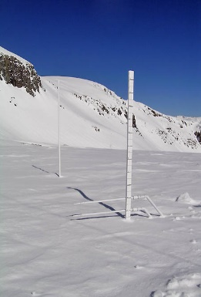
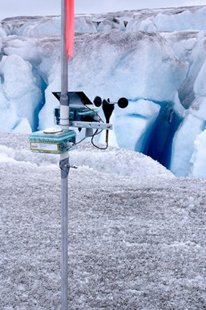
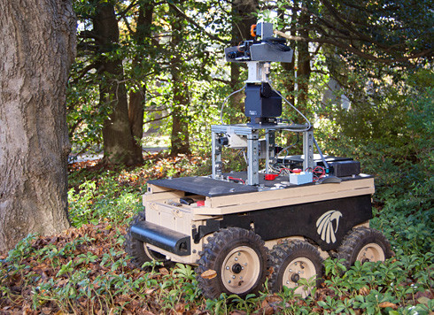
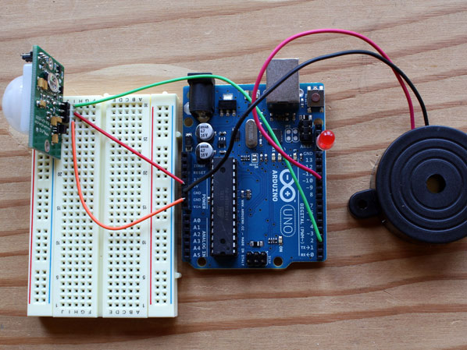
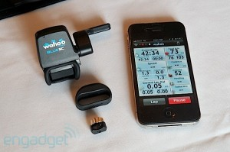
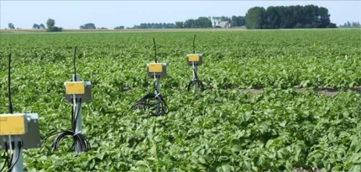
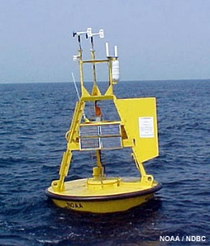
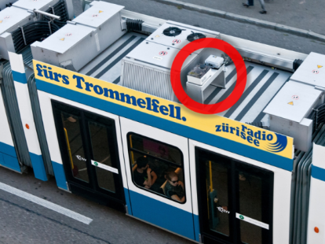
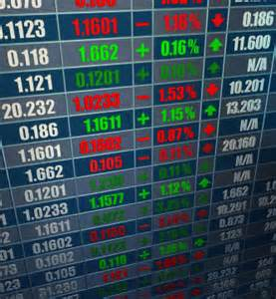
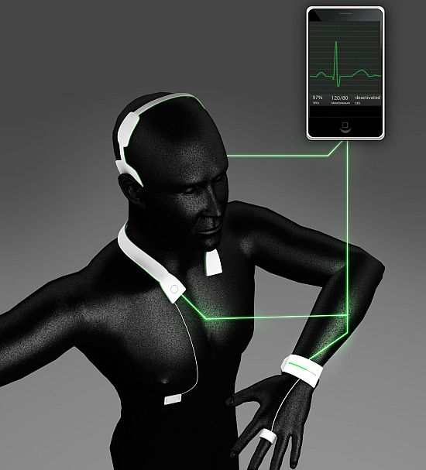
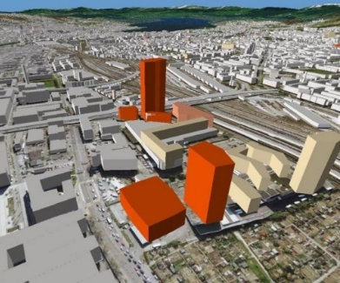
Why Streams?
Internet of Things
Sensor Networks
Mobile Networks
Smart Devices
Participatory Sensing
Transportation
“It’s a streaming world!”[1]
Financial Data
Social Media
Urban Planning
Health Monitoring
Marketing
Della Valle, et al : It's a Streaming World! Reasoning upon Rapidly Changing Information. IEEE Intelligent Systems

Slide 3
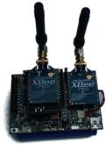
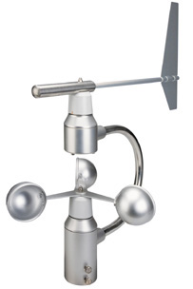
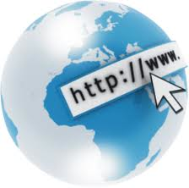
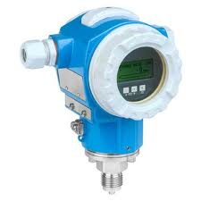
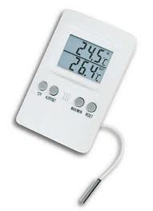
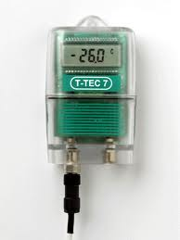
Sensor Networks and the Web
Volume
users
Sensor Networks
Velocity
Variety
WEB
applications
data streams
Universal Web-based access to Sensor data

Slide 4
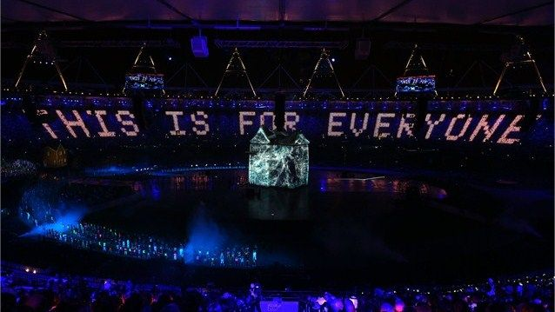
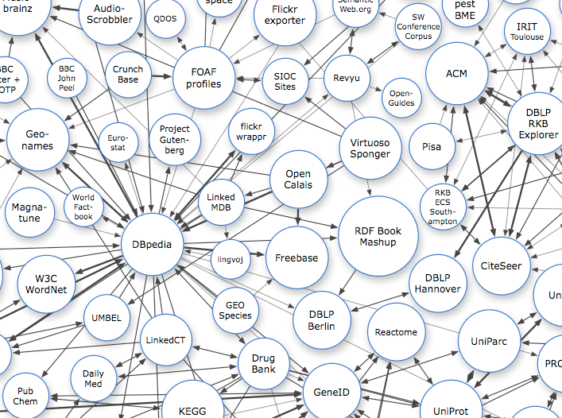
Linked Data on the Web
Web of Data
Linked Data
W3C Standards: RDF, SPARQL, etc.

Slide 5
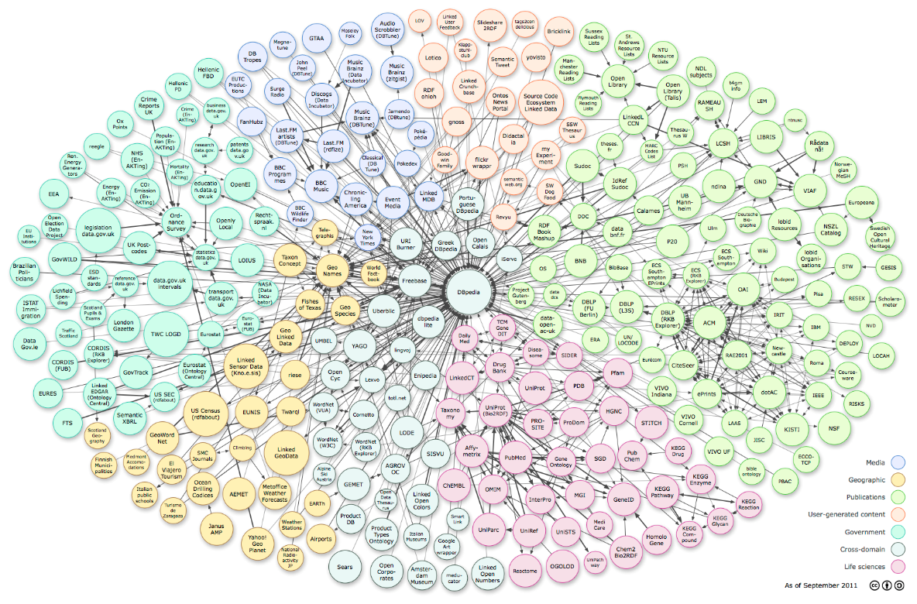
Querying the semantic sensor Web
e.g. publish sensor data as RDF/Linked Data?
static vs. streams
URIs as names of things
HTTP URIs
useful information when URI is dereferenced
users
Link to other URIs
WEB
applications
one-off vs. continuous
Use ontology models to continuously query real-time data streams originated from sensors?

Slide 6
Continuous extensions of RDF
As you know, “RDF -> standard model for data interchange on the Web” (http://www.w3.org/RDF/)
<sub₁ pred₁ obj₁>
<sub₂ pred₂ obj₂>
Extend RDF to model data streams
A data stream is an (infinite) ordered sequence of data items
A data item is a self-consumable informative unit
Simple model:
Subject Predicate Object

Slide 7
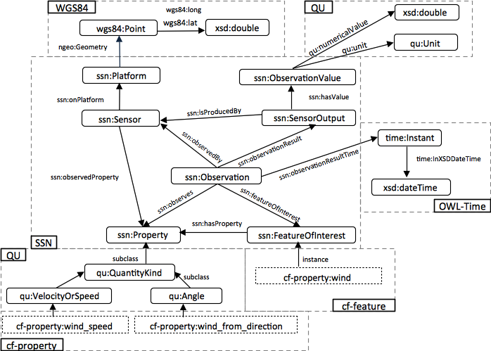
Example: SSN Ontology

Slide 8
A simple ontology…
Observation
Room
subClassOf
where
observes
subPropOf
who
Post
Sensor
discusses
subClassOf
Person
authorOf

Slide 9
Data items
With data item we can refer to:
A triple
A graph
<:alice :isWith :bob>
<:alice :posts :p>
<:p :who :bob>
<:p :where :redRoom>
:graph1

Slide 10
RDF stream model
:alice :isWith :bob
:bob :isWith :diana
:alice :isWith :carl
:diana :isWith :carl
S
e1
e2
e3
e4
1
3
6
9
t
A commonly adopted RDF stream model
A RDF triple is an event
Application time: point-based
<:alice :isWith :bob>:[1]
<:alice :isWith :carl>:[3]
<:bob :isWith :diana>:[6]
...

Slide 11
Querying RDF: SPARQL
Where is alice?
SELECT ?room WHERE{
:alice :posts ?post
?post :where ?room
}
<:alice :posts :p>
<:p :who :bob>
<:p :where :redRoom>
How many posts about bob?
SELECT COUNT(?post) WHERE{
?person :posts ?post
:post :who :bob
}
How about streams?

Slide 12
Querying data streams – The CQL model
Sliding windows
Relational algerbra
stream-to-relation
relation-to-relation
Streams
Relations
…
<s,τ>
…
relation-to-stream
<s₁>
<s₂>
<s₃>
infinite
unbounded
sequence
finite
bag
Stream
Relation R(t)
Mapping: T → R
*Stream operators

Slide 13
CQL-like extensions for RDF stream queries
Sliding windows
S2R operators
SPARQL operators
RDF Streams
RDF Mappings
R2S operators
*Stream operators

Slide 14
Ontology-based access for data streams
“Query virtual RDF streams”[1]
users, applications
SPARQLStream
Push:
Using Websockets! ☺
Two way communication
Responsive answers
query processing
Morph-streams
Virtual RDF Stream
rewritten queries
Blocking queries
Sync communication
Bottlenecks
No end to end reactivity
☹
data layer
DSMS
CEP
Sensor middleware
…
Responsive?

Slide 15
Similar (not equals!) query languages
SELECT ?sensor
FROM NAMED STREAM <http://www.cwi.nl/SRBench/observations> [NOW-3 HOURS SLIDE 10 MINUTES]
WHERE {
?observation om-owl:procedure ?sensor ;
om-owl:observedProperty weather:WindSpeed ;
om-owl:result [ om-owl:floatValue ?value ] . }
GROUP BY ?sensor HAVING ( AVG(?value) >= "74"^^xsd:float )
SPARQLStream
SELECT ?sensor
FROM STREAM <http://www.cwi.nl/SRBench/observations> [RANGE 1h STEP 10m]
WHERE {
?observation om-owl:procedure ?sensor ;
om-owl:observedProperty weather:WindSpeed ;
om-owl:result [ om-owl:floatValue ?value ] . }
GROUP BY ?sensor HAVING ( AVG(?value) >= "74"^^xsd:float )
C-SPARQL
SELECT ?sensor
WHERE {
STREAM <http://www.cwi.nl/SRBench/observations> [RANGE 10800s SLIDE 600s] {
?observation om-owl:procedure ?sensor ;
om-owl:observedProperty weather:WindSpeed ;
om-owl:result [ om-owl:floatValue ?value ] .} }
GROUP BY ?sensor HAVING ( AVG(?value) >= "74"^^xsd:float )
CQELS

Slide 16
Classification of existing systems
 | Model | Continuous execution | Union, Join, Optional, Filter | Aggregates | Time window | Triple window | R2S operator | Sequence, Co-ocurrence
TA-SPARQL | TA-RDF | ✗ | ✔ | Limited | ✗ | ✗ | ✗ | ✗
tSPARQL | tRDF | ✗ | ✔ | ✗ | ✗ | ✗ | ✗ | ✗
Streaming SPARQL | RDF Stream | ✔ | ✔ | ✗ | ✔ | ✔ | ✗ | ✗
C-SPARQL | RDF Stream | ✔ | ✔ | ✔ | ✔ | ✔ | Rstream only | time function
CQELS | RDF Stream | ✔ | ✔ | ✔ | ✔ | ✔ | Istream only | ✗
SPARQLStream | (Virtual) RDF Stream | ✔ | ✔ | ✔ | ✔ | ✗ | ✔ | ✗
EP-SPARQL | RDF Stream | ✔ | ✔ | ✔ | ✗ | ✗ | ✗ | ✔
Instans | RDF | ✔ | ✔ | ✔ | ✗ | ✗ | ✗ | ✗
Disclaimer: other features may be missing

Slide 17
Existing RSP systems (oversimplified!)
C-SPARQL: RDF Store + Stream processor
Combined architecture
CQELS: Implemented from scratch. Focus on performance
Native + adaptive joins for static-data and streaming data
static
RDF Store
C-SPARQL
query
continuous
results
translator
Stream processor
streaming
CQELS
query
continuous
results
Native RSP

Slide 18
Existing RSP systems (oversimplified!)
SPARQL_{stream}: Ontology-based stream query answering
Virtual RDF views, using R2RML mappings
SPARQL stream queries over the original data streams.
EP-SPARQL: Complex-event detection
SEQ, EQUALS operators
SPARQLStream
query
continuous
results
rewriter
DSMS/CEP
R2RML mappings
EP-SPARQL
query
Prolog engine
continuous
results
translator

Slide 19
The RSP Community
RDF Streams
Stream Reasoning
Complex Event Processing
Stream Query Processing
Stream Compression
Semantic Sensor Web
Research work
Many Papers
PhD Thesis
Datasets
Prototypes
Benchmarks
Many topics
Tons of work
W3C RSP Community Group
http://www.w3.org/community/rsp
discuss
standardize
combine
formalize
evangelize
Effort to our work on RDF stream processing

Slide 20
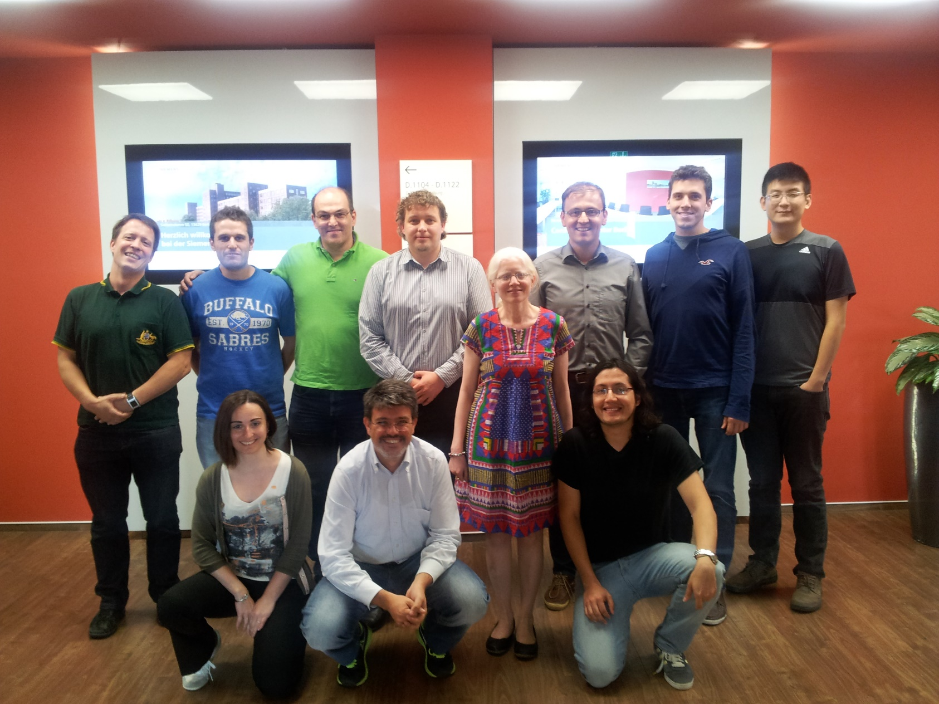
The RSP Community

Slide 21
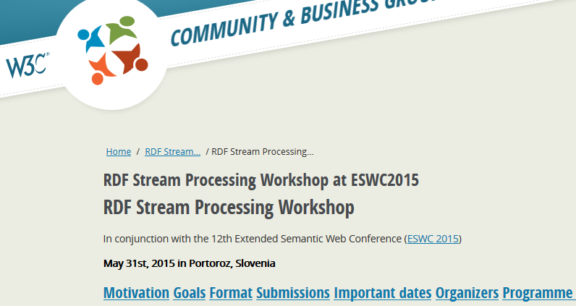
RDF Streams Workshop! @ESWC
https://www.w3.org/community/rsp/rsp-workshop-2015/

Slide 22
Why Streams?
Work in progress
RDF
Web standards
Data discovery
Data sharing
Web queries
Query languages
Query answering
Efficient processing
Query Federation
Go Web
Processing
Is this what
we require?
Semantics
Vocabularies
Data Harvesting
Data linking
Matching
Ontologies
Expressivity
Inference
Rule processing
Knowledge bases
Integration
Reasoning

Slide 23
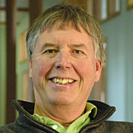
Looking back 10 years ago…
Keep data moving
Query with stream SQL
Handle imperfections
Predictable outcomes
Integrate stored data
Data safety & availability
Partition & scale
Respond Instantaneously
“8 requirements of real-time stream processing”[2]
8 Requirements
Do we address them?
Do we have more requirements?
Do we need to do more?
Stonebreaker et al. The 8 requirement of Real-TimeStream Processing. SIGMOD Record. 2005.

Slide 24
Reactive Systems
Keep data moving
Query with stream SQL
Handle imperfections
Predictable outcomes
Integrate stored data
Data safety & availability
Partition & scale
Respond Instantaneously
Events:
Event-Driven
Load:
Scalable
react to
Failure:
8 Requirements
Resilient
Users:
Responsive
Do we address them?
Do we have more requirements?
Do we need to do more?
Jonas Boner. Go Reactive: Event-Driven, Scalable, Resilient & Responsive Systems. 2013.

Slide 25
Reactive RSPs
Keep data moving
Query with stream SQL
Handle imperfections
Predictable outcomes
Integrate stored data
Data safety & availability
Partition & scale
Respond Instantaneously
We go beyond only these
Data Heterogeneity
Data Modeling
Stream Reasoning
Data discovery
Stream data linking
Query optimization
… more
8 Requirements
Reactive Principles
Needed if we want to build relevant systems

Slide 26
Reactive RSP workflows
s
Etalis
CSPARQL
Morph
Streams
Event-driven message passing
Async communication
Immutable streams
Transparent Remoting
Parallel and distributed
Supervised Failure Handling
Responsive processing
s
s
Dynamite
CQELS
TrOWL
s
Minimal agreements: standards, serialization, interfaces
Formal models for RSPs and reasoning
Working prototypes/systems!
Reactive RSPs

Slide 27
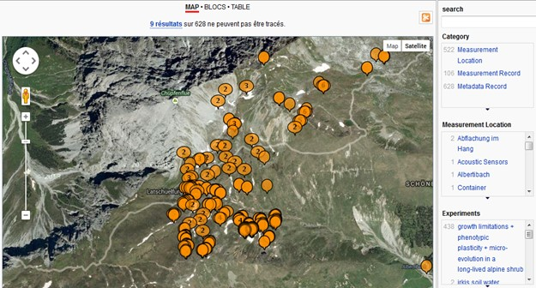
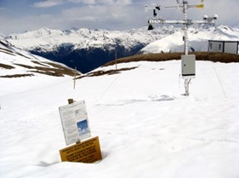
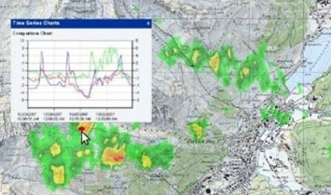
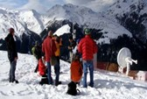
OSPER - Swiss Experiment
Open support platform for environmental research
Platform
managing environmental
sensor data &metadata
heterogeneous
sensing devices
acquisition
processing
summarization, filtering,
compression, interpolation
querying
continuous processing,
streaming, geospatial, aggregation
Data
analysis
pattern discovery,
correlation, regression
discovery
metadata management, semantics
provision
data services, visualization, standards
Multidisciplinary research team
Real world data + problems
Facilitating research in:
Precipitation patterns in mountains
Evaporation in Africa
Return periods of Natural Hazards
Stream flows in Alpine catchments
Permafrost in the Alps
http://swiss-experiment.ch

Slide 28
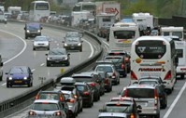
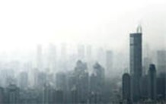
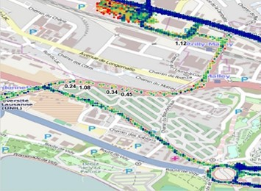
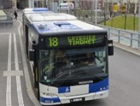
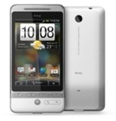
OpenSense2
Crowdsourcing High-Resolution Air Quality Sensing
global concern highly location-dependent
time-dependent
Air Pollution
Accurate location-dependent and real-time information on air pollution is needed
Link high-quality and low-quality data
Integration of pure statistical models and physical dispersion models
Better coverage through crowdsensing
Incentives for crowd data provision
Finer temporal and spatial resolutions
Utilitarian approach for trade-off between model complexity, privacy and accuracy
Higher accuracy of pollution maps models
Integrated air quality measurement platform
Heterogeneous devices and data
Human activity assessment, lifestyle and health data
Institutional stations
Personal mobile sensors
CrowdSense
OpenSense infrastructure
http://opensense.epfl.ch

Slide 29
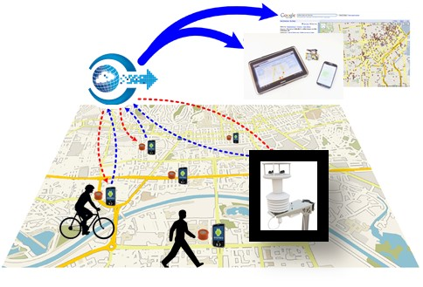
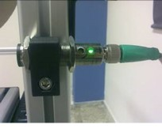
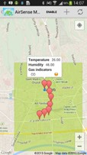
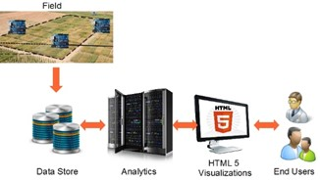
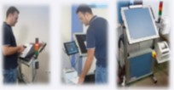
OpenIoT FP7
Open Source Cloud solution for the Internet of Things
Established Open-source platform for IoT
https://github.com/OpenIotOrg/openiot
Integrate sensors & things with cloud computing
Configure, deploy and use IoT services
Auditing/assessing privacy of IoT apps in the cloud
Semantic annotations of internet-connected objects
Energy-efficient data harvesting
Publish/subscribe for continuous processing and sensor data filtering
Mobility of sensors and QoS aspects in IoT
Use cases and validation scenarios
Smart Manufacturing
Agriculture Sensing
Campus Guide
Air Monitoring
http://openiot.eu

Slide 30
Muchas gracias!
@jpcik
Jean-Paul Calbimonte
LSIR EPFL

