Slide 1
Decision Making in IBM Watson™ Question Answering Dr. J. William Murdock IBM Watson Research Center
IBM, the IBM logo, ibm.com, Smarter Planet and the planet icon are trademarks of International Business Machines Corp., registered in many jurisdictions worldwide. Jeopardy! Elements TM & © 2015 Jeopardy Productions, Inc. All Rights Reserved. A current list of IBM trademarks is available on the Web at www.ibm.com/legal/copytrade.shtml. © International Business Machines Corporation 2015.
Notes:
1

Slide 2
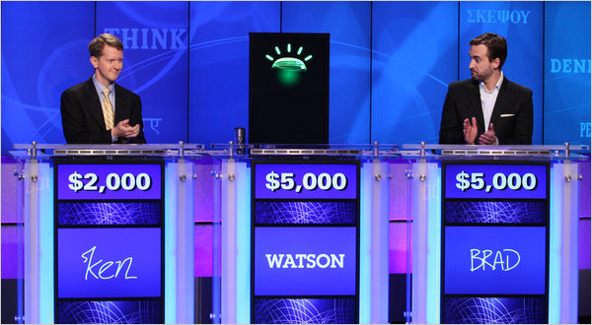
IBM Watson
IBM Watson is an automated question answering system.
It competed against Jeopardy!’s two all-time greatest champions.
This match appeared on television in February of 2011.
Watson won the match, outscoring both opponents combined.
More recent work on IBM Watson focuses on business applications such as medicine and customer service.

Slide 3
Decision Making in Question Answering
Choosing answers to questions!
IBM Watson generates many candidate answers
For each answer, how confident are we that the answer is right?
Deciding whether to answer
Based on how confident we are that the answer is right
Based on cost/benefit of right answers and wrong answers
Deciding how many answers to provide
Deciding whether to hedge

Slide 4
Jeopardy! Watson
Statistical
Machine Learning
Creates instances & features
Learned Models
help combine and weigh the Evidence
Evidence Sources
Models
Models
Answer Sources
Question
Evidence
Retrieval
Deep Evidence Scoring
Answer Scoring
Models
Models
Primary
Search
Candidate
Answer
Generation
Models
Models
Question & Topic Analysis
Hypothesis
Generation
Hypothesis and Evidence Scoring
Final Confidence Merging & Ranking
Adds more features
Adds more features
Statistical & rule-based NLP
Answer & Confidence
4

Slide 5
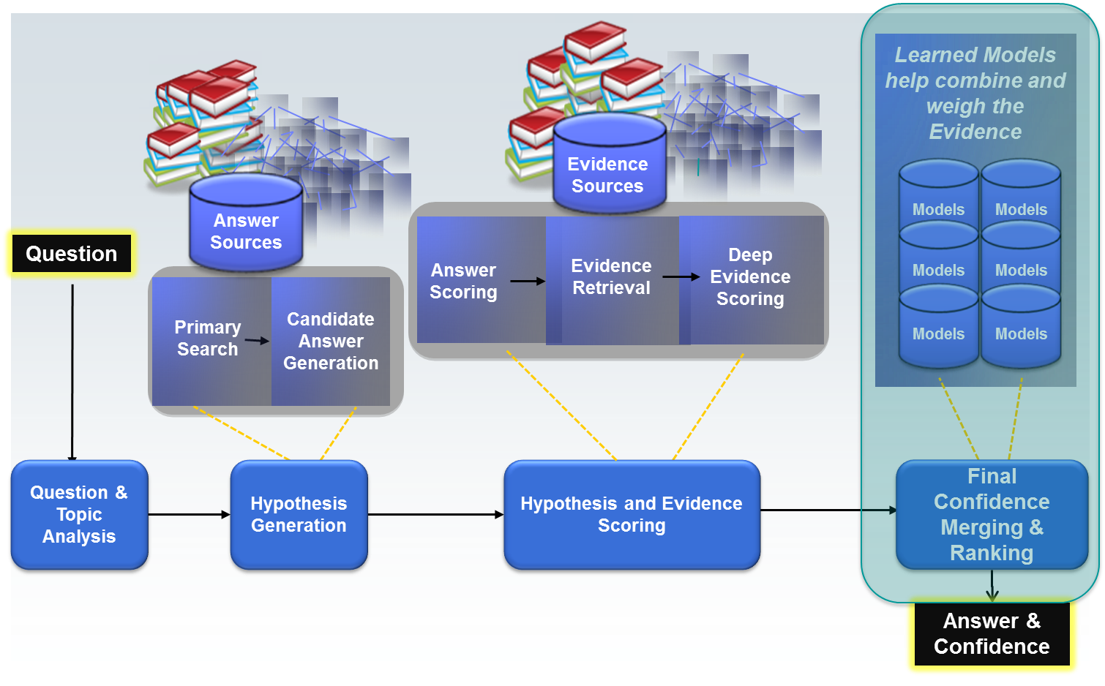
Watson Paths (e.g., Medical Diagnosis)
(Lally et al., 2014)
Scenario
Basically the same
QA system (different details)
Basically the same
Machine Learning
Assertion
Assertion
Assertion
Assertion
Assertion
Question
Assertion
Answer & Confidence
Assertion
Answer & Confidence
Assertion
5

Slide 6
Watson Engagement Advisor
Basically the same Statistical ML
Known Questions and Answers
Learned Models
help combine and weigh the Evidence
Primary
Search
Candidate
Answer
Generation
Answer Scoring
Deep Evidence Scoring
Question
Hypothesis
Generation
Hypothesis and Evidence Scoring
Models
Models
Many of the same features
Many of the same features
Models
Models
Answer Docs
Models
Models
Primary
Search
Candidate
Answer
Generation
Answer Scoring
Deep Evidence Scoring
Question & Topic Analysis
Hypothesis
Generation
Hypothesis and Evidence Scoring
Resolve Feature Name Conflicts
Final Confidence Merging & Ranking
Off-Topic Classification
Answer & Confidence
6

Slide 7
Final Confidence Merging & Ranking
Start with:
Answers in isolation, with feature values
Answers embedded in evidence, with feature values
Configured for each feature:
What to do when it is missing (typically if F is missing, then set F=0 and set F-Missing=1)
Standardization (see next slide)
How to merge across instances? (Max? Min? Sum? Decaying sum?)
Combine “equivalent” answers, merging feature values
“frog”:f1=3,f2=4,f3=1
“order Anura”:f3=3
“frog”:“Frogs like ponds”:f4=0.8,f5=4.5
“frog”:“I saw a frog in a pond”:f4=0.6,f5=2.5
“frog”: f1=3,f2=4,f3=1,f4=1.1,f5=4.5
Run ML
At training time, record features and class label (right or wrong) for training a model
At run time, apply the model to the features to compute a confidence score

Slide 8
Standardization
Question 1
Question 2
Question 3
F2
F2
F2
F1
Standardization subtracts the mean for that question and divides by the standard deviation for that question
F1
F1
For each question, F1 and F2 are very useful for separating right answers from wrong answers.
Combined Standardized
Combined
Across questions, it is much harder to use these features to separate right from wrong.
Question 3 Standardized
F2
F2
F1
Subtracting the mean drags the points to the middle.
Dividing by the standard deviation spreads them out or squeezes them in.
F1

Slide 9
Phases and Routes
Merging in ranking occurs in multiple phases
All answers to all questions are processed in all phases
Phases are used for sequential learning operations: cases where the outputs of earlier learning should influence later learning.
(Example on next slide)
Within each phase are alternative routes
Within a phase, all answers to a single question are processed by only one route
Routes are generally used for special kinds of questions
In Jeopardy! this includes puzzles, multiple-choice questions, etc.
In business applications in can include factoid, definition, why, how-to, and many more.

Slide 10
Phases: Answer Merging (Made-Up) Example
1976: This Kansas legislator was Gerald Ford’s running mate.
These two are definitely the same!!!
These might also be the same
These might be the same
Merge these two first!
Then rank the answers. Then merge the others.
Bob Dole
Robert Dole
Senator Dole
Dole Bananas
from Kansas
Ford’s running mate
a legislator
available in Kansas

Slide 11
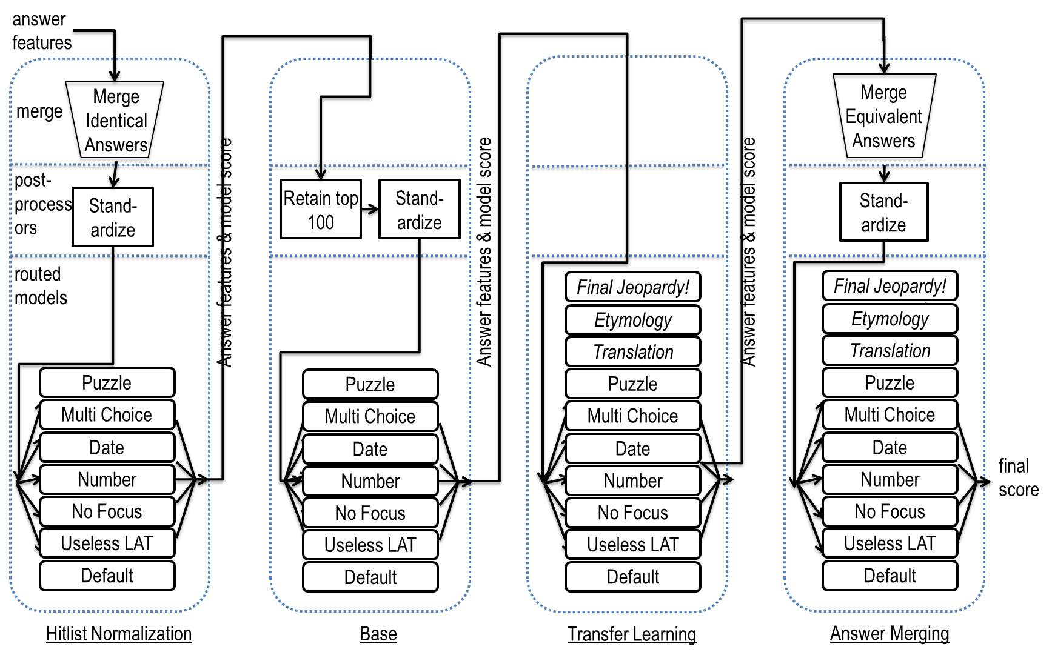
(Gondek et al., 2011)

Slide 12
Learning to rank?
Jeopardy! Watson (1.0) and all the other configurations described so far rank answers one at a time using logistic regression.
Learning is instance based.
One instance is a single answer to a single question.
Should be possible for a system to do a better job ranking answers by looking at the answers as a group and learning to rank them instead of just scoring them one at a time in isolation.
Learning to rank is very successful in other applications
We tried learning to rank for Jeopardy! Watson and found it was not more effective than multi-phase logistic regression.
We’re not really scoring them one at a time in isolation: standardization and multiple phases are effective ways to let answers influence each other.
We design features and test them using logistic regression and discard the ones that are not effective. Result: features are well suited to logistic regression.
However, the field of learning to rank has continued to progress.
Stay tuned!!!

Slide 13
Decision Making in Question Answering
Choosing answers to questions!
IBM Watson generates many candidate answers
For each answer, how confident are we that the answer is right?
Deciding whether to answer
Based on how confident we are that the answer is right
Based on cost/benefit of right answers and wrong answers
Deciding how many answers to provide
Deciding whether to hedge

Slide 14
Deciding whether to answer
In Jeopardy!, if you answer wrong, you lose money (hence the name).
Very important to not answer when you don’t know the answer.
A big part of what motivated us to pursue Jeopardy!: Systems that know what they don’t know.
Lots of data in Jeopardy! to optimize win rate based on outcomes.
Jeopardy! Watson (1.0) had extensive game playing capability for key Jeopardy! decisions like what category to select, how much to wager, and whether to try to answer a question (see upcoming slides)
The core Watson question answering capability is responsible for selecting an answer AND deciding how likely the answer is to be correct.
The Watson Jeopardy! playing application decides whether to answer using the confidence AND the game state (e.g., if Watson is way behind, it may take bigger risks).
Similarly in business applications, core Watson QA ranks answers and assigns confidence scores; each application has its own logic for what to do with it.
For example, applications with very casual users may want to avoid wasting the users time with answers with a low probability of correctness
In contrast, applications used by highly motivated users may be more aggressive.

Slide 15
Stochastic Process Model of Jeopardy! Clues
For Jeopardy! we had lots of data about human opponents behavior.
This plus our own confidence in our own answer allows us to precisely model expected outcomes of answering or not answering.
(Tesauro et al., 2012)
79.7%
5.9%
0.4%
right
right
right
Initial buzz
wrong
wrong
wrong
0.2%
Rebound 1
Rebound 2
No buzz
No buzz
No buzz
8.6%
4.1%
1.1%

Slide 16
Stochastic Process Model in Business Applications?
We could do something similar in many business applications, e.g.:
right
7%
Watson tries to answer
Customer buys product
Customer asks question about product
2%
wrong
Watson admits it does not know the answer
4%
Customer does not buy product
(customer is most likely to buy the product if Watson answers correctly but more likely to buy if Watson doesn’t answer than it if it answers wrong)
However, typically you don’t really have data like that.
Core Watson just provides answers + confidence, applications must decide.
Mostly just have a pre-defined confidence threshold (subjective user experience).

Slide 17
Decision Making in Question Answering
Choosing answers to questions!
IBM Watson generates many candidate answers
For each answer, how confident are we that the answer is right?
Deciding whether to answer
Based on how confident we are that the answer is right
Based on cost/benefit of right answers and wrong answers
Deciding how many answers to provide
Deciding whether to hedge

Slide 18
Deciding how many answers + hedging
In Jeopardy!, you can give only one answer.
However, in real life you can show multiple answers to a user.
Generally not as good as just providing the one correct answer
However, sometimes IBM Watson has several answers that all have reasonably good scores and no one answer with a very good score.
Show one answer when you are very confident of one answer, and show multiple answers you have several that all have similar confidences?
A system can hedge an answer, by saying something like: “I don’t really know, but I think the answer might be…” before answering.
It would do this for medium confidence answers: high enough to be worth showing a user but not high enough to
Users may be more forgiving of wrong answers if they are hedged.
Like deciding whether to answer, these are addressed at the application level. The core IBM Watson QA system provides many ranked answers with confidences, and the application decides what to do with that information.

Slide 19
References
A Lally, S Bagchi, M A Barborak, D W Buchanan, J Chu-Carroll, D A Ferrucci, M R Glass, A Kalyanpur, E T Mueller, J W Murdock, S Patwardhan, J M Prager, C A Welty. WatsonPaths: Scenario-based Question Answering and Inference over Unstructured Information. Technical Report Research Report RC25489, IBM Research, 2014.
D C Gondek, A Lally, A Kalyanpur, J W Murdock, P Duboue, L Zhang, Y Pan, Z M Qiu, C A Welty. A framework for merging and ranking of answers in DeepQA. IBM Journal of Research and Development 56(3/4), 14, 2012
J W Murdock, G Tesauro. Statistical Approaches to Question Answering in Watson. Mathematics Awareness Month theme essay, Joint Policy Board for Mathematics (JPBM), 2012
G Tesauro, D Gondek, J Lenchner, J Fan and J Prager. Simulation, Learning and Optimization Techniques in Watson’s Game Strategies. IBM Journal of Research and Development 56(3/4), 14, 2012.
D Ferrucci, E Brown, J Chu-Carroll, J Fan, D Gondek, AA Kalyanpur, A Lally, J W Murdock, E Nyberg, J Prager, N Schlaefer, and C Welty. Building Watson: An overview of the DeepQA project. AI Magazine 31(3), 59-79, American Association for Artificial Intelligence, 2010.

