Slide 1
Cyber Physical Systems and IoT
Keith Marzullo
Division Director, Computer and Networking Systems
Directorate of Computer and Information
Science and Engineering
National Science Foundation
13 April 2015

Slide 2
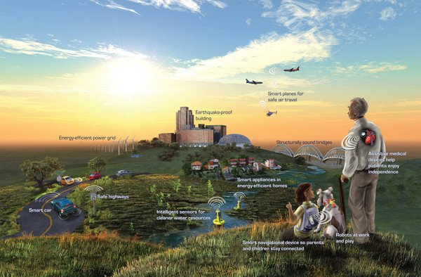
Imagine a world …

Slide 3

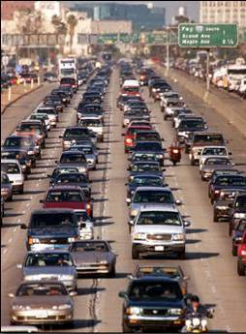
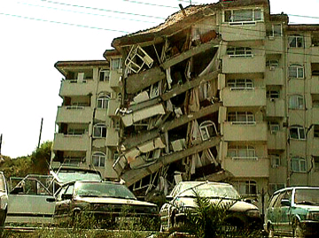
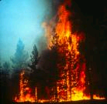
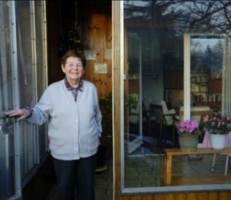
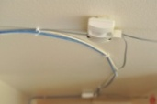
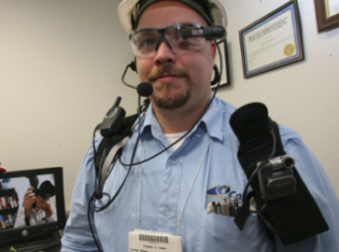

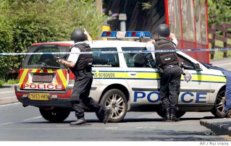

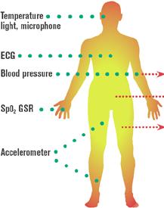



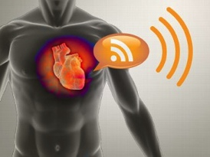
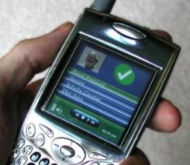
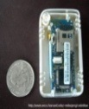
Smart Systems: Sensing, Computation, and Control
Environment Sensing
Emergency Response
Situation Awareness: Humans as sensors feed multi-modal data streams
Percepts (sensors)
Agent (Reasoning)
Pervasive Computing
Social Informatics
Actions (controllers)
People-Centric Sensing
Smart Hearth Care
Sense
Assess
Intervene
Evaluate
Identify
Public Sensing
Social Sensing
Personal Sensing
Source: Sajal Das, Keith Marzullo
Credit: Image courtesy of University of Florida
Notes:
3

Slide 4
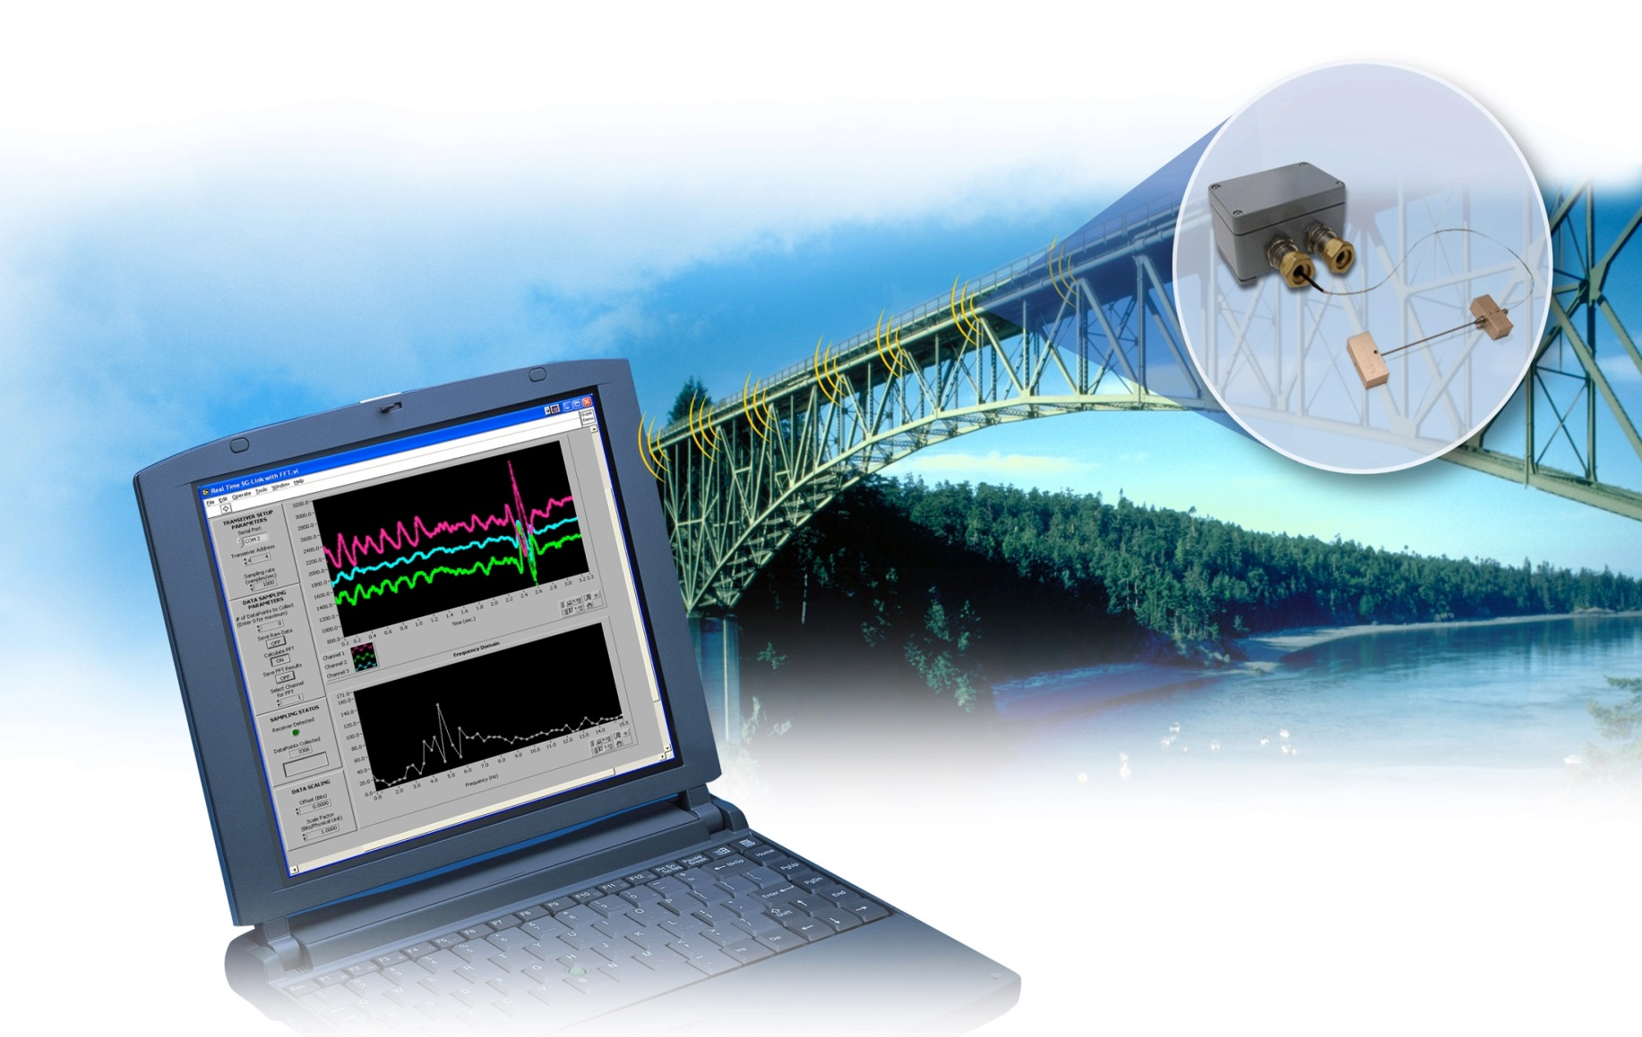
Smart Infrastructure
Imagine a day where…
static infrastructure is adaptable and safe
Image Credit: MicroStrain, Inc.
Notes:
Static infrastructures, such as buildings and bridges, are transformed into smart spaces that adapt to consumption, growth, and/or changing environmental needs or can continuously monitor and identify risk, moderate the impact of failures, and avoid disasters through the use of networked instrumentation and software control.
___________
Civil engineers can continuously monitor and identify at risk man-made structures like bridges, moderate the impact of failures, and avoid disasters.

Slide 5
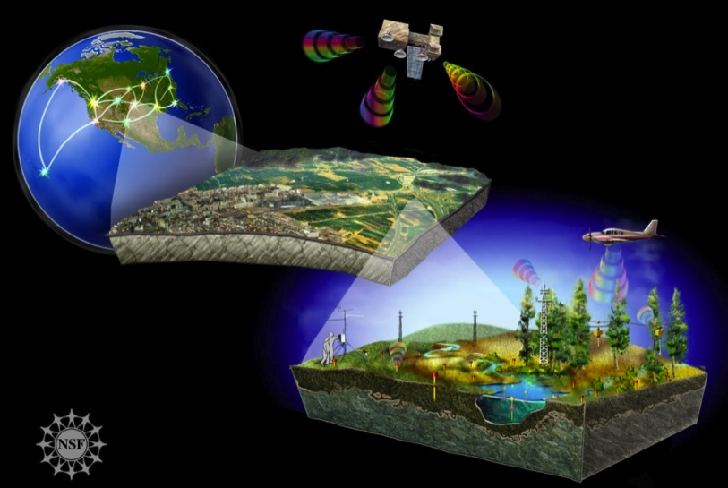
Environment and Sustainability
Imagine a day where…
we can forecast and mitigate ecological change
Image Credit: Nicolle Rager Fuller, National Science Foundation
Notes:
By developing rich ecological and environmental monitoring systems, we can create accurate models that support forecasting and management of increasingly stressed resources.

Slide 6

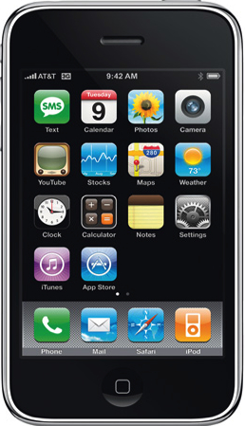


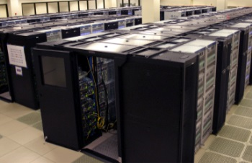
Health and Wellbeing
Imagine a day where…
wellbeing is pervasive and healthcare is personalized
Training
Coaching
GPS
EEG
Chronic Care
Decision Support
Population Statistics
Epidemiology
Evidence
Pulmonary Function
SpO₂
Social Networks
Health Information
Posture
ECG
Gait
Blood
Pressure
Inference
Datamining
Balance
Step Height
Performance
Step Size
Prediction
Early Detection
Notes:
We can improve quality of life through personalized healthcare and assistive technologies, enabled in part by robust, usable, and trustworthy wearable mobile devices integrated with instrumented environments.
We can create a healthcare system that helps people prevent and manage chronic and acute diseases in their own every day context; robots extend independent living for seniors; and devices worn or embedded in the home can report adverse health events.

Slide 7
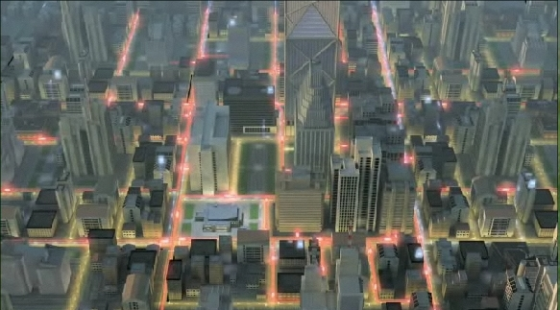
Smart Grids
Imagine a day where…
energy is efficiently used and intelligently managed
Image Credit: Cisco, Inc.
Notes:
We can efficiently manage energy through the deployment of intelligent sensor networks and distributed control and decision capabilities. These smart grids will improve resource utilization, reduce congestion, and enable real-time response and real-time pricing.

Slide 8
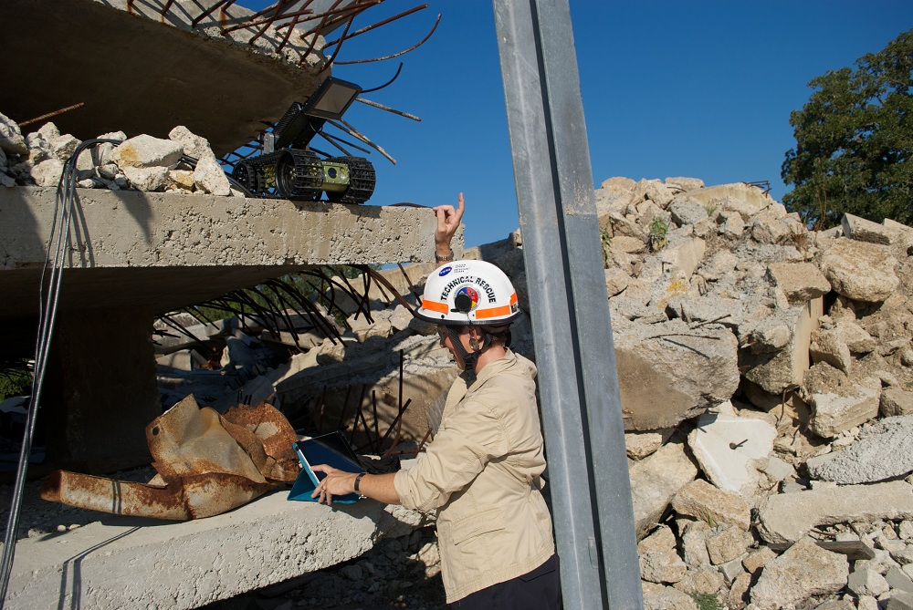
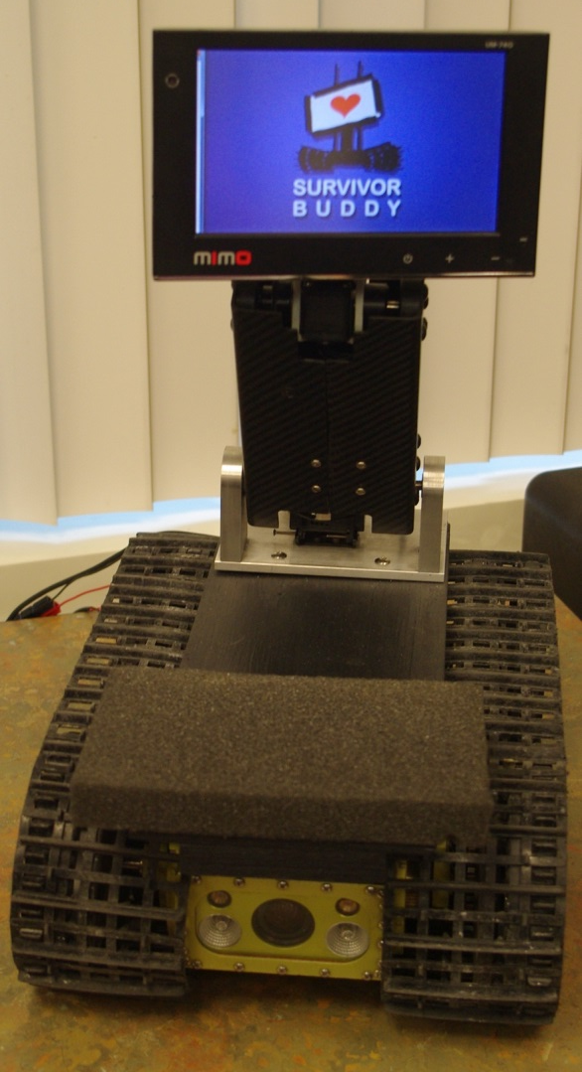
Emergency Response
Imagine a day where…
we can prevent, mitigate, and recover from disasters
Image Credits: Karen Geary, NSF (left) and Texas A&M University (right)
Notes:
During the time of a natural disaster or a national emergency, unmanned search, rescue, and recovery is a reality through the use of autonomous, highly coordinated, and remotely operated robots in shared physical spaces – the promise of distributed, low-power sensing combined with communications and control.

Slide 9
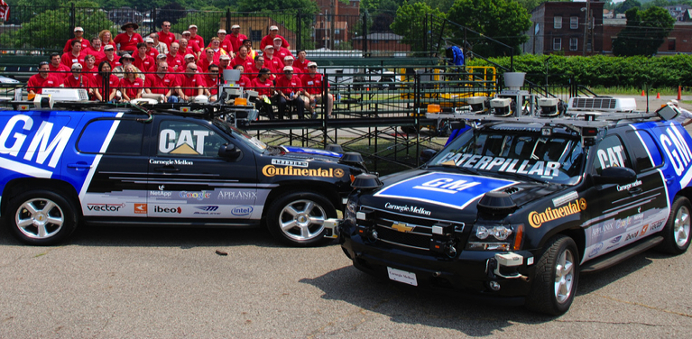
Transportation: Safety and Energy
Imagine a day where…
traffic fatalities no longer exist
Image Credit: PaulStamatiou.com
Notes:
Your car will be able to drive you safely and securely to your destination, where traffic fatalities are uncommon rather than daily events.
Your home and car both consume energy from – and provide energy to – the electricity grid, and where advanced controls can provide substantial energy savings that can decouple the economic benefits of transportation from regional and global environmental impacts.

Slide 10
IoT and CPS – Embrace the Synergies
WSN
IoT
Core Science,
Technology,
Engineering
Safety
CPS
WSN –Wireless Sensor
Networks
CPS – Cyber Physical
Systems
IoT – Internet of Things
Control
Verification
Real-time
Systems
Networking
Security
IoT & CPS share many core technology elements
Open Programmable Devices and Objects are here
  By 2020, 26B smart devices: lights, locks, security sensors …
  By 2019, 70% homes with IoT devices
Industry standards promise simple IoT inter-operability
  Examples: AllJoyn, Thread, SmartThings, Open Interconnect, …
Developers and IoT Apps are coming!
1,400 global developer survey – 40% working on IoT apps today _{[Source:} _{Evans Data Corporation]}

Slide 11
CPS Program Relationship with IoT
CPS Program typically dealt with “big” scope systems
  Airplanes and automobiles are CPS on grand scale with hundreds of networked processors, sensors, and actuators integrating with the physical world in real-time
  Smart grid very large numbers of processors, sensors, actuators
  Human in the loop or on the loop
  Integration and composition
  Security and Privacy
IoT scale dwarfs our traditional view of cyber physical systems but share many of the same technologies and challenges - but at scale, with potentially ad-hoc and opportunistic connections, and with potentially even more stringent challenges in security and privacy

Slide 12
CPS In Context
National
Priorities
Energy, health care, advanced manufacturing, …
IoT
Low-cost sensors, MEMs, low power, 5G, …
CPS
Industrial
Interests
commercialization, monetization, standards, consortia, …
S&T
Advances
machine learning, big data, control, sociotechnical systems, advanced materials…

Slide 13
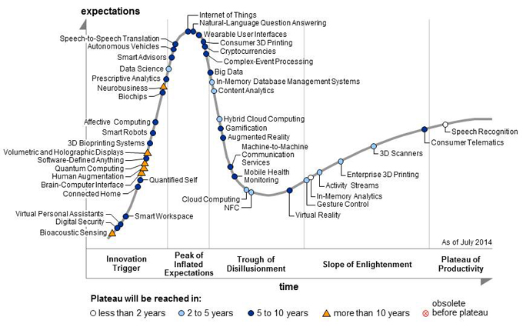
IoT in Perspective
Source: Gartner Hype Cycle for Emerging Technologies 2014

Slide 14
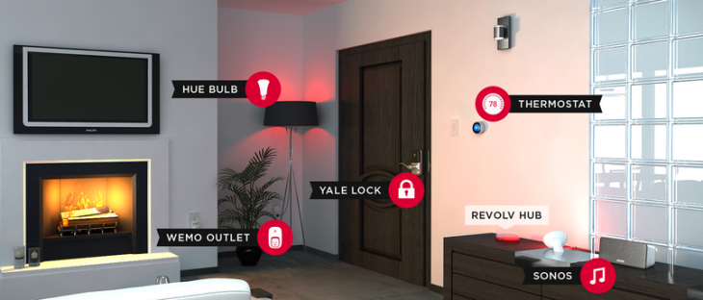
IoT for a smart, connected home

Slide 15
IoT Core Technologies
Security and Privacy
Energy Management
Real-time computing
Sensors and Actuators
Wireless Networking
Signal Processing
Sensing and Control
Mobile Computing
Big Data

Slide 16
IoT Research Challenges*
Massive Scaling
Architecture and Dependencies
Knowledge and Big Data
Robustness
Openness
Security and Privacy
Human Integration
* Borrowing heavily from: “Research Directions for the Internet of Things”, Jack Stankovic, IEEE Internet of Things Journal, Vol. 1, No. 1, February 2014

Slide 17
Massive Scaling as number of smart devices being deployed eventually reaches trillions
How to name, authenticate access, maintain, protect, and support
Architectural model to support heterogeneity of devices and applications
Standards and protocols – beyond IPv6?
Energy management / harvesting / low power
Data storage and management
Real-time behavior
Reliability

Slide 18
Architectures and Dependencies
What types of architectures will evolve that permits connectivity, control, communications, and integration of new / multiple applications and sharing of data?
How do we incorporate dependencies between multiple applications and devices?
  Specify, detect, and resolve across applications
  Beyond versions of underlying OS and hardware
  Resolve conflicts between applications and devices – one may wish to turn off a light – and another may want to turn it on

Slide 19
Knowledge and Big Data
IoT sensors will be generating potentially huge streams of data
How will the data be utilized? How will it be converted into actionable information? How will it be fused with other streams?
What algorithms will be used for analysis?
Protocols and formats
Will it be usable for real-time control?
How and to where will it be transmitted? How will it be stored – if at all?
What are the energy / bandwidth trades?
Privacy / Security / Trust – more detail later

Slide 20
Robustness / Criticality
("Internet of Broken Things")
Typically applications will involved deployed sensing, actuation, and communication platforms – each of which may have separate clocks and positioning. What synchronization is needed, and what is the impact?
What is the impact on system performance if some of the IoT nodes are degraded?
What run-time assurances are available?
Can we include as an element of safety critical systems, and what will need to be qualified or certified?

Slide 21
Openness and Integration
IoT devices will interact with each other and with other non-IoT nodes.
We may need to rethink composition and integration techniques for incorporating them into a system design
Modeling of system behavior including participation in real-time control

Slide 22
Security
IoT devices may be highly vulnerable to security attacks
  Vulnerability to malware out of the box
  Minimal processing may be challenging for attack detection, real-time response, and encryption
  Open design & wireless interfaces
  Random failures may mask attacks
  Recovery and resilience of system may be enhanced with redundancy
  Update approach? Authentication?
  Security architecture for heterogeneous environments including ‘green fields’ and legacy systems

Slide 23
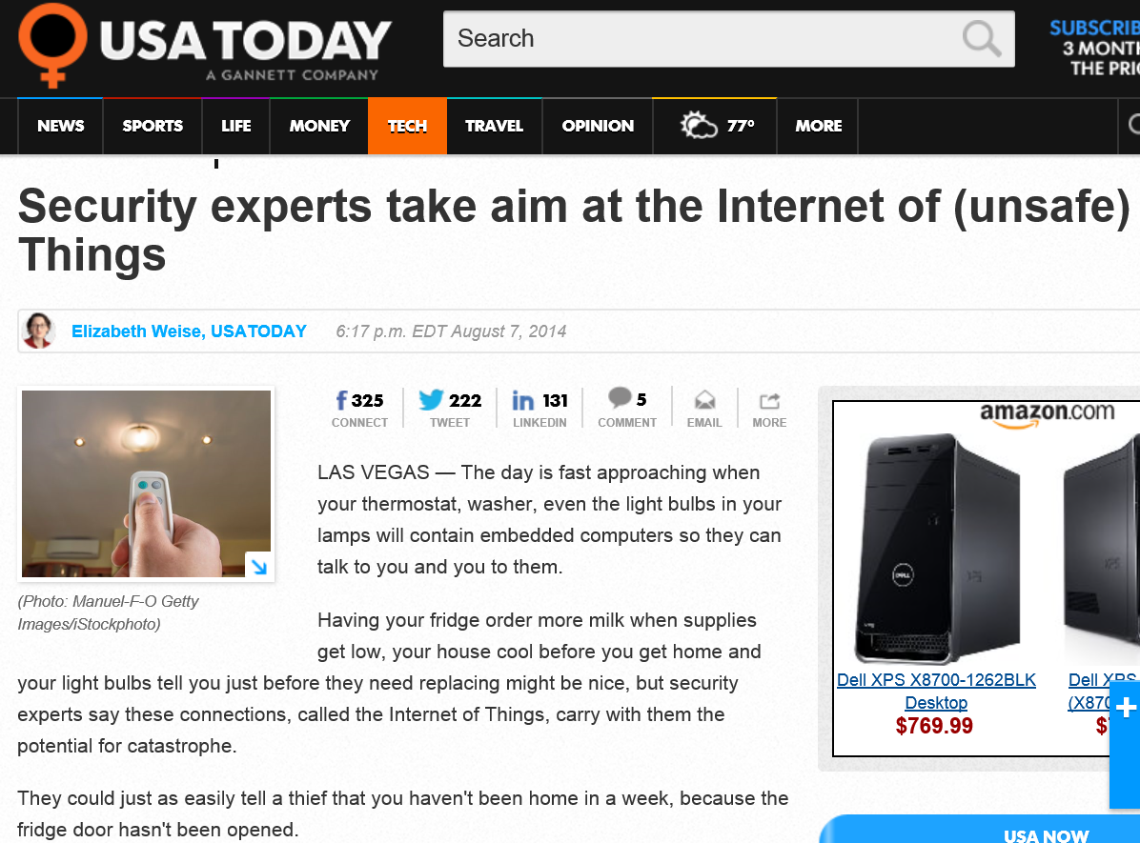

Slide 24
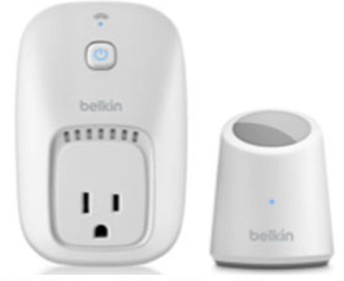
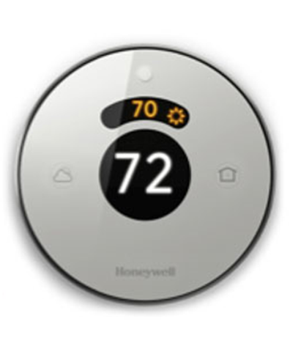
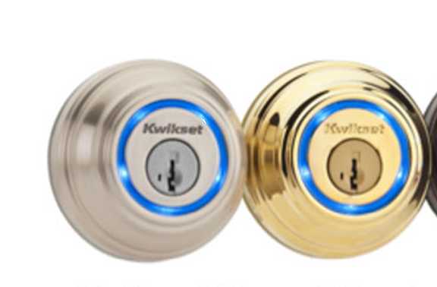
Unsafe Internet of Things Environments
Today’s IoT systems are fundamentally unsafe and subject to a range of vulnerabilities
  Study of top 10 IoT devices across multiple categories finds vulnerabilities in 70% of devices
  March 2014: “Remote-steering” attack demonstrated on recent car models
  August 2014: IoT baby monitor in Texas hacked; parents enter room to find strangers swearing and yelling remotely at two-year old girl
  October 2014: “First cyber-death [IoT related] will happen... ”
  …
  ^{[Source: HP]}
  ^{[Source: Forbes]}
  ^{[Source: CNN]}
  ^{[Source: Independent} ^{(UK) ]}

Slide 25
Privacy
Privacy Policies and enforcement among the diversity of heterogeneous elements
  Where do the policies get enforced?
  Data owners interaction among domains – perhaps there is a need for an IoT privacy language
  Aggregation at the device may be challenge – responding to higher level requests for reduced data sets
  Provenance for verification of adherence to policy
Information leakage

Slide 26
Human Integration
Humans will be deeply integrated with IoT both as customers of their data and generators of data
How will the human interact with the systems? How will this impact cyber physical systems that interact with the human and the IoT devices (e.g. transportation)
  User resolve contradictory actions / information from the IoT
  IoT devices may become safety critical as they are integrated more deeply with the human (and used in making decisions) and with traditional CPS
How do we customize the systems to preferences and priorities of user?
What re-programming of IoT will be available to the individual?

Slide 27
Cyber-Physical Systems
Deeply integrating computation, communication, and control into physical systems
Pervasive computation, sensing and control
Networked and controlled at multi- and extreme scales
Dynamically reorganizing / reconfiguring
High degrees of automation and potential human role
Dependable operation with high assurance of reliability, safety, security and usability
Conventional and unconventional substrates / platforms
Transportation
Energy and Industrial Automation
Healthcare and Biomedical
Critical Infrastructure
Faster and safer aircraft
Improved use of airspace
Safer, more efficient cars
Homes and offices that are more energy efficient and cheaper to operate
Distributed micro-generation for the grid
Increased use of effective in-home care
More capable devices for diagnosis
New internal and external prosthetics
More reliable power grid
Highways that allow denser traffic with increased safety
“CPS will transform how we interact with the physical world
just like the Internet transformed how we interact with one another.”

Slide 28
In a few words…
Cyber-physical systems are smart, complete systems of tomorrow;
Cyber-physical systems will enable ubiquitous technologies and applications for the future.
Advances in cyber-physical systems will reshape our world with more responsive, secure, and efficient systems that:
  Transform the way we live
  Drive economic prosperity
  Underpin national security
  Enhance societal well-being
  Users can bet their life on

Slide 29
CPS Research Model
Application Sectors
Abstract from sectors to more general principles
Apply these to problems in new sectors
Build a new CPS community
Encourage other communities to join
medical
aeronautics
agriculture
Core Science,
Technology,
Engineering
Safety
Control
Verification
automotive
manufacturing
Real-time
Systems
Networking
energy
Security
civil
chemical
materials
Notes:
The goal of the CPS program is to develop the core system science needed to engineer complex cyber-physical systems upon which people can depend with high confidence. The program aims to foster a research community committed to advancing research and education in CPS and to transitioning CPS science and technology into engineering practice. By abstracting from the particulars of specific systems and application domains, the CPS program aims to reveal cross-cutting fundamental scientific and engineering principles that underpin the integration of cyber and physical elements across all application sectors. To expedite and accelerate the realization of cyber-physical systems in a wide range of applications, the CPS program also supports the development of methods, tools, and hardware and software components based upon these cross-cutting principles, along with validation of the principles via prototypes and test beds.

Slide 30
How did it start?
Pre-history:
  A synergy of QUORUM, SEC, MOBIES, PCES programs in DARPA ITO (and formal methods component of EDCS) – “what’s in a mode?”
  Workshops on real-time safety, certification
  Exploratory workshop at Oregon Graduate Institute
  Embedded and Hybrid Systems program at the NSF
  International collaboration –Åström, Henzinger, Sifakis, Broy, Kopetz, Damm, …
Direct history:
  Workshop, UT Austin (Al Mok, James Truchard (NI), Jeff Kodosky)
    “Seedling” NSF program in 2008
  Interagency collaboration in High Confidence Software and Systems (DoD/AFRL, FDA, NIST, NSA) –context for workshops
    Frankie King, NCO
  Community-led workshops – Raj Rajkumar, Jack Stankovic, George Papas, Janos Sztipanovits, Insup Lee, Edward Lee, Claire Tomlin, Doug Schmidt, Chris Gill, Bruce Krogh, Marija Ilic, …

Slide 31
CPS and National Priorities
Broadband & Universal Connectivity
Secure Cyberspace
Health & Wellbeing
Transportation & Energy
Education and Workforce Development
Environment & Sustainability
Manufacturing, Robotics, & Smart Systems
Emergency Response & Disaster Resiliency
Notes:
Advances in CPS are closely intertwined with and will have a pervasive impact on many of our national priorities
Cyber
Including smart systems for manufacturing and robotics,
environment and sustainability, emergency response
and on to healthcare,
and transportation and energy networks and infrastructure

Slide 32
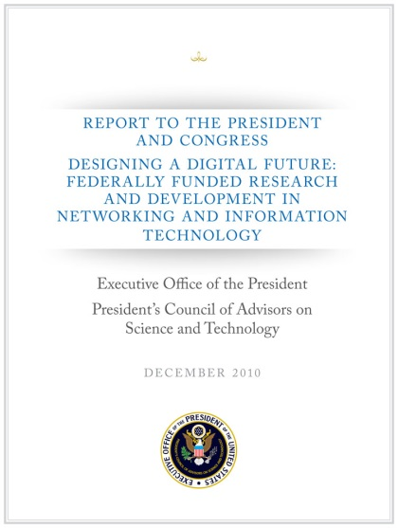
A National Imperative
2007 PCAST NITRD Report –Recommended cross-disciplinary programs to accelerate work in CPS by Federal R&D agencies
2010 PCAST NITRD Report – Expanded this recommendation to energy, transportation, health care, and homeland security
2011 PCAST Advanced Manufacturing Report – Recommended investments to strength US leadership in the areas of robotics, cyber-physical systems, and flexible manufacturing
Notes:
A PCAST 2007 report recommended that Federal R&D agencies strengthen existing programs or create new, cross-disciplinary ones programs to accelerate work in this area. The 2010 PCAST Networking and Information Technology (NIT) R&D report expanded on this recommendation, particularly as it applied to energy, transportation, health care, and homeland security. A PCAST 2011 report on Advanced Manufacturing has called for focused investments in advanced manufacturing to “strengthen U.S. leadership in the areas of robotics, cyber-physical systems, and flexible manufacturing” as a means to promote sustainable economic growth and job creation. These recommendations, consistent with President’s Innovation Strategy (2011), all arise from the accelerated demand and the increasing technical challenges they bring for new capabilities and services all deemed to be intelligent or “smart,” including transportation systems, medical technologies, buildings, and manufacturing.

Slide 33
NSF CPS Program - A Community-driven History
CPS Research Importance – Testimony of Don Winter (VP Boeing) and others before House Committee on Science & Technology
CPS Week 2008 – St. Louis, MO
  (RTAS, HSCC, IPSN)
  CPS Summit
CPS Week 2009 – San Francisco, CA
CPS Week 2010 – Stockholm, Sweden
  (ICCPS)
CPS Week 2011 – Chicago, IL
CPS Week 2012 – Beijing, China
  (HiCoNS)
CPS Week 2013 – Philadelphia, PA
CPS Week 2014 – Berlin, Germany
CPS Week 2015 – Seattle, WA
RTAS 2006 – San Jose, CA
  Wei Zhao at NSF: 2-page writeup
  “Cyber-Physical Systems”
2008 – CSR/CPS “seedling”
CPS 2009 (NSF 08-611) – First CPS
  NSF CISE and ENG/ECCS
CPS 2010 (NSF 10-515)
CPS 2011 (NSF 11-516)
CPS 2012 (NSF 12-520) – First Frontier
CPS 2013 (NSF 13-502)
CPS 2014 (NSF 14-542) – First Joint (DHS, DOT)
CPS 2015 (NSF 15-541) – Adds NASA and NIH
Note: CPS Week is the premier conference on all apsects of Cyber-Physical Systems. It typically consisits of 5 colocated conferences: HSCC (Hybrid Systems, ICCPS, IPSN (Sensor Networks), HiCoNS (High Confidence), RTAS (Real-time and Embedded technology and Applications

Slide 34
Present - Some CPS Program Info
Cross-cutting initiative including Directorate for Computer and Information Science and Engineering (CISE) and Directorate for Engineering (ENG)
Since CPS Launch in 2009:
  Well over $200M investment
  More than 300 awards
  350+ PIs and Co-PIs in 35 states
  Over $35M investment in FY13, over $40M in FY14
  Mission Agency Partners since 2014 solicitation

Slide 35
Building a CPS Community
CPS Senior Steering Group
  Co-chairs Chris Greer (NIST) and Keith Marzullo (NSF)
  Participating agencies DHS, DoD, DoT, NASA, NIFA, NIST, NSF…

Slide 36
CPS Research Themes –
Mining Past Awards
Autonomous Systems
Coordinated Control
Complex Systems
Real-time Systems
Event triggered Control
Supervisory Control
Formal Verification
Medical CPS
Energy Grid
Energy Harvesting
Cyber Infrastructure
Predictive Control
Machine Learning
Mobile Robotics
Markov Chain
Modular Robotics
Robust Control
Situation awareness
Optimization algorithms
Time Synchronization
Cyber security
Wireless sensing
Wearable CPS
Safety Critical
System Infrastructure
GPU Performance & System Integration
Fault detection and health monitoring
Intelligent transportation
Mobile agents
Security usability
Situational awareness
Energy Grid
SCADA Systems
Resilience
Game Theory
Intrusion Detection
Machine learning
Cyber-enabled Manuf.
Design Optimization

Slide 37
CPS Portfolio Overview
Grants by Research Area
Grants by Application Domain

Slide 38
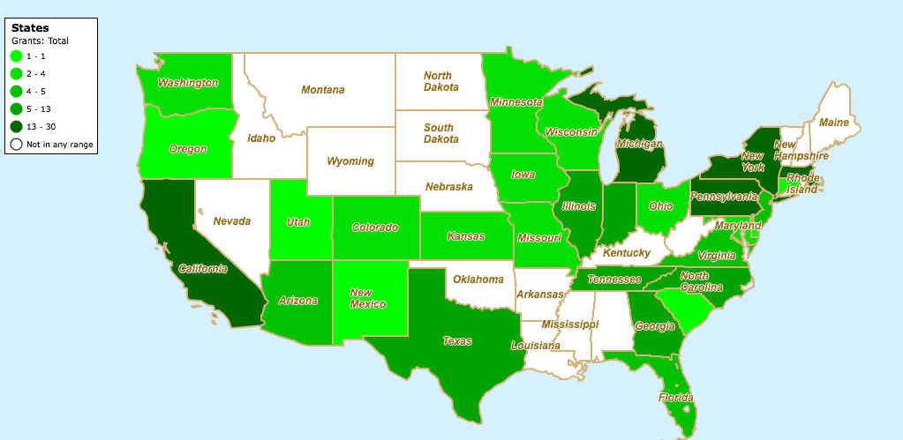
Geographic Map of Active CPS Grants
# of Grants
Arizona | 5
California | 30
Colorado | 4
Connecticut | 1
District of Columbia | 1
Delaware | 1
Florida | 5
Georgia | 7
Iowa | 4
Illinois | 13
Indiana | 9
Kansas | 2
Massachusetts | 19
Maryland | 4
Michigan | 14
Minnesota | 2
Missouri | 2
North Carolina | 11
New Jersey | 5
New Mexico | 1
New York | 14
Ohio | 4
Oregon | 1
Pennsylvania | 29
South Carolina | 1
Tennessee | 9
Texas | 13
Utah | 1
Virginia | 5
Washington | 4
Wisconsin | 2

Slide 39
CPS Frontiers / Large Portfolio 2009-2014
Roseline (May ‘14)
  Quality of time and synchronization for CPS
  Multiple domains
  UCLA, UCSD, UCSB, CMU, Utah
Correct By Design Control Software Synthesis for Highly Dynamic Syst
(May ‘13)
  Formal synthesis of complex control software
  Robotics and transportation
  Michigan, UCLA, TAMU
Science of Integration for CPS (Oct ‘10)
  Foundations for composition of complex systems including passivity based design
  Tools and architectures
  Vanderbilt, Notre Dame, UMD
Foundations of Resilient Systems (May ‘13)
  Economic incentives and resilience for CPS in energy, and transportation
  UCB, MIT, Michigan, Vanderbilt
Center for Autonomous Transportation (Oct ‘10)
  Technologies for autonomous vehicles emphasizing safety, rapid verification, sensor fusion
  CMU
Safety, Security, and Reliability of Medical Device CPS (Oct ’10)
  Technologies for design, implement, and certification of medical devices
  Interoperability , closing loop with human
  Penn, MGH
Action Webs (Sept ‘09)
  Theory of networked, embedded, sensor rich systems
  Stochastic hybrid systems
  Multi-objective control for safety and efificiency
  UCB, MIT

Slide 40
Community Building - Cyber-Physical Systems Virtual Organization
Agency Partners
National Science Foundation
National Security Agency
Office of the Director of National Intelligence
Advanced Research Projects Agency-Energy
Department of Transportation / FHWA
Defense Advanced Research Projects Agency
Collaborative
web-site building
Membership and
Group Management
File sharing,
Metadata search
Technical Approach and Key Innovations
Building upon the open-source Drupal content management system, this project provides virtual organization technologies to facilitate electronic community building by connecting researchers, students, educators and industry practitioners within the growing, cross-disciplinary field of cyber-physical systems.
Long-Term Research Vision
Complement the existing knowledge dissemination repository to make the VO an action destination
Virtual Organization Content/Usage
+140 special interest groups • 14,000 web pages • 21,000 versioned file artifacts uploaded • 4,000 active users • 2 terabytes of data served • 6,000 community announcements posted
On-Site Community Events Supported
+80 CPS-related conferences, planning meetings, seminars, and workshops organized
5 Annual CPS PI meetings, 1 SaTC PI Meeting, +4 HCSS Conferences, 3 Science of Security Conferences

Slide 41
Lots of Progress

Slide 42
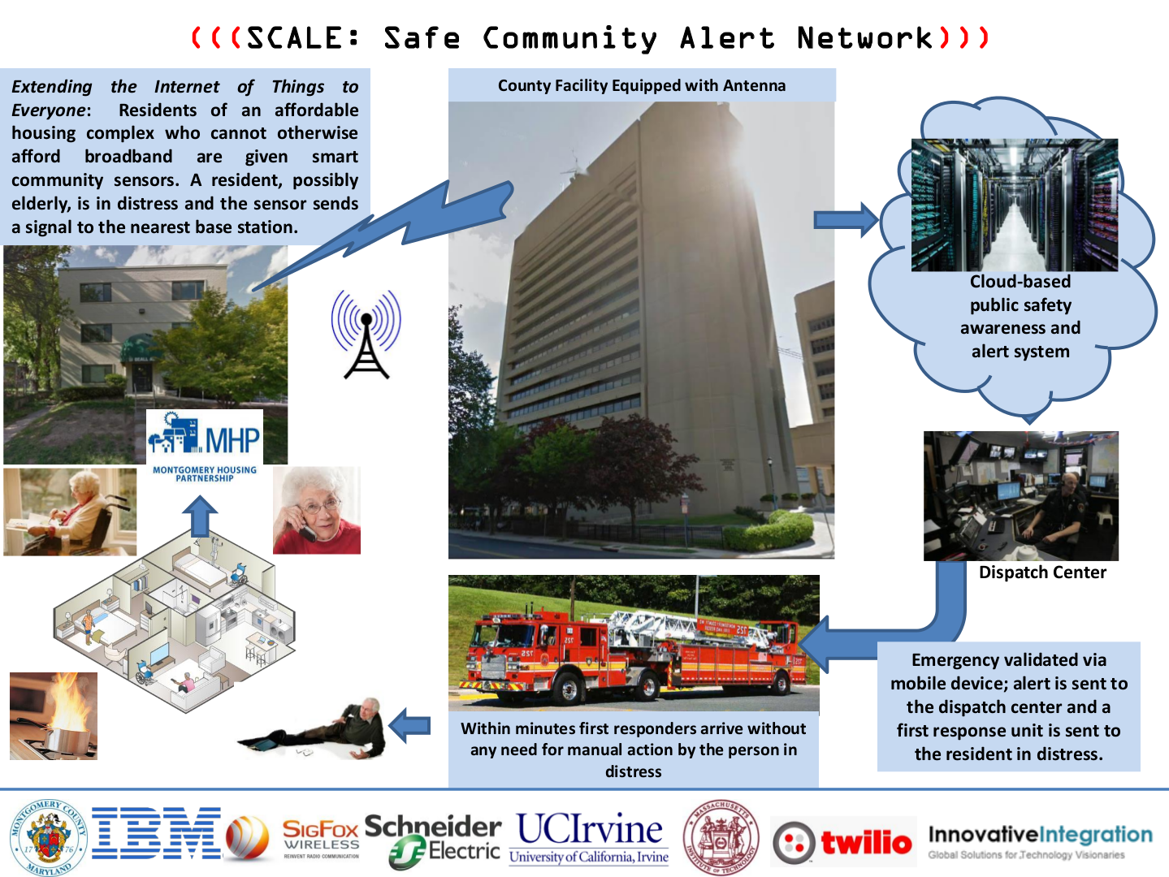
CPS Smart Cities Projects
Safe Community Awareness and Alerting(1450768) –Resilient data acquisition, communication and sense-making in a community-wide CPS under steady-state and emergency situations in a real-world deployment in Montgomery County, MD and initiate actions for protection of individuals and property

Slide 43
CPS Smart Cities Projects
Plug-and-play cyber-physical systems to enable intelligent buildings (1329875) - Pre-engineered intelligent modules for easy configuration and re-configuration of buildings for thermal and visual comfort & efficiency
Software defined buildings (1239552) – Foundational substrate for efficient model-driven, human centered building systems. Creates an Open Building Integrated Operating System
Architectural and Algorithmic Solutions for Large Scale PEV Integration into Power Grids (1239224) - Algorithms for the integration of plug-in hybrid electric vehicles (PEVs) into the power grid including PEV owners, commercial charging station owners, aggregators, and distribution companies -- at distribution / retail level.

Slide 44
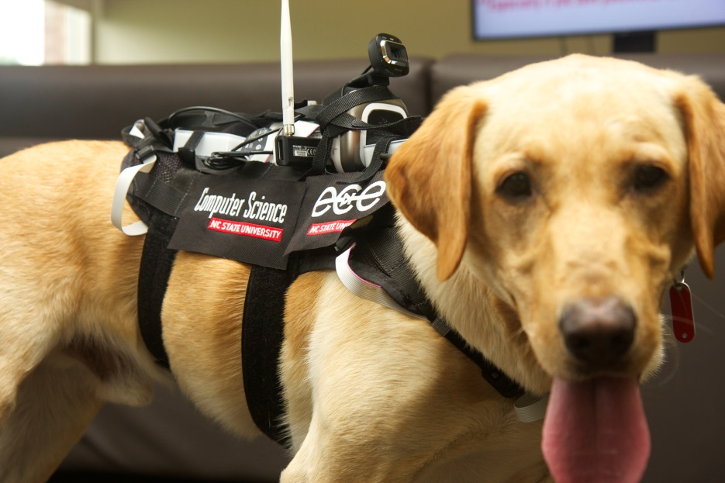
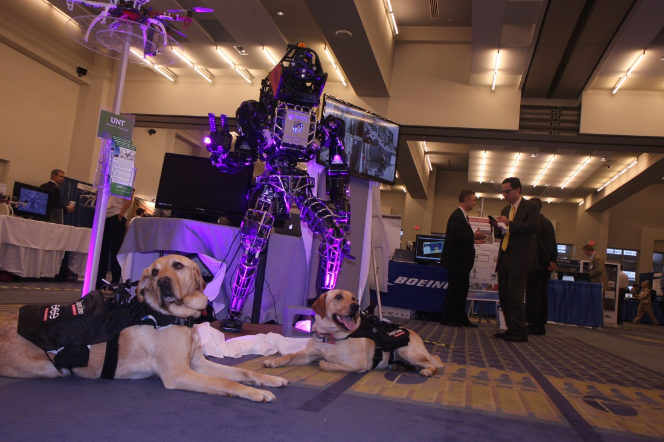
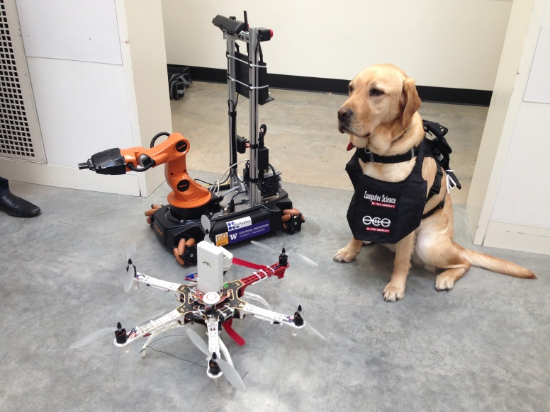
CPS Enabled Smart Search and Rescue

Slide 45




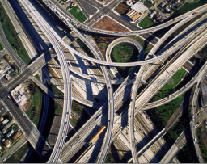
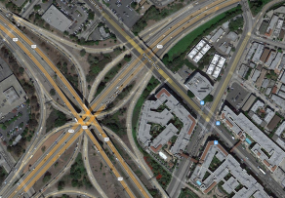
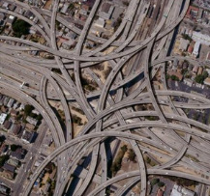
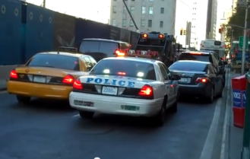
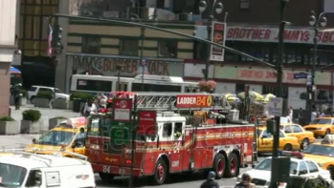
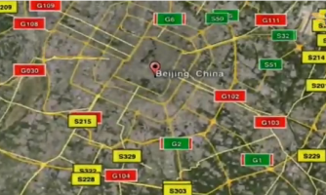
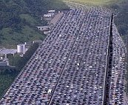
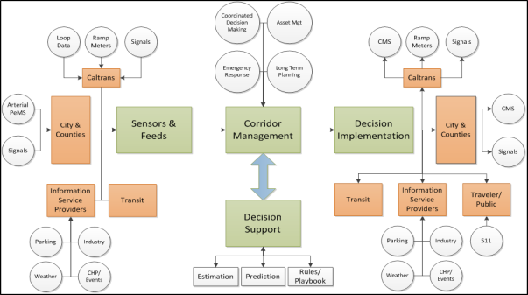
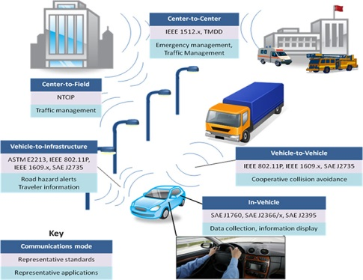
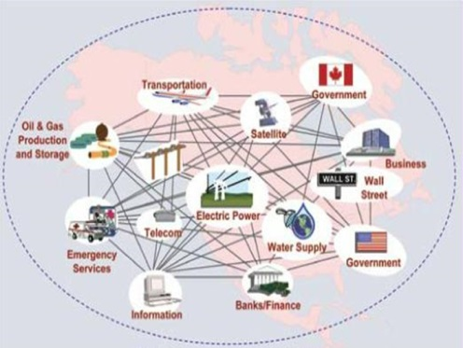
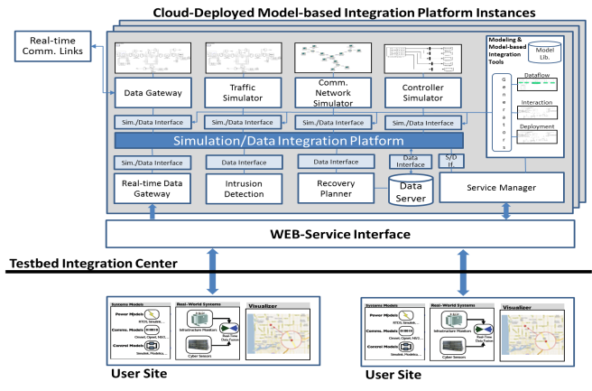

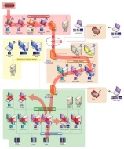
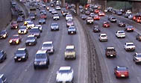
NSF FORCES and Connected Corridors Projects, UC Berkeley
Institute for Software-Integrated Systems, Vanderbilt University
The Smart Roads testbed / system integrates advanced control algorithms and high-fidelity simulation software with real-time data to predict and manage traffic flows, to support resilience to cyber attacks.
The Status Quo:
Complex and interconnected road networks
Emergency vehicles delayed due to traffic
World’s largest traffic jam: 100+ Km/10+ days
Vulnerable Communication & Control:
Our Solution:
Connected Corridors
(CC)
+
High-fidelity
simulation software
(C2WT)
FHWA ITS Connections
Cobweb of global critical IT Infrastructure
Cyber
Attacks
Well-managed and resilient traffic flows

Slide 46
Global Cities Technology Challenge

Slide 47
Dear Colleague Letter: CPS EAGERs Supporting Participation in the Global City Teams Challenge
EArly-Concept Grants for Exploratory Research (EAGER) proposals to support NSF researchers in participating in the NIST GCTC teams, with the goal of pursuing novel research on effective integration of networked computer systems and physical devices that will have significant impact in meeting the challenges of the smart city.
Priority will be given to researchers who have previously received funding from CPS, or related projects from other NSF programs, and who are members of, or are seeking to, establish GCTC teams building upon the resultsof NSF-funded projects
35 EAGER proposals submitted – funding 13 for approximately $2.5M
  Announcements of awards soon

Slide 48
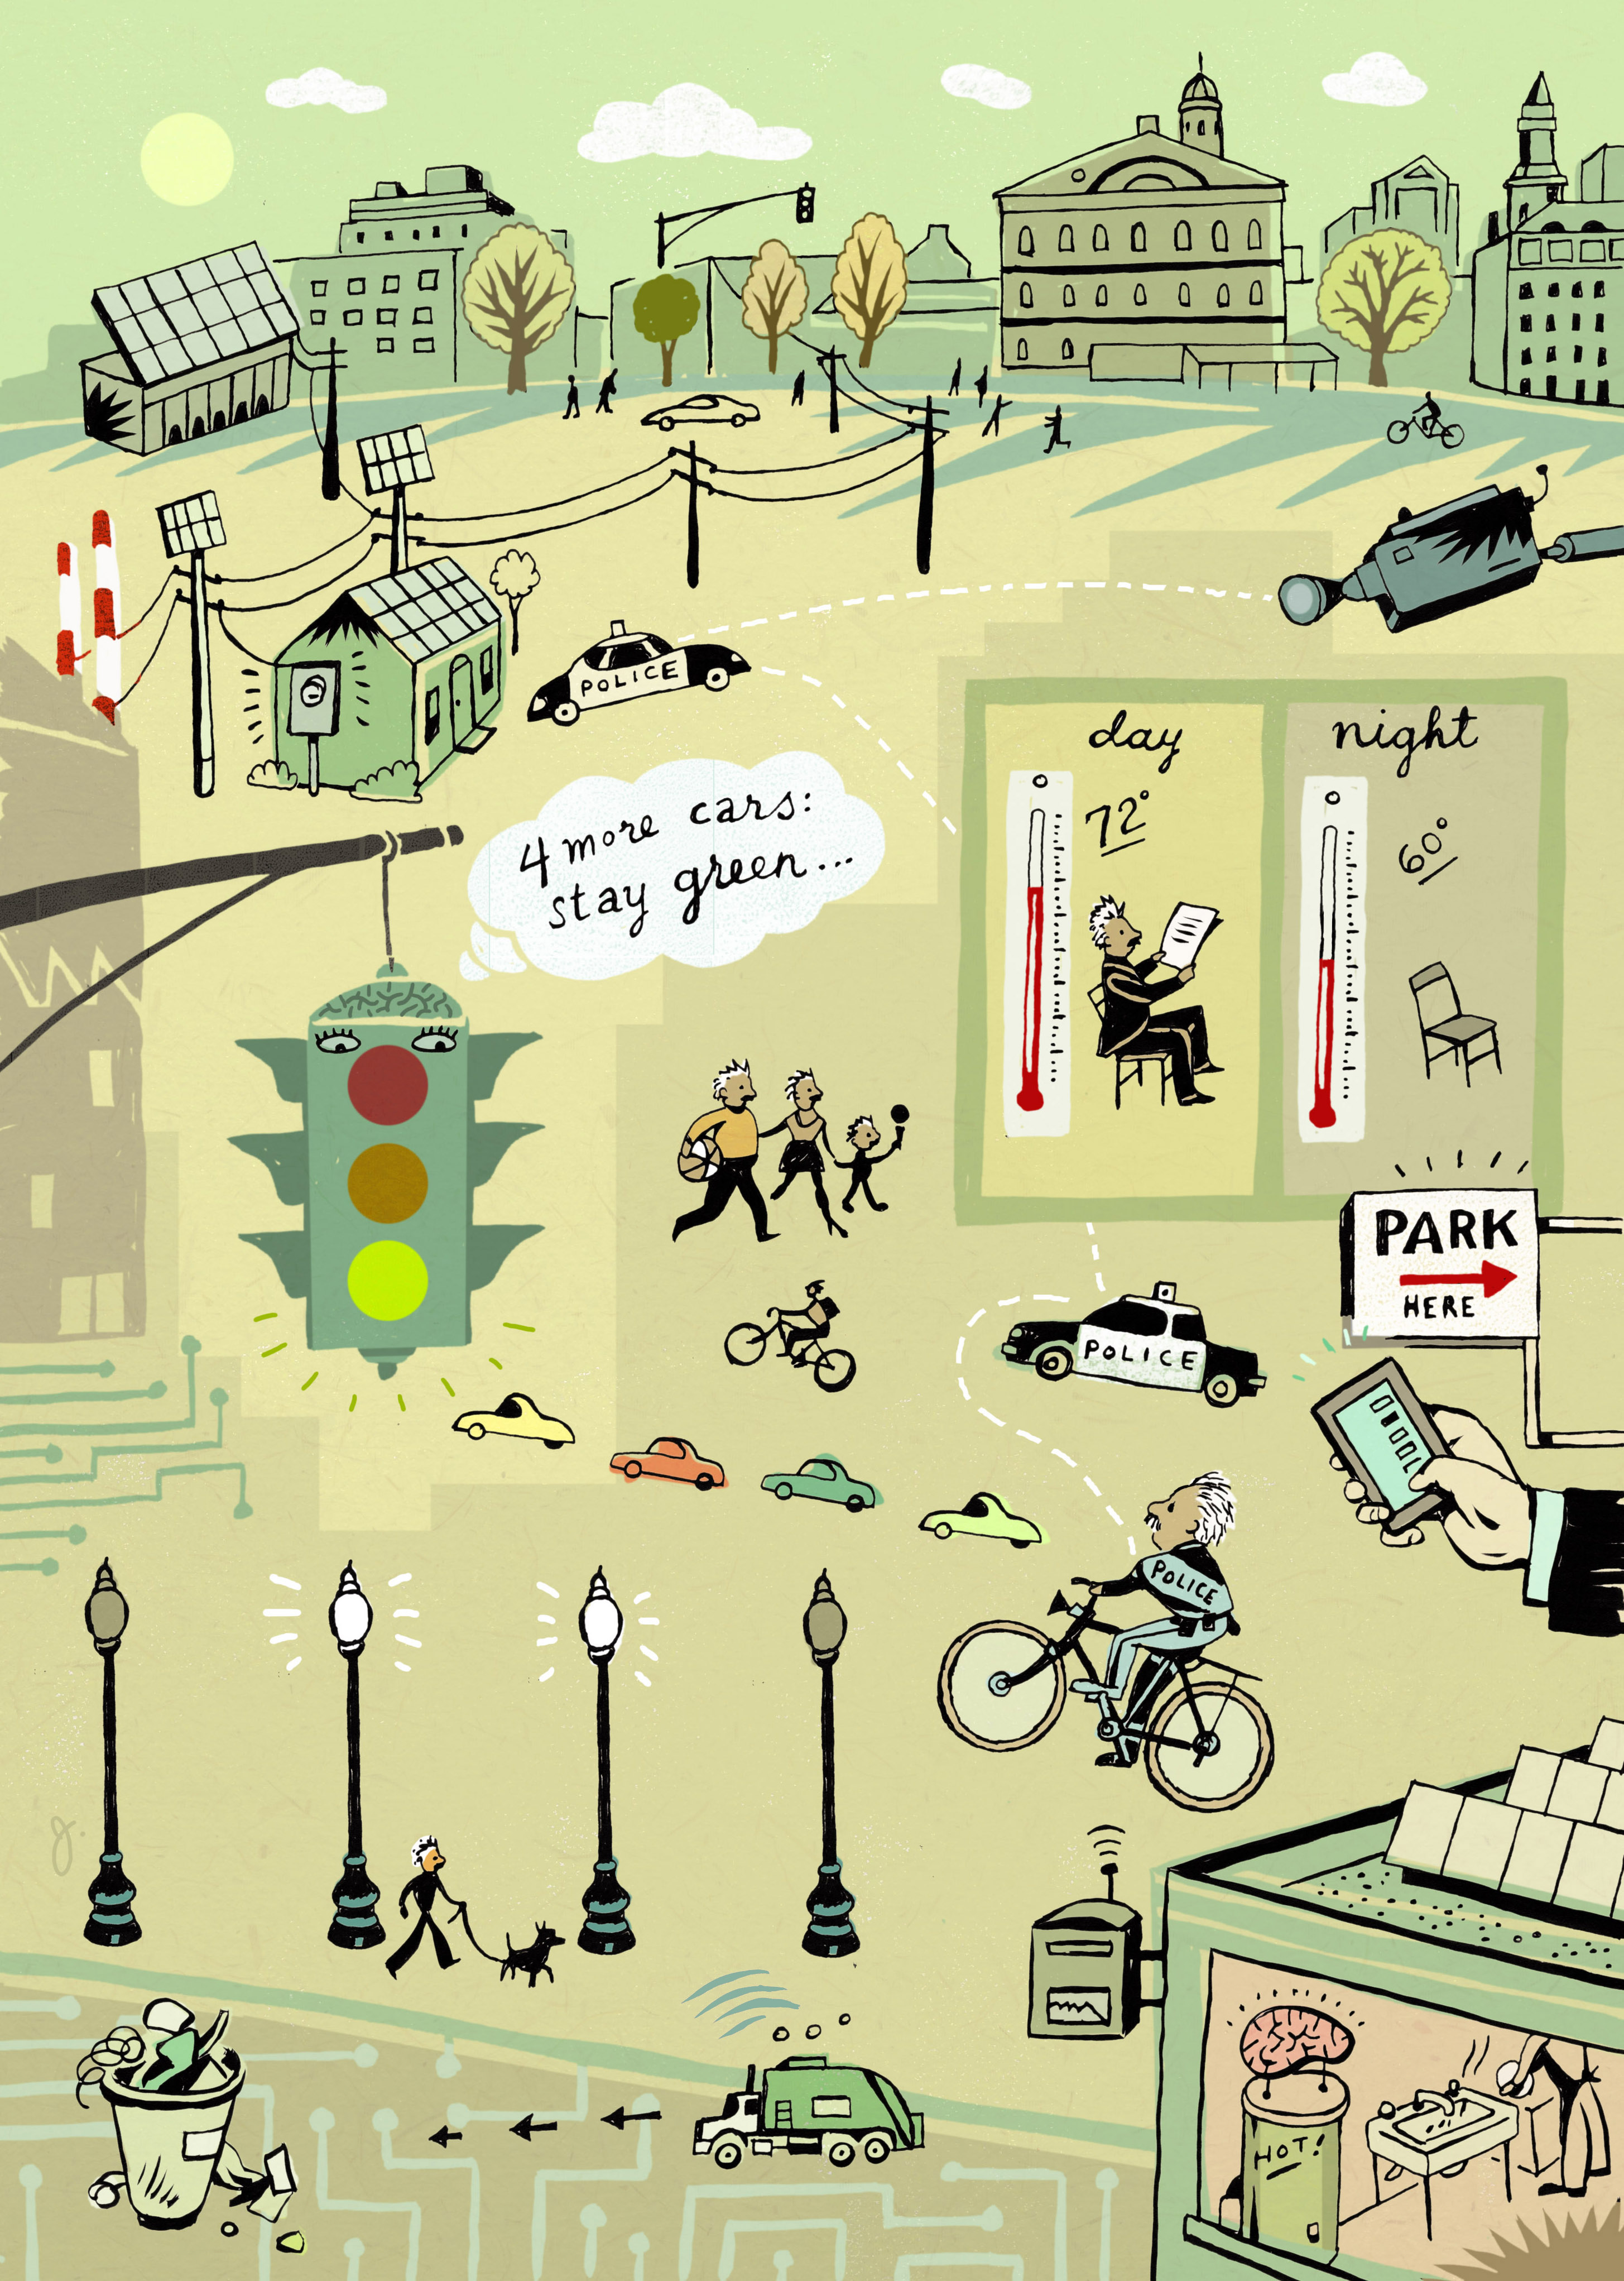
CPS Program and IoT Converge in Smart City and the Industrial Internet
NSF 15-541
System Design
System Verification
Real-time Control and Adaptation
Manufacturing
Internet of Things
Smart Cities
DHS
DoT/FHWA
NASA
NIH
CPS
Science
Engineering
Technology
Notes:
A CYBER-PHYSICAL INFRASTRUCTURE FOR THE “SMART CITY”
CNS-1239021 –
C.G. Cassandras – Boston University [Co-PIs: Bestavros, Kfoury, Paschalidis, Gong (UMass), Gao (UConn)]
A novel optimization framework capturing CPS dynamics modeled as a stochastic hybrid system with interacting time-driven and event-driven components. Two classes of Smart City problems captured in this setting: (a) dynamic optimization problems (e.g., Smart Parking”) and (b) parametric optimization problems (e.g., Traffic Light Control.)
Techniques for detecting/localizing sources of harmful releases (pollution, chemical, bio/radiological/nuclear) in an urban environment.
Methods for data collection from the urban cyber-physical infrastructure using vehicles.
A novel framework and associated tool for specification and verification of security properties associated with flow networks commonly arising in CPS applications (e.g., traffic flows in Smart Cities).
An analytical framework for realizing trustworthy sensing enabled by probabilistic modeling with uncertainty quantification, implemented in particle filtering.

Slide 49
Next Generation Workforce “CPS Capable”

Slide 50

A Key Challenge: CPS Education
http://sites.nationalacademies.org/CSTB/CurrentProjects/CSTB_084351
An ad hoc committee will conduct a study on the current and future needs in education for cyber-physical systems (CPS). Two workshops would be convened early on to gather input and foster dialogue, and a brief interim report would be prepared to highlight emerging themes and summarize related discussions from the workshops. The committee's final report would articulate a vision for a 2l-st century CPS-capable U.S. workforce. It would explore the corresponding educational requirements, examine efforts already under way, and propose strategies and programs to develop faculty and teachers, materials, and curricula. It would consider core, cross-domain, and domain-specific knowledge. It would consider the multiple disciplines that are relevant to CPS and how to foster multidiscplinary study and work. In conducting the study, the committee would focus on undergraduate education and also consider implications for graduate education, workforce training and certification, community colleges, the K-12 pipeline, and informal education. It would emphasize the skills needed for the CPS scientific, engineering, and technical workforce but would also consider broader needs for CPS “fluency.”

Slide 51
The very near future

Slide 52
NSF 15-541 Research Areas
System Design including safety, resilience, security and privacy
System Verification including certification, preserving safety but dramatically reducing test space, very large & complex systems
Real-time Control and Adaptation – How do we integrate big data in real-time control? How do we achieve real-time in new environments such clouds or network challenged spaces?
Manufacturing – Harnessing CPS research to conceive, design, and manufacture new products at pace far exceeding today
Smart Cities – What foundational research is needed to achieve effective integration of networked computing systems, physical devices, data sources, and infrastructure to have a major impact on quality of life within the city?
Internet of Things - What are the foundational research elements needed to harness the power of the IoT? How do we go from the IoT to the Internet of Dependable and Controllable Things at enormous scale? What new areas of CPS research emerge from this?

Slide 53
Mission Agency Partners
Core of foundational technologies with direct relevance to application areas of value to partners. Enables accelerated maturation and transition
DHS S&T Directorate Cyber Security Division – 2014/15
DOT FHWA & Intelligent Transportation System JPO -2014/15
NASA Aeronautics Research Mission Directorate - 2015
NIH institutes including NIBIB (Imaging and Bioengineering), OBSSR (Behavioral and Social Sciences Research), National Cancer Institute (NCI), and National Center for Advancing Translational Sciences (NCATS) – 2015

Slide 54
CPS Themes – Building Partnerships
NSF/Intel Partnership on Cyber-Physical Systems Security and Privacy (CPS-Security) (Solicitation 14-571)
  Integration of concepts for technical & social elements of CPS with Security
New Opportunities
  Smart Cities EAGER Support (NSF 15-015)
  Cyber Enabled Manufacturing
  Food, Energy, Water nexus

Slide 55
Building a Future - Other Activities
Recent CPS PI meetings: Oct 2013, Nov 2014
  300 attendees including Grantees, Gov, and Industry
  Webcasts for keynotes
  You tube videos for PI posters
  Invitations for other participants to learn about CPS
Aspiring PI meeting: Jan 2014
  Open to PIs who have not yet received CPS funding
  Presentations, discussions, and 1-1 program officer meetings
  Results appear to indicate success
Early Career Workshop – March 2014
  Grad Student, Post Docs, Assistant Prof
  Head start on CPS program
  Seems to have had impact in CRII
  Repeating at CPS Week 2015

Slide 56
Challenges
Diversity (underrepresented groups) is a problem for CPS like many other CISE programs
  Meeting with lots of prospective PI’s from non-traditional NSF universities (e.g. Western Kentucky, Georgia Southern)
  Inviting people from outside program to the PI meetings and outreach for reviewers
Significant accomplishments - Getting research community to think more broadly about what are significant accomplishments and what is real impact
Impact - Foundational research can have a short and mid-term impact
CPS Testbeds are lacking and we need a targeted solicitation to really engage the community of testbed developers and users

Slide 57
Future Directions
CPS Security is critical -- focus on defense, resilience, and not “hacks”
Accelerating the transition of CPS programs to practice
Generalizable principles of CPS research / science
Human and society as recipients of CPS research
  Urban Science / Smart Cities
  Cyber manufacturing
Broadening our perspective of CPS
  Establishing research agenda in IoT

Slide 58
Examples of Federal Smart Cities Activities
Built Environment
Energy
Government Ops.
Health
Human Services
Public Safety
Public Engagement
Telecommunications
Transportation
Climate
Water
DOE: Smart Building Technologies
HUD: Block Grants
NSF: Cross-
Cutting
Research
NIST: Cyber
Physical
Systems
Standards
NIST: Global City
Teams Challenge
DOE: Smart Grid
Expanding the impact of CPS research beyond our traditional view
Smart City Application Areas
NSF: CPS
DHS: Urban Security
NSF: U.S. Ignite
NTIA: Community Broadband
DOT: Connected Vehicle Research
DOE: Connected and Automated Vehicles Research
EPA: Air Monitoring
EPA: Water Resilience and Security
Research Testbed
R&D
Pilot Scale
Deployment
TA / Capacity Building / Financing

Slide 59

A Sense of the Future
The innovation ecosystem of the Industrial Internet
A world in which our environment interacts seamlessly with us
"STWink Eye" by Star Trek: The Original Series episode, "Wink of an Eye". Licensed under Fair use of copyrighted material in the context of Star Trek via Wikipedia - http://en.wikipedia.org/wiki/File:STWink_Eye.jpg#mediaviewer/File:STWink_Eye.jpg

