Slide 1
Internet of Systems
Ontology Summit ● NSF-NITRD ● April 13, 2015
IoS
Dr Shoumen Palit Austin Datta
SVP, IIC ● Research Affiliate, MIT
● shoumen@mit.edu ● datta@iiconsortium.org ● www.iiconsortium.org ● http://bit.ly/MIT-IOT ●

Slide 2
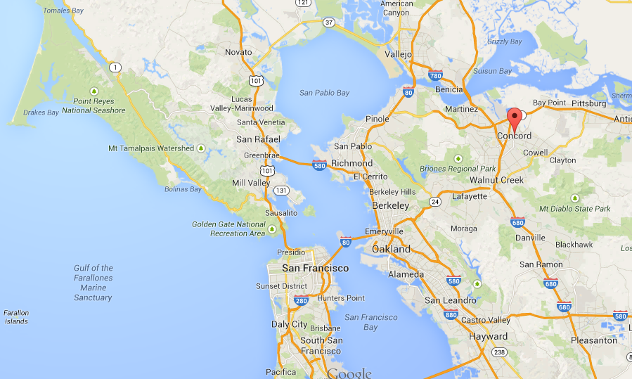
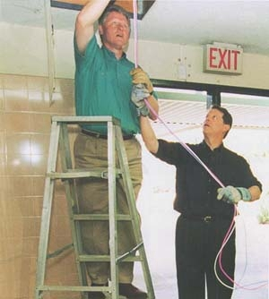
Diffusion of the Internet - NetDay 1996
President Bill Clinton installing computer cables with Vice President Al Gore on NetDay at Ygnacio Valley High School (Concord, CA - Mar 9, 1996)

Slide 3
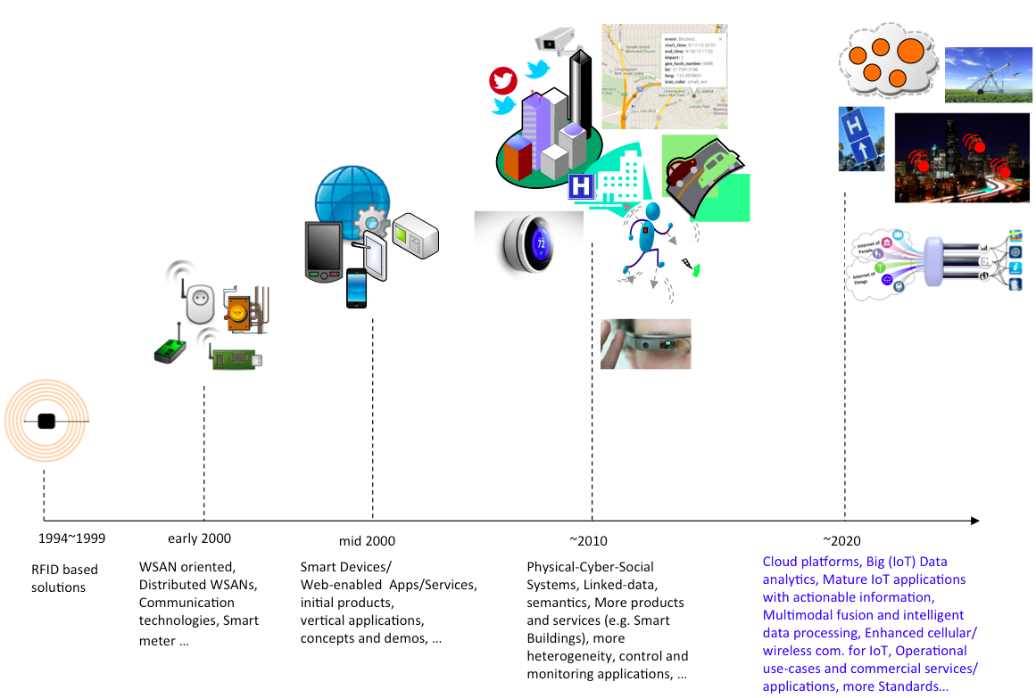
A Short History of the Development of the Internet of Things starts with the re-invention of RFID
http://iot.ieee.org/images/files/newsletter/201409-barnaghi-figure1.png

Slide 4
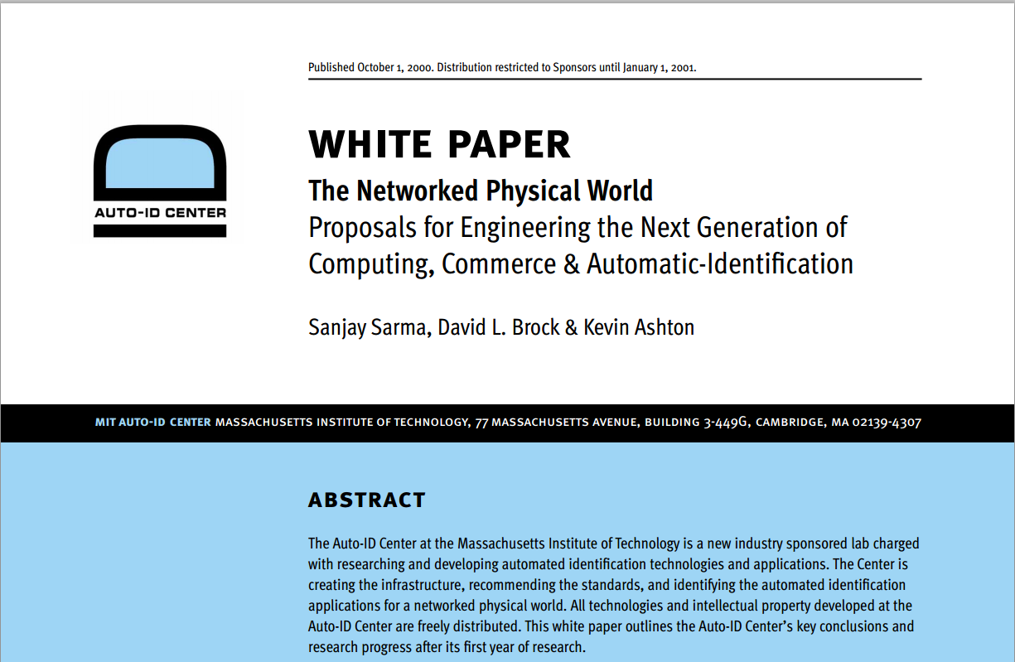
http://cocoa.ethz.ch/downloads/2014/06/None_MIT-AUTOID-WH-001.pdf

Slide 5
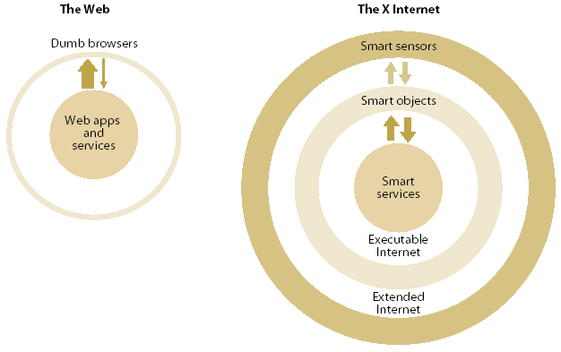
Sketch of Industrial Internet 2003 → Internet 0 Ubiquitous Infrastructure
Datta 2003 , Datta 2008
Internet 0
Internet 1
Internet 2
Bits, Atoms, Decisions
MEMS / NEMS
Intel Motes, Crossbow
D2B/RFID/UWB/O2O
Object Oriented Hardware
Service (Value) Supply Chain
A G E N T S
IPv6
From
an office
in Shinzen,
China, you log
on a SDR reader in
a warehouse in USA,
to check if your products
arrived on-time. They did.
You also get to know that
your distributor in Santiago,
Chile and retailer in Espoo,
Finland also checked the delivery
status, moments before you logged on.
Right-Time
Analytics
dERP
GRID
Web Services
Service (Value) Supply Chain
Real Time Data
Streaming Data, Continuous Queries
S E C U R I T Y
Semantic Grid
Web Portal
SDR Data Interrogators as Ubiquitous Internet Appliance

Slide 6
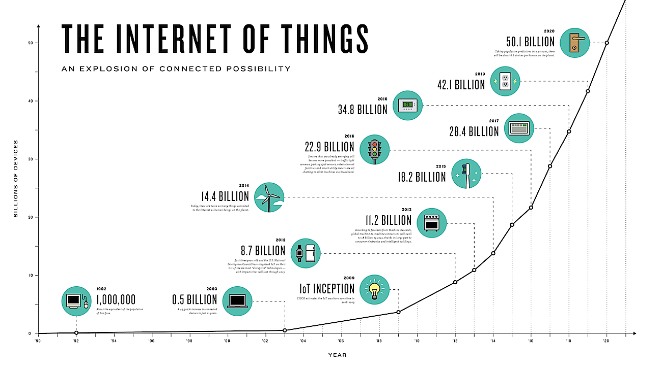
THE NETWORKED PHYSICAL WORLD
ECONOMIC GROWTH ENGINES

Slide 7
At the beginning - How did the IoT concept / industrial internet start ?
The grand vision of the Industrial Internet may have started circa 1988 with the work of Mark Weiser of Xerox Palo Alto Research Center (XPARC) who predicted that computers may “weave themselves into the fabric of everyday life” and influence the future of business as well as lifestyle technologies, in his 1991 article in the Scientific American. The release of the commercial internet in 1995 paved the way for the Industrial Internet of the future. In 1998, Sanjay Sarma (MIT) extended the idea of using RFID tags on objects for track and trace purposes. To make it feasible for businesses to use RFID tags in the management of their supply chains, the price of the RFID tag had to be reduced, significantly. Sarma suggested RFID tags contain only a reference number (electronic product code) rather than any actual data about the object. It was against the conventional wisdom. At the time, RFID tags were used and designed to contain data about the object or product. By eliminating need for data storage on the tag, the cost of the RFID tags were reduced. Sarma designed the EPC to act as an unique URL to access the object data stored on the Internet. In 1999, Sarma along with colleagues David Brock and Sunny Siu co-founded the Auto ID Center to transform this vision made possible by the “emerging” medium and the platform of the internet. The internet was still in its infancy and immature to act as a catalyst to augment business processes and industrial productivity. Sarma, Brock and Siu were later joined by Kevin Ashton who was loaned to the Auto ID Center at MIT from Proctor & Gamble. Auto ID Center at MIT developed the EPC and other technical concepts and standards prevalent today in the global RFID industry. Sarma, Brock and Ashton coined the term Internet of Things which envisioned objects /things connected to object-specific data on the internet which could be accessed using the unique EPC on the tag attached to the object. IoT is a vision, not a technology. In 2000, a paper by Sarma et al gave birth to that IoT concept. Please download (MIT-AUTOID-WH-001) THE NETWORKED PHYSICAL WORLD from this link http://tinyurl.com/Industrial-Internet (this folder contains many papers). Professor Sarma talked about the IoT at the MIT Sloan Symposium. It is on YouTube http://tinyurl.com/MIT-IoT-1998
I was a part of the Auto ID initiative since 2001 as a member of the Technology Board at Auto ID Center.
The industrial internet started with the birth of Internet of Things

Slide 8
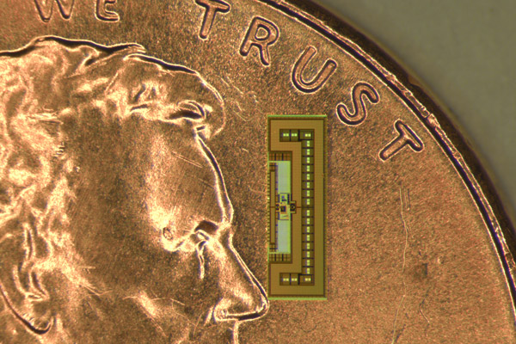
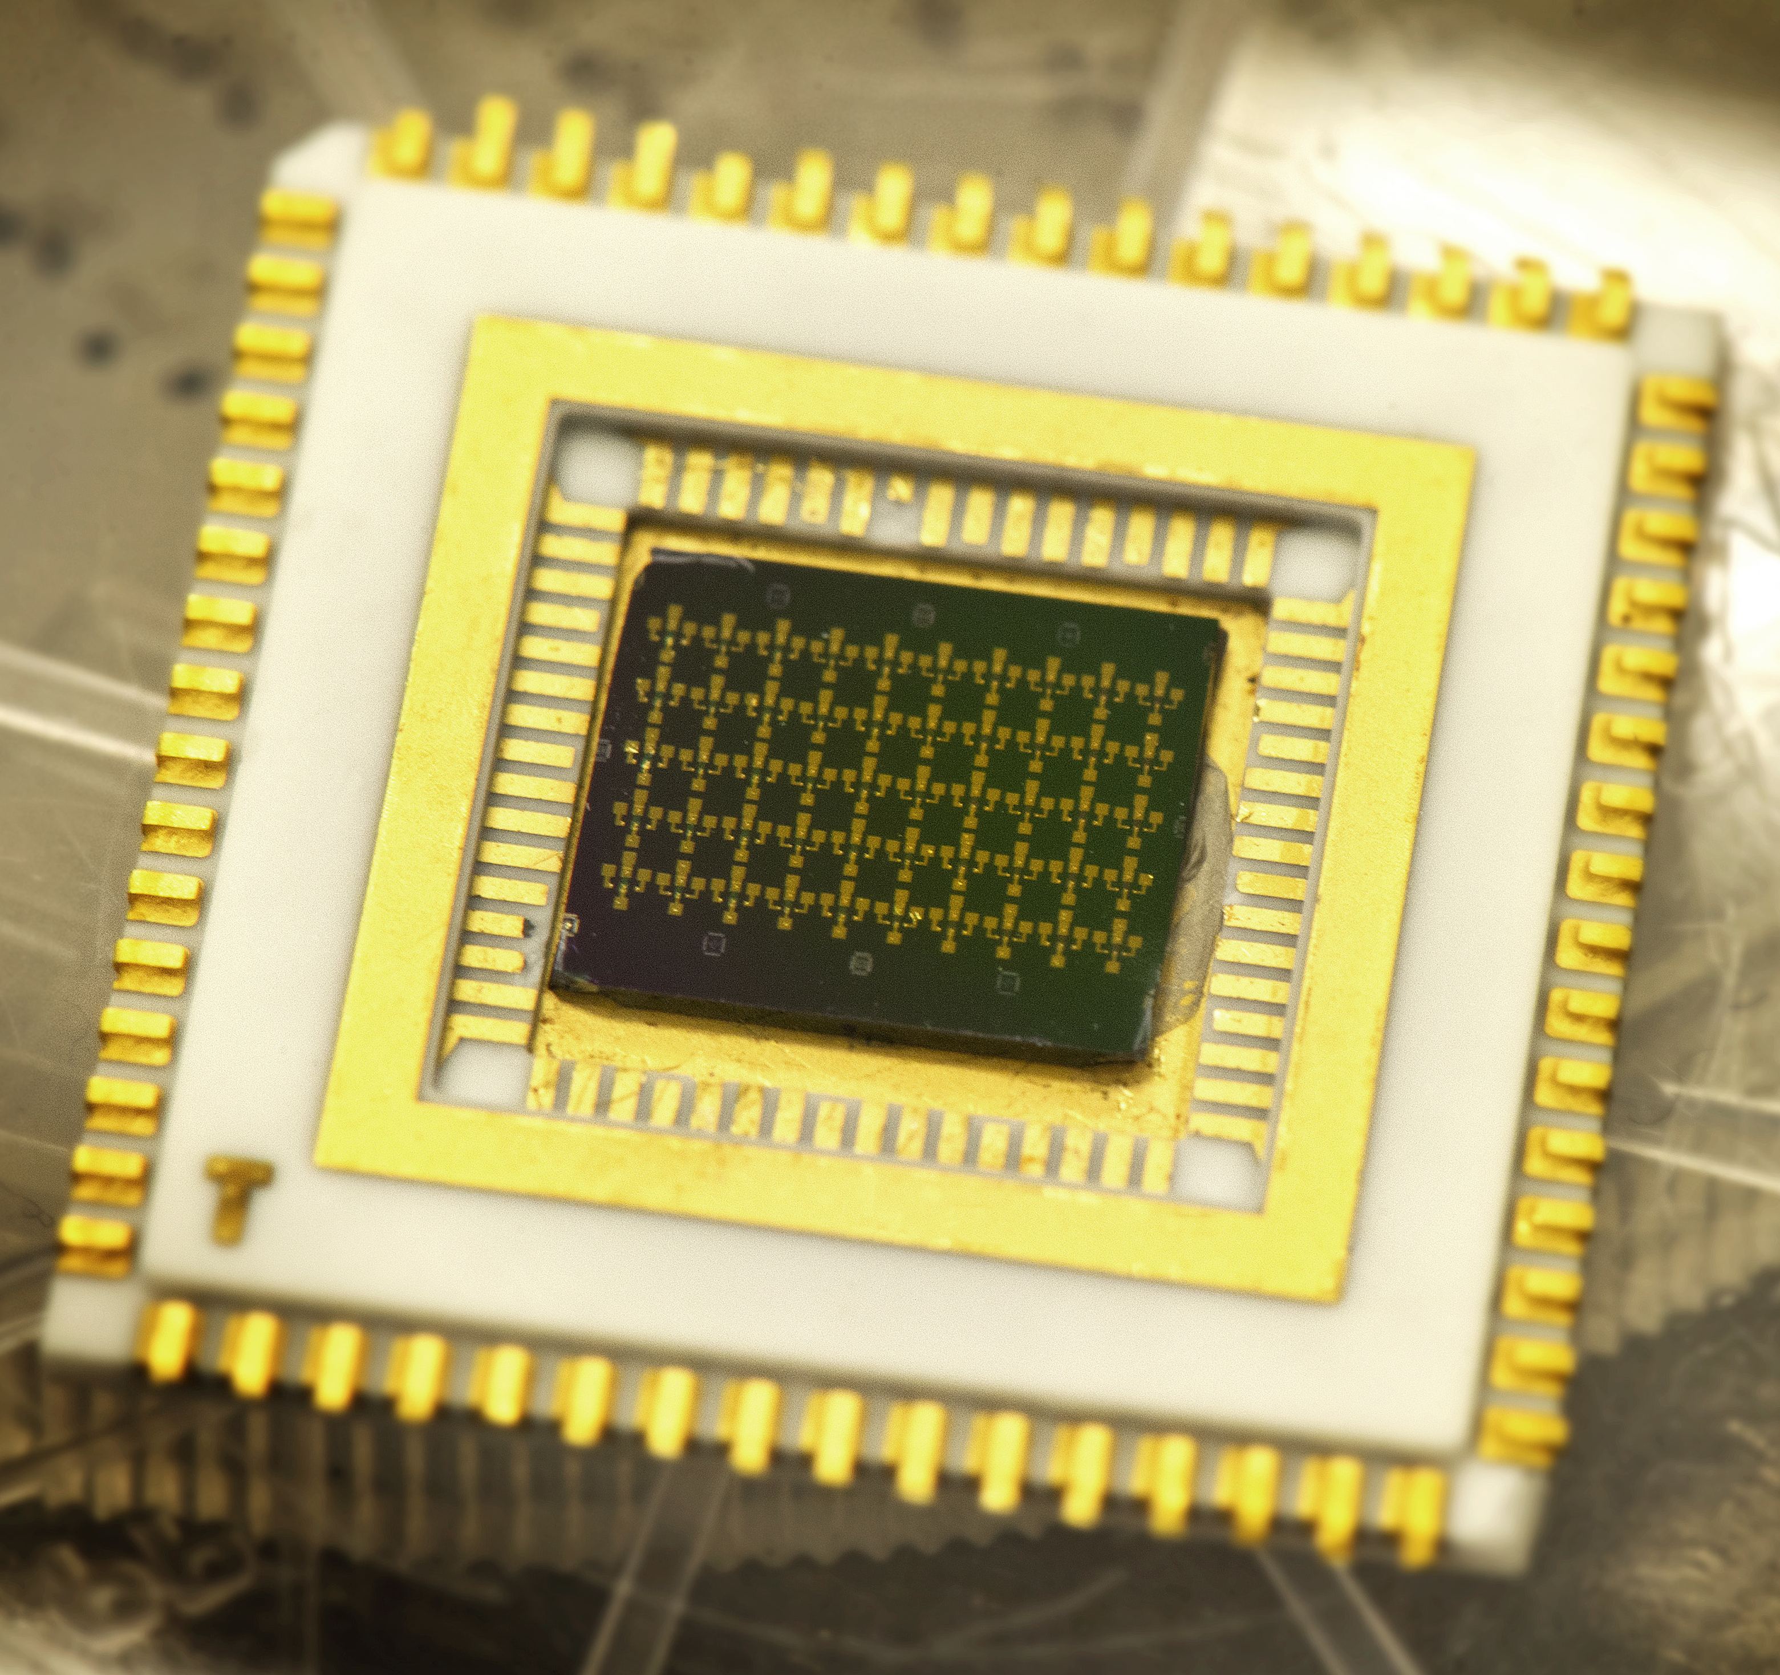
COMBINE THE TWO 2 CONNECT
IoT
Convergence
Community
Collaboration
Components
Connectivity
Arbabian, Stanford (IoT radio-on-a-chip)
KOH, UT Arlington (cold electrons at RT)
KOH●DOI: 10.1038/ncomms5745
ARBABIAN●http://web.stanford.edu/~arbabian/Home/IoT_Radio.html

Slide 9
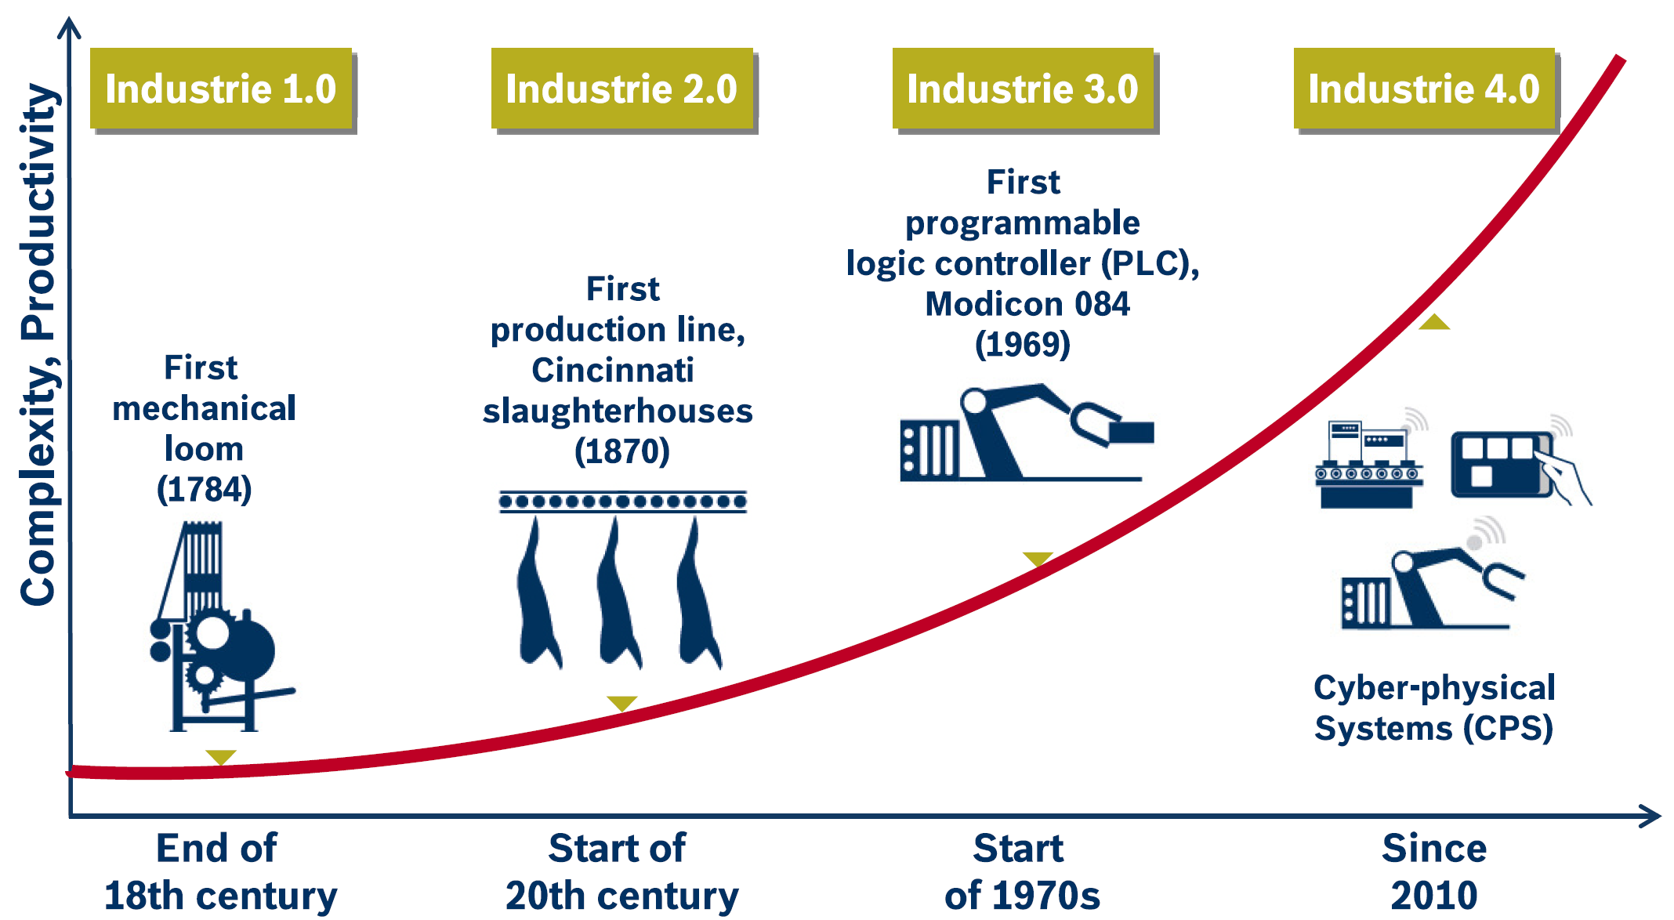
THEN PREPARE FOR THE NEXT REVOLUTION

Slide 10
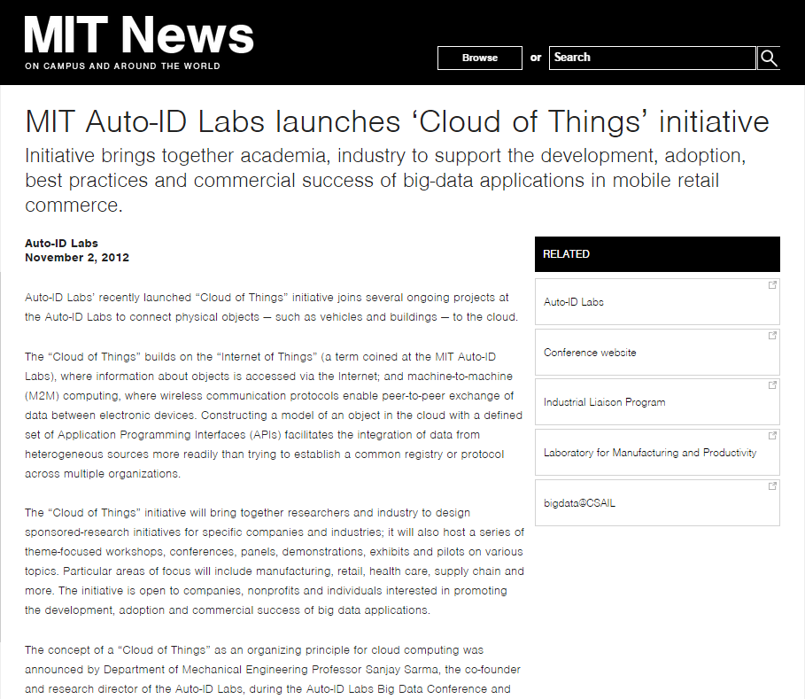

Slide 11
27 March 2014 – 5 members
27 March 2015 – 159 members

Slide 13
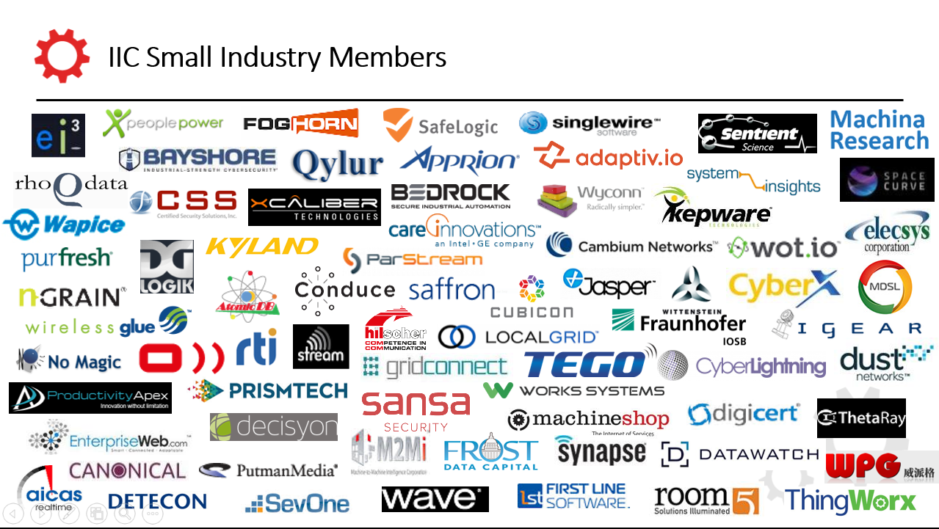

Slide 15
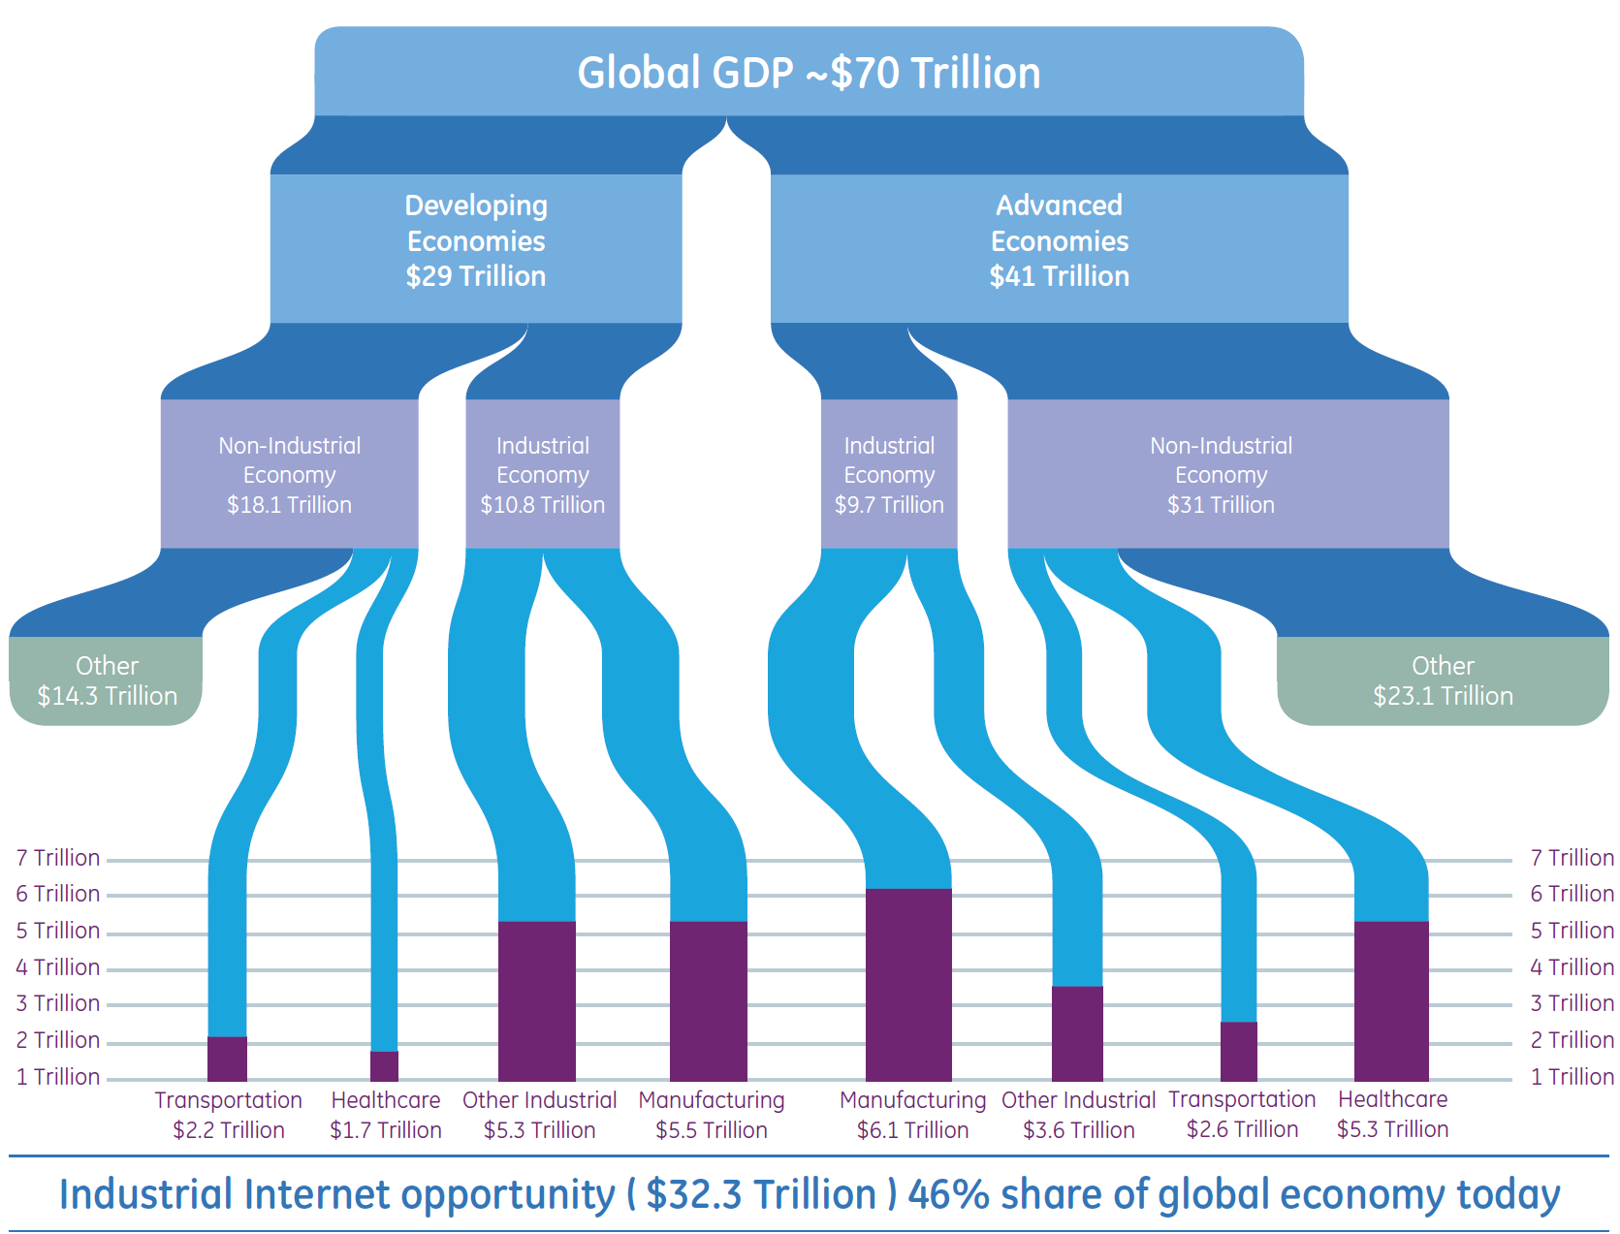
Projected Economic Impact of The Industrial Internet
World Bank, GE

Slide 16
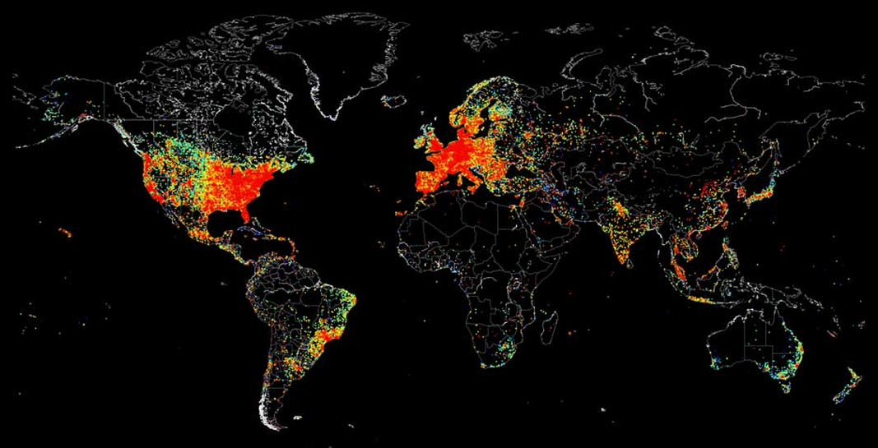
THE NETWORKED PHYSICAL WORLD
Map of every device connected to the internet on the evening of 2 August 2014 (Shodan). John Matherly pinged all IP addresses of devices online on 2 August (11pm UK). It took about 5 hours. Map represents all the devices (red = many) that pinged back in 12 hours using matplotlib.

Slide 17
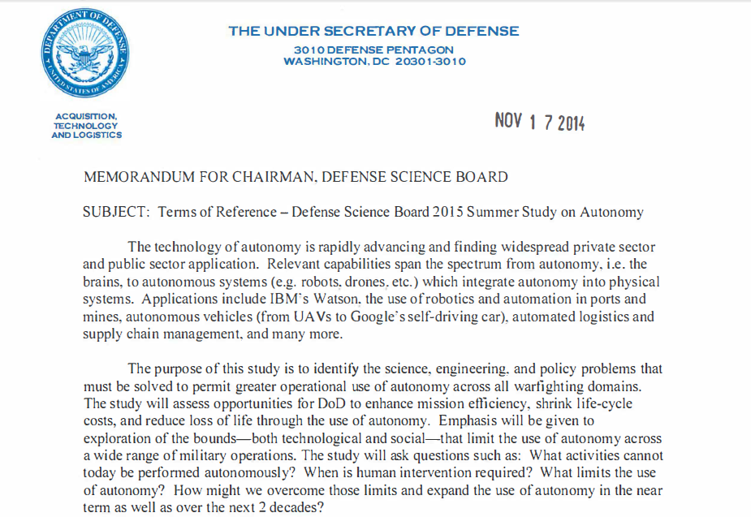

Slide 18
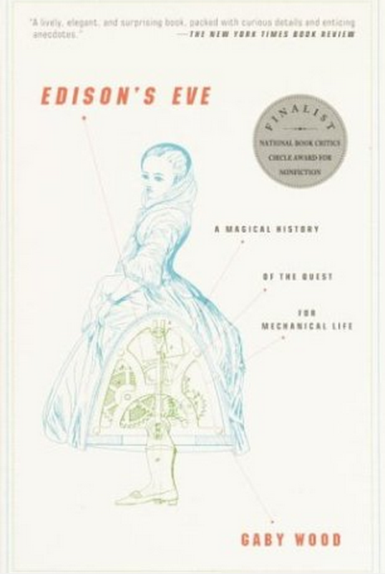
A Brief History of Automaton

Slide 19
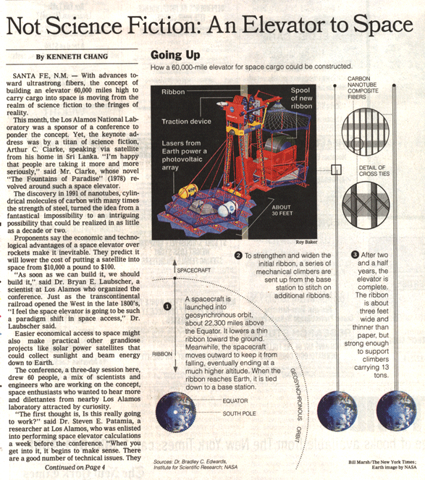
A Brief History of Automaton
“ A Sense of the Future ”

Slide 20
Internet of Systems ● http://bit.ly/MIT-IOT
● Vision, Mission and Opportunities
● IIC Grand Challenges
 Transportation (SDV)
 Smart Cities
 Healthcare
 Data
IoS
https://hbr.org/2014/11/setting-standards-for-the-internet-of-things

Slide 21
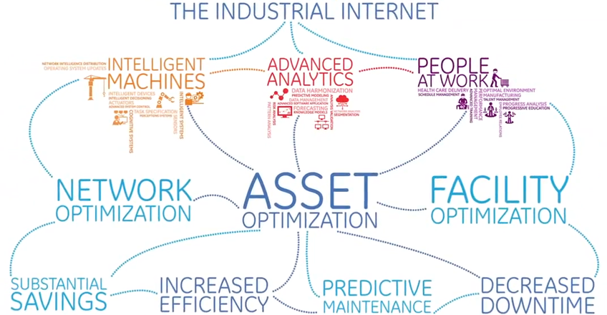

Slide 22
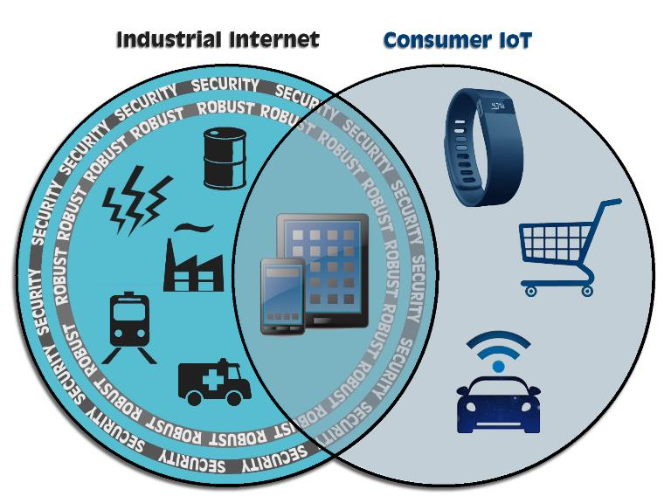
What is the difference?
Industrial Internet
Consumer IoT

Slide 23
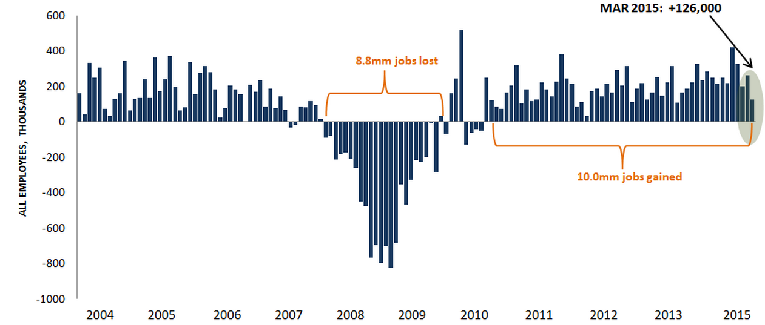
The Holy Grail – Economic Growth and Employment
BLS

Slide 24
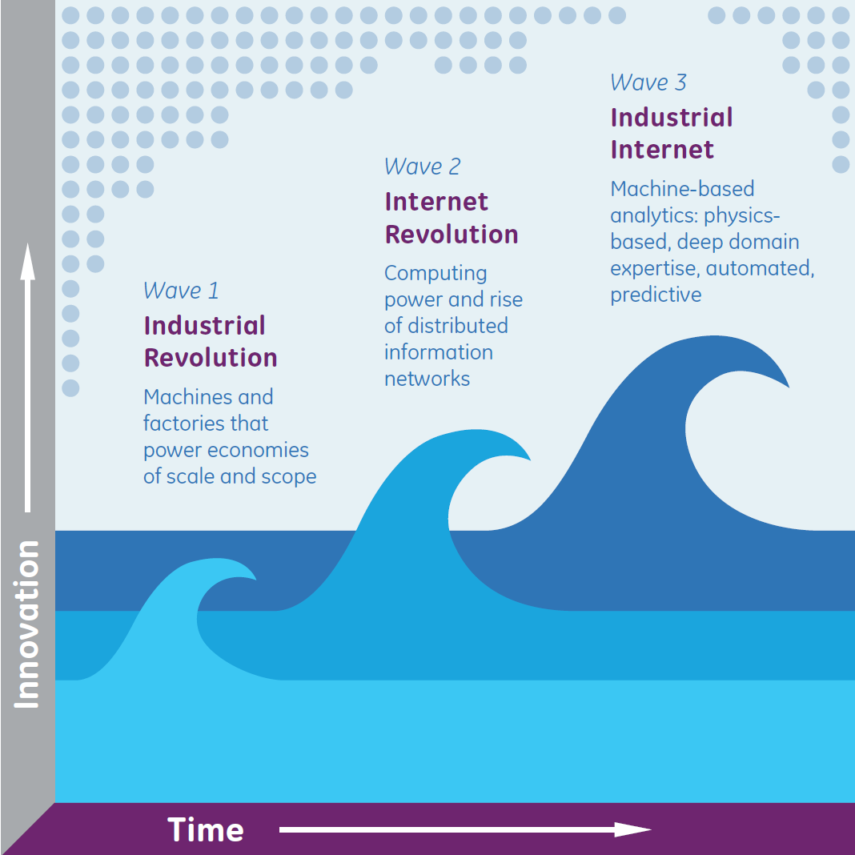
IoS – Sum of Parts – Combination of the Industrial Revolution with the Evolution of the Internet
Dr Peter Closson Evans

