Slide 1

IoS – IIC
DREAM BIG
Dr Shoumen Datta

Slide 2
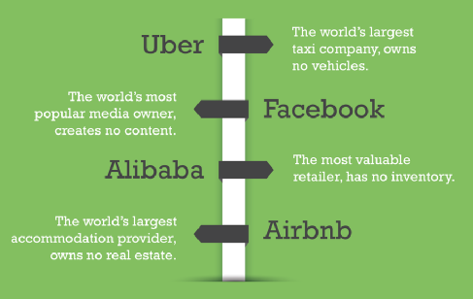
The wealth of nations can’t depend only on castles in the cloud.

Slide 3
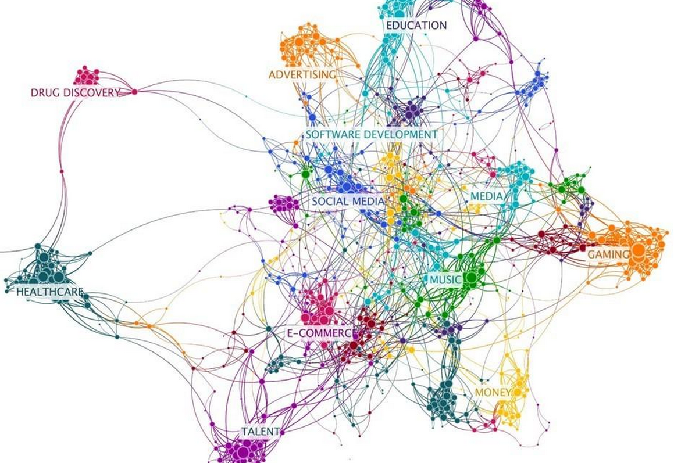
EMERGING
PLATFORM
ECONOMY
Peter Evans

Slide 4
SMART CITIES http://bit.ly/GLOBAL-SIM-CITIES
In progress
TRANSPORTATION http://bit.ly/DOT-DOT-DOT
HEALTHCARE http://bit.ly/HIP-HIP-HIP

Slide 5
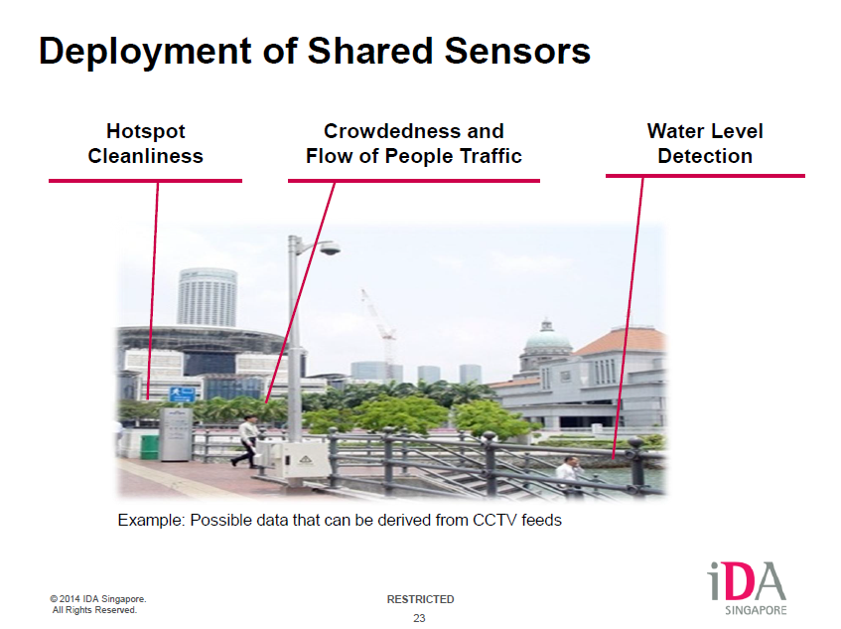
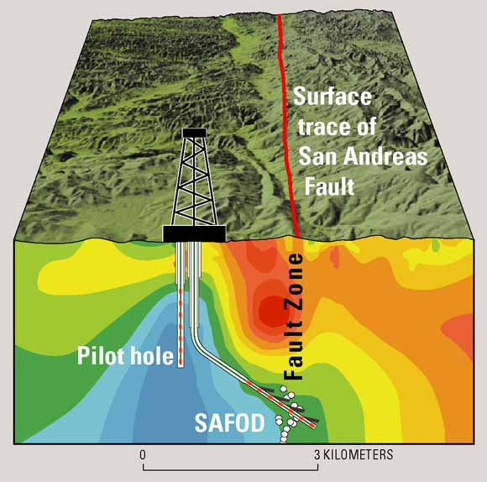
SMART CITIES ● http://bit.ly/GLOBAL-SIM-CITIES
NIST GLOBAL CITIES SUMMIT ● June 1, 2015 ● Washington DC
Seismic and Infrastructure Monitoring
Buildings
Bridges and Roads
Water/Sewer

Slide 6
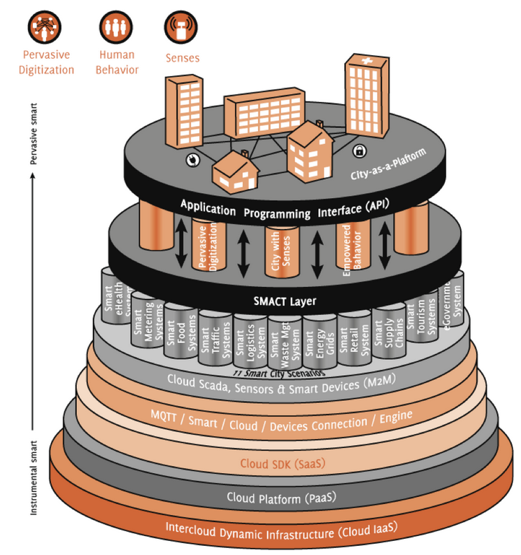
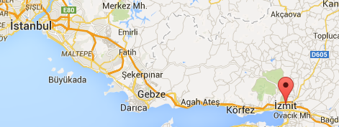
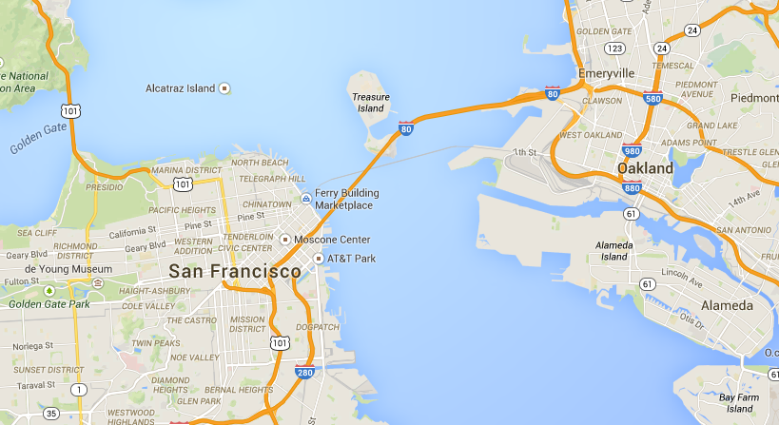
SMART PLATFORMS
CONDITION MONITORING

Slide 7
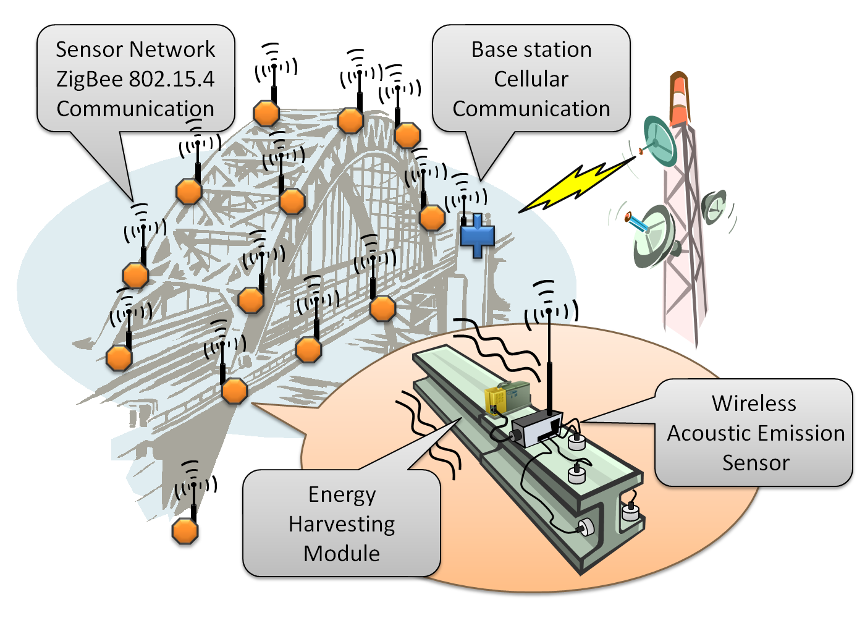
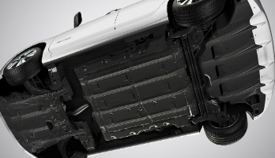
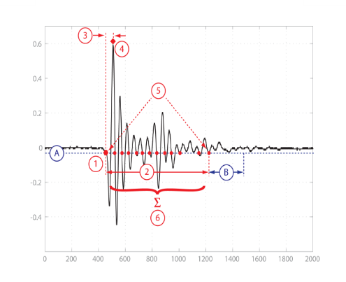
DATA COLLECTION FROM INFRASTRUCTURE – BRIDGES & OTHER MAJOR CRITICAL STRUCTURES
Autonomous vibration (accel-erometers), stress (strain gauges) & cracks (AE sensors) monitoring supported by vibration-based energy harvester
VEHICLE WITH UNDERBODY MONITORS
Peter Volgyesi, Vanderbilt University
sites.google.com/site/marmoteplatform/

Slide 8
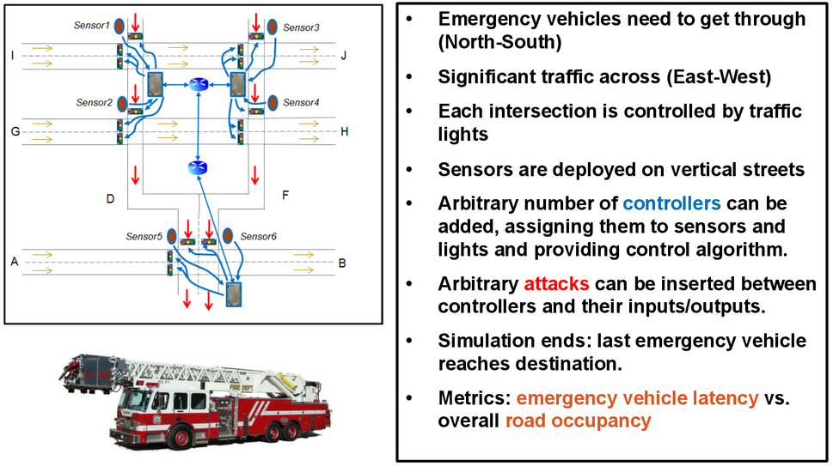
CONNECT DATA and ANALYTICS for EMERGENCY VEHICLE TRAFFIC
Peter Volgeysi, Vanderbilt University

Slide 9
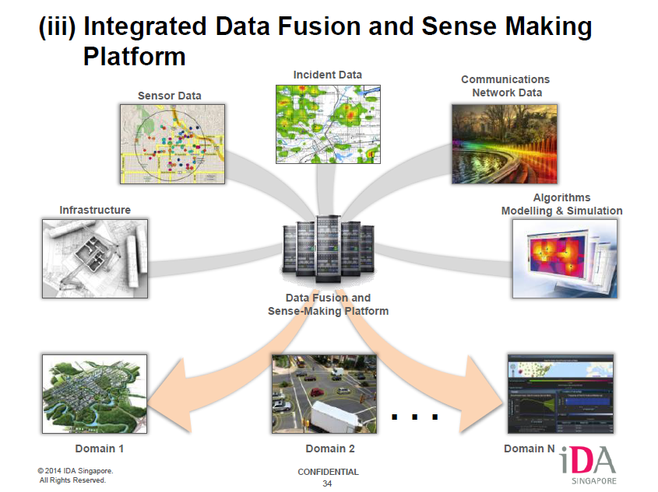
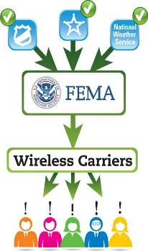
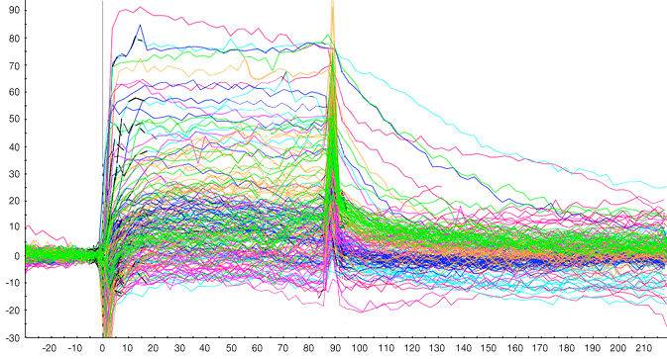
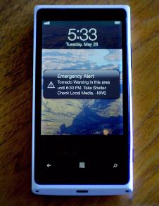
EMERGENCY
MANAGEMENT

Slide 10
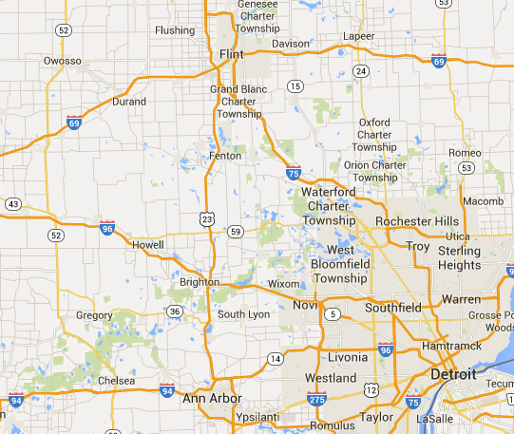
TRANSPORTATION ● http://bit.ly/DOT-DOT-DOT
ENTERPRISE WEB
GALOIS
MSFT
MIT
NI
RTI
TECHMAHINDRA
VANDERBILT UNIVERSITY

Slide 11
OUTLINE OF THE INDUSTRIAL INTERNET CONSORTIIUM PROPOSAL TO DOT
Submitted on March 27, 2015

Slide 12
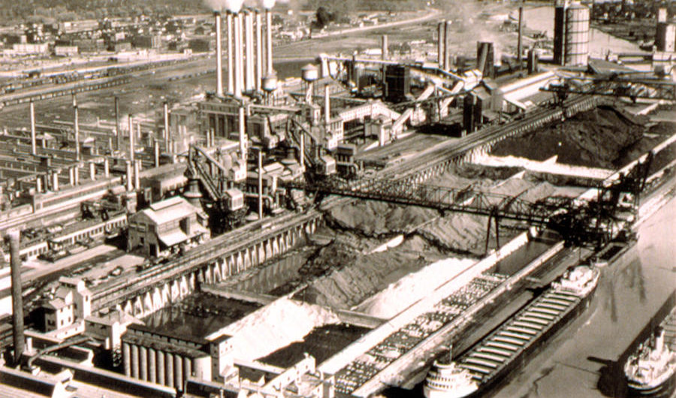
The Transportation Grand Challenege coalition of IIC members and non-members who jointly submitted the proposal to DoT drew inspiration from the Ford Rouge River Plant (1928)
Notes:
In 1917, Henry Ford began construction of the huge Rouge River plant in Dearborn, Michigan. Ford had already proven the fundamental potential of the assembly line concept. However, he knew that the next generation of transportation required an infrastructure that could integrate technologies and scale to meet the exploding challenges of modern automobile manufacturing. When completed in 1928, the Rouge plant was the largest integrated factory in the world. More than any other effort, this plant revolutionized not only transportation, but also manufacturing technology across industries.
We stand today at a similar crossroads. The US DoT needs a new, smart infrastructure for highway systems. Successful initial results with the "CVRIA" system in SE Michigan showed the potential. However, this system is difficult to program, hard to scale, expensive to operate, and unprepared to evolve. Like the Rouge plant, the industry needs a new design capable of leveraging the many critical technologies required by the next generation of transportation.

Slide 13
IIC Transportation Proposal Team
IIC team proposes to develop a scalable, practical, usable next generation connected-vehicle infrastructure and demonstrate it in actual use in Owosso, MI
  Software automation, scalable networking and security are key deliverables
Team:
  Vanderbilt University (tools) Prime Phase 1
  RTI (middleware) Prime Phase 2
  Arada (deployment) Prime Phase 3
  Transformation Network (domain expert)
  Microsoft (Azure cloud)
  Verisign (certificate provisioning)
  Galois (security arch review, testing)
  Enterprise Web (provisioning)
  MIT (traffic control, autonomy)
  Tech Mahindra (operations)
  NI (engineering software & roadside equipment)
  Cyber Lightning (visualization)
  Parstream (analytics)
  SiriusXM (connectivity)
US DoT Connected Vehicle Reference
Implementation Architecture (CVRIA)

Slide 14
Team Structure by Architectural Emphasis
Project Management Support
C3/Consulting
Security
RTI
VeriSign
Galois
Connected Vehicle Applications
Transformation Network
Safety
MIT
Application Framework
Vanderbilt
Connectivity Platform
RTI
Device Platform
Arada
Cloud Platform
Microsoft

Slide 15
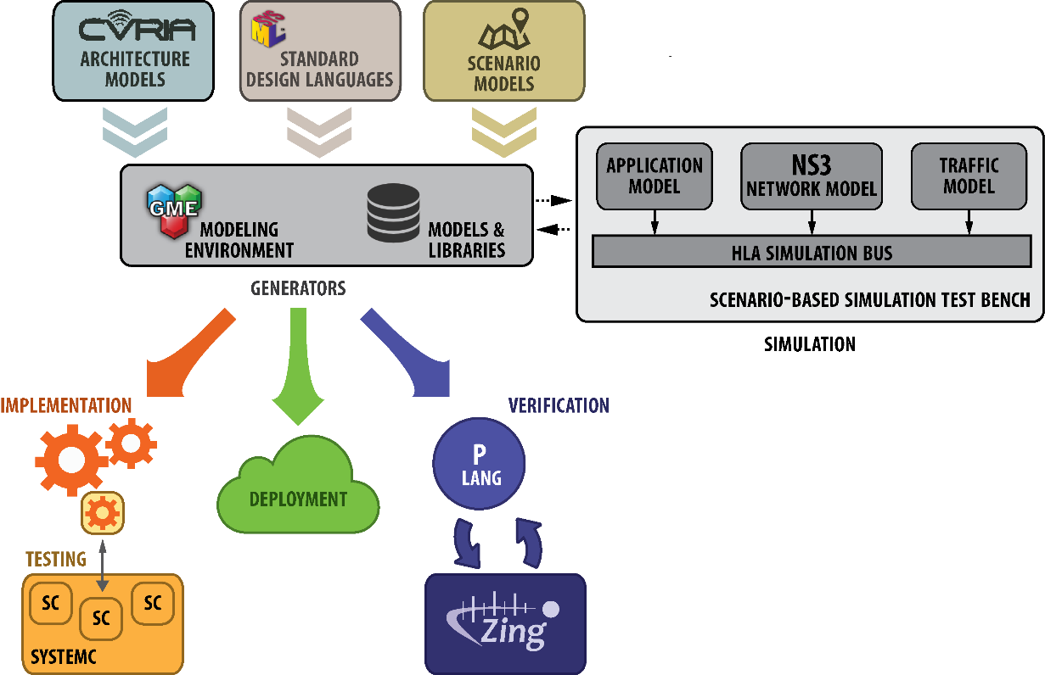

Domain-Specific Modeling Languages

Slide 16








Standard Connectivity Platform
Cloud
Shared Global Data Space
Signalized Intersection
Driver Information
Vehicle Status
Vehicles
Driver Info
DDS DataBus
Roadside Equipment
Notes:
The DDS 100% open standard implements a shared DataBus that links any language, device, or transport. It understands data types and communicates them to all participants. It scales across millions of data paths, enforces millisecond timing, ensures reliability, supports redundancy, and selectively filters information. Each path can be unicast, multicast, open data, or fully secure.

Slide 17
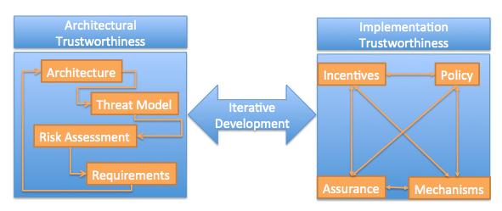
Security Analysis

Slide 18
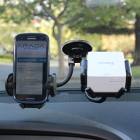

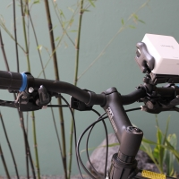
Deployment
DAVID ACTON
Board Member and Chief Engineer of OnStar
GM’s global telematics and ITS planning and deployment
Chief Electrical Engineer of Cadillac
Director of Electrical Engineering for GM North America
2004 SAE Delco Electronics ITS Award for invention, design leadership, deployment, and operation.
First deployment of 5.9GHz DSRC technology
Founding member of the VII Working Group, which set the direction for V2X systems in the United States.

Slide 19

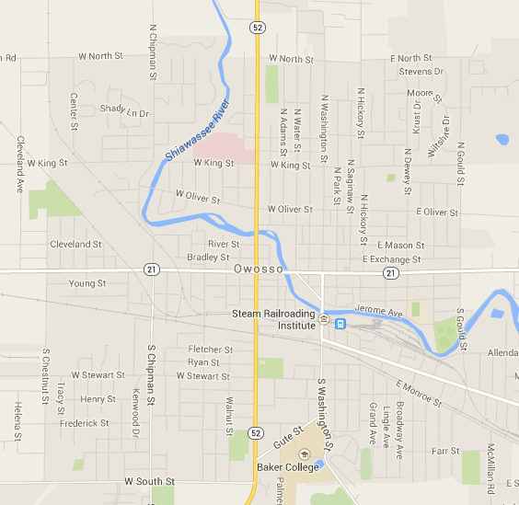
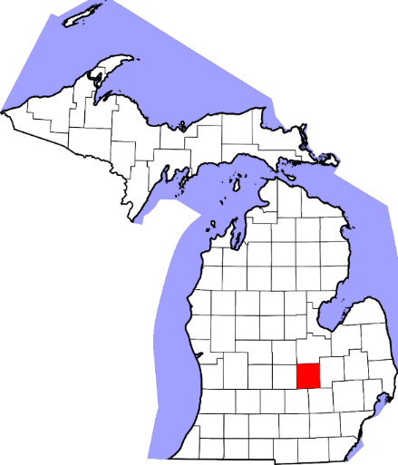
Deployment Location: Owosso, MI
Size: 4,000 vehicles
  Big enough for proof of concept
  Small enough to manage systems
Citizens Involved
  Populace, Mayor, City Council, Public Safety Officer, Traffic Engineer, County Road Commissioner & autonomous vehicle related program in public schools
Adjacent to US DoT South East Michigan testbed
Notes:
Owosso, MI is the perfect testbed. Owosso is big enough to find problems and tease out bugs, yet small and cooperative enough to iterate rapidly. We will have full cooperation of the populace, Mayor, City Council, City staff including the Public Safety Officer, the Traffic Engineer and the County road commissioner, including permission to instrument all problem spots and at least 4000 vehicles.
In addition, there will be School Board and Owosso Public Schools involvement. Owosso was the first school district in the US to offer a systems engineering class based on V2X technology deployment using 1/10 scale vehicles to demonstrate use cases to the general public. Their efforts were so remarkable that they were invited to showcase and demonstrate their accomplishments at the 2010 SAE World Congress.

Slide 20
US DoT Proposal
Award Decision Aug-Sep 2015

Slide 21
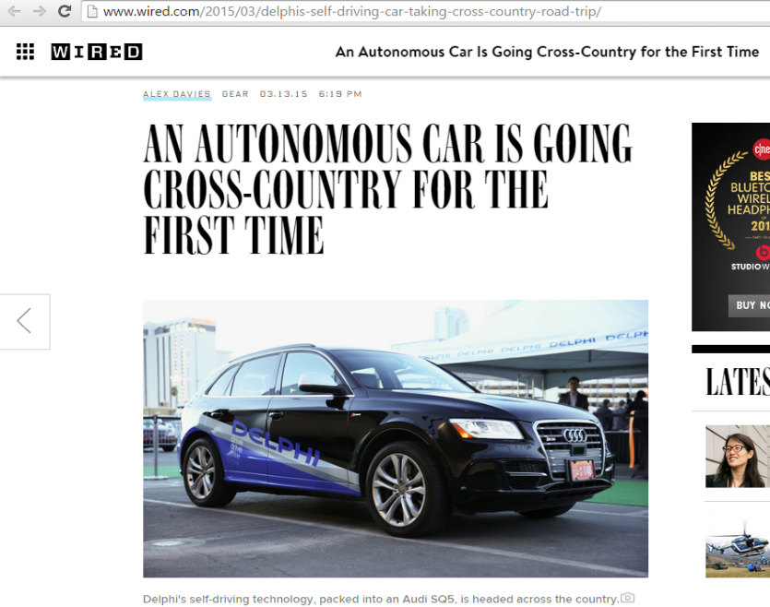
TRANSPORTATION ● http://bit.ly/DOT-DOT-DOT
Arrives in New York today April 2, 2015
S Semi
A Autonomous
F Freight
T Transportation
I Initiative
MARCH 22, 2015

Slide 22
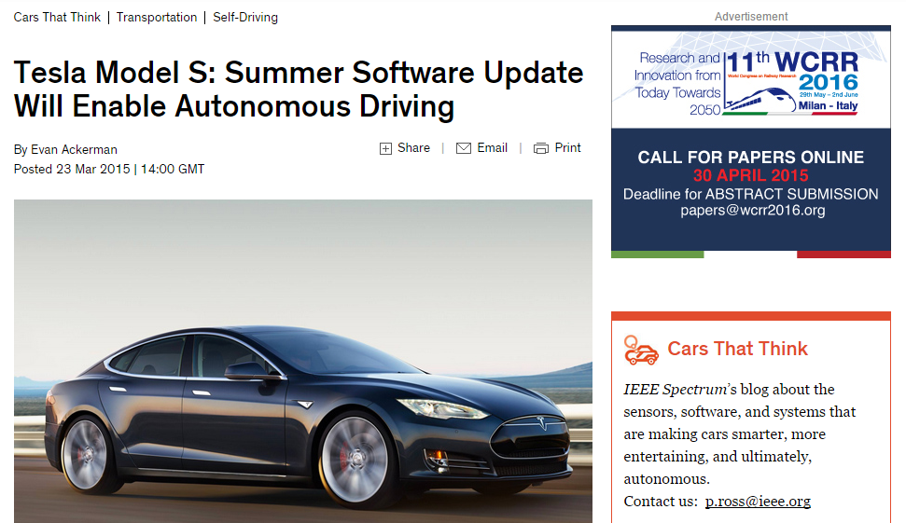
What we are thinking – SDV – Software Defined Vehicles
UBIQUITOUS DRIVING FUNCTION
Drive to Anywhere
Drive from Everywhere

Slide 23
UBIQUITOUS DRIVING FUNCTION
Drive to Anywhere
Drive from Everywhere
Potential partners - a “wish list” based on preliminary conversations:
Intel US Department of Transportation
National Instruments Massachusetts Institute of Technology
Ottomatika Carnegie Mellon University
Ford Instituto de Biomecánica de Valencia
Jaguar-Land-Rover Loughborough University
Navistar Arada Systems
TechMahindra Delphi
Caterpillar Bosch

Slide 24
What we are thinking – Precision Farming Test Bed
IoT and IIoT in agriculture is a part of the broad fabric of the Smarter Planet movement which catalyzed the “farm to fork” and “seed to mouth” scenarios. Major farm equipment manufacturers are leading the charge in this domain by introducing sophisticated data communication with farming equipment (eg John Deere). In this new attempt, we may also include NASA SMAP data.
Precision Farming attempts to synthesize the data relevant to users (farmers) in an accessible visualization template which can connect to or may be in addition to on-board data and analytics.
For a preview, please explore “Internet of Systems” under the Smart Cities section – see page 3 (please download the PDF which is at the bottom of the list here http://bit.ly/MIT-IOT)
Would you like to join this coalition and contribute to the precision farming test bed initiative?
US Department of Agriculture - NIFA ● September 30, 2015 ● Funding $116M
http://bit.ly/PRECISION-FARMING ● http://smap.jpl.nasa.gov/

Slide 25
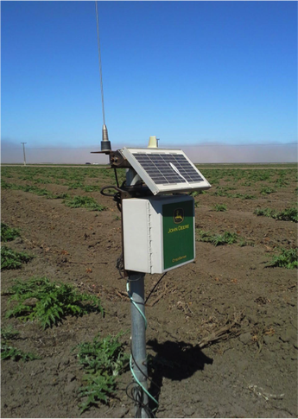
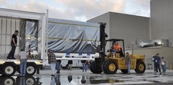
Grand Challenge ▪ Convergence of ecosystem of inter-dependent systems
The potential convergence of
Precision Farming ecosystem
- Seed to Mouth (S2M)
- Farm to Fork (F2F)
with other ecosystems, such as:
- Smart Cities
- Autonomous Transportation
and operations management for trusted and secure supply chain network of partners. Compliance with SOX-409 type regulations and DHS e-manifest
are a part of this scenario.
Additional links to energy and environmental systems are also obvious. Food safety, security, nutrition, availability and consumption are inextricably linked with global health, malnutrition, infant mortality and healthcare, in general.
Farming in California alone is a $50 billion industry
Retail Supply Chain – Sourcing / Distribution / Warehouse / Transportation
Track & Trace – Commodity Traders – Risk Management – Regulators (FDA)
SALES
DATA
Agro-Machine Manufacturer
Supply
Real-Time Precision Farming PLATFORM
Seed
Pesticide
Fertilizer
-Measure, understand and apply
-Impact of data on quality & yield
-Weather data
-GPS micro-localization data
-Soil chemistry (GCMS) specifics
-Seed (sterile unless cultivated)
-Fertilizers (catalytic vs toxicity)
-Protection (pesticide, herbicide)
-Storage, shelf-life and waste
-Country of origin - goods supply
Leverage data to run long and short term simulations to plan for “what if” to optimize profit
- Weather patterns
- Demand uncertainty
- Export and import
- Tariff, cost, excise
- Regulatory policy
Field Connect Sensors
John Deere
▪ Optimize MRO to improve asset uptime
▪ Mobile data collection and dissemination
soil sample / nutrient analysis (GCMS)
moisture monitors / field connect data
temperature / dielectric constant
color and chemistry of crops
growth rate / fertilizer distribution
weather micro-impact / acidity-alkalinity
NASA Soil Moisture Active Passive (SMAP)

Slide 26
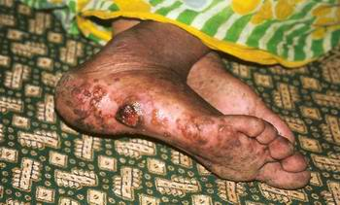
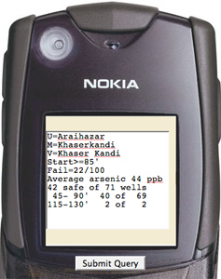
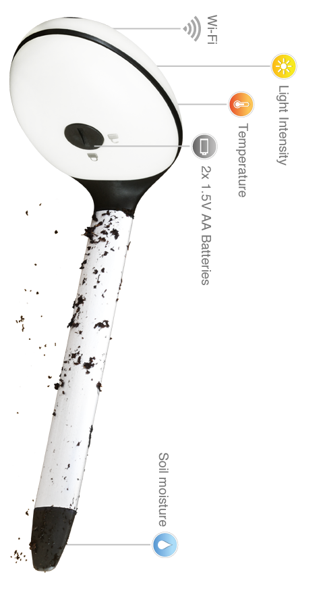
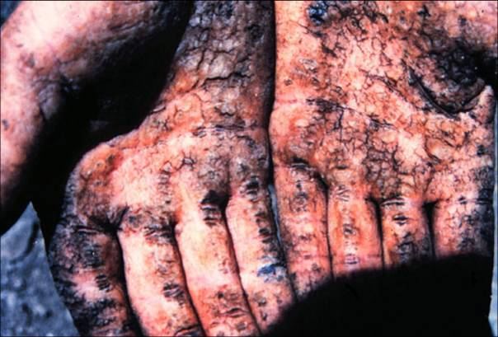
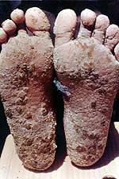
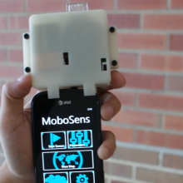
Socio-economic Impact of IoS – Arsenic in Water in Bangladesh

Slide 27

HEALTHCARE http://bit.ly/HIP-HIP-HIP
Grand Challenge Healthcare – it is about convergence – http://bit.ly/NEURO-QWERTY
It is an umbrella term for healthcare test beds
HIP - abbreviation for Healthcare Integrated Platforms – www.openice.info
Concept for healthcare test beds related to data integration – www.mdpnp.org
GCH may include HIP test bed(s) such as ICE as well as other test beds for –
Device and Imaging
Data and Analytics
Precision Medicine
Wearables
How to use MDPnP ● ICE test bed at MGH-HMS

Slide 28
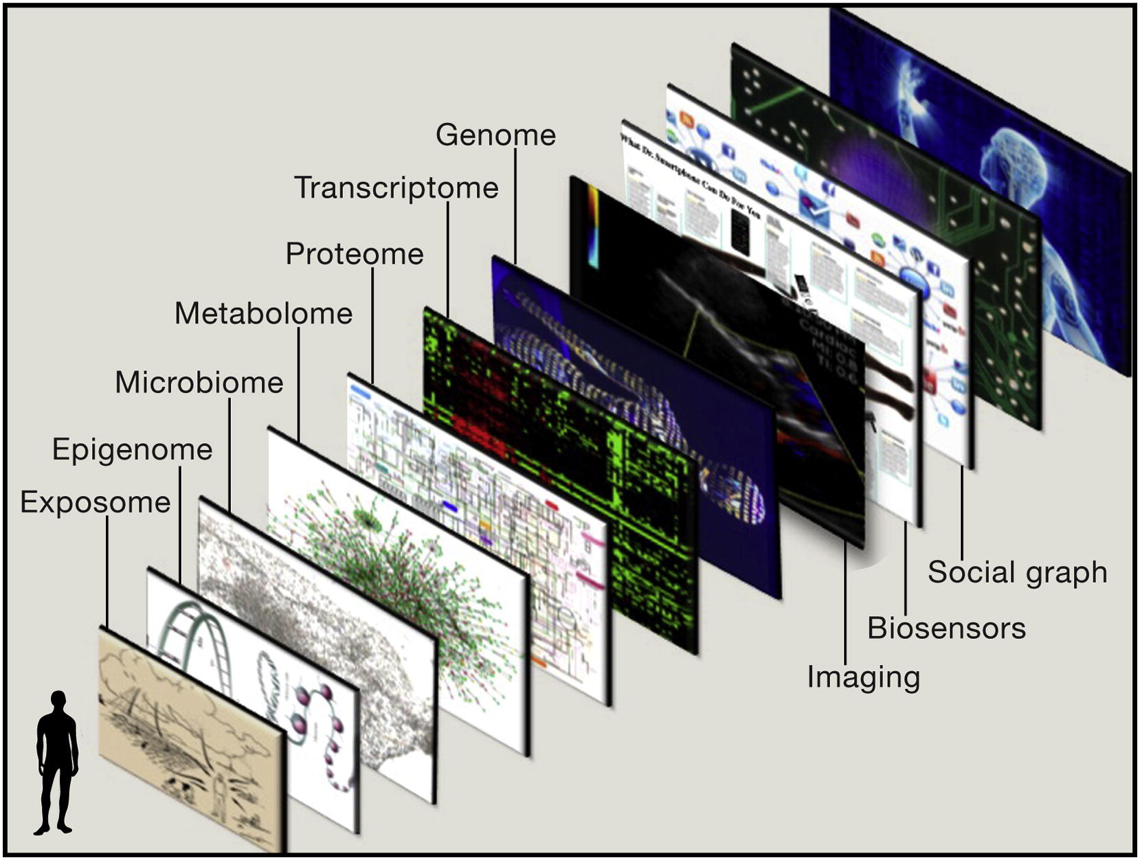
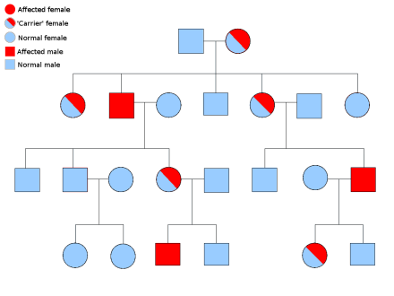
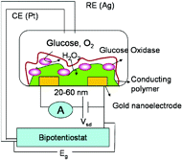
Human Genomics in the IoT era - Is your genome connected to mine?
Glucose
NanoSensor
NanoRadio
Mendelian Inheritance in Man: A Catalog of Human Genes and Genetic Disorders by Victor A. McKusick
Cell 157 241-253 (2014)

Slide 29
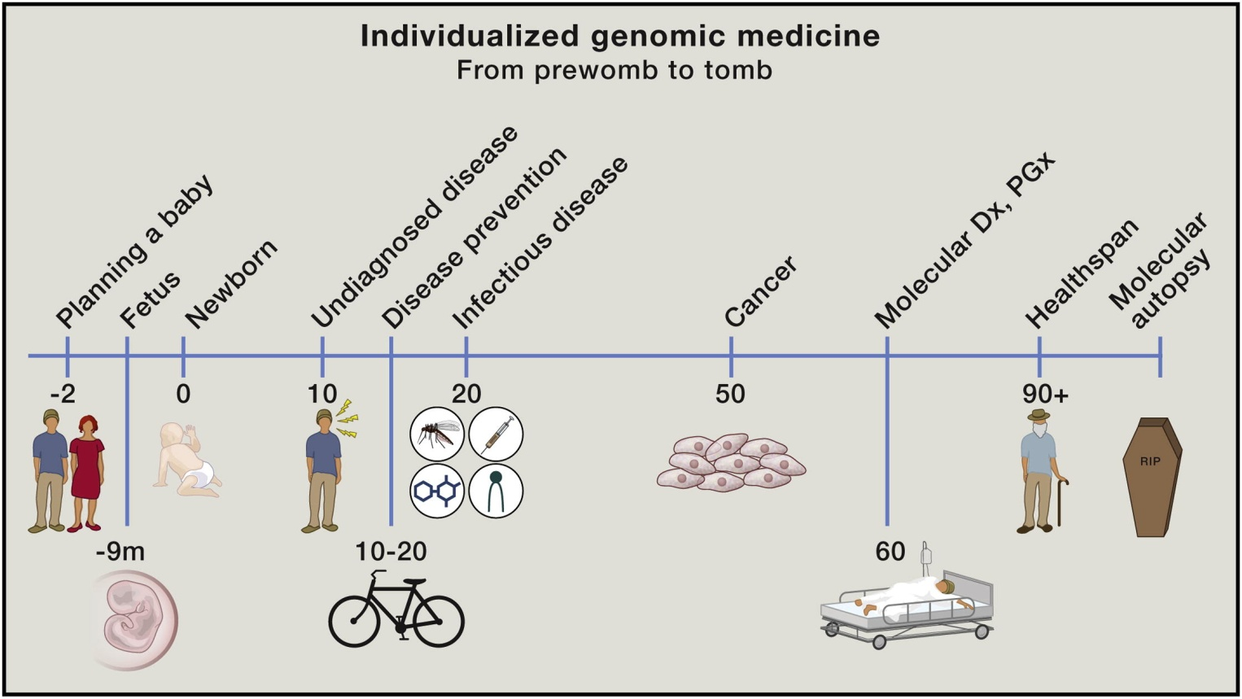
Human Genomics in Precision Medicine
Cell 157 241-253 (2014)

Slide 30
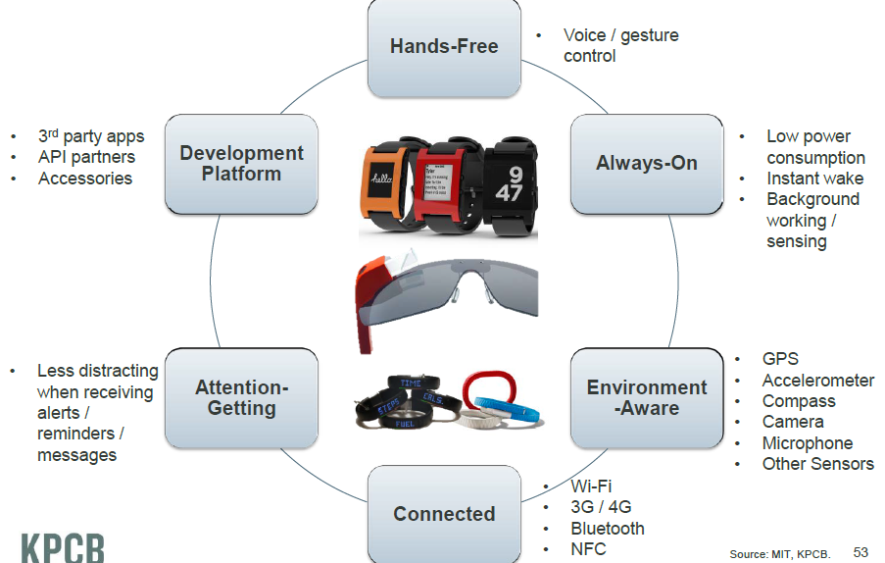
Sensor enabled wearables - appropriate attributes may improve prevention, prediction and protection
MIT

Slide 31
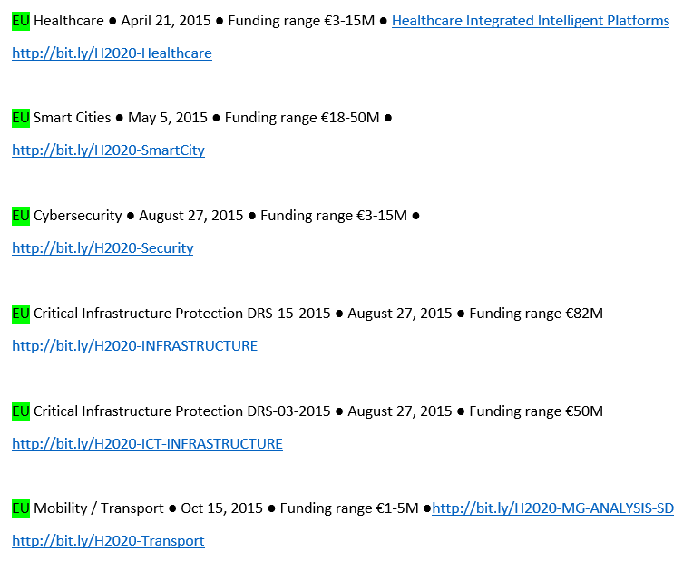
http://bit.ly/OPPORTUNITIES

Slide 32
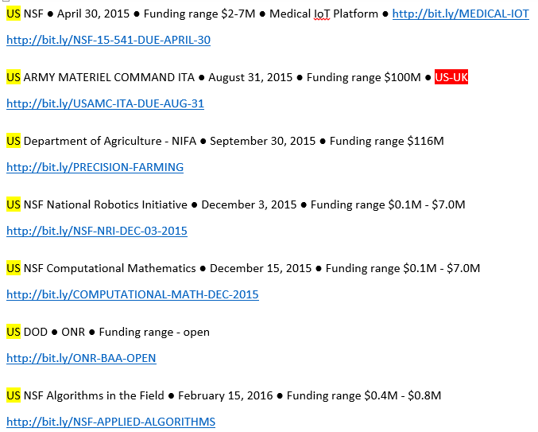
http://bit.ly/OPPORTUNITIES

Slide 33
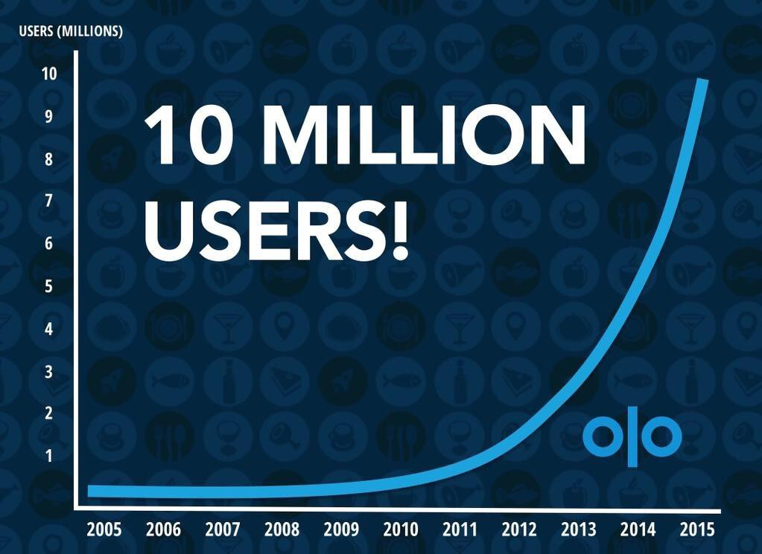
Olo hit 10 million users on April 2, 2015. It took 2,229 days to get the 1st million. 47 days to get to the last
But was the Newton a failure? The timing of Newton’s entry into the handheld market was akin to the timing of the Apple II into the desktop market. It was a market-creating, disruptive product targeted at an undefinable set of users whose needs were unknown to either themselves or Apple. On that basis, Newton’s sales should have been a pleasant surprise to Apple’s executives: It outsold the Apple II in its first two years by a factor of more than three to one. But while selling 43,000 units was viewed as an IPO-qualifying triumph in the smaller Apple of 1979, selling 140,000 Newtons was viewed as a failure in the giant Apple of 1994.
http://bit.ly/INNOVATORS-DILEMMA

