Slide 1
Internet of Systems
From Things to System of Things – Internet of Things evolves to Internet of Systems
Dr Shoumen Datta

Slide 2
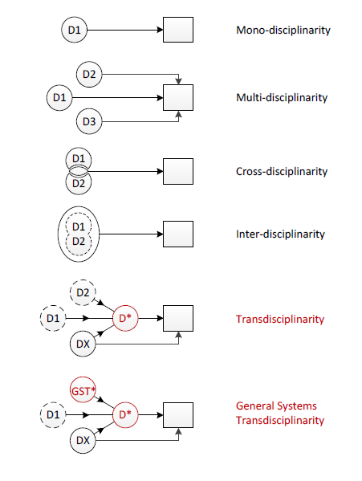
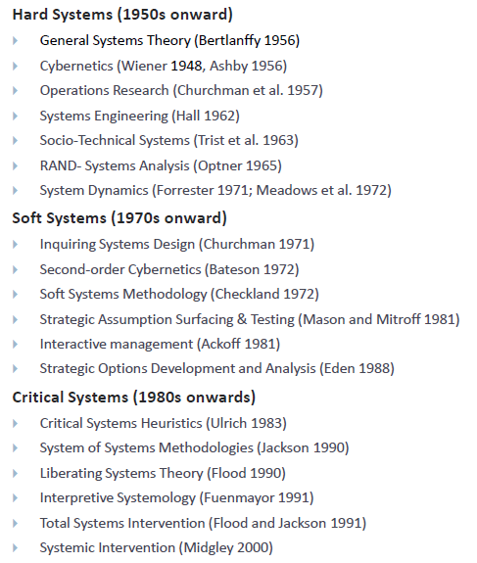
System of Systems ● Transdisciplinarity

Slide 3
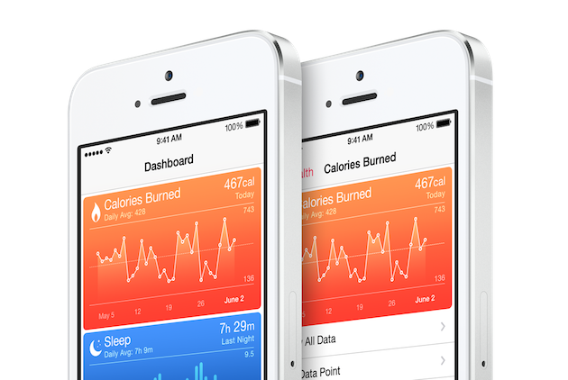
What are we connecting? At a granular level – bits to atoms
SYSTEMS
● Manufacturing Systems
● Transportation Systems
● Cyberphysical Systems
● Health Care Systems
● Emergency Systems
● Financial Systems
● Supply Chains
● Security
Internet of Systems, therefore, is a convergence of system
of systems from a systems engineering perspective along
with CPS, IoT, WoT, IoE, industrial internet (IIoT) applications

Slide 4
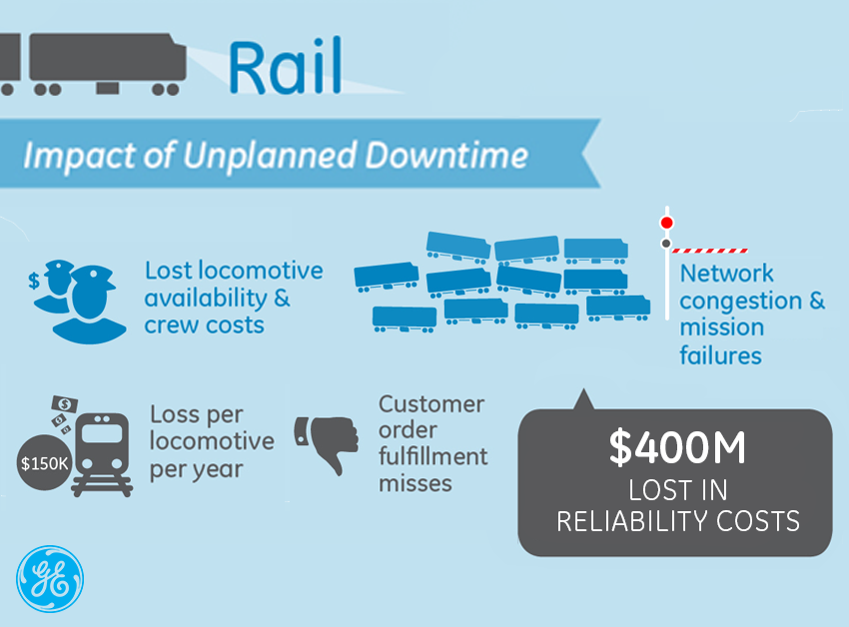
What is the value of connectivity? Savings/gain $400 million

Slide 5
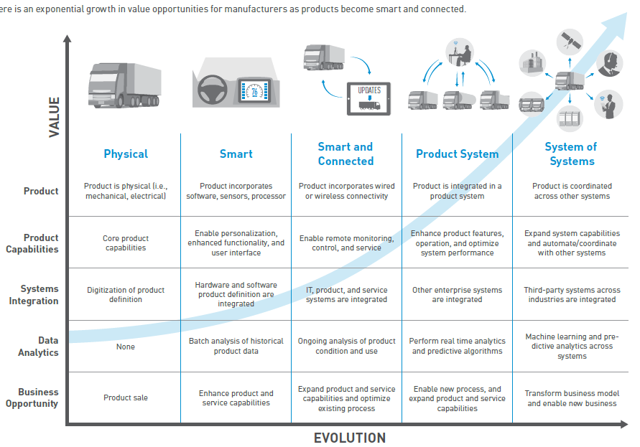
Exponential Growth in Value by Connecting System of Systems – Internet of Systems
PTC.COM

Slide 6
Systems Science
Chaos theory
Complex systems
Complex system
Cybernetics
  Biocybernetics
  Engineering cybernetics
  Management cybernetics
  Medical cybernetics
  New Cybernetics
  Second-order cybernetics
Control theory
  Affect control theory
  Control engineering
  Control systems
  Dynamical systems
  Perceptual control theory
Operations research
Systems biology
  Computational systems biology
  Synthetic biology
  Systems immunology
  Systems neuroscience
System dynamics
  Social dynamics
Systems ecology
  Ecosystem ecology
Systems engineering
  Biological systems engineering
  Earth systems engineering and management
  Enterprise systems engineering
  Systems analysis
Systems theory in anthropology
Systems psychology
  Ergonomics
  Family systems theory
  Systemic therapy
Systems theory
  Biochemical systems theory
  Ecological systems theory
  Developmental systems theory
  General systems theory
  Living systems theory
  LTI system theory
  Sociotechnical systems theory
  Mathematical system theory
  World-systems theory
Systems theory in sociology
  Talcott Parsons
  John N. Warfield
  Niklas Luhmann
Etc
IoS

Slide 7


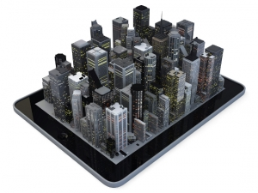

System of Systems ● Transdisciplinarity
Transportation
Energy
Smart Cities
Healthcare
IoS
Grand Challenges
I simply collect, connect, converge and suggest potential confluence. It may be akin to seeing old ideas with new eyes ▪ Shoumen Datta

Slide 8

Transportation
Energy
OS
Smart Cities
Healthcare
Grand Platforms
From Things to System of Things – Internet of Things evolves to Internet of Systems

Slide 9
P
L
A
T
F
O
R
M
S
www.economist.com/news/special-report/21593583-proliferating-digital-platforms-will-be-heart-tomorrows-economy-and-even
Notes:
http://www.economist.com/news/special-report/21593583-proliferating-digital-platforms-will-be-heart-tomorrows-economy-and-even

Slide 10
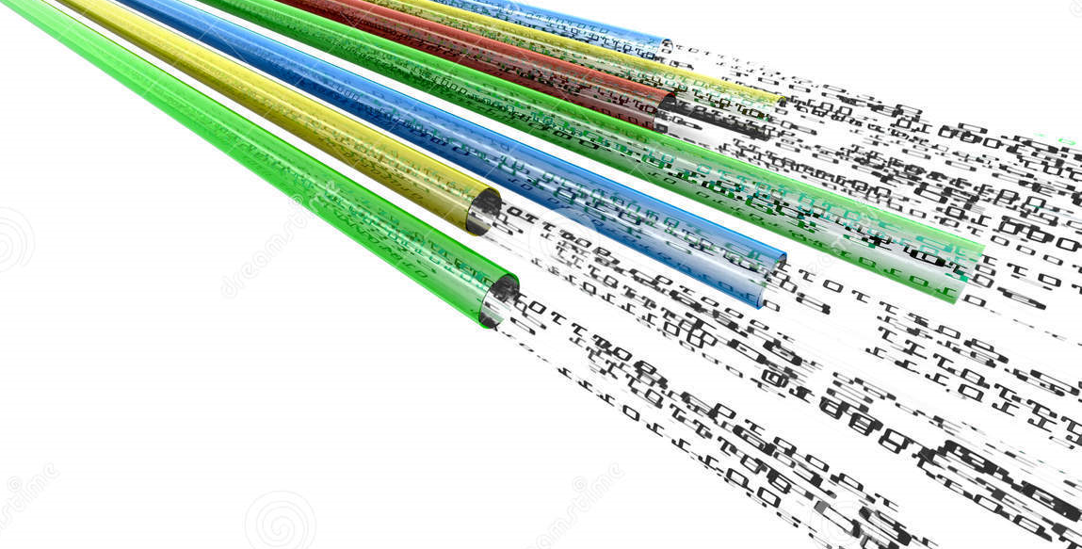

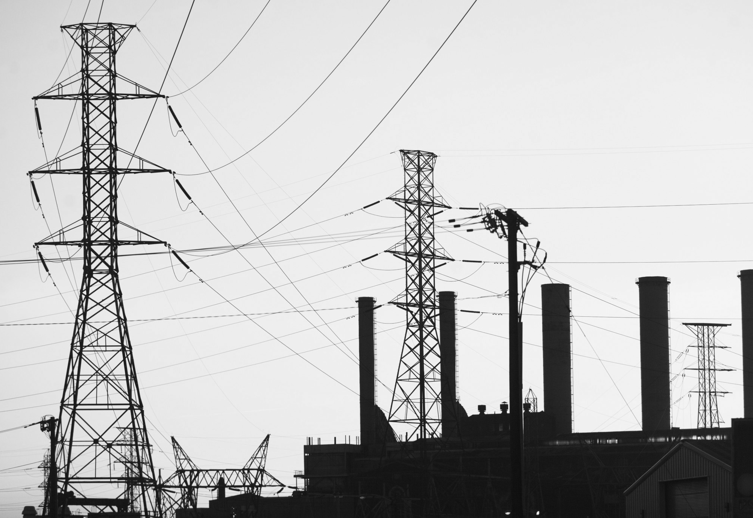

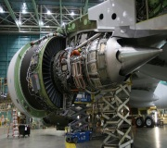
SMARTER PLANET
INTERNET OF SYSTEMS
IoT CONSUMERS
Industry Specific Smart Solutions
Smart Infrastructure services
Predix
IBM
SAP
Analytical Output / Push-Pull Dynamic GUI / Pay-Per-Use Platforms
Analytics Association Agents / Analytical Processing Ensembles
Analytical App Store/ Analytical Engine Component / Module
Apps / User Interfaces
API / Interoperability
Atoms to Bits / M2M
DaaS
Security ● Cyber-security + Physical Security Remote Management
Dr Ahmed El Adl

Slide 11
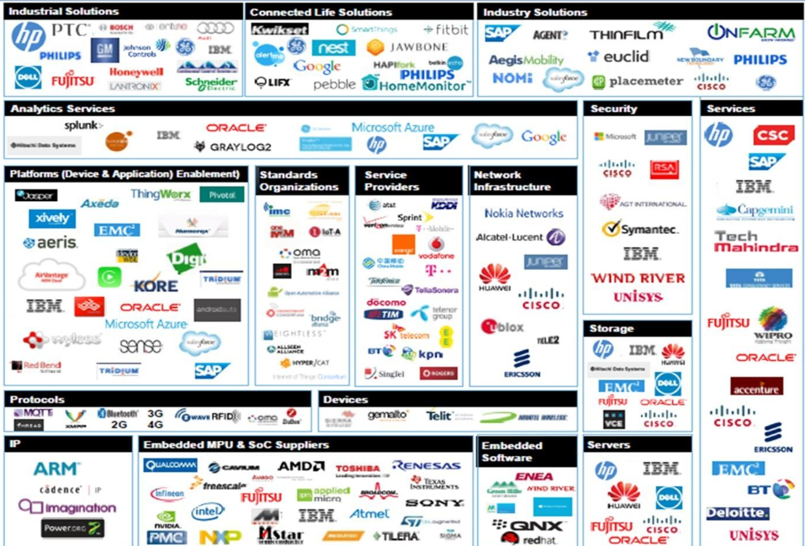
IoS ● Business Ecosystem ● http://bit.ly/MIT-IOT
IDC

Slide 12
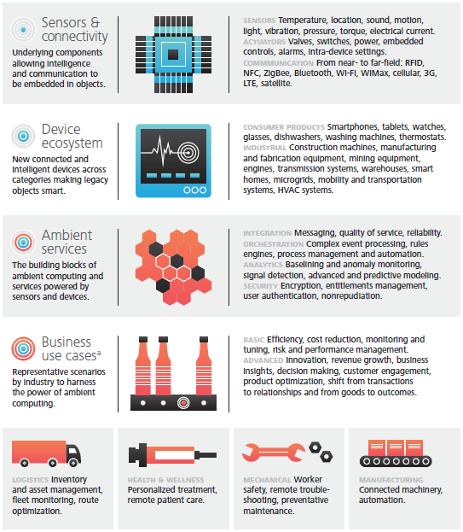
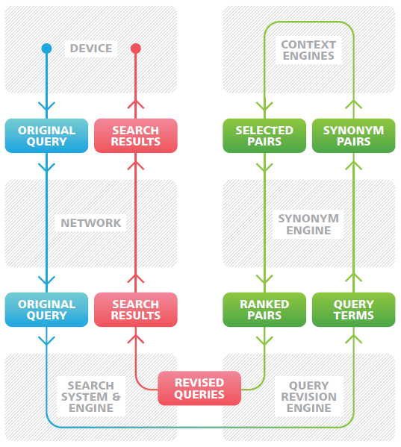
Internet of Systems ● Functional Ecosystem
Deloitte Cartoon
www.google.com/patents/US8538984

Slide 13
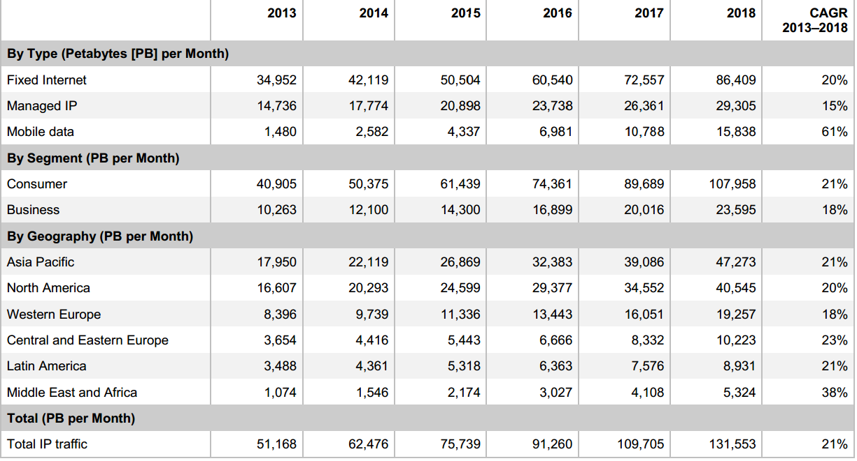
DAWN OF THE HELLABYTE ERA ● GLOBAL IP TRAFFIC
http://www.cisco.com/c/en/us/solutions/collateral/service-provider/ip-ngn-ip-next-generation-network/white_paper_c11-481360.pdf

Slide 14
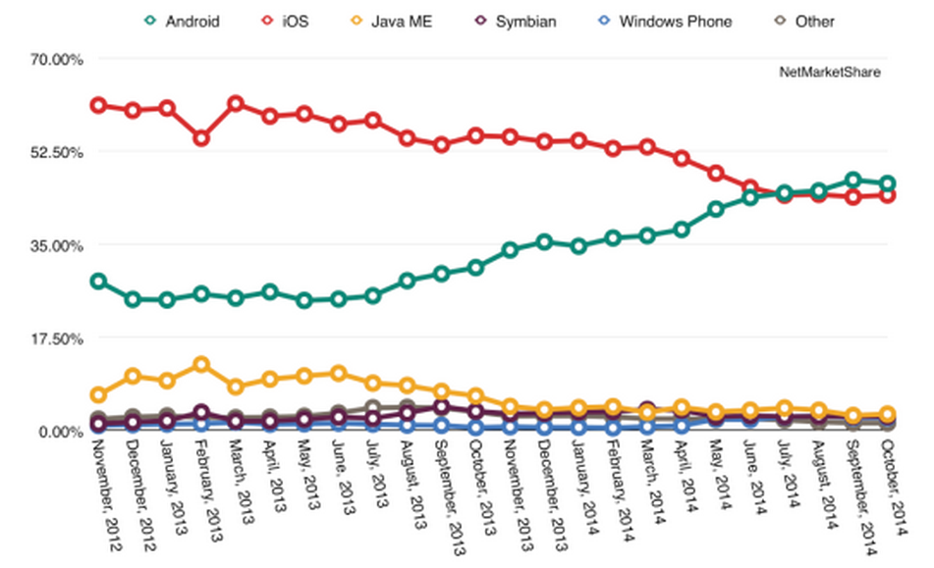
The Next MOB ● Mobile Only Billion
http://time.com/3589909/internet-next-billion-mobile/

Slide 15
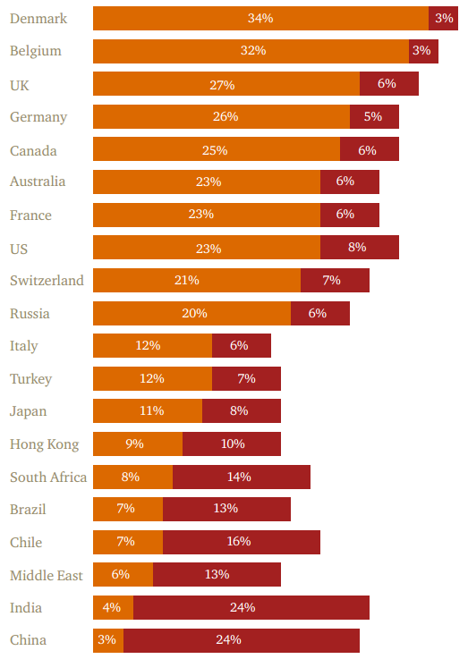

Apply ABCDEF Principle
Analyses based on context,
demographics and economic future
My mobile phone will
be my purchasing tool
www.pwc.com/gx/en/retail-consumer/retail-consumer-publications/global-multi-channel-consumer-survey/assets/pdf/total-retail-2015.pdf

Slide 16
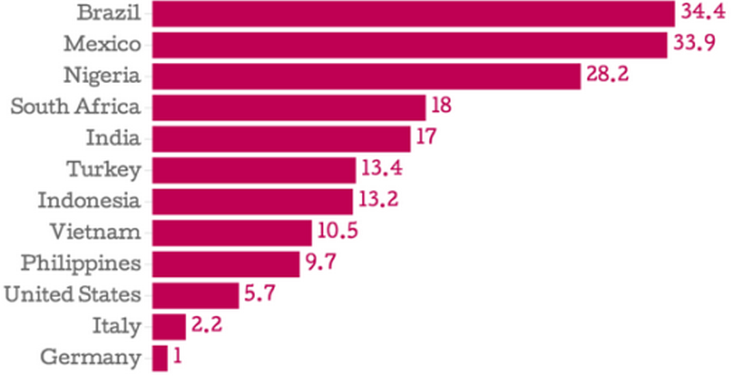
Hours at minimum wage needed to pay for 500MB Mobile Data Plan
http://time.com/3589909/internet-next-billion-mobile/

Slide 17
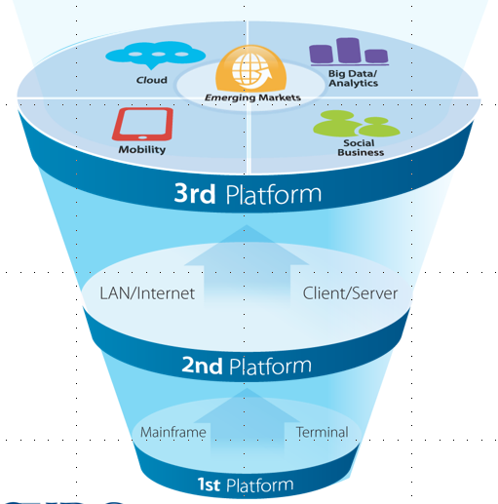
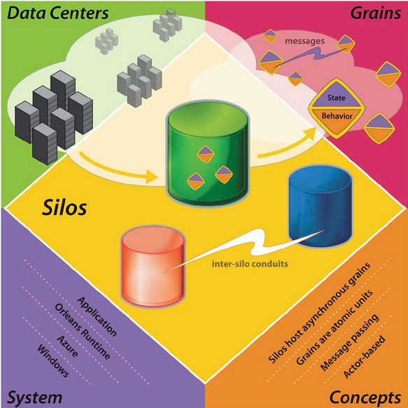
Platforms
Paradox to Paradigms to Platforms
IDC
http://thecge.net/category/research/the-emerging-platform-economy/
PaaS, SaaS, IaaS, DaaS must generate revenue for IoS Platforms Business

Slide 18
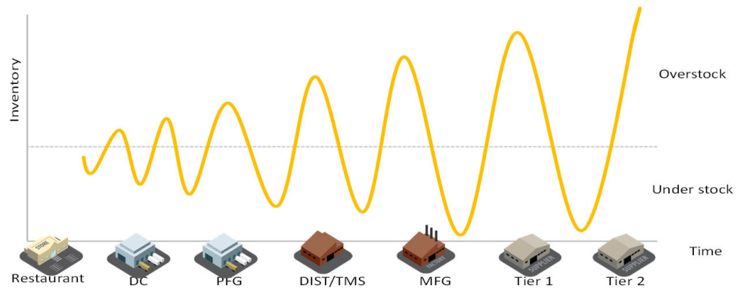
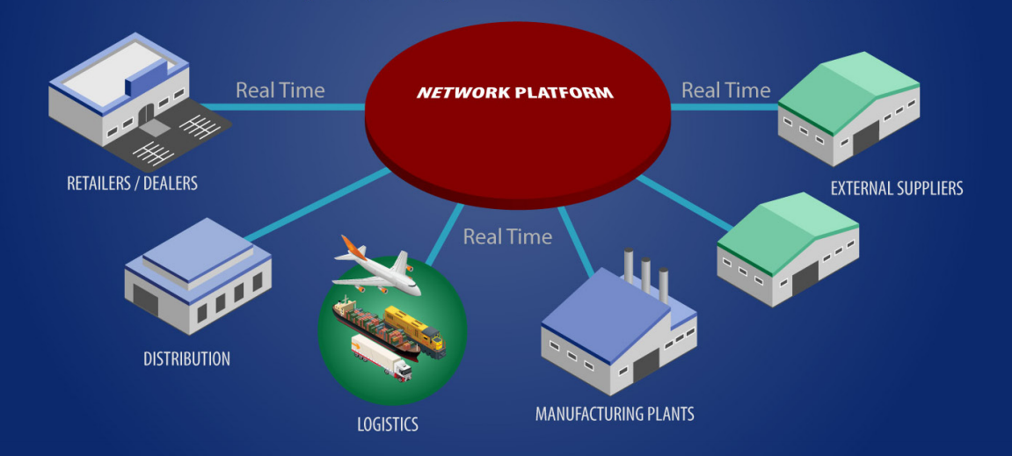
SUPPLY CHAIN OF GOODS – REAL TIME PLATFORM
The Elusive Quest to Tame the Bull Whip Effect
RETAIL
?

Slide 19
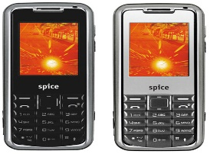
Retail
Travel
Services
Education
Healthcare
Entertainment
BILLIONS OF PEOPLE
ONE TRANSACTION PLATFORM ?
Roads
Energy
Housing
Transport
Sanitation
Food
Society
Infrastructure

Slide 20
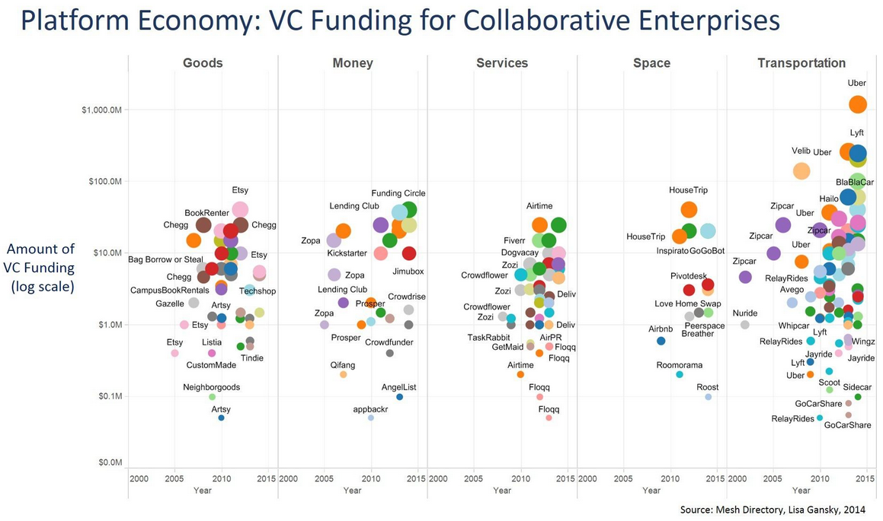
Platform Economy – VC Funding for Collaborative Enterprises

Slide 21
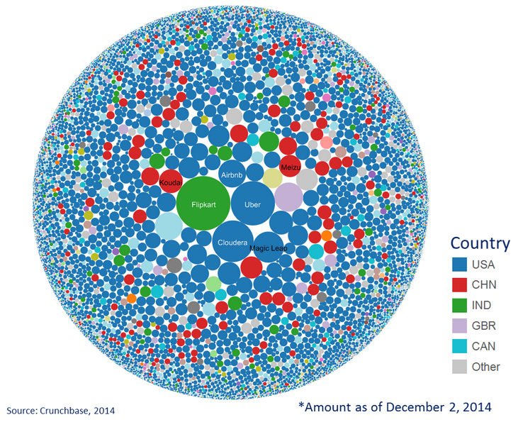
Over 10,000 companies were able to raise over US$80 billion in 2014. In the lead are Flipkart (India); Airbnb, Uber, Cloudera (US); Koudai, Meizu (China)

Slide 22
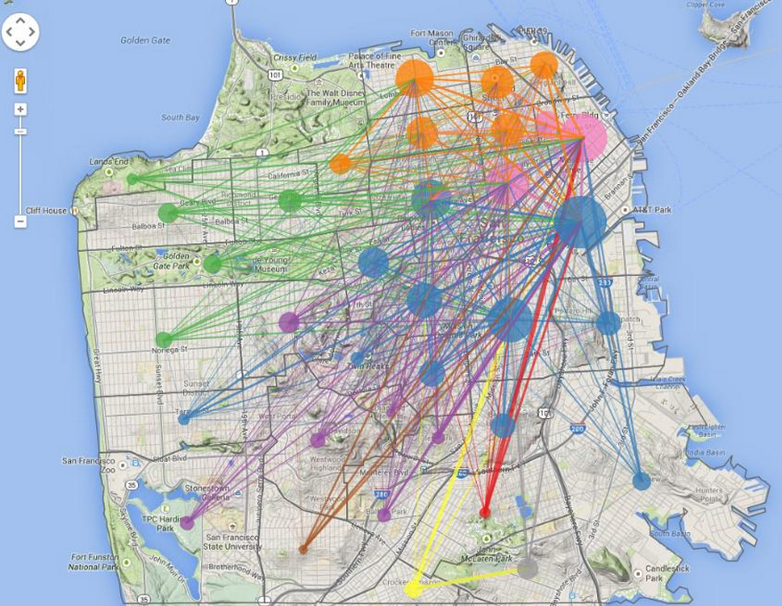

Mobile IoS Economy
Uber’s Information Flow

Slide 23
Makes Money – Generates Revenue
Machines
Aerospace
Fuels, FMCG
Automobiles
Commodities
Manufacturing
Services
Analytics
Data Systems
The Hyper-Horizontal Function
Coal was a huge industry that fueled other huge industries during the latter part of the Industrial Revolution. A purpose-built infrastructure was required to deliver coal from mines to manufacturers. In the age of the industrial internet and the internet of things, is data the new coal?

Slide 24
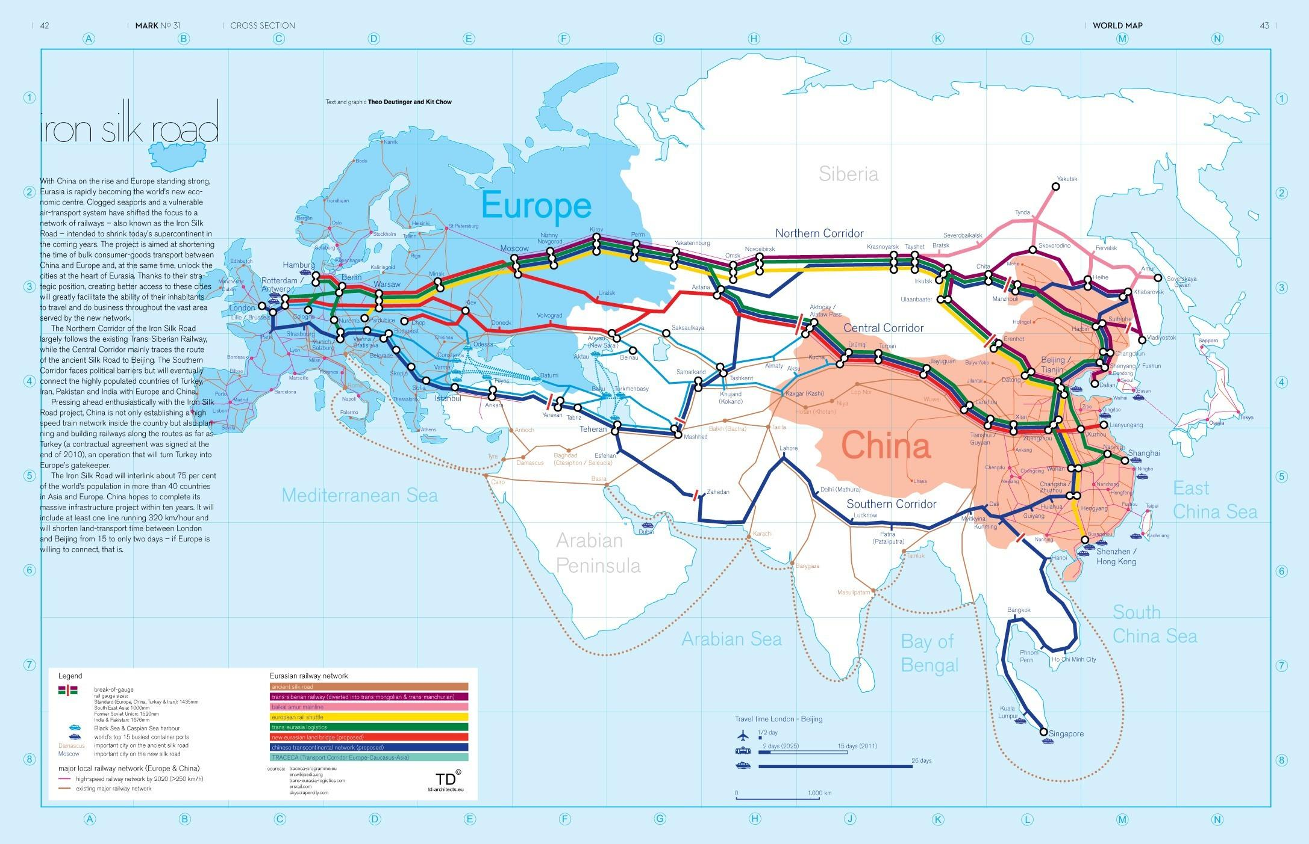
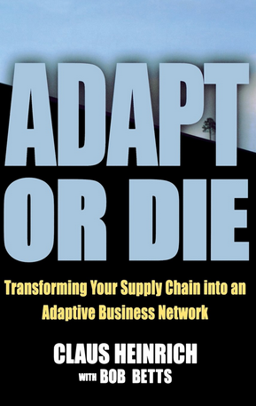

Adapt or Die – Changes on the road ahead
MONEY

Slide 25
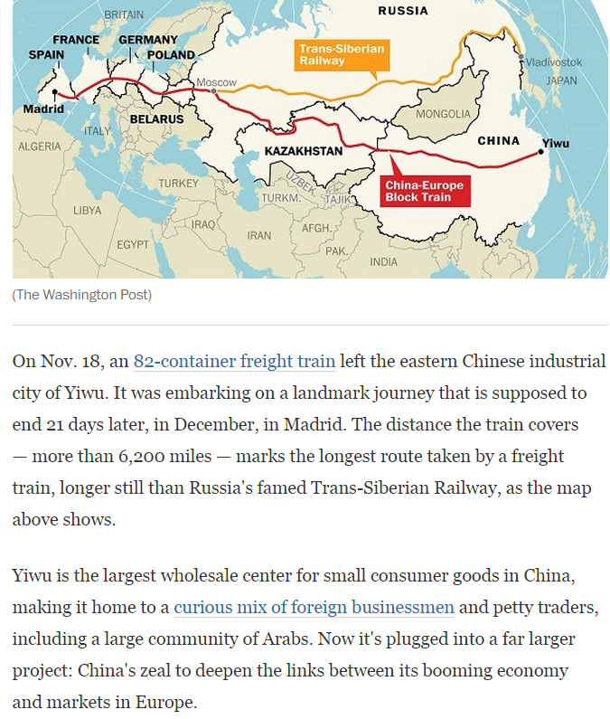
BEIJING to CAPE TOWN by RAIL
As suggested in 2008, Yiwu to Madrid
is a prelude to the next phase in freight
transportation → Beijing to Cape Town.
http://dspace.mit.edu/bitstream/handle/1721.1/41897/WiFi%20Meet%20FuFi%20_%20MIT%20ESD%20WP.pdf?sequence=1

Slide 26
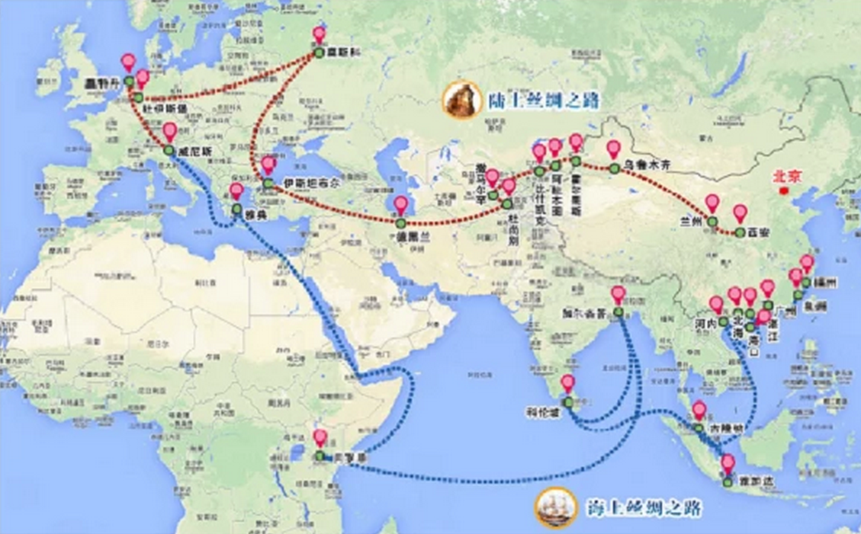
Asia-Africa Goods Transport ● South-South Business Development
Xinhuanet.com
To Cape Town, South Africa
http://dspace.mit.edu/bitstream/handle/1721.1/41897/WiFi%20Meet%20FuFi%20_%20MIT%20ESD%20WP.pdf?sequence=1

Slide 27
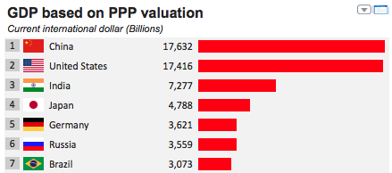
Internet of Systems (Me) Economy
HYPER-HORIZONTAL ● HYPER-VOLUME ● HYPER-SOLIPSISTIC
Think different ● Re-think security
Alibaba and Forty Drones
Kathleen Fisher and DARPA HACMS

Slide 28
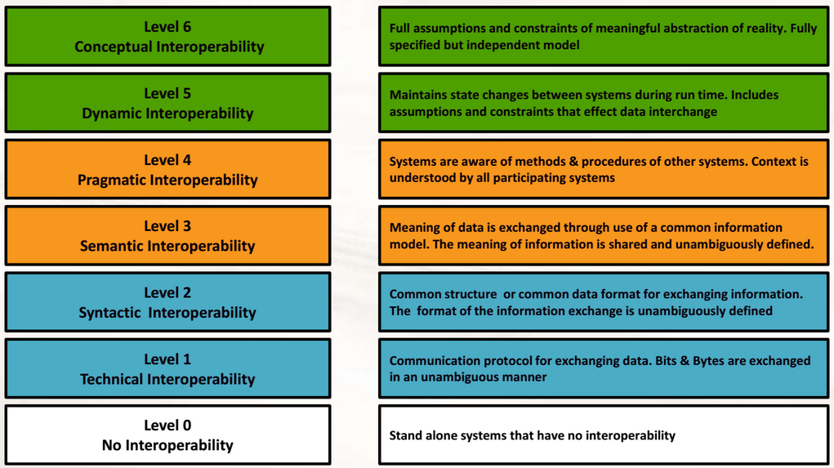
● The IoS Economy ●
Interoperability
VMASC

Slide 29

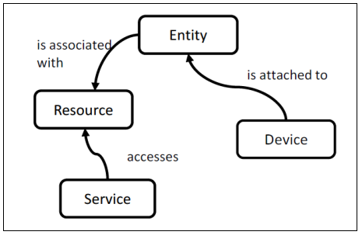
● The IoS Economy ●
Basic IoT Model
Grand Platforms

Slide 30
Macro-economics of micro-revenue
● The IoS Economy ●
Dr Shoumen P Austin Datta ● Research Affiliate, School of Engineering, MIT ● SVP, Industrial Internet Consortium ● shoumen@mit.edu
Think different ● Re-think security
Alibaba and Forty Drones
Kathleen Fisher and DARPA HACMS

Slide 31
Idea
Lifestyle related points of transaction
Consumer
pays for
Transaction
Retail
Homes
Cars
Phones
Health
Friends
Education
Media
Children
Value
Transaction Cost Analysis
Revenue
Micro-payments

Slide 32
MONEY MAKING IDEAS
Connect (telematics software) with personal automobile id (IPv6) to bill distance data.
Internet of Systems ● Growth potential from pay per mile car insurance
Estimated number of personal automobiles in India and China 30 million
Estimated average distance 6000 miles or 180 billion car-miles per year
Charge (average) 2 cents per mile (age adjusted) for car insurance *
Revenue pa with 10% share $360 million
Pay Per Mile insurance reduces barrier to entry and improves economies of scale
* US average for low risk, low cost insurance for middle-age individuals approximates 5 cents per mile based on 12,000 miles per year.

Slide 33
MONEY MAKING IDEAS
Connect (domestic telematics SaaS) with WSN - IPv6 (self-organizing motion sensors ad hoc mesh)
IoS Growth potential from security - pay per hour home insurance
Estimated number of personal homes in India and China 250 million
Estimated average 4 hours unoccupied or 365 billion home-hours pa
Charge (average) 1 cent per hour
Revenue pa with 10% share $365 million
Pay Per Hour insurance reduces barrier to entry and improves penetration

Slide 34
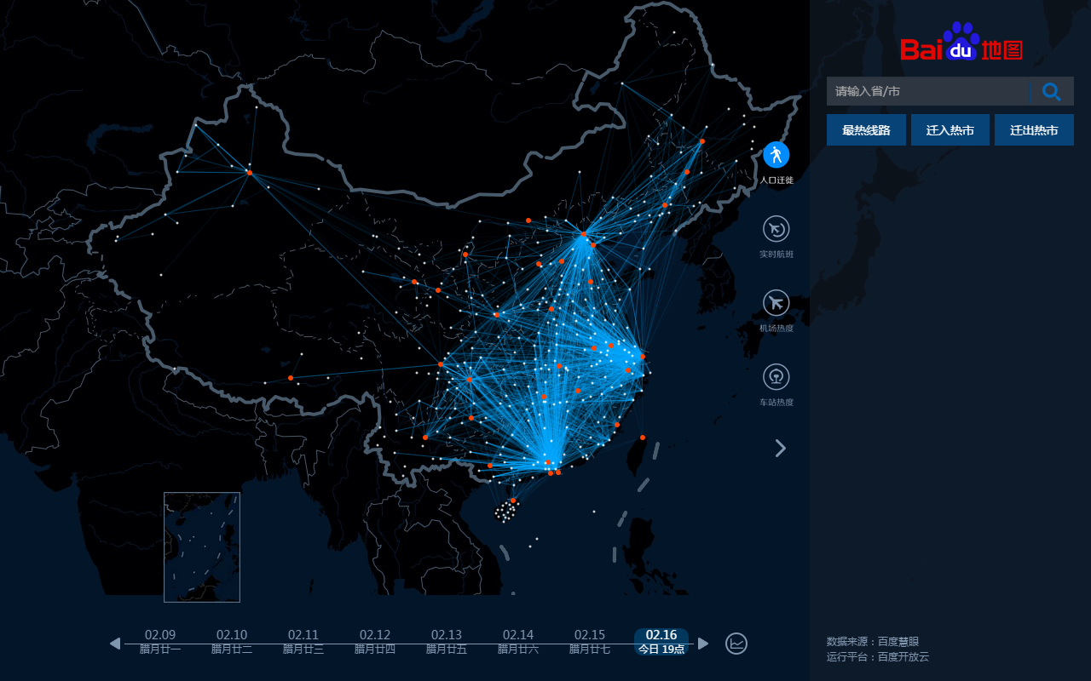
Paradox to Paradigms to Platforms to Populations
Beijing
Shanghai
Taipei
Guangzhou
Chinese New Year
February 16, 2015

Slide 35
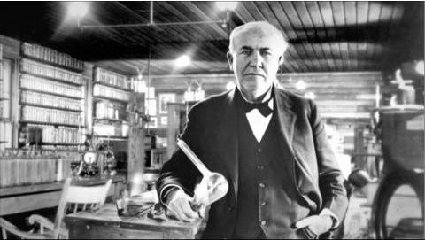
Disrupt
Total energy under the curve
The concept of energy under the curve is directly analogous
to an economy's money supply at a given time. Both the energy
and the money supply are known amounts. The money is going
to be spent by someone (device is going to output its energy).
The key is for the money to be spent where it has the most benefit
(the light bulb must produce visible light).
In engineering parlance, there is a phrase called 'energy under the curve.' This refers to the total energy output of a
device—light bulb, acoustic transducer —as measured on a graph across a range of frequencies. While every effort is
made to maximize the amount of energy output from that device, in the end it's still a finite amount. The key to best
performance is getting the device to deliver energy that is usable. A light bulb may produce x lumens of energy, but it
won't do much good if its output is predominately at ultraviolet frequencies that are invisible to the human eye. An
acoustic transducer (speaker) can be modified to produce more or less energy at different frequencies, but the total
acoustic energy produced by that specific speaker is finite. The engineers can move the energy output from one
frequency region to another, but the 'total energy under the curve' remains the same. The key to a speaker's useful
performance, of course, is for it to produce its energy at frequencies that are audible and useful to humans, not bats.
www.americanthinker.com/2004/09/the_light_bulb_economy.html

Slide 36
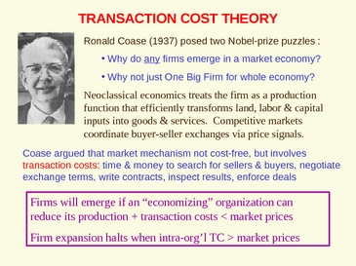
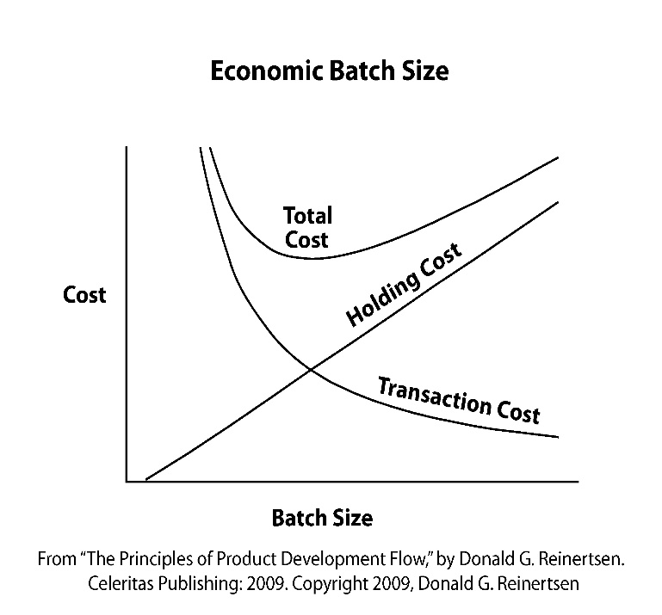
Projected Economic Impact of Internet of Systems
Re-engineer Transaction Cost
Transaction Cost Economics

Slide 37
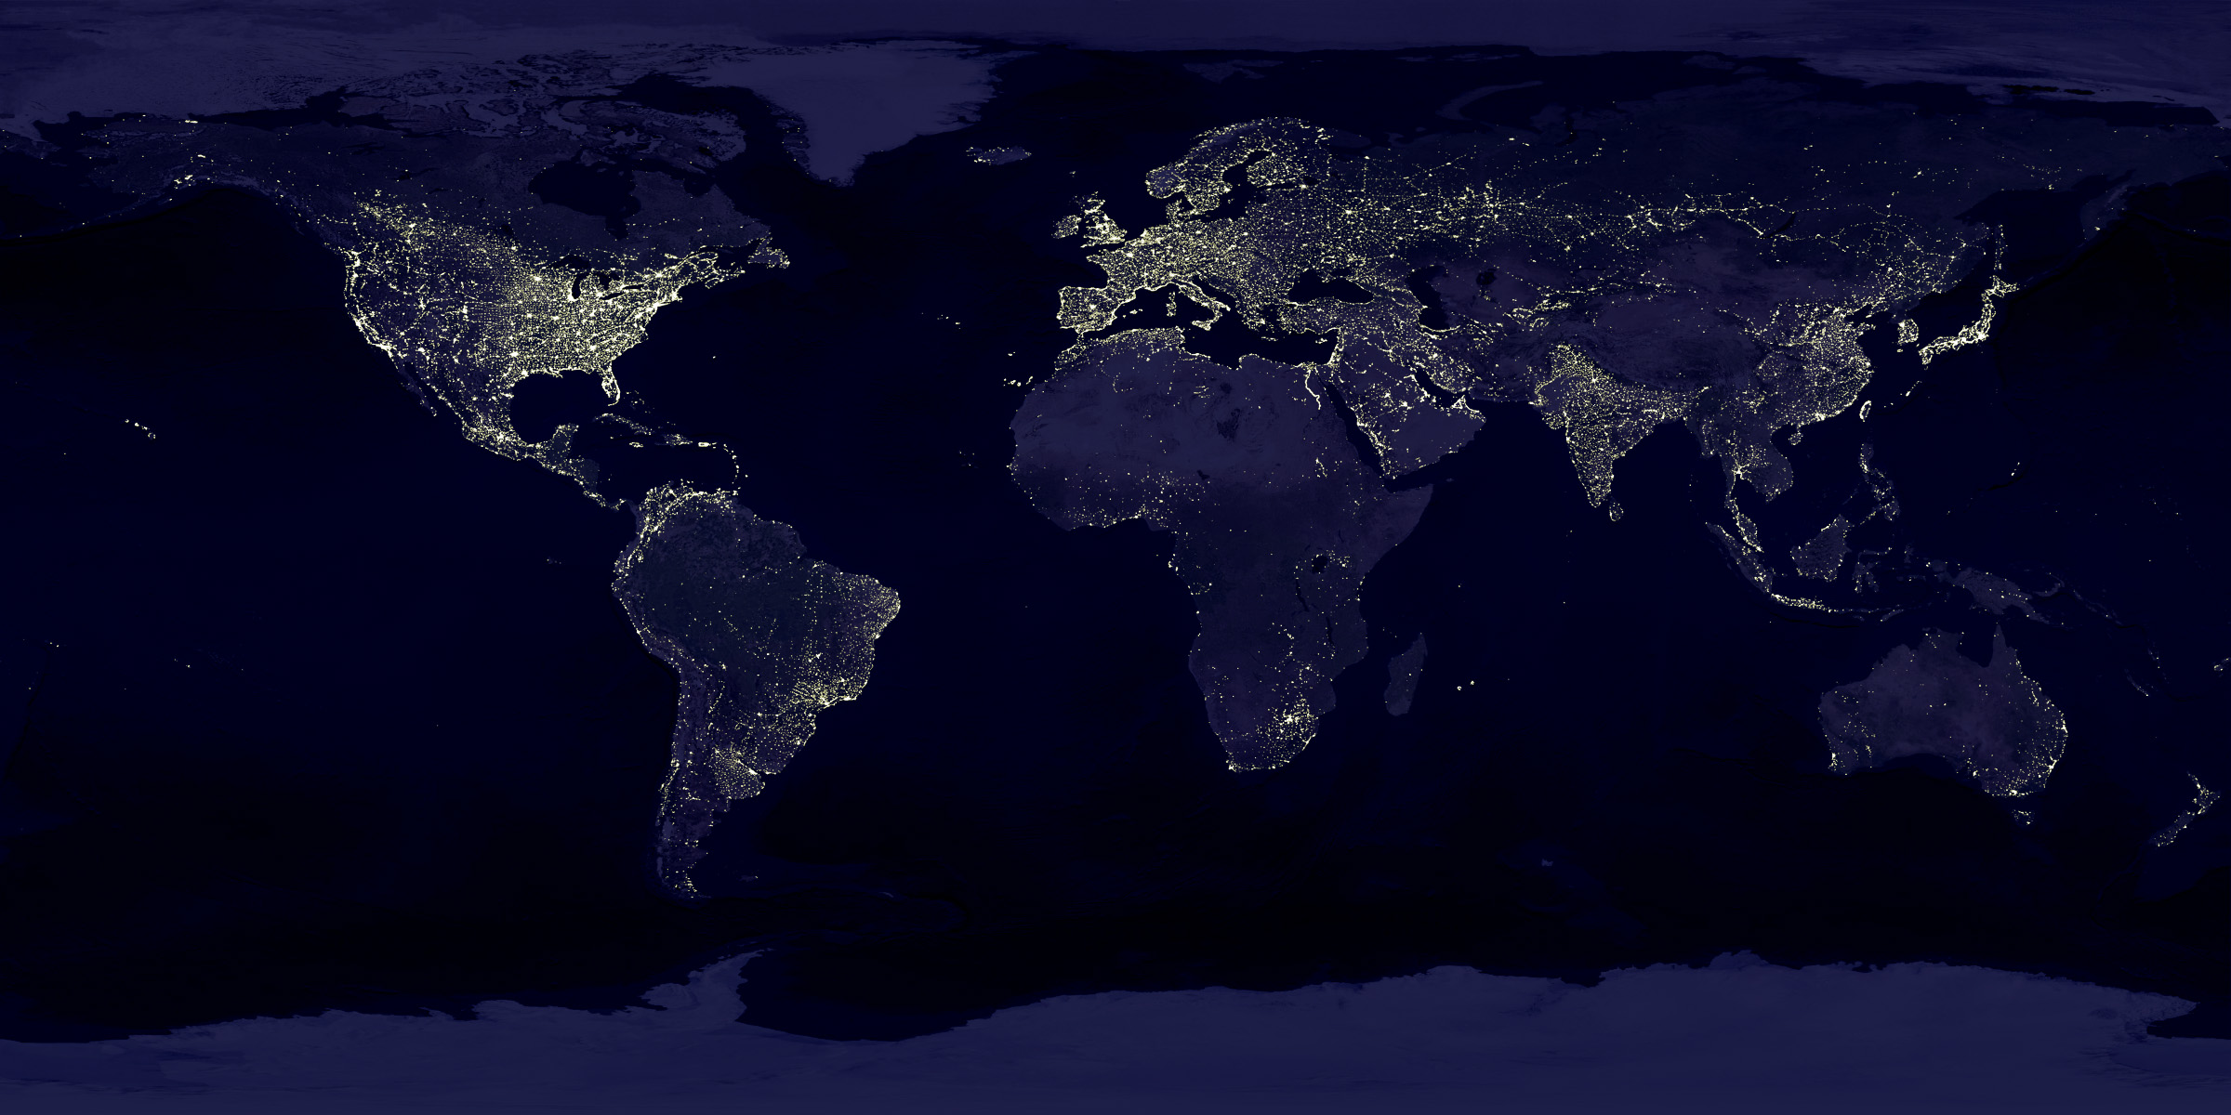
Projected Socio-Economic Impact of Internet of Systems
Re-engineer Resource Utilization

Slide 38
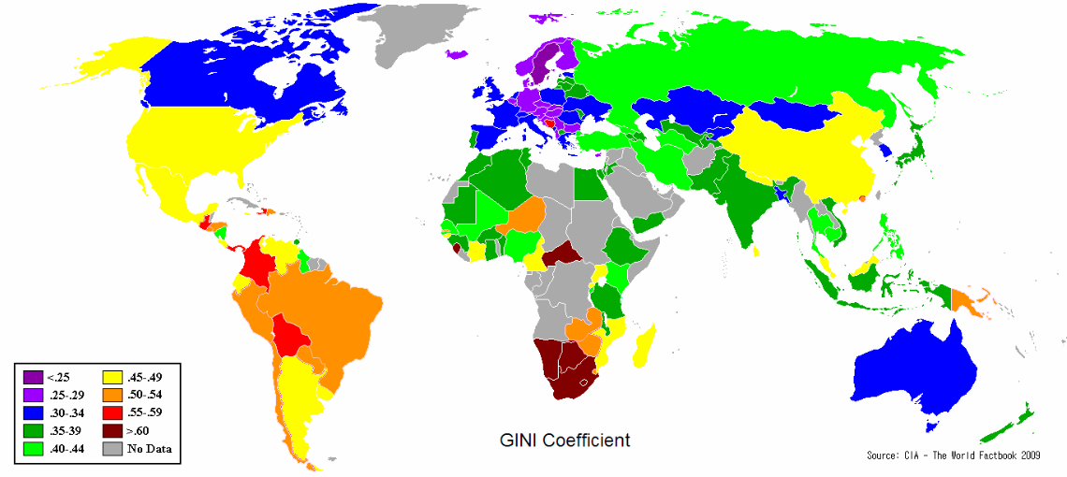
Projected Socio-Economic Impact of Internet of Systems
Re-engineer GINI Coefficient
Gini coefficient measures the inequality among values of a frequency distribution (for example levels of income). Coefficient = zero expresses perfect equality (everyone has an exactly equal income). Coefficient = 1 expresses maximal inequality (where only 1 person has all the income).

Slide 39
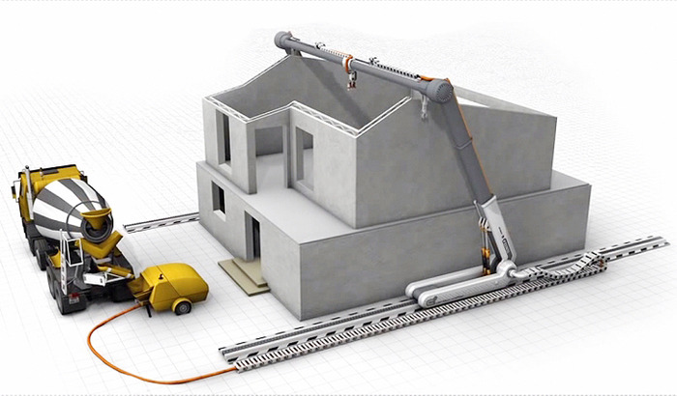
Disrupt
3dprint.com
Deploy

Slide 40
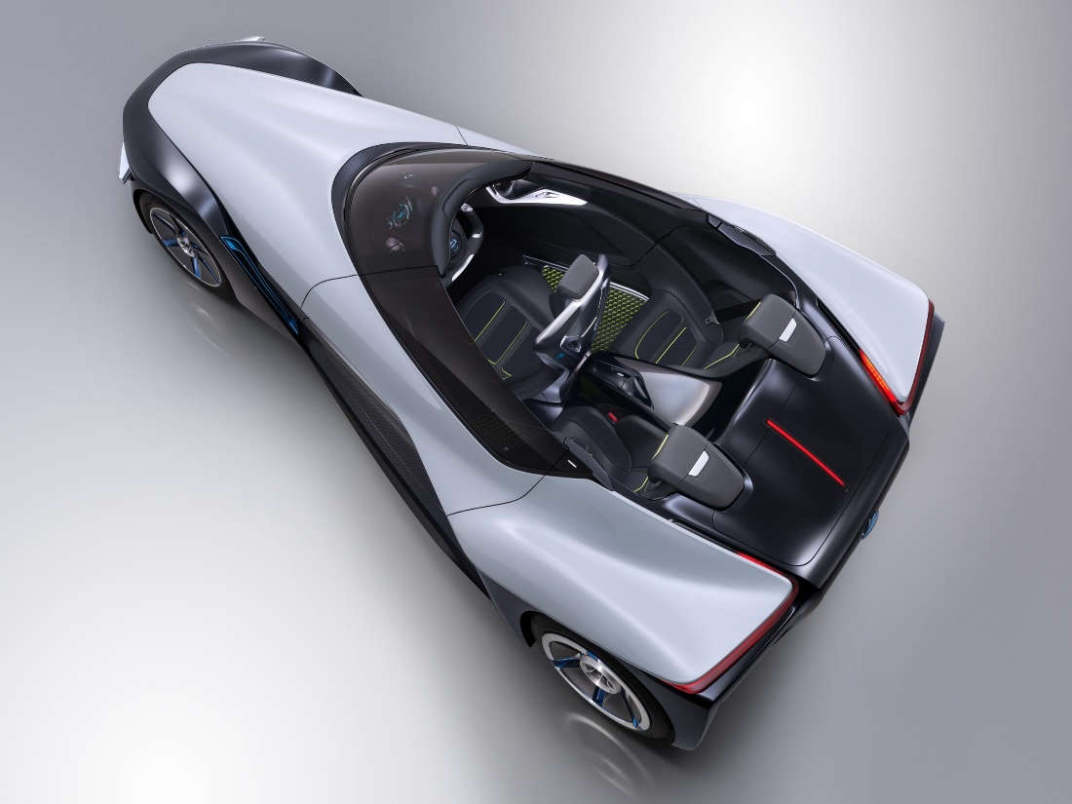
● Vision, Mission and Opportunities
● Challenge  migration path from PNGV to SDV
 Autonomous Transportation (SDV)
 Global Smart Cities
 Healthcare
 Data
SDV - Software Defined Vehicles  http://bit.ly/MIT-IOT
Paradox to Paradigms to Platforms  http://bit.ly/MIT-IOT
http://bit.ly/YESTERDAY-NEVER-DIES
http://bit.ly/TOMORROW-NEVER-DIES

Slide 41
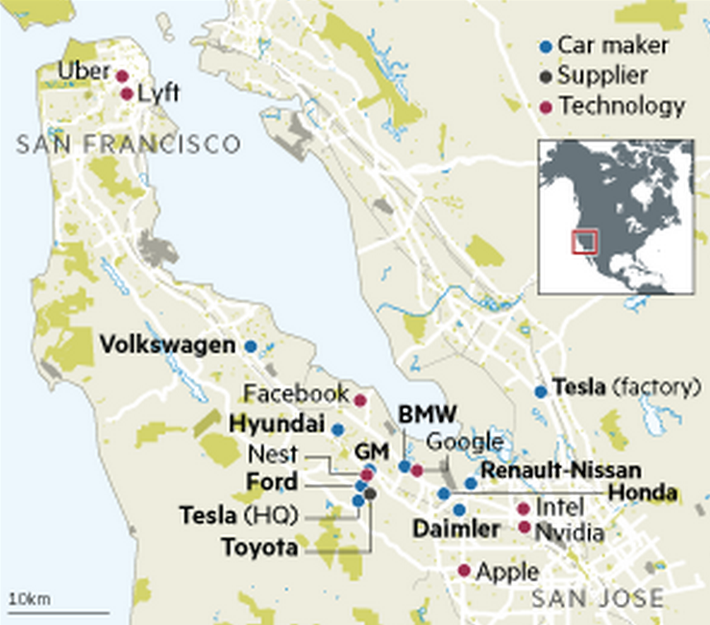
SDV = Consumer Electronics = Automobile Manufacturers in Silicon Valley
FT

Slide 42
Internet of Systems
Data - What is it good for?
Pervasive and Ubiquitous
Ambient Intelligence
Autonomy

Slide 43

Big Data IoS
Volume
Variety
Velocity
Volatility
Veracity
Components
Connectivity
Convergence
Collaboration
Community
5 C
5 V

Slide 44


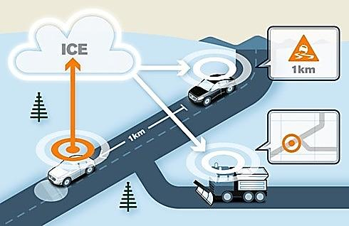
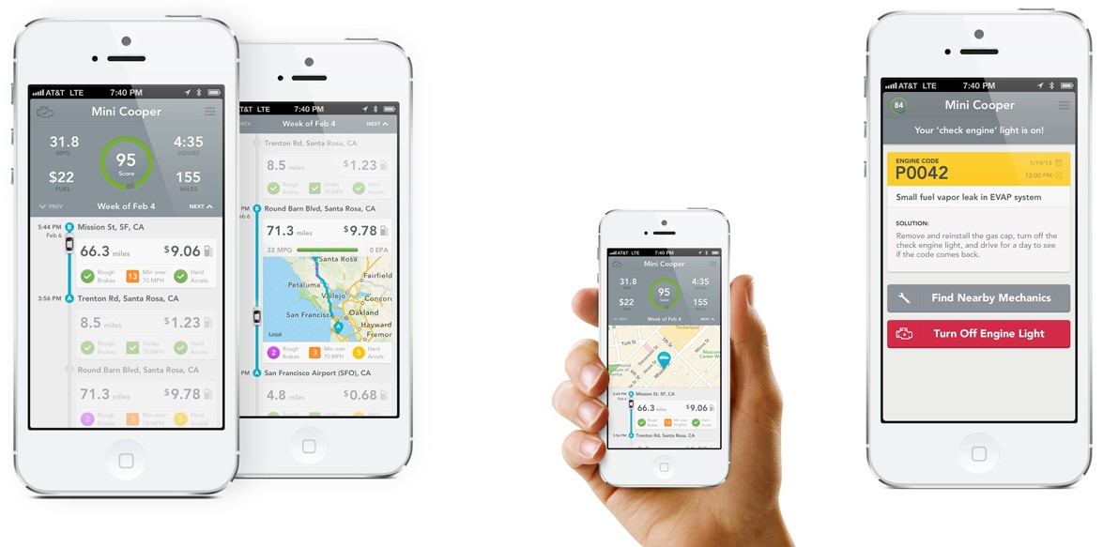
IoS, DaaS, IaaS, PaaS, SaaS, KaaS - Connected Car Composable Computing
http://bit.ly/Connected-Car-AUSTIN
http://bit.ly/Connected-Car-Sequel
Public
Government
Private
VOLVO
D = Data ▪ I = Infrastructure ▪ P = Platform ▪ S = Software ▪ K = Knowledge

Slide 45
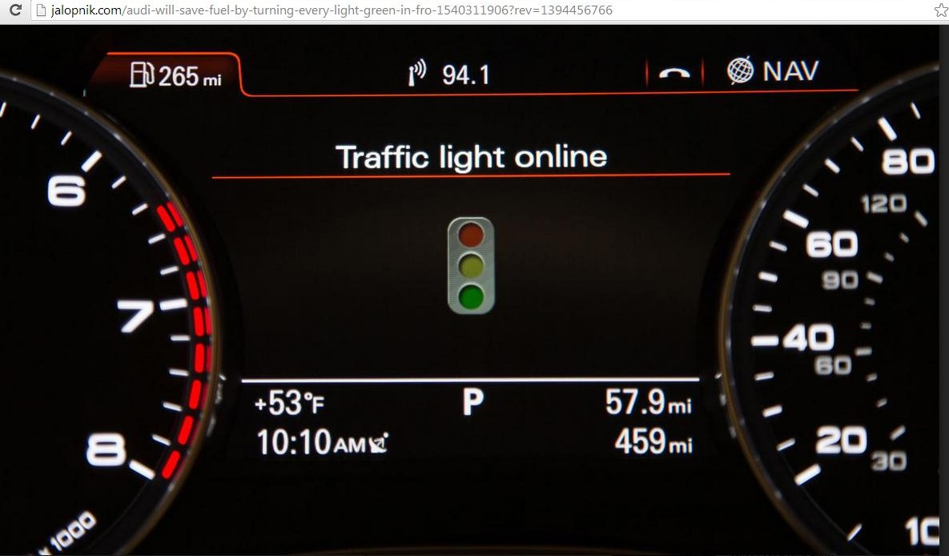
Reduce emissions by 15% and save ~1 billion liters of fuel each year (in Germany alone)
How? By synchronizing vehicle speed with traffic lights online to eliminate stop and start at red lights. Demonstrated in Las Vegas using Audi A6 navigating 50 sets of traffic lights. Testing is underway in Verona with 60 traffic lights. In Berlin, select Audi customers are driving cars fitted with online traffic information that can link up to a total of 1000 traffic lights.

Slide 46
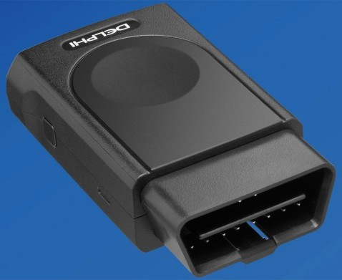
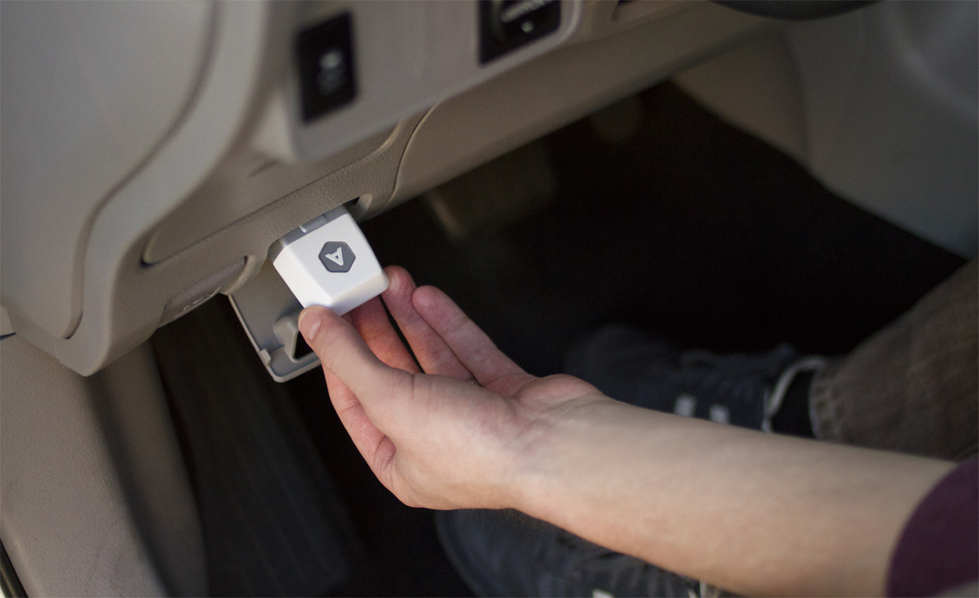
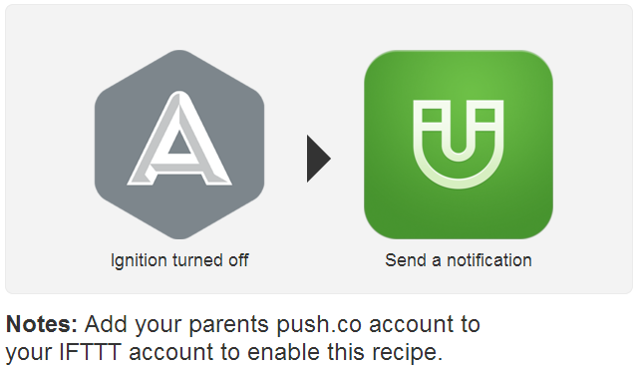
CAR TALKS TO CLOUD
For auto diagnostics, jealous spouses, concerned parents,
geo-fence fanatics and auto shut-off for theft prevention
OBD-II
PORT
If This Then That - IFTTT

Slide 47
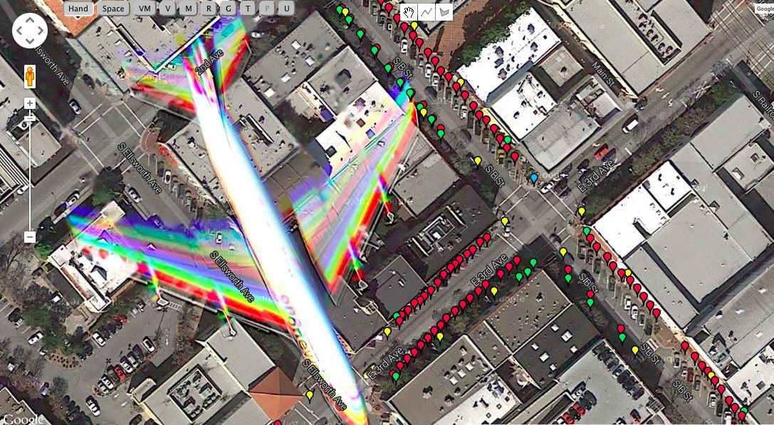
Industrial Internet ← IoS Services → Parking Spaces Talks to Cars
Google Earth photo of a plane flying over downtown San Jose, CA. Parking space sensors showing available car parking spaces using Parker™ by Streetline (Photo courtesy of Zia Yusuf, President & CEO, Streetline Inc)

Slide 48
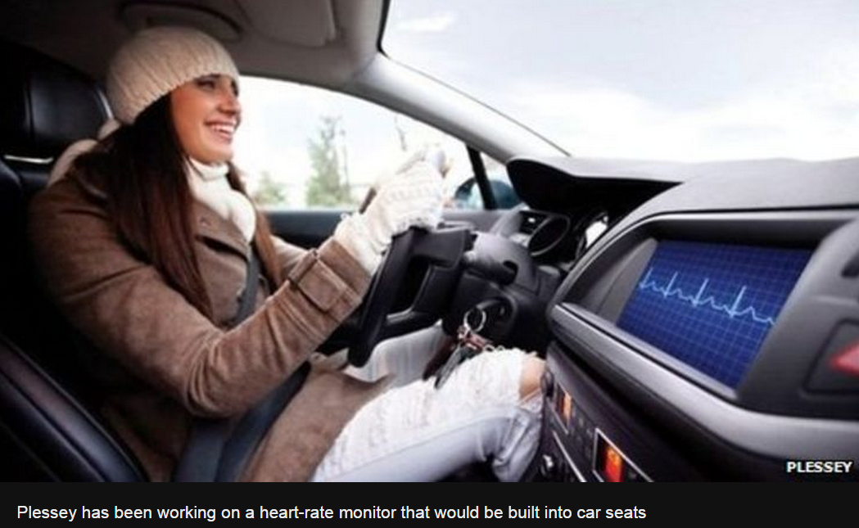
Monitor and Predict Physiological Status of Humans in Vehicles
Transport Connects to Healthcare through Smart City Platform

Slide 49
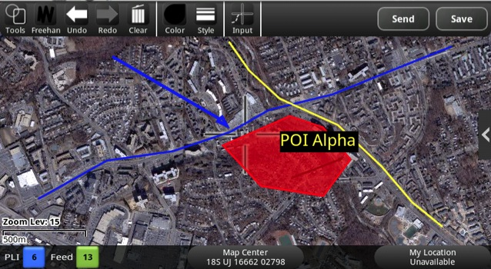
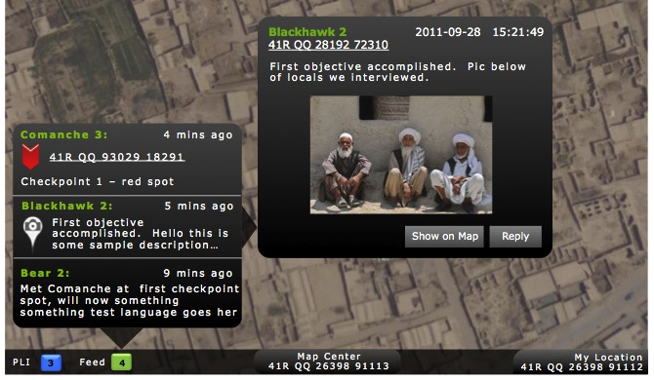

Android Mobile Middleware Objects
Situational Awareness
Tactical Chat
Medevac Reports
● Monitor/Track
● Mark spots on map
● Share maps with peers
● Send text messages
● Pictures, videos, audio
● Location tagged
● Injury and location
● Real-time
● Reliable delivery
DARPA Transformative Apps – AMMO provides data persistence and communication-networking backbone (Dr Sandeep Neema, Institute for Software Integrated Systems, Vanderbilt University)

Slide 50

LOGICAL ARCHITECTURE FOR AUTONOMY by Professor Raj Rajkumar, Carnegie Mellon University
Health
Monitor
User Interface
Communication Interfaces
PERCEPTION
Road
World
Model
Mission Planning
Behaviors
SENSORS
Short Term Path
Planning
Wire by Wire Controls
DATA LOGGER
From Professor Raj Rajkumar
Carnegie Mellon University
Embedded Computing Platform

Slide 51
LOGICAL ARCHITECTURE FOR AUTONOMY by Professor Raj Rajkumar, Carnegie Mellon University
Data analysis problems and algorithmic issues for autonomous driving functions
Health
Monitor
User Interface
Communication Interfaces
PERCEPTION
Road
World
Model
Mission Planning
Behaviors
SENSORS
Short Term Path
Planning
Wire by Wire Controls
DATA LOGGER
From Professor Raj Rajkumar
Carnegie Mellon University
Embedded Computing Platform

Slide 52


Slide 53




Slide 54


How does an autonomous vehicle
understand the difference between
an object without threat in a run
time collision avoidance context?
Without algorithmic solutions,
even a harmless plastic bag in the air may cause an accident.

Slide 55


Oh I see a plastic bag
What is the “brain” of the autonomous vehicle thinking?

Slide 56

Neural Image Caption (NIC) Generator
Translates images to natural language
http://arxiv.org/pdf/1411.4555v1.pdf
To translate languages, Recurrent Neural Network (RNN) transforms a French sentence into a vector representation, and a second RNN uses that vector representation to generate a target sentence in German. Replace first RNN and input words with deep Convolutional Neural Network (CNN) trained to classify objects in images and add known classes of objects in semantic baffles with corresponding behavior (plastic bag versus wooden plank) with assigned probability of object in the image (environment). Feed CNN’s rich encoding of the image into a RNN designed to produce phrases. We can then train the whole system directly on images and their captions, so it maximizes the likelihood that descriptions it produces best match the training descriptions for each image. The natural language spoken by human (inside vehicle) better trains the algorithms.
Author’s idea is adapted from → http://googleresearch.blogspot.co.uk/2014/11/a-picture-is-worth-thousand-coherent.html

Slide 57


Connected Vehicle Tools
Support Vector Machine
SVM distinguishes gazelles, ostrich,
trees and ground in Namibia, Africa
www.cs.toronto.edu/~hinton/csc2515/notes/lec10svm.ppt
www.epfl.ch ▪ Patrick Meier at www.qcri.com

Slide 58

SVM in ITS China

Slide 59

OODA Loop in Autonomous Driving Functions?
John Boyd

Slide 60

Temporal Decomposition of Complex Simulations
ECU based intruder dectection? Run-time condition monitoring?
Neema, H., J. Gohl, Z. Lattmann, J. Sztipanovits, G. Karsai, S. Neema, T. Bapty, J. Batteh, H. Tummescheit, and C. Sureshkumar, "Model-Based Integration Platform for FMI Co-Simulation and Heterogeneous Simulations of Cyber-Physical Systems“ in Proceedings of the 10th International Modelica Conference, Lund University, Solvegatan 20A, SE-223 62 LUND, Modelica Association and Linkoping University Electronic Press, pp. 235-245, 03/2014.
Partition: Driver vehicle (Vehicle mechanics, Electrical and Driver) and Thermal Management (Fluid and Thermal parts of the model)
Simulation with different processes and clock-rates but achieves correct behavior

Slide 61


Connected Vehicles 101
Transportation of Data
Autonomy?
www.nissan-global.com/EN/TECHNOLOGY/OVERVIEW/its.html

Slide 62

How to Connect – Systems Integration
Mike Blicher, Auto-Talks

Slide 63

F6 Information Architecture
Abstraction applicable to connected vehicle pilot?
GABOR KARSAI, Institute for Software Integrated Systems, Vanderbilt University

Slide 64




ITS Autonomy: Opportunistic cyber attacks?
http://bit.ly/VANDERBILT-C2-HN
Himanshu Neema at Vanderbilt
Smart Roads Platform control algorithms + real-time data may
predict & manage flows to support resilience to cyber attacks.
Saurabh Amin
Sankar Shastry
Claire Tomlin
Game Theory in resilient control design - Stackelberg games

Slide 65
What level of autonomy ?
Observe
Orient
Decide
Act
Monitor
Diagnose
Plan
Execute
Perception / Situational Awareness
Analysis / Coordination
Decision Making
Capability
Sensory Processing
Perception / Working Memory
Decision Making
Response Selection
Monitoring & Detection
Situation Assessment
Response Planning
Response Implementation
Sensing / Perception
Analyzing / Planning / Decision Making
Acting / Executing
Communicating

Slide 66


Essential for Autonomy ?
IIoT
IoS
5G
SECURITY
http://bit.ly/KATHLEEN-CAR-HACKED
http://bit.ly/KATHLEEN-FISHER-60-MINUTES

Slide 67

GOAL (For example, “Man on the Moon” was a goal set by JFK)
Deployment of Semi-Autonomous Freight Transportation
  Refrigerated truck transporting cargo containers with perishable grocery arrives at an intermodal operation (for transportation by sea or air or rail or cross-dock)
  Driver disembarks prior to entering security perimeter
  Truck shifts to autonomous mode and enters secure zone
  Unloads / uploads cargo (informs supply chain partners)
  Exits secure zone and arrives at a Hilton to pick-up driver
  Truck driver continues to warehouse / distribution center
SAFTI Semi-Autonomous Freight Transportation Initiative
Approved for OTI

Slide 68



Raj Rajkumar (CEO, Ottomatika) provides the brain and nervous system any automaker can use.
www.wired.com/2014/11/delphi-automated-driving-system/
Connected Automation
SDV
http://bit.ly/RAJ-DELPHI-AUDI
Professor Raj Rajkumar, CMU
http://pjtec.info/a-system-that-any-automaker-can-use-to-build-self-driving-cars/
www.ctvnews.ca/sci-tech/dutch-approve-driverless-cars-for-public-large-scale-testing-1.2203969
Adapt “brain and nervous system” for cargo/commercial vehicles for large scale deployment ?

Slide 69




http://bit.ly/KATHLEEN-CAR-HACKED
http://bit.ly/AUDI-CONCEPT-7
http://bit.ly/WASHINGTON-DC
Prof Raj Rajkumar (CMU) + House Transportation and Infrastructure
Committee Chairman Rep Bill Shuster (R-PA) in DC on 06/24/14 [↓]
http://bit.ly/MB-AutoTruck
http://bit.ly/SCHUSTER-AUTONOMOUS
http://bit.ly/RAJKUMAR-CMU

Slide 70
SAFTI
This is an undertaking by select members of the Industrial Internet Consortium (IIC), a coalition
of other corporations, various government agencies and guided by a group of academics in US.
Semi-Autonomous Freight Transportation Initiative
Broad Deployment Packages (BDP)
Dr Shoumen Datta

Slide 71


Is SAFTI necessary?
DEATHS
www.iihs.org/iihs/topics/t/large-trucks/fatalityfacts/large-trucks

Slide 72


SAFTI
Semi-Autonomous Freight Transportation Initiative
Connect Data
SECURE
PLATFORMS

Slide 73






Network Resilience - What happens if the network is disrupted?
Transportation
Cybersecurity
GEO
Truck installed Micro-Droneport
● [1] Drones on board using HACMS and fitted with UWB transceivers to create ad hoc radio network
● [2] Roof-top wireless electricity charging pad for droneport provided by WiTriCity
● [3] Drones transmit to LEO, MEO, NEO, HEO or GEO satellites in range
● [4] Satellite re-transmits to safe zones for communication / update
● [5] Responds with message and/or guidance to autonomous vehicle
3
4
www.technologyreview.com/news/532176/a-brain-inspired-chip-takes-to-the-sky/
2
1
5
http://bit.ly/MICRO-DRONES-AFRL
http://bit.ly/ALIBABA-AND-40-DRONES

Slide 74


UAV in security mission with USAF 8th Wing
SCENARIO
Integration of loosely coupled models
Track and trace time-critical targets
Includes humans in decision support
Resilience in face of cyber security threat
Time-sensitive and reactive (adaptive) model
Bi-directional action in urban environment
EXPERIMENTATION
isis.vanderbilt.edu
C2 by Himanshu Neema

Slide 75



Hellabytes of data from deployment of software define networked vehicles (SDV)
SDV’s in the MIST
Where is the data? Where are the sense and response run time analytical engines?
● Depends on bounded latency
● Cloud or Fog or Software Defined Vehicles in the Mist (Gorillas in the Mist)
What is the Mist ? Ad hoc Composable Mobile Dynamic Grid Computing
Access available computing power in near field vehicles for run time analytics (Mist)
Reuse concept of “grid computing to solve protein structure by using idle computers” Globus Tool Kit by Steve Tuecke (do not confuse with marketing material by MS Cloud)
Run-time
Uncertainty
Estimation?

Slide 76


Tools for Composable Mobile Dynamic “Mist” Computing

Slide 77
Evolution of Grid Computing and Globus Toolkit
Composable Near Field Computing or “ Mist ”
GT 2.0
Released
GT 2.2
Released
Physiology of the Grid
Paper Released
GT 2.0 beta
Released
NSF GRIDS Center
Initiated, DOE begins
SciDAC program
Anatomy of the Grid
Paper Released
GT 1.1.4 and
MPICH-G2 Released
Significant
Commercial
Interest in
Grids
The Grid: Blueprint for a New Computing
Infrastructure published
NSF & European Commission
Initiate Many New Grid Projects
First
EuroGlobus
Conference
Held in
Lecce
DARPA, NSF, and DOE begin funding Grid work
GT 1.1.3
Released
MPICH-G
released
Globus Project wins
Global Information Infrastructure
Award
Early Application
Successes Reported
GT 1.1.2
Released
GT 1.0.0
Released
GT 1.1.1
Released
NASA initiates
Information Power Grid,
DOE increases support

Slide 78
Hellabytes of Data Per Second from Software Defined Vehicles
An example of collaboration of the cyber-physical systems is the collaboration of vehicles in proximity to avoid collisions. These vehicles communicate with each other in the cyber space dynamically forming an ad hoc communities to inform others the actions each of them is taking that may affect the communities of vehicles. Examples of such actions include applying a brake or changing lanes. They also interact, albeit indirectly, in the physical space by continuously sensing and measuring the movement and trajectory neighboring vehicles. The information gathered from both the cyber and the physical spaces is then synthesized to gain an understanding of the state and intent of the vehicles in proximity. From this understanding and based on prescribed objectives (e.g. to avoid collision, a physical effect), control decisions are continuously made to produce the desired physical effects in the vehicle in question, e.g. to slow down, stop, accelerate or change course, in order to avoid the undesired ones, such as collision between vehicles or between vehicles and other objects. [NIST CPS PWG ▪ Frameworks]
IoS (Cyberphysical Systems + Data) = Collision Avoidance

Slide 79

Internet of Systems ● http://bit.ly/MIT-IOT
● Vision, Mission and Opportunities
● Challenges
 Autonomous Transportation
 Global Smart Cities
 Healthcare
 Data
$

Slide 80
Internet
of
Systems
Healthcare
Systems
Grand Challenges
I simply collect, connect, converge and suggest potential confluence. It may be akin to seeing old ideas with new eyes ▪ Shoumen Datta

Slide 81


US$ 292,643.73

Slide 82

Outcome vs Spending
The Economist & WHO

Slide 83



The Management of Diabetes
The Medical Internet of Things
The Industrial Internet of Healthcare
Blood Glucose Nano-sensor
Nanotube Radio
NanoLetters (2004) 4 1785-1788
NanoLetters (2007) 7 3508-3511

Slide 84


Internet of Systems - Remote Heath Monitoring
May I implant a glucose nano-sensor nano-radio chip on your shoulder? You are fat. You could become diabetic.
Jan 2015 CGM ▪ www.dexcom.com
Nov 2005 TCD

Slide 85


RFID Linked Biometrics & Nano-sensor Net
UC Berkeley, 1997
VISIT
CLINIC
Glenn Seaborg
Yuan T. Lee
Charlie Townes
Helene Langevin Joliot-Curie
Shoumen Datta
Dudley Herscbach
MGH
VISIT
CLINIC
802.11b
WiFi
802.11g
802.16a
Metabolomics
Genetic Risk
EHR - EMR
RT Analytics
SNP Analysis
The Prevention of Diabetes
Improved healthcare services, savings, create jobs from new products, new services and potential to create as well as capture new emerging markets of billions (BRICS)

Slide 86

IoS Diabetes Management ● Artificial Pancreas Device Systems
www.tcs.com/SiteCollectionDocuments/White%20Papers/Personalized-Artificial-Pancreas-Device-Systems_1014-1.pdf

Slide 87




Pay-Per-Pee Home Health – IoS Wireless Toilet Bowl Connected to Health Informatics
Weigh-scale, BMI, FOBT, urine analysis, sugar, ketone body analysis, blood pressure monitor, pulse oximeter, networked to phone via WiFi and/or Bluetooth with biometrics and face recognition for secure communication with
physician and hospital or clinic, globally.
I pee on everything
Vint Cerf

Slide 88



Walgreens Specials - $1.99 for 24-pack Diet Coke • $1.99 for Bone Density • $1.99 Mammogram
Value Network Ecosystem Testbed
Walgreens – Retail Healthcare
GE – Equipment
Cisco – IPv6 Routers
AT&T – Data Transmission
Intel – MIPS
IBM – Data Analytics
Samsung – Diagnostic Apps
Walmart – Grocery Supply Chain
PDEXA SCAN
BONE MINERAL
DENSITY PROFILE

Slide 89




CVS IoS Special - $0.99 for 1-quart Milk • $1.99 for Bone Density • $2.99 Mammogram
PDEXA SCAN
BONE MINERAL
DENSITY PROFILE
Osteoporosis
EU → 28 million in 2010 to 34 million in 2025 (increase of 23%)
US → 44 million (represents 55% of people aged 50+)
Brazil → 10 million (1 in every 17)
India → 36 million (2013)
China → 70 million (50+). Cost of treatment USD1.5 billion in 2006.
Estimated US$12.5 billion in 2020 and US$265 billion in 2050.
PDEXA SCAN
in every drug
store, petrol
pump, grocery
In 2008, Indonesia had 34 DXA machines, half of them in Jakarta (population 237 million) which translates to
0.001 machine per 10,000 population. The equivalent recommended number for Europe is 0.11 (per 10,000)
Health data without de-identification
GROCERY STORE
PURCHASE LOG
CONNECT
http://bit.ly/BONE-HEALTH
Integrated system detects fall in bone density and correlates with reduced purchase of milk. Prevention for osteoporosis starts early. Avoids trauma and/or morbidity from broken bones. Connected healthcare data.

Slide 90

Density of Doctors per 1000 people (WHO, 2011)
Population of India 1,252,000,000
Number of doctors in India 750,000
Number of new cervical cancer patients in India 70,000
Number of new gynecological cancer specialist each year in India 1
http://qz.com/269394#2/why-you-have-to-share-a-doctor-with-1424-other-people/

Slide 91
Fast Forward → Penny Per Person Per Use Per Day
$1 - Bone density
$1 - Mammogram
at the corner of Happy and Healthy in every zip code in India, China, Indonesia
data transmitted to specialists and reports sent to individuals, doctor and clinic
The micro-revenue earnings potential with 10% penetration for population of 3+ billion & aging!

Slide 92

Internet
of
Systems
Grand Platforms

Slide 93
www.propublica.org/article/how-many-die-from-medical-mistakes-in-us-hospitals
1999 – IOM published “To Err Is Human” up to 98,000 die each year because of mistakes.
2010 – OIG US HHS: bad hospital care caused 180,000 deaths in Medicare in a given year.
2013 – Journal of Patient Safety: between 210,000 and 440,000 patients suffer some type of preventable harm that contributes to their death.
That would make medical errors the third-leading cause of death in the US, behind heart disease, which is the first and cancer, which is second.
http://journals.lww.com/journalpatientsafety/Fulltext/2013/09000/A_New,_Evidence_based_Estimate_of_Patient_Harms.2.aspx
Notes:
http://www.propublica.org/article/how-many-die-from-medical-mistakes-in-us-hospitals

Slide 94

Screen capture from intra-operative EMR during surgery
Julian M. Goldman, MD (Massachusetts General Hospital)
Notes:
Source – Metvision / MGH / Goldman

Slide 95


Autonomous Control of Morphine Infusion Pump – Medical Device Integration
Infusion Pump
Patient Simulator
Ventilator
Intelligent Monitor
Capnometer
Approx 6,875 serious preventable PCA-related adverse events pa.
Annual Economic impact $15-145M ($13,803 per injured patient)
O₂ Saturation
Connected Data
Collective Analysis
Automated Response
Respiratory Rate
end-tidal CO₂
Morphine Infusion Safety
Vital Signs Monitor
Simulator
connected
to vital signs
monitor
Fluke ProSim 8
connected
to intelligent
monitor
Julian Goldman MD (MDPnP.org and Partners.org)
Massachusetts General Hospital, Harvard Medical School
Harvard – MIT Center for Integrative Medicine and Information Technology
Patient Controlled Analgesia Safety Application

Slide 96


Autonomous Control of Morphine Infusion Pump – Medical Device Data Integration

Slide 97

BAND-AID
MEDICAL DEVICE DATA

Slide 98

Apply Analytical Rigor of CPS to Healthcare
NIST CPS PWG

Slide 99



AVM Component Model
Helps medical device interoperability & integrated clinical environment ?
Parameter/property
interfaces
Power
interfaces
Signal
interfaces
Structural
interfaces
Structural
interfaces
TED BAPTY, Vanderbilt
Low-Fidelity Dynamics
Detailed Geometry
FEA Geometry

Slide 100

General Abstraction ● Connectivity, Open Platforms and Broad Spectrum of Applications
www.cea.fr

Slide 101

http://pulse.embs.org/november-2014/solving-interoperability-challenge/
mdpnp.org
EHR
Internet
of
Systems

Slide 102

What Things? Are things part of systems?

Slide 103

Internet
of
Systems

Slide 104











Integrated Healthcare Platforms
Data Logging and Access via Secure Interoperable Standards
Clinical Devices
Medical
History
Imaging
EHR-Admin
EMR-Physician
EHR
Internet
of
Systems
Clinic - Ward
Pharmacy
Laboratory
Exchanges
Devices
Homecare

Slide 105








Integrated Healthcare Platforms
n-Directional Data Access via Secure Interoperable Standards
Home
Physician
Surgery
Cardiologist
Cardiologist
Laboratory
Radiology
Dr Ram Sriram, NIST

Slide 106
Congestive Heart Failure
Why should CHF claim about 5 million lives in the US?
● About 5.1 million people in the United States have heart failure.
● About half of people with CHF die within 5 years of diagnosis.
● CHF costs the nation an estimated $32 billion each year.
Abundance of prognostic biochemical markers –
● C-reative protein (CRP5 / CRP6) – 1954 and Framingham Heart Study
● Tumour necrosis factor alpha (TNFα)
● Brain Natriuretic Peptide (1981) BNP <100 pg/ml CHF unlikely and >400 pg/ml CHF likely
● N-terminal (NT) pro-BNP <300 pg/ml CHF unlikely and >400-900 pg/ml CHF likely (age related)
48,629 patients of acute decompensated heart failure found linear correlation between BNP levels and in hospital mortality. Failure of BNP to decline during hospitalization predicts death and re-hospitalization while discharge levels of 250pg/ml or less predicts event free survival.
http://bit.ly/CHF-US
http://bit.ly/CHF-IN
http://bit.ly/CHF-JP
www.cdc.gov/dhdsp/data_statistics/fact_sheets/fs_heart_failure.htm

Slide 107


Lab on a Chip - Detection of Non-Small Cell Lung Cancer (C) and Ovarian Cancer (D)
A
http://pubs.rsc.org/en/content/articlepdf/2014/LC/C4LC00662C

Slide 108







Pay 1c Per Analytics Apps, Data Distribution Service
What does the data suggest about my health?
Glucose Sensor
Internet
of
Systems
Cholesterol Sensor
BNP Sensor
Glucose Sensor
Hot swappable, modular, smart
Cholesterol Sensor
NK Labs
ARA Prototype

Slide 109

BAN – Body Area Networks
- glucose
- heart rate
- pulse oximeter
- body temperature
- pedometer
- Bluetooth-enabled sensors / devices
- AMMO receives/uploads sensor data
Sensor
TA HH
- Soldier in desert (high temperature)
- Monitor health via sensor data / analytics
- Intervene before it is necessary / prevent A&E
AMMO
Sensor
Sensor
POTENTIAL AMMO APPLICATIONS
  Pre- and Post- surgery interactive care plan execution and monitoring
  Improved home-health & patient communication with social partners
  Remediate loss of HIV patients identified for anti-retro viral treatment
  Ebola Infection - patient, population and physician data / monitoring
  Adhoc mesh / zero configuration networking for search & rescue (A&E)
  Google Project Ara - integrated/on-platform tactical radio and SDR
  Novel nano-sensors with embedded sub-cutaneous radio/transmitters
Sandeep Neema
Android Mobile Middleware Objects

Slide 110








Global Healthcare Economics – Platform Shifts ?
3D Printed Medical Devices + OS Hardware / Software
Internet
of
Systems

Slide 111

Emergence of IoS Preventive Medicine Era ● Wearable Diagnostic Devices with High Performance Ultra-Sensitive Nano-Sensors
Swiss engineer George de Mestro invented Velcro after his dog came home covered with thistle burrs, Speedo learned from sharkskin to make faster swimsuits, and chemical companies designed self-cleaning paint after studying lotus leaves.
GE scientists have observed that Morpho wings change their color when they come into contact with heat, gases and chemicals. The normal iridescent blue color of butterfly wings (A) changes when exposed to ethanol (panel B top) or toluene (panel B bottom). Radislav Potyrailo’s team at GE wants to use their findings to develop fast, ultra-sensitive thermal and chemical imaging sensors for applications in night vision goggles, super-sensitive surveillance cameras, handheld or wearable medical diagnostic devices.  www.gereports.com/post/80985289914/like-a-butterfly-out-of-hell-the-next-wave-of

Slide 112

Changes to be ushered in by the connectivity potential from the IoS will shape the global economy in ways which could be limited only by our imagination
Scientists at GE Global Research discovered that the nanostructures on the wing scales of Morpho butterflies have excellent sensing capabilities. They could allow them to build sensors that can detect heat and also as many as 1,000 different chemicals. Image: GE Global Research

Slide 113

Can Butterflies Help Prevent Diabetes?
This is only a suggestion by the author and not a fact or system which is under investigation or is available at present.
Dual Acetone Sensors on a single chip may differentiate between acetone in the environment vs
acetone in the blood, breath or urine of diabetics. Subtractive analysis alerts to blood ketones.
Occurs when body uses fat instead of glucose. It signals insulin dysfunction. If undiagnosed, it
may lead to diabetic ketoacidosis (DKA) which may result in diabetic coma and may be fatal. The
acetone (ketone bodies) sensors may be able to detect trace levels (nano milli moles eq) and may
help preventive care to stem the clinical onset of type II diabetes mellitus (glucose >120 mg/dl).

Slide 114


Changes to be ushered in by the connectivity potential from the IoS will shape the global economy in ways which could be limited only by our imagination
http://bit.ly/OS-ARDUINO

Slide 115




Robotics Community Responds to Safety of Ebola Workers
Bill and Gerry Brinton of Charles Creek Winery
pose with Sonoma Valley Hospital (SVH, CA)
CEO Kelly Mather to display the “Lisa” aka the
Germ-Zapping Robot manufactured by Xenex (pulsed xenon UV disinfection technology to
rapidly reduce germ loads). The Brintons
donated the robot to the hospital (SVH).
www.nytimes.com/2014/10/23/science/scientists-consider-repurposing-robots-for-ebola.html?ref=technology

Slide 116


Center for Integrated Healthcare Platforms?
You cannot buy a TV without a remote. You cannot buy a medical device with a remote. Dr Julian M Goldman (MGH/HMS) MD PnP
Internet
of
Systems
http://bit.ly/EBOLA-MGH-HMS

Slide 117

Robotic Tools in Infectious Diseases Management
Need for Medical Device Interoperability Platform
www.gereports.com/post/104422691785/hospital-hack-a-thon-attacks-ebola-with-robots

Slide 118
Healthcare Data Integration and Interoperability Platform is a Quintessential Global Infrastructure
Infrastructural technologies, in contrast, offer far more value when shared than when used in isolation. Imagine yourself in the early nineteenth century, and suppose that one manufacturing company held the rights to all the technology required to create a railroad. If it wanted to, that company could just build proprietary lines between its suppliers, its factories, and its distributors and run its own locomotives and railcars on the tracks. And it might well operate more efficiently as a result. But, for the broader economy, the value produced by such an arrangement would be trivial compared with the value that would be produced by building an open rail network connecting many companies and many buyers. The characteristics and economics of infrastructural technologies, whether railroads or telegraph lines or power generators, make it inevitable that they will be broadly shared—that they will become part of the general business infrastructure.
Nicholas Carr in Harvard Business Review, 2003 ● https://hbr.org/2003/05/it-doesnt-matter

Slide 119

Investment to Create and Deploy Integrated Healthcare Platforms
The trap that executives often fall into, however, is assuming that opportunities for advantage will be available indefinitely. In actuality, the window for gaining advantage from infrastructural technology is open only briefly. When the technology’s commercial potential begins to be broadly appreciated, huge amounts of cash are inevitably invested in it, and its buildout proceeds with extreme speed. Railroad tracks, telegraph wires, power lines—all were laid or strung in a frenzy of activity. In the 30 years between 1846 and 1876, reports Eric Hobsbawm in The Age of Capital, the world’s rail trackage increased from 17,424 km to 309,641 km. During this same period, total steamship tonnage also exploded, from 139,973 to 3,293,072 tons. The telegraph system spread even more swiftly. In Continental Europe, there were just 2,000 miles of telegraph wires in 1849; 20 years later, there were 110,000 miles. The pattern continued with electrical power. The number of central stations operated by utilities grew from 468 in 1889 to 4,364 in 1917, and the average capacity of each increased tenfold.
Nicholas Carr in Harvard Business Review, 2003 ● https://hbr.org/2003/05/it-doesnt-matter

Slide 120

US Federal HIT Goals from the ONC, US HHS
F
D
A
www.healthit.gov/sites/default/files/federal-healthIT-strategic-plan-2014.pdf

Slide 121


Proprietary Data – Prevents Interoperability

Slide 122
Global Healthcare Economics – Paradigm Shift ?
3D Printed Medical Devices + OS Hardware / Software

Slide 123
Proprietary Healthcare Systems ?
EHR, EMR, Data Silos and
Medication Reconciliation

Slide 124

PHARMACEUTICAL CONVERGENCE : MEDICATION RECONCILIATION LIST ?
www.youtube.com/watch?v=YoSxlKl0pCo

Slide 125

Role of ONC FHA US HHS ?
Karen Desalvo. OASH

Slide 126


Slide 127
ONC FHA US HHS ? Standards and Interoperability ?
Multilevel Decision Support Systems
Security and Privacy Regulatory Policies
Sensors, Tracking and Communication
Ontologies for Objects and Events
Predictive Analytics
Data Mining and Pattern Identification
Architecture for Storage and Services

Slide 128

www.uthouston.edu/sbmi/faculty-and-staff/amy-franklin.htm

Slide 129

Joe Bormel MD MPH
jbormel@gmail.com

Slide 130

Operating Room: Today

Slide 131

Operating Room of the Future - Dr Julian Goldman MD
Ascent of the Wireless Hospital

Slide 132

Data of Things – Forecast – Cloudy
Building Castles in the Cloud

Slide 133

Internet of Systems ● http://bit.ly/MIT-IOT
● Vision, Mission and Opportunities
● Challenges
 Autonomous Transportation
 Global Smart Cities
 Healthcare
 Data
How to Use Data Tools ?
This type of acoustic
signal processing data
may be used to detect
Parkinson’s Disease with
a smartphone or predict
torrential rainfall or used in
hydrogeomorphology apps.
http://www.maxlittle.net
Clues to onset of Parkinson’s Disease may be detected using a Smartphone

Slide 134


DATA and DATA ANALYTICS – UNQUESTIONABLE QUINTESSENTIAL VALUE
www.forbes.com/sites/sap/2015/02/19/how-big-data-keeps-planes-in-the-air/

Slide 135

With current technology you can find the haystack but with big data you can find the needle - Nils Herzberg, SAP AG
BIG DATA
SMALL DATA

Slide 136
BIG DATA
A marketing hype

Slide 137


Slide 138




Recombinant Data
Raw Data (in any silo) is of limited value unless analyzed in conjunction with other data in temporal context of the problem-question to deliver the value the application seeks.

Slide 139

How smart can you make SMART ?? Depends on Recombinant Data
R
RECOMBINANT DATA
Modified from illustration by Jaap Bloem

Slide 140




Paradigm Shift in Data Analytics ?
Marvin Minsky “cube on cube” (The Society of Mind, 1959)
nanocubes
www.nanocubes.net/assets/pdf/nanocubes_paper.pdf
http://bit.ly/GFS-2004

Slide 141

Data De-Identification  http://bit.ly/MIT-IOT
MIT IoT – Talk 10082014
EHR and EMR Data
De-identification &
Re-construction
ANONABOX

Slide 142
Data Elements in Internet of Systems
www.nitrd.gov/bigdata/rfi/02102014.aspx

Slide 143
Department of Homeland Security ● Operation Safe Commerce
C-TPAT
ATS
ACE
e-manifest
Vehicle Identification
Driver’s Passport Number
Address of Importer
Forecast Risk
Tier 1
Attests company performs risk analysis of supply
chain and has mitigation mechanisms in place.
Tier 2
ATDI
Distributed data silos and lack of
interoperability creates blindspot.
Hinders non-obvious relationship
analysis (NORA) for risk estimate.
Attestation audited by Customs.
100 Data Elements
Trucking Route
Driver Id (Biometrics)
Cargo Id (Biomarkers)
Purchase Order
Proof of Delivery
Advance Shipping Notice
Ports of Passage
Destination
Origin
Tier 3
Audited by Customs for best
practices in supply chain and
information (data) sharing.
C-TPAT > Customs-Trade Partnership Against Terrorism
ACE > Automated Commercial Environment (the enterprise system equivalent)
ATDI > Advanced Trade Data Initiative (necessary for C-TPAT Tier 3)
ATS > Automated Targeting System (in operation since 1990’s)

Slide 144

Making Sense of and Extracting Value from Data
Temporal Context, Relationships, Semantics, Value (Information or Operation), Analytics
Using a combination of systems engineering, learning algorithms and econophysics
Agent
Intelligent Analytical Engines
Distributed Intelligent Algorithms
Edge Apps
Platforms
Data
Agent
Intelligent Analytical Engines
Distributed Intelligent Algorithms
Semantics of Time in Sense and Response
0.1 sec Run-Time?
1.0 sec Real-Time?
10 sec Near-Real Time?
100 sec Just in Time?
1,000 sec Right Time?
10,000 sec Any Time?
Agent
Intelligent Analytical Engines
Distributed Intelligent Algorithms
Edge Apps
Platforms
Data

Slide 145

How much more data can we expect?
Can you imagine infinity ?

Slide 146


Data – Imagine what happens if 50% of the population were connected

Slide 147

Don’t confuse data with drivel
http://lnkd.in/dPNs7Gf
Twitter use in New York City

Slide 148

Data Cybersecurity – Digital Attack Map – The Prelude to Cyber Warfare

Slide 149

Data Breaches
2014
2004
www.businessinsider.com/data-breaches-infographic-2014-12

Slide 150
EQM – Elusive Quest for Monetization (pre-proposal available on request)
● Connect, Converge, Combine → Obvious, Non-Obvious, Unusual
[a] Space-time-node engine
[b] Stigmergic computation
[c] Cognitive matrices
[d] Dynamic networks
[e] Semantics of time
[f] Spatio-temporal detection of unusual behavior
[g] Artificial retina pattern recognition in high volume data
[h] CLA + temporally integrated software/embedded systems
[i] Conventional (time series, GARCH, OR, machine learning)
[j] Neural Image Caption Generator

Slide 151

MONETIZE DATA ?
Elusive Quest for Monetization  http://bit.ly/MIT-IOT

Slide 152

OPEN DATA INTEROPERABILITY
Socio-Economic Disequilibrium  http://bit.ly/MIT-IOT

Slide 153
All data are not created equal
A Systematic Review of Barriers to Data Sharing in Public Health
DON’T USE MY DATA

Slide 154


Slide 155
Healthcare Data Neutering
De-Identified Data

Slide 156

Trusted GeoLocation in the Cloud (NIST NCCOE) – Is this an adequate solution for health data?
Server B
http://csrc.nist.gov/publications/drafts/ir7904/draft_nistir_7904.pdf
http://csrc.nist.gov/nccoe/health-it/index.html

Slide 157

De-identified Data (DID) will drive Research – Management Science – Policy – Funding
Device
from
GE
Device
from
Medtronic
Device
from
Hitachi
Device
from
Siemens
API
API
API
API
Secure OS Platform
Open Standard DDS
Open ICE
Secure Data
Open Global
Secure Data
DID
known
unknown
Medical
Research
Economic
Research
Big Data
Analytics
Innovation
Application
Note: In certain instances, CPS related time constraints may render traditional cloud based D2D architecture unacceptable [QoS] due to latency.

Slide 158
Data Dissociation using meta data to identify/label data type
Name | SSN-UID | Street Address | Zip Code | Blood Glucose | Weight in kg
Jane Does Tag N1 | 123-45-6789 Tag S1 | 77 Mass Ave Tag A1 | 02139 Tag Z1 | 190 mg/dl Tag G1 | 190 Tag K1
John Does-Not Tag N2 | 123-45-6790 Tag S2 | 86 Brattle St Tag A2 | 02138 Tag Z2 | 109 mg/dl Tag G2 | 159 Tag K2
Clinic VIEW
Name | SSN-UID | Street Address | Zip Code | Blood Glucose | Weight in kg
 |  |  | 02139 Tag Z1 | 190 mg/dl Tag G1 | 190 Tag K1
 |  |  | 02138 Tag Z2 | 109 mg/dl Tag G2 | 159 Tag K2
DID VIEW
Z1
G1
K1
Z2
G2
K2
Data Re-association using De-Identified Data (DID) Stack

Slide 159

Same data but different correlation
QUESTION
http://www.biomedcentral.com/content/pdf/1471-2458-14-1144.pdf

Slide 160
Same Data ← Different Questions → Extracting Information from DID
Epedimiologists
What is the distribution of potential diabetics by zip code?
Economists
Is there a relationship between per capita income and body fat?
Physician
Can we correlate high blood glucose with increased body weight?
Name | SSN-UID | Street Address | Zip Code | Blood Glucose | Weight in kg
 |  |  | 02139 Tag Z1 | 190 mg/dl Tag G1 | 190 Tag K1
 |  |  | 02138 Tag Z2 | 109 mg/dl Tag G2 | 159 Tag K2
Z1
G1
K1
Z2
G2
K2
This is a suggestion by the author. Not a proven concept in practice.

Slide 161


Secured Data <> Re-association of De-Identified Data (DID)
Re-sequence DID → HADOOP-esque concept ?
N1
A2
G1
S2
K2
Z1
Z2
G2
S1
N2
K1
SSC
A1
Name | SSN-UID | Street Address | Zip Code | Blood Glucose | Weight in kg
Jane Does Tag N1 | 123-45-6789 Tag S1 | 77 Mass Ave Tag A1 | 02139 Tag Z1 | 190 mg/dl Tag G1 | 190 Tag K1
John Does-Not Tag N2 | 123-45-6790 Tag S2 | 86 Brattle St Tag A2 | 02138 Tag Z2 | 109 mg/dl Tag G2 | 159 Tag K2
This is a suggestion by the author. Not a proven concept in practice.
Re-stitch De-Identified Data - create Secure Sequencing Code (SSC)

Slide 162
PRIVACY
Privacy is a complex topic; there’s no black and white. … The question becomes: Are providers of the service trustworthy? This idea stretches back to Shakespeare and beyond. In Othello, Iago spells out the importance of reputation:
Good name in man and woman, dear my lord,
Is the immediate jewel of their souls:
Who steals my purse steals trash; ’tis something, nothing;
’Twas mine, ’tis his, and has been slave to thousands;
But he that filches from me my good name
Robs me of that which not enriches him
And makes me poor indeed.
In this world of data and information, both people and companies must maintain their reputations. People will be very reluctant to transact with those they can’t trust. Reputation, I think, will guide the kinds of decisions people make in the future.
Dr Joe Salvo in The Economist ● http://gelookahead.economist.com/future-scope/futurescope-joseph-salvo/#sthash.8iy07Sd3.dpuf

Slide 163

Platform for Trusted Data Access via Secure Standards and Interoperability

Slide 164
Healthcare Data Interoperability & Standards
… semantics, data dictionaries, billing codes
Terminology
  SNOMED, LOINC
Classification Systems
  ICD10, CPT
Devices
  IEEE 11073
EHR-Related
  DICOM, HL7 (CDA)
Interoperability
  DICOM, HL7 Messaging, HIPAA Transactions, NCPDP
Language Formats
  XML, X12
Increase in computational time may
be compensated by a relaxed priority
queue which allows throughput scaling
for large number of threads. Hence,
parallelizing common algorithms to
work on multicore chips: The SprayList
www.mit.edu/~jerryzli/SprayList-CR.pdf

Slide 165

DIAGNOSIS CODES for SPRAINED & STRAINED ANKLES

Slide 166
CONVERGENCE : DIAGNOSIS CODE and SEMANTIC INTEROPERABILITY ?
Proprietary closed semantic data dictionaries (EPIC) and heterogeneity of billing codes are contributors to lack of semantic interoperability and inhibitor for OS platforms

Slide 167
Meta Tool Suite Architecture
Helps medical device interoperability & integrated clinical environment ?
Modeling &
Model- Integration
in CyPhyML
Model Integration Platform
Components
Designs
Design Spaces
Test Benches
Parametric
Explorations
Model
Transformations (CyPhyML → Domain Models)
Component
Exporter
Design
Composer
Static An.
Geometry
Dynamics
Formal
Models
. . .
Experiment
Specifications
Tool Integration Platform
Analysis
Scheduling
Job Manager
Execution Integration Platform
Execution runtime
Simulation
Tools
CAD Tools
Impact
Tools
Verif. Tools
. . .
OpenMDAO
Simulation Trace Files, Analysis Results, Computed Metrics
Results storage
Local File system and/or Cloud Storage
Visualization of results
Data Visualizer
DR TED BAPTY ● www.isis.Vanderbilt.edu ● http://bit.ly/META-TOOL-SUITE

Slide 168

Can we adopt and adapt FACE modus operandi for healthcare platforms?
Data and message models aligned with OMG Model Driven Architecture ™
Addition of the Component (UoP) model allows component integration with messages and data elements in the Platform Model
Supports definition and potentially auto-generation of code and other artifacts
Figure from FACE Technical Standard, edition 2.1 ● www.opengroup.org/face/tech-standard-2.1

Slide 169




Can Policy Forge Aid Healthcare Platforms ?
Vulcan
Framework
VehicleFORGE
PolicyForge
ISISForge
MAIhub
Custom analysis, visualization,
collaboration,
resources,
and competitions
Custom modeling, analysis, visualization, and
collaboration
Basic software forge,
custom tools and tool integrations,
testbed
Data archival/sharing, tool interchange, community metadata, collaborative workflows
Applications
Cyber-physical systems
Medical infomatics
S/W development
Materials science
vulcan.isis.vanderbilt.edu ● Larry Howard, Vanderbilt University

Slide 170

Build bridges to create secure healthcare data platforms?
Healthcare
Integrated
Intelligent Platforms
The complexity of healthcare is inextricably linked with regulatory compliance, security and privacy. The top down approach to create interoperable systems may be short of impossible but the bottom up approach to create bridges for data interoperability may help vendors continue with their system sales but enables practitioners to use the data, via data platforms, effectively.

Slide 171

Handrails – Constraints or Opportunities to Cross the River
http://www.sciencedirect.com/science/journal/03032647/123/supp/C

Slide 172
Think and Connect like a Neuron
ANALYTICS
Extracting value from data to generate information

Slide 173


Santiago Ramón y Cajal
Slice of neo-cortex, as identified by Cajal. Every cubic mm
contains about 100,000 neurons and 2-4 km of axons and
dendrites. Layers I-VII on the right = 2mm vertical distance.
Born | 1 May 1852 Petilla de Aragón, Navarre, Spain
Died | 18 October 1934 (aged 82) Madrid, Spain

Slide 174




Slide 175


Slide 176

THE SOCIETY OF MIND
Marvin Minsky (1959)

Slide 177

Hierarchical Temporal Memory (HTM), a form of ANN
Section of a HTM region, equivalent to 1 layer of neurons in the neocortical region (layer 3). Each 4-cell column connects to a subset of the input and each cell connects to other cells in the region (connections are not shown).
The principle of this connectivity was abstracted in Minsky’s cube-on-cube.
Numenta

Slide 178
HTM (CLA) attributes include time and context – essential for many CPS (cyberphysical systems) applications and data analytics (context)
Hierarchical Temporal Memory (HTM) is a machine learning tool to capture the structural and algorithmic properties of the neocortex which is the seat of intelligent thought in the mammalian brain. High level vision, hearing, touch, movement, language and planning are performed by the neocortex. Given such a diverse suite of cognitive functions, the neocortex may be expected to implement an equally diverse suite of specialized neural algorithms. In reality, the neocortex displays a remarkably uniform pattern of neural circuitry. In other words, the neocortex implements a common set of algorithms to perform many different intelligence functions. It may be analogous to an abstraction which is used in a systemic context.
Programming HTM cortical learning algorithms require training through exposure to a stream of sensory data (capabilities are determined largely by exposure). HTM is a memory based ANN system. HTM networks are trained on time varying data and rely on storing a large set of patterns and sequences. A crucial distinction of HTM is embedded in the semantics of time which is an important element in applications relating to cyberphysical systems (CPS). Classic computer memory has a flat organization and does not have an inherent notion of time because the semantics of time are not available in the ISA (instruction set architecture). Therefore, in the classical programming environment, we can implement any kind of data organization and structure on top of the flat computer memory and control how and where information is stored.
HTM memory is more restrictive. HTM memory has a hierarchical organization and is inherently time based. Information is always stored in a distributed fashion. HTM user is expected to specify the size of the hierarchy and what to train the system on but the HTM controls where and how information is stored (data, patterns, text, sequences). Hence, HTMs are learning and prediction machines that can be applied to many types of problems through the inherent abstractions in the system. Although an HTM region is equivalent to only one portion of a neocortical region (layer 3), it can perform inference and prediction on complex data streams. Hence the significance of HTMs in data analytics in multiple domains or verticals.
Although neurons in the neocortex are highly interconnected, inhibitory neurons guarantee that only a small percentage of the neurons are active at one time. Thus, information in the brain is always represented by a small percentage of active
neurons within a large population of neurons. This kind of encoding is called a “sparse distributed representation” where a small percentage of neurons are active at one time. “Distributed” refers to the characteristic that the activation of many
neurons are required in order to represent something. A single active neuron conveys some meaning but it must be interpreted within the context of a population of neurons to convey the full or complete meaning relevant to the context.

Slide 179

Understanding the neurological basis of certain anomalies provides clues to information/data processing

Slide 180


Neurons connect to process data and information using the mechanism of pattern recognition as a tool
Syntactic Web
Semantic Web

Slide 181

Synapses can connect, converge and coalesce data from various regions to generate the precise response
Syntactic Web
Semantic Web
Synaptic Web

Slide 182


Neuro-Synaptic Chips & Multi-core platforms for parallel processing of noisy, multi-modal, unstructured data
Neuro-synpatic Chip
Dr Dharmendra Modha
IBM • www.modha.org

Slide 183

Multi-Core Analytical Platforms
Data Driven
Anomaly Detection
Model Based
Fault Detection
MULTICORE PROCESSOR
Software Monitors
FDI Supervisor
Control Algorithms
Signal Processing
Perimeter - Distributed API for data ● Core - holds matrix of questions

Slide 184
Devices will generate data
Healthcare Platform

Slide 185


2014
Revenue
MKT CAP
Global Top 40 Medical Device Manufacturers

Slide 186



Global
Medical
Technology
Product
Market
2012
$B
http://bit.ly/MED-TECH-2013
WW Sales 2012
Imaging
WW Market Share, 2012
CAGR 2012-2018

Slide 187

I pee on everything – Vint Cerf

Slide 188
How do you make sense of data?
When analytics can add value to applications

Slide 189

When can you turn data into profit?
Increasing Profit
Cirrus Shakeri

Slide 190

monetize
that
PAY-PER-ANALYTICS
02/21/2014

Slide 191
The Inhibitor for Progress in Healthcare
Lack of Semantic Interoperability
Lack of OS Health Data Platform

Slide 192
At the heart of the matter ?
Ontology and Semantics Interoperability Issues ?

Slide 193

Ontology
A machine interpretable representation of relationship in the context of reality
  what kinds of things exist?
eye disc
sense organ
develops
from
is_a
  what are the relationships between these things?
eye
part_of
ommatidium
Notes:
diff between ontology and data

Slide 194

The Foundational Model of Anatomy

Slide 195
Ontology Spectrum
strong semantics
Modal Logic
First Order Logic
Logical Theory
Is Disjoint Subclass of with transitivity property
From less to more expressive
Description Logic
DAML+OIL, OWL
UML
Conceptual Model
Is Subclass of
RDF/S
Semantic Interoperability
XTM
Extended ER
Thesaurus
Has Narrower Meaning Than
ER
DB Schemas, XML Schema
Structural Interoperability
Taxonomy
Is Sub-Classification of
Relational
Model, XML
Syntactic Interoperability
weak semantics
Leo Obrst, MITRE
Notes:
195
1
The Ontology Spectrum depicts a range of semantic models. What is normally known as an ontology can range from the simple notion of a the terminological model can range from the simple notion of a Taxonomy (terms[1] or concepts[2] with minimal hierarchic or parent/child structure), to a Thesaurus (terms, synonyms, broader than/narrower than term taxonomies, association relation), to a Conceptual Model (concepts structured in a subclass hierarchy, generalized relations, properties, attributes, instances), to a Logical Theory (elements of a Conceptual Model focusing however on real world semantics and extended with axioms and rules, also represented in a logical KR language enabling machine semantic interpretation). A Conceptual Model can be considered a weak ontology; a Logical Theory can be considered a strong ontology. The Ontology Spectrum therefore displays the range of models in terms of expressivity or richness of the semantics that the model can represent , from “weak” or less expressive semantics at the lower left (value set, for example), to “strong” or more expressive semantics at the upper right. The blue lines, labeled by syntactic interoperability, structural interoperability, and semantic interoperability, indicate roughly the expressiveness of the model required to respectively address those levels of interoperability. XML is sufficient for syntactic interoperability, XML Schema enables structural interoperability, but a minimum of RDF is necessary for semantic interoperability.
[1] Terms (terminology): Natural language words or phrases that act as indices to the underlying meaning, i.e., the concept (or composition of concepts) The syntax (e.g., string) that stands in for or is used to indicate the semantics (meaning).
[2] Concept: A unit of semantics (meaning), the node (entity) or link (relation) in the mental or knowledge representation model. In an ontology, a concept is the primary knowledge construct, typically a class, relation, property, or attribute, generally associated with or characterized by logical rules. In an ontology, these classes, relations, properties are called concepts because it is intended that they correspond to the mental concepts that human beings have when they understand a particular body of knowledge (subject matter area or domain). In general, a concept can be considered a placeholder for a real world referent, and thus ontology as an engineering prduct is about representing the semantics of the real world in a model that is usable and interpretable by machine.

Slide 196
Ontologies – A Broader Perspective – Ram Sriram, NIST
KEGG
TAMBIS
BioPAX
Thesauri:
BT/NT,
Parent/Child,
Informal Is-A
Formal is-a
Frames (Properties)
Disjointness, Inverse
Catalog
DB Schema
RDF(S)
Ontylog
CYC
Terms/
glossary
Value Restriction
OWL
IEEE SUO
Formal
instances
General
Logical
constraints
MeSH,
Gene Ontology,
UMLS Meta
Snomed
EcoCyc
Gene Ontology
Next Generation
Simple Taxonomies
Expressive Ontologies
Notes:
GO (Gene ontology). KEGG (Kyoto Encyclopedia of Genes and Genomes) is a bioinformatics resource for understanding higher order functional meanings and utilities of the cell or the organism from its genome information. TAMBIS (Transparent Access to Multiple Bioinformatics Information Source). TAMBIS aims to aid researchers in biological science by providing a single access point for biological information sources round the world. EcoCyc, a part of the BioCyc library, is a scientific database for the bacterium Escherichia coli. The EcoCyc project performs literature-based curation of the entire E. coli genome, and of E. coli transcriptional regulation, transporters, and metabolic pathways. BioPAX (Biological Pathways Exchange).

Slide 197


Slide 198


Slide 199


Slide 200


Slide 201


Slide 202


Slide 203


Slide 204


Slide 205


Slide 206


Slide 207


Slide 208
Why is it necessary to define ontology class with UID ?
● Global Semantic Interoperability
● Reduce natural language ambiguity

Slide 209


Slide 210


Slide 211


Slide 212


Slide 213

X

Slide 214


Slide 215

Daniel Engels, MIT

Slide 216
Healthcare Data Interoperability Standards ?
… semantics, data dictionaries, billing codes …
Terminology
  SNOMED, LOINC
Classification Systems
  ICD10, CPT
Devices
  IEEE 11073
EHR-Related
  DICOM, HL7 (CDA)
Interoperability
  DICOM, HL7 Messaging, HIPAA Transactions, NCPDP
Language Formats
  XML, X12

Slide 217
DIAGNOSIS CODES for SPRAINED and STRAINED ANKLES

Slide 218
CONVERGENCE : DIAGNOSIS CODE and SEMANTIC INTEROPERABILITY ?
Proprietary closed semantic data dictionaries (EPIC) and heterogeneity of billing codes are contributors to lack of semantic interoperability and inhibitor for OS platforms

Slide 219
Build bridges to create secure healthcare data platforms?
The complexity of healthcare is inextricably linked with regulatory compliance, security and privacy. The top down approach to create interoperable systems may be short of impossible but the bottom up approach to create bridges for data interoperability may help vendors continue with their system sales but enables practitioners to use the data, via data platforms, effectively.

Slide 220


Internet of Systems ● http://bit.ly/MIT-IOT
http://bit.ly/Water-Gate
Internet
of
Systems
Dr Shoumen P Austin Datta ● Research Affiliate, School of Engineering, MIT ● SVP, Industrial Internet Consortium ● shoumen@mit.edu

