Slide 1
Ontology and Standards in the Internet of Things
Eric Simmon
Systems and Software Division
Information Technology Laboratory
eric.simmon@nist.gov

Slide 2
Standard
Universally or widely accepted, agreed upon, or established means of determining what something should be
Notes:
Rules for determining what something should be (a thing or process)

Slide 3
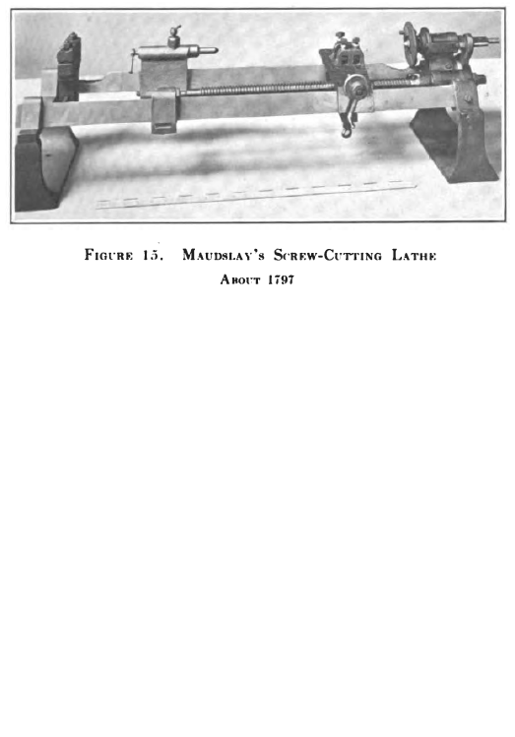

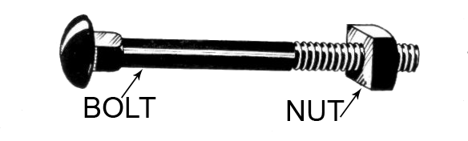
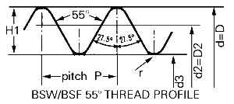
Early Industrial
Standardization

Slide 4
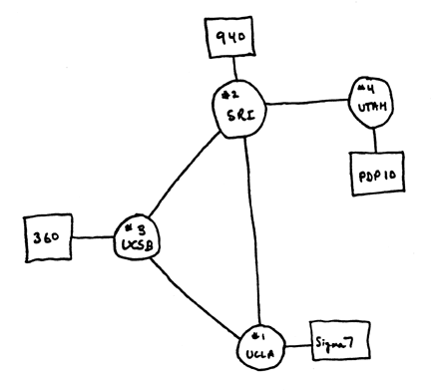
Early Internet
Standardization
Notes:
UC SB, UCLA, SRI, University of Utah

Slide 5
Internet of Things

Slide 6
Core IoT Characteristics
Interoperable
Heterogeneous
Shared
Adaptable
Describable
Reliable

Slide 7
IoT Stakeholders

Slide 8
Application Domains
ICT
Manufacturing
Finance
Food
Transportation
Domestic
Infrastructure
Entertainment
Public Safety
Retail/Service
Government

Slide 9
Technologies

Slide 10
IoT Challenges
Domains - Technologies - Stakeholders
  Different requirements
  Different backgrounds
  Different jargon
  Different viewpoints
  Different assumptions
Results in
  Difficulty in defining requirements
  Limit interoperability and potential for reuse
  Wasted effort and potentially damage

Slide 11
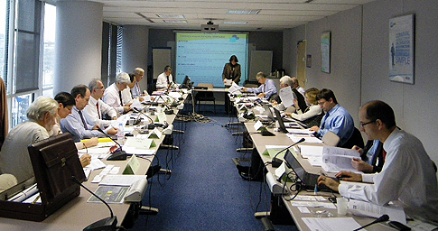
Standards

Slide 12
Standards Development Challenges
Committee Experts
  Different backgrounds
  Different jargon
  Different viewpoints
  Different assumptions
  Different requirements
Results in
  Difficulty in defining requirements
  Limit interoperability and potential for reuse
  Wasted effort and potentially damage

Slide 13
Example
Semantic Issues
IoT vs CPS
CPS – new vs old
Thing
Device
Architecture
Framework - Reference
Model
Network
Co-design
System

Slide 14
The Internet of Things?
An infrastructure of interconnected objects, people, systems and information resources together with intelligent services to allow them to process information of the physical and the virtual world and react*
*JTC1 Internet of Things Preliminary Report

