Slide 1
Standards: What are Design Patterns for Ontologies in IoT?
Mark Underwood | krypton Brothers
@knowlengr @kryptonbrothers
Co-chair nist big data working group, security & privacy subgroup

Slide 2
Presenters
William Miller – mact-usa
Geoff brown – M2MI Corp

Slide 3
Design Patterns Light
Goals
To influence software engineering practice in IoT
Pry semantic information from “code”
Embedded semantics is: Hard to share – Hard to reuse – Hard to upgrade
Leverage Greenfield project opportunities
Foster domain-specific solutions
Foster smart cut-and-paste templating (i.e., reuse)
Accept ongoing debate over “Is that really a design pattern?”

Slide 4
Ontology-based Design Pattern Features
Logic
Automated reasoning via union of classes, disjoint classes, multi-inheritance, datatype property, existential restriction, etc.
Architectural
Taxonomy (lightweight, canonical across developers)
Metamodels
Artifacts such as UML graphs
Slot – Value operations, data structures
Orchestration and Workflow
Usability
Orderly access to domain-specific natural language solution “explanations”
Developer / analyst accessibility
Network-ready
Roles: Analyst-Ontologist | Developer | Domain Expert
Simulate | Test | Audit | Forensic Automation (“new”)
Test harness created from use cases, expressed in metamodel
DevOps for IoT
- Cite: neon-project.org

Slide 5
Presentation by William Miller Quick Skim for Gist

Slide 6
Miller – Stds List

Slide 7
Miller – Cont’d

Slide 8
Miller- Cont’d

Slide 9
Miller – XMPP + extended

Slide 10
Credit: CBS Television
Mark Underwood
Principal
Design Modularity to Reasoning Systems
or
IoT Ontology Meets CSI

Slide 11
Forensics & other use cases
Would focus on use cases energize sdo’s?

Slide 12
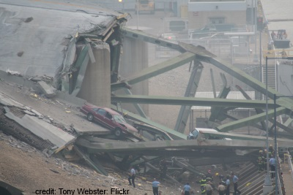
Digital Forensics: Story of an Intrepid IoT Engineer
Scenario
It’s 2050 and the smart city is a reality – albeit jumbled and haphazardly evolved. A terminal and parking garage at a major airport has collapsed and the public wants answers. The nimble (downsized) economy means a small team of software engineers (you) is responsible for data streams from several hundred thousand sensors, cameras and myriad assorted devices. Many contractors have had a hand at building the sensor systems over a decade of software projects, stop-start funding and political interference.

Slide 13
Q: What device data is relevant to the building collapse? E: Isn’t “relevance” an analytics problem?
Design pattern: ontologies may be omitted from the software engr canon, but taxonomies, semantics offer a semblance of order that customers will expect from system architectures.

Slide 14
Craft vs. Engineered Ontologies
Craftsperson Approach
Design new framework for device generation
Set bits to turn features on or off
“Fast” prototyping
Distaste for overhead
Developer impersonates a domain expert
Engineering Approach
Create models for each device
Leverage existing models (even if from different domains)
Build cross-generational self-describing frameworks
Slower initial prototyping, but faster with each new model
Accept overhead, generated- / interpretative solutions
Developer facilitates domain expert scripting / templating
Accept “fragility”

Slide 15
Bake in the Ontology?
The curious (?) case of HL7 FHIR
Help? Hinder? Make no difference?

Slide 16
HL7 FHIR – Standards Integration

Slide 17
Q: Was a black SUV driving by the west gate casing the airport over the past year? E: Which devices sensed the gate? When?
Design pattern: device properties such as location map to knowledge in complicated, unanticipated patterns

Slide 18
Q: Which devices are still working? E: Over the years, some devices were obsoleted or suppliers went out of business. Not my fault.
design pattern: longitudinal cmdb for iot
Proposed solution: big data animation with fwd/bck replay

Slide 19
Sensor Provenance Via Old School CMDB

Slide 20
IoT & Big Data Velocity
Premise: system architects should design to evolve to real time frameworks.

Slide 21
Microsoft IoT Framework (HDInsight)
Where is the ontology?
Where is provenance?

Slide 22
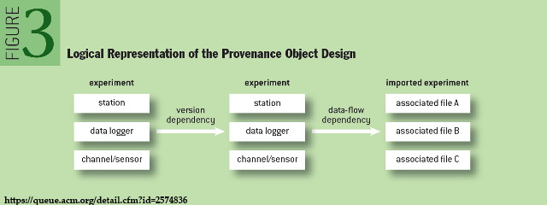
“Modern” Ontology-enabled Sensor Provenance
Prov-O
Leverages Big Data frameworks
Stream-ready (Storm, Spark, etc.)
Version-aware
Measurement, event, calibration concepts across domains
Cite: Hensley, Sanyal, New “Provenance in Sensor Data Mgmt” ACM Queue, 11(12), 2014.

Slide 23
Connection: Provenance + Ontology
Who concluded what about who when?
Old: intelligent agent. New: analytics-as-a-service

Slide 24
Q: Who is that in the video? (What did the detection?) E: Am I legally able to fuse data needed to answer?
Design pattern: privacy issues infuse iot ubiquity

Slide 25
Q: Will that IoT evidence stand up in court? E: We can’t trust data from that sensor.
Design pattern: provenance, uncertainty, intermittent streams and “triangulated” inference

Slide 26
Q: But why does the other camera show something different? E: Sorry. That device wasn’t designed to collect that sort of information.
Design pattern: mapping device to mission (see dod, dhs cyberphysical systems research)

Slide 27
Integrate IoT + Analytics
Analytics integration is not “Maybe later”

Slide 28
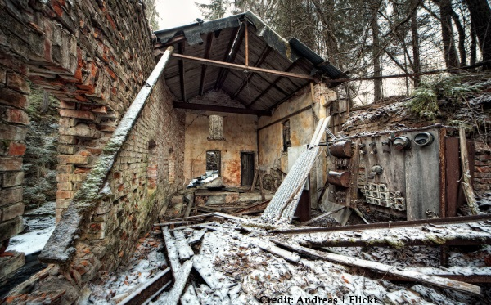
Q: Why don’t you have data for 10:23A the day of the collapse? E: Sorry. That sensor’s data is aggregated.
Design pattern: metaknowledge about device granularity and edge computation

Slide 29
Q: Local TV news knew it would snow that day. Why didn’t your sensors take that into account? E: Sorry. Interop problem.
Design pattern: low tolerance for interop disconnects
Design pattern: multisensor correlation design
Pattern? Intermittent, partially relevant time & Gps streams

Slide 30
Q: What happened to sensors on the west side of the building? E: Somebody cut power to the subnet and we lost the array.
Design pattern: network and infrastructure dependencies
Can “simple” issues like power outage, lost signal create onramps for larger projects/

Slide 31
“The nice thing about standards is that there are so many to choose from.”
Ontologies for: Geospatial integration, provenance, domains (e.g.,biomedical), security and privacy

Slide 32
Mainstreaming of IoT
Add in Big data volume / variety
What it will mean for iot system builders
Much of the The public thinks we’re already there

Slide 33
Smart City Crimesolving
Brush over data incompatibilities
Ignore data ownership
Assume data trustworthiness, reliable

Slide 34
“Mainstream” Geospatial Information Fusion
What seems “Elementary” may be anything but.

Slide 35
Ontology Needs As Exposed by Fusion Tasks
Challenges in time base and synchronization (sampled vs. “continuous” streams)
Dissimilar Event frameworks (see Complex Event Processing models)
Changes in one sensor technology affect fused sensor streams
Connecting static data (e.g., GPS) to streams (e.g., video)
Recreation scenarios for simulation, test, audit, forensics (-> Big Data frameworks)

Slide 36
The Standards Influence Maze

Slide 37
Phil Archer phila@w3.org
What device model abstractions apply to IoT system developers?

Slide 38
Semantic Sensor Network Ontology

Slide 39
Related Threads (Maybe not stds)
Process Specification Language (Gruninger)
Constrained Application Protocol CoAP (Miller)
Complex Event Processing
Intelligent Agents
Domain Specific Languages
Decentralized (edge aggregation or preprocessing)
Abstract Services (from XMPP): Federation, Gateway, “Direct I/O,” Concentration
SENSEI & other EU initiatives
Simulation, Prototyping and Test Environments
DoD fusion, composable services

Slide 40
IoT Events, Processes
XMPP Events
XMPP Discovery
XMPP XEP-0325-SN Control
XMPP XEP-0324-SN Provisioning
Error Recovery, Correction (XMPP TEDS)
XSLT for W3C uniformity
Decision framework

Slide 41
IoT Objects, Things (Examples)
Battery-powered Sensors (XMPP XEP-0000-SN)
Concentrators (XMPP XEP-0326-SN) (Miller, Voas)
Actuators
Communication Channels (Voas)
Smart Transducers, Transducer Electronic Data Sheets (21451)
Self-ID, self-describing, time- location-aware, networked, resident metadata
Require sub-ontologies?

Slide 42
Networked IoT Devices
Related work: Named Data Networking http://bit.ly/1BsEZPK
Conceptual: ACM’s “information-centric networking”
Data-centric security, adaptive routing, in-network storage
Cite: networked sensors
Software Defined Networks
Interesting – Out of scope for this presentation

Slide 43
Named Data Network Use Case: Cyber-physical Systems
http://bit.ly/1BsEZPK

Slide 44
Cross-Cutting Concerns
Temporal measurement, reasoning
Geospatial measurement, reasoning
Message parsing, interpretation (XMPP: “IoT Message Channel”)
Principally rely on work by others?
Ambiguities and Weak Definitions
“Meter” Compare IEC 61968, Multispeak V4.1, IEC 61970, NAESB PAP10 (Steve Ray)
Workflow and Orchestration
Semantic Workflow (Jack Hodges)
Data fusion workflow (Underwood)
Provenance
SSNO + PROVO-O (Jenson), Stale sensor data, failed devices, sensors in motion (Voas)

Slide 45
Design Patterns
Stimulus – Sensor – Observation (C. Henson)
Sensors as Agent-based or Control Entities (G. Berg-Cross et al.)
Middleware adapted / co-opted for IoT (G. Berg-Cross)
Big Data ontology solutions, approaches (G. Berg-Cross)
Pub/sub, discovery/integration, in-networking “paradigms” (G. Berg-Cross)
Updates to Software Development Life Cycles (SDLC) for Real Time / High Velocity Systems (Underwood)

Slide 46
Lessons Learned
Lessons from using SSN Ontology
Semantic annotation issues (Barnaghi)
Standard-to-standard as model-to-model interop or translation?
“Model refactoring” (S. Ray)
From DoD Sensor Platforms & Experiments
CPOF etc.
From Ontology Summits
May need a knowledge modeling language adapted for IoT scenarios (G. Berg-Cross)
Reusable patterns, modeling granularities, etc. (G. Berg-Cross)

Slide 47
Edge Proximity
Taxonomies & Identification: Universal Unique Identifier (Miller)
Semantics at the Edge (C. Henson)
=> Lessons from distributed computing literature?
Are old, new or hybrid design patterns visible?

Slide 48
Security, Privacy, Resilience, Audit
Q: Does the device and its subnet operate after the collapse?
XMPP – Encryption, service broker “isolation”
XMPP – Private, group, public provisioning; decommissioning
Trust frameworks
Quality of Service (QoS in Oasis MQTT)
Ownership “bundle” (Voas, Underwood)
Security and Privacy Lessons from Big Data

Slide 49
Standards Orgs & Initiativesupdated
W3C – Web of Things Community Group
Industrial Internet Consortium
ECHONET Consortium (home appliances, LITE spec, cert equip)
Share-PSI 2.0 Thematic Network (EU Open Data initiatives)
ZigBee Alliance (IEEE 802.15)
Oasis Message Queuing Telemetry Transport (IBM, Cisco, Red Hat, Tibco, Facebook)
ISO/IEEE 11073 Health Informatics Devices
OGC Sensor Web Enablement
International Telecommunication Union (IoT-GSI)
European Research Cluster on IoT
Project Haystack
Wi-SUN Wireless smart utility networks
AllJoyn | OPENIoT
ISO/IEC/IEEE 21451-1-4 | XMPP IoT
Eu Lighthouse Integrated Project IoT-A
AllSeen Alliance
OneM2M
Process Specification Language
Open Interconnect
* more at Postscapes.com

Slide 50
Related Standards & Groupsupdated
OGC Spatial Data (GeoSPARQL, NeoGeo, ISA Locn)
IEEE TC’s: Smart Cities, Big Data, Cybersecurity, IoT Communities
Semantic Sensor Web (OGC + SWE specifications)
RFID
W3C Semantic Sensor Networks Incubator Group
BPMN – BPEL: Connect to other enterprise events, workflow
REST (Bosch)
Thread Group (Google, etc.)
Heterogeneous System Architecture Foundation
Micro Electro Mechanical Systems (MEMS) Industry Group
Marine Metadata Interoperability Project
City Pulse Project | Knoesis
Temporal Abstractions Ontology
Temporal Ontologies (e.g., SWRLTO)
JSON (Steve Ray)
Apple HomeKit

Slide 51
Ontology Developers or Standards
Quantities (qudt.org) (J. Hodges)
Human Health: Anatomical parts, symptoms, diseases (obofoundry.org) (J Hodges)
ZigBee Ontology (Chien et al., 2013)
W3C Semantic Sensor Network XG Final Report (June 2011)
SENSEI, SemSorGrid4Env (G. Berg-Cross)
Activity Streams (Slides by C. Messina @Google)
CHALLENGES
Ontologies have dissimilar design (J. Hodges)
Ontology-to-ontology mapping is difficult, impossible or manual (J. Hodges)
Manufacturer-driven “ontologies” (e.g., Siemens, Vandrico)
Need for ontology-based standards (G. Berg-Cross)

Slide 52
Questions
How can an IoT ontology / standard help avoid a dead end (update when a standard updates?)
What about IoT ontologies and vendor lock-in issues? Are there ways that integrating an ontology can create a competitive edge, or does it allow competitors into the game?
IoT standards and universal access? How? Discovery? Standardized taxonomies? Metadata?
Can a standardized IoT ontology help to lower cost for integrators, startups or bridge technologies?

Slide 53
Questions – 2
Heads-up for nonprofits and NGOs: Are there broader social problems that IoT ontologies, working in connection with open data, or linked data initiatives can do “good” while preserving privacy and intellectual property?
Can a more readily accessible ontology / std broaden a market? What antecedent conditions?
What lessons can be learned from early (IoT, IoT-ontology) adopters?
Which organizations should be added to slide 5?
Which roles have been omitted from the “Influence Maze? (slide 6)
What partnerships are working well? Which aren’t?
Specific Challenge areas? (Power mgmt., security, signal post-processing, provenance, signal quality, discovery, metadata, network issues, Big Data
Lessons from history: Modsim, Sensor fusion, CEP, intelligent agents, middleware, embedded systems
Favorite use cases: how you’ll know there’s a place for ontologies in IoT
IEEE 1588 temporal / time issues

Slide 54
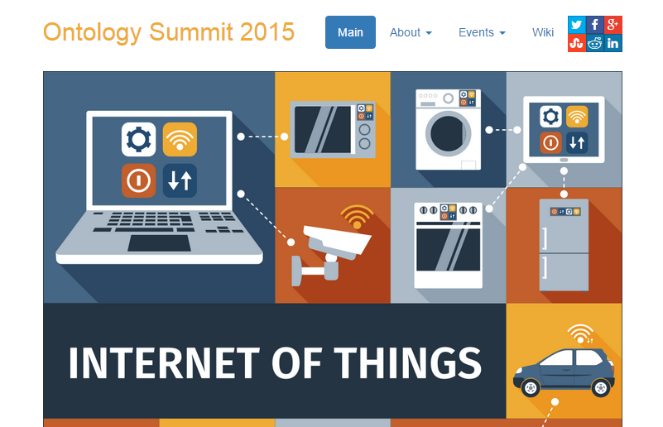
Credit: Ontology Summit 2015
http://ontolog.cim3.net/OntologySummit/2015/

