Slide 1
BioPortal Status and Plans September 2011
Ray Fergerson
NCBO Project Director
Stanford University
ray.fergerson@stanford.edu

Slide 2
Outline
What is the NCBO?
What is BioPortal?
What is new?
What is coming?

Slide 3
What is the NCBO?
A National Center for Biomedical Computing (NCBC) created by the US National Institutes of Health and administered by NHGRI.
Collaborating Sites
Stanford University (Mark Musen)
Mayo Clinic (Chris Chute)
University of Victoria (Peggy Storey)
University at Buffalo (Barry Smith)

Slide 4
NCBO Key Activities
We create and maintain a library of biomedical ontologies.
We build tools and Web services to support the use of ontologies.
We collaborate with scientific communities that develop and use ontologies.

Slide 5
What is BioPortal?
Library of 290+ biomedical ontologies
Gene Ontology (GO) and Extended Gene Ontology
Systematized Nomenclature of Medicine Clinical Terms (SNOMED CT)
International Classifications of Diseases (ICD)
Medical Subject Headings (MeSH)
Read Codes (CTV3)
Biomedical Resource Ontology (BRO)
NCBI organismal classification
RadLex
NCI Thesaurus
RxNORM
Foundational Model of Anatomy (FMA)

Slide 6
What is BioPortal?
Work with ontologies themselves
Submit, update, and download an ontology
Browse and visualize an ontology
Comment on and suggest changes to an ontology (Notes)
Post a review of an ontology
Create a view of an ontology
Create mappings between ontology terms
Demonstrate the use of ontologies
Text annotation with ontological terms (Annotator)
Resource search with ontological terms (Resource Index)

Slide 7
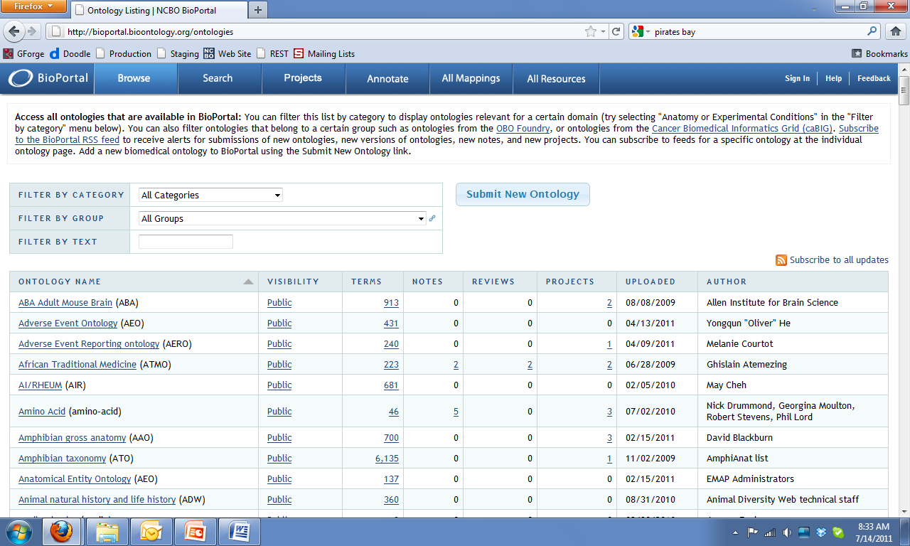
Ontology Browsing

Slide 8
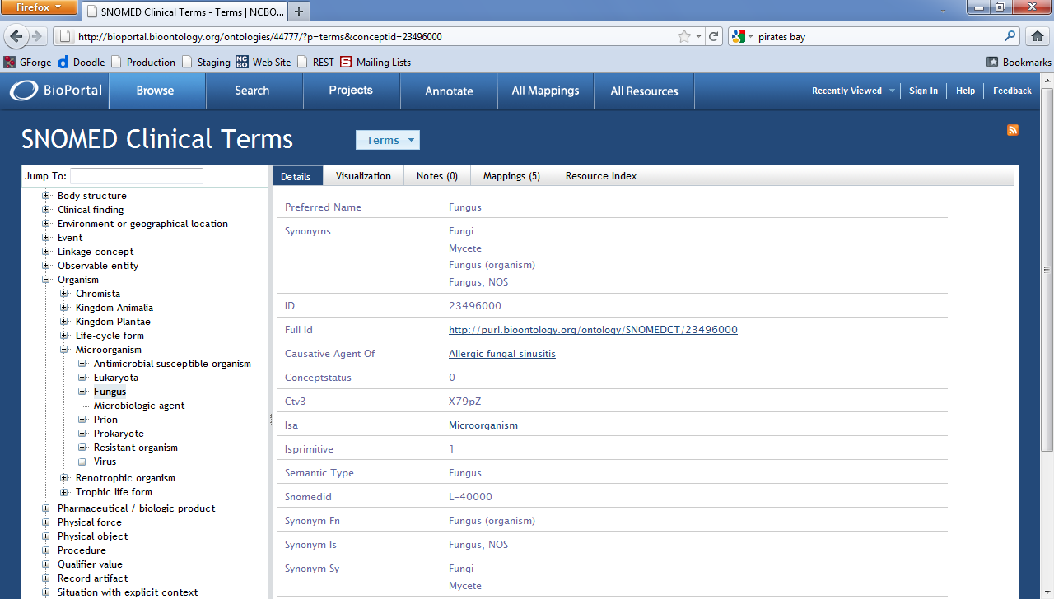
Term Browsing

Slide 9
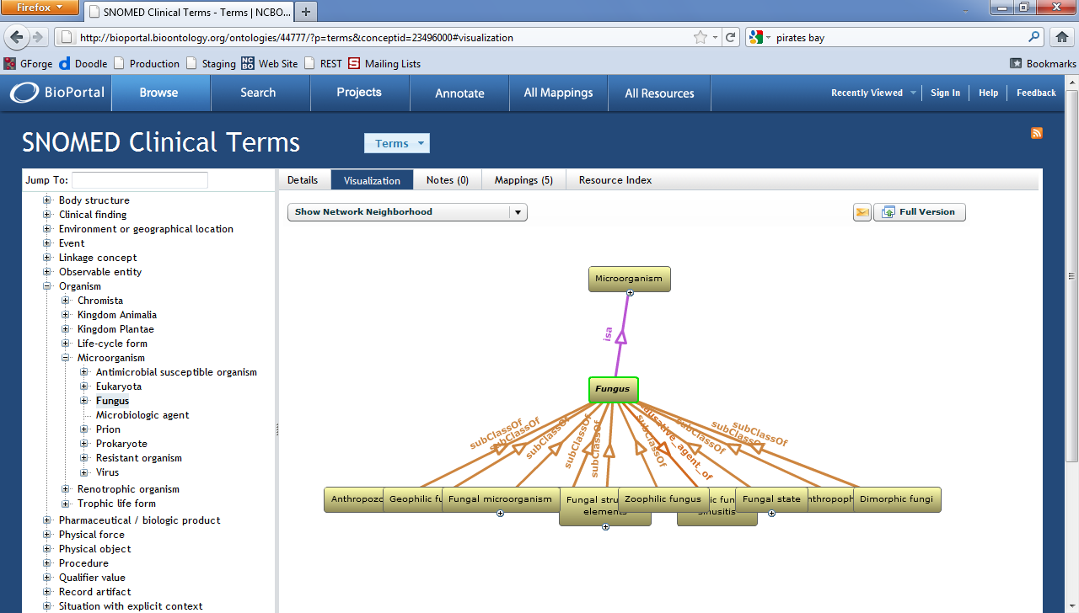
Visualization

Slide 10
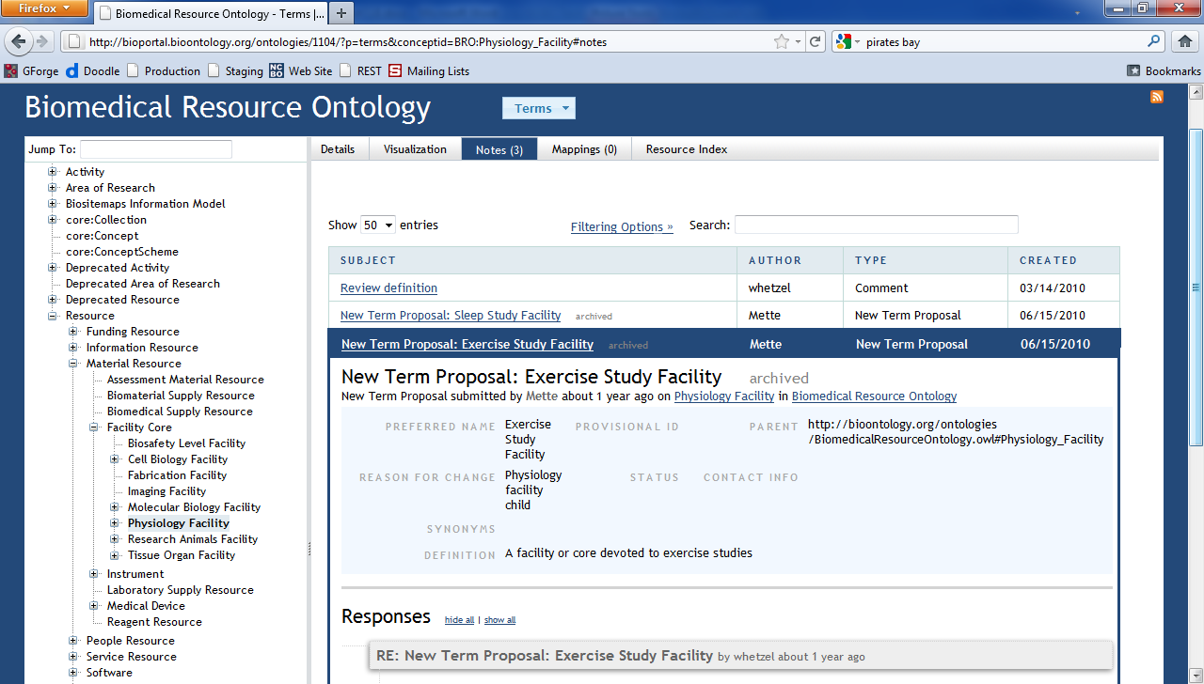
Notes

Slide 11
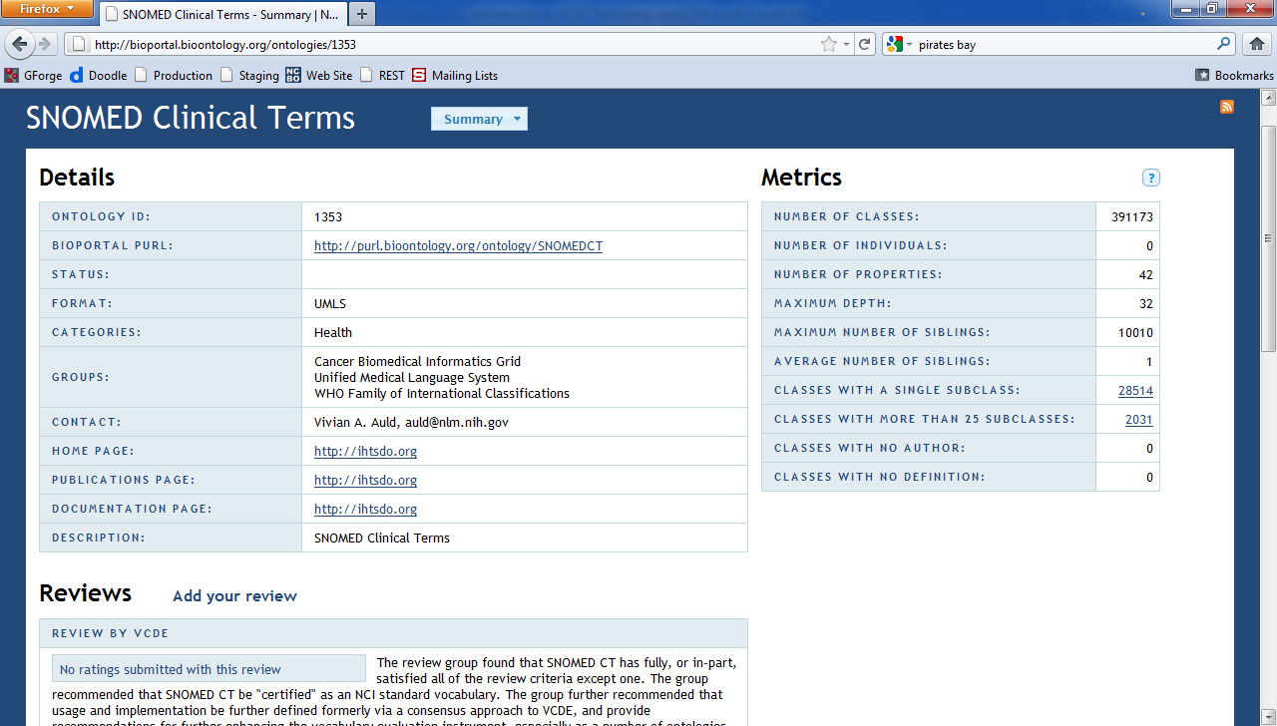
Reviews

Slide 12
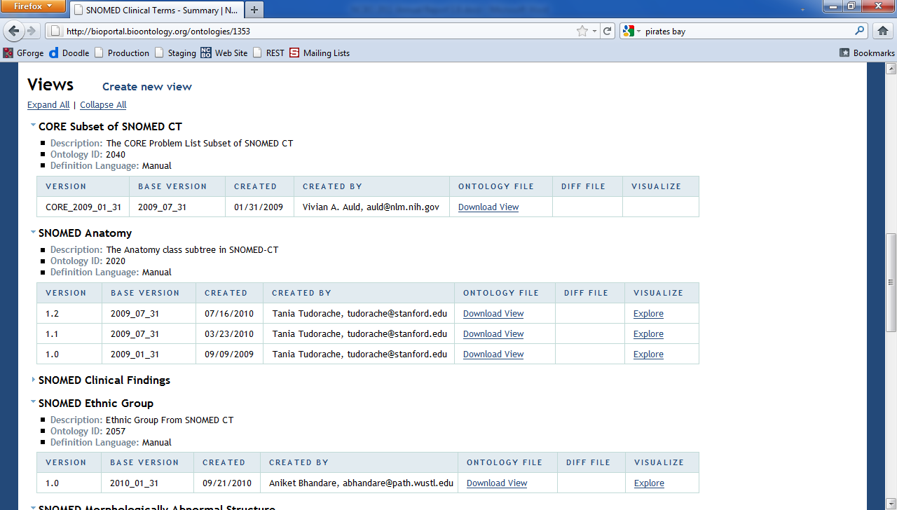
Views

Slide 13
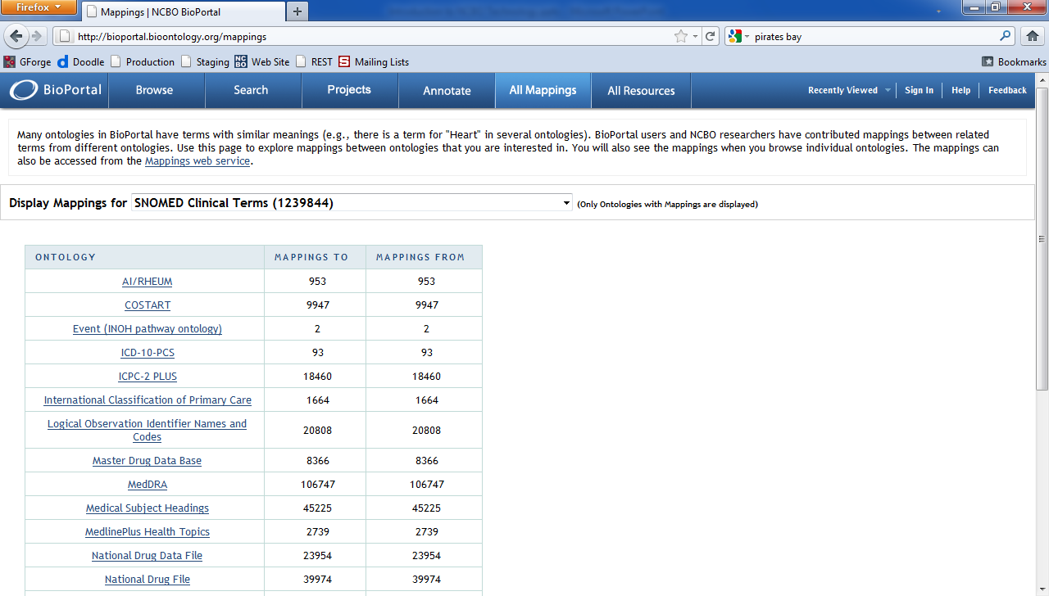
Mappings

Slide 14
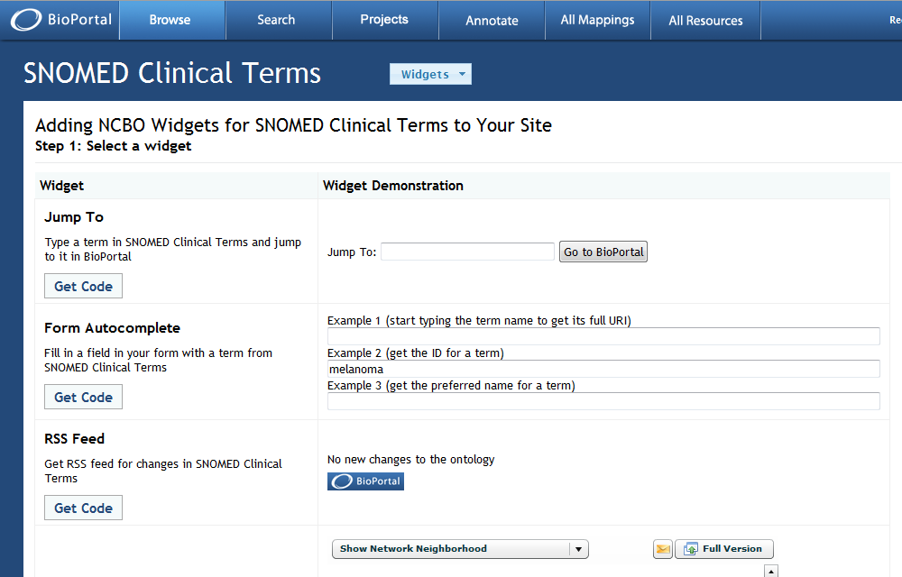
Web Page Widgets

Slide 15
Current Architecture
BioPortal
BioPortal
BioPortal
Other Applications
REST Layer
Protégé
LexGrid
Hierarchy Cache
Resource Index

Slide 16
Planned Architecture
BioPortal
BioPortal
BioPortal
Other Applications
REST Layer
RDF Triplestore
Hierarchy Cache
Resource Index

Slide 17
Applications Using Our Technology
35 applications use our infrastructure, including:
eleMap data harmonization tool from the eMERGE network
Gene Wiki for documenting all notable human genes
ODiSSea biomedical resource explorer created by Elsevier

Slide 18
Local BioPortal Installations

Slide 19
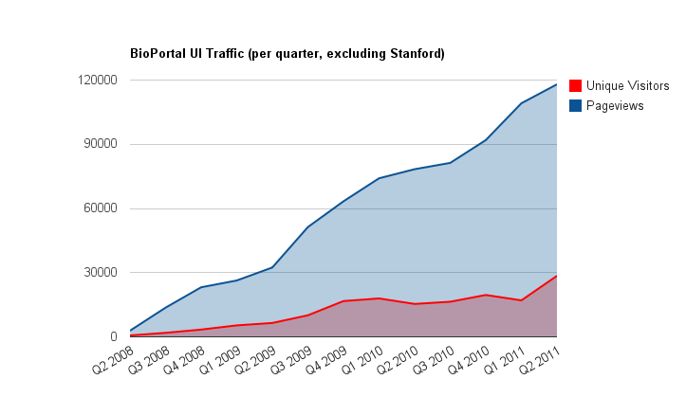
BioPortal UI Traffic

Slide 20
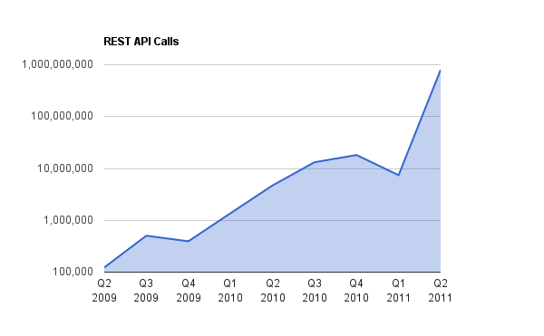
REST Traffic

Slide 21
What is new?
Adoption of 2-clause BSD license
Ontology Recommender
Accept a paragraph or two of text
Analyze its use of ontology terms
Recommend closely matched ontologies
Private ontologies
Submitter designates who can browse ontology
Improved support for OWL 2

Slide 22
What is coming?
Licensed Ontologies
RDF triple-store supporting SPARQL queries
MyBioPortal (limiting visible ontologies)
Improved ontology visualization
Removal of all usage of Flash technology
Allow local installations to add/remove tabs
http://palexander.posterous.com/extending-bioportals-rails-ui

