Slide 1
Landscape Ontologies The Case for the Domain of Landforms
Gaurav Sinha
Assistant Professor
Department of Geography
Ohio University
Athens, OH

Slide 2
Comparing Terminological Systems (Focus on Eminences)
SDTS
GNIS
Wordnet
EnvO
Other (e.g., Granö, 1927)
OED, Merriam Webster, Wikipedia, Dictionary.com

Slide 3
Eminence Related Types: GNIS (USA)
Feature Class | Definition | Associated Generics
Bench | area of relatively level land on the flank of an elevation such as a hill, ridge, or mountain where the slope of the land rises on one side and descends on the opposite side (level) | None
Cliff | very steep or vertical slope | bluff, crag, head, headland, nose, palisades, precipice, promontory, rim, rimrock
Pillar | vertical, standing, often spire-shaped, natural rock formation | chimney, monument, pinnacle, pohaku, rock tower
Range | chain of hills or mountains; a somewhat linear, complex mountainous or hilly area | cordillera, sierra
Ridge | elevation with a narrow, elongated crest which can be part of a hill or mountain | crest, cuesta, escarpment, hogback, lae, rim, spur
Slope | a gently inclined part of the Earth's surface | grade, pitch
Summit | prominent elevation rising above the surrounding level of the Earth's surface; does not include pillars, ridges, or ranges | ahu, berg, bald, butte, cerro, colina, cone, cumbre, dome, head, hill, horn, knob, knoll, mauna, mesa, mesita, mound, mount, mountain, peak, puu, rock, sugarloaf, table, volcano

Slide 4
Eminence Types: SDTS (USA)
Entity Type | Definition | Included Types
Cliff | A high, steep, or overhanging face of rock. | beach scarp, bluff, ceja, crag, escarpment, ice cliff, marine cliff, palisade, precipice, scar, scarp, scaw
Mount | A mountain or hill | bald, bank, bery, cerrito, cerro, cinder cone, cuesta, dome, drumlin, foothill, hill, hillock, hummock, kame, knob, knoll, lava cone, monadnock, mound, mountain, pingo, rise, sand dune, sand hills, seaknoll, seamount, shield volcano, volcano
Mount Range | A series of connected and aligned mountains or mountain ridges | Mountain range, range, seamount chain, seamount group, seamount range
Peak | The summit of a mountain | ice peak, nunatak, seapeak, summit
Pinnacle | A tall, slender, spire-shaped rock projecting from a level or more gently sloping surface | chapeirao, coral head, crag, pillar, precipice, scar
Plateau | An elevated and comparatively level expanse of land | butte, guyot, intermontane plateau, mesa, tableknoll, tableland, tablemount
Ridge | A long and narrow upland with steep sides | arete, beach cusps, beach ridge, cerro, crest, cuesta, drumlin, esker, kame, range, sand dune, sand hills, sill, spur, volcanic dike
Ridge Line | The line separating drainage basins | None

Slide 5
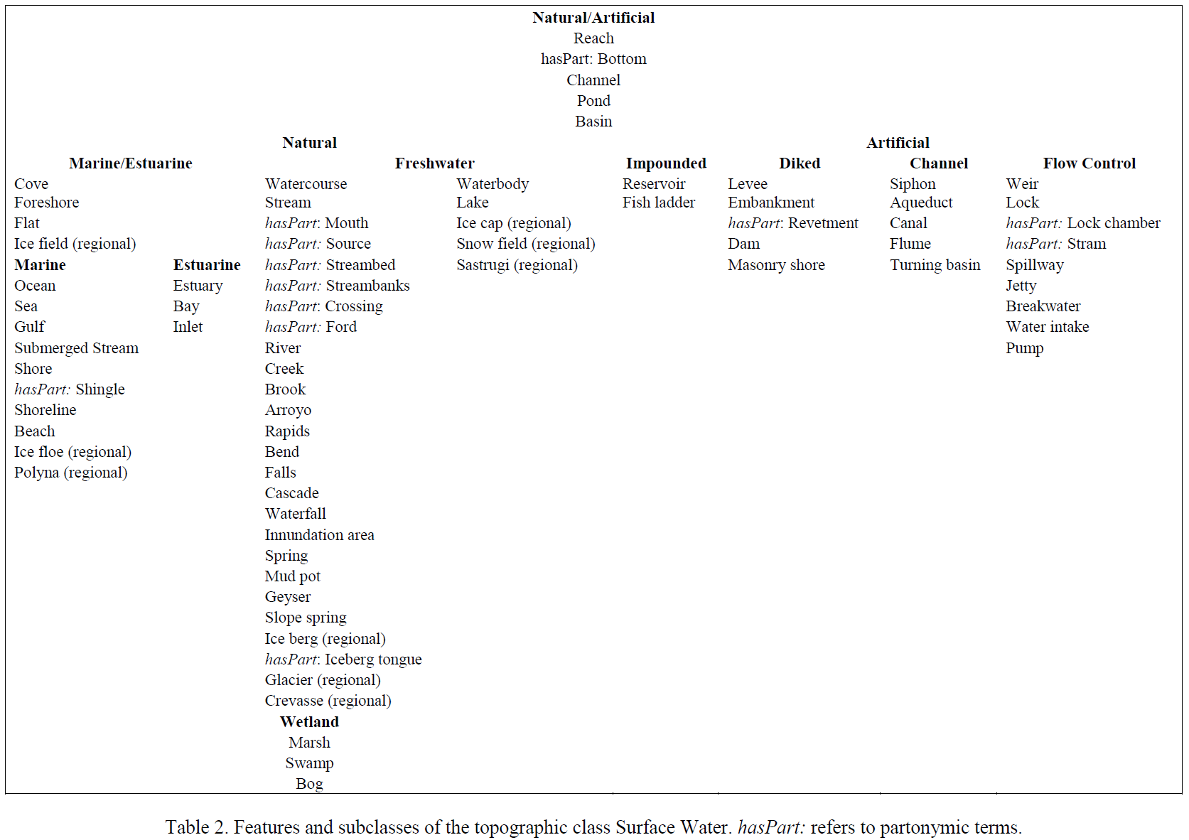
National Map Ontology (USGS)
Dalia Varanka,, USGS.. A TOPOGRAPHIC FEATURE TAXONOMY FOR A U.S. NATIONAL TOPOGRAPHIC MAPPING ONTOLOGY

Slide 6
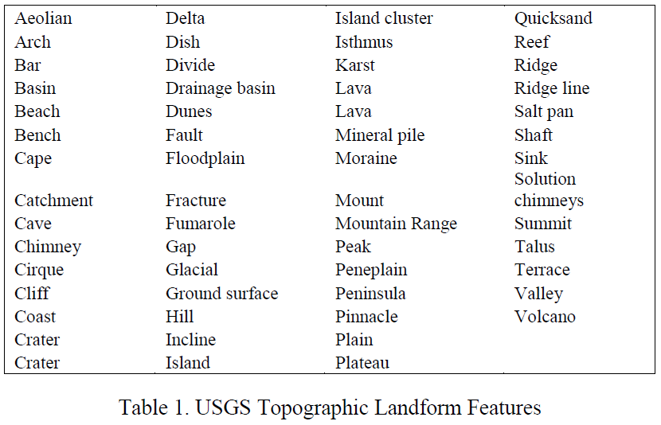
National Map Ontology (USGS)
Dalia Varanka,, USGS.. A TOPOGRAPHIC FEATURE TAXONOMY FOR A U.S. NATIONAL TOPOGRAPHIC MAPPING ONTOLOGY

Slide 7
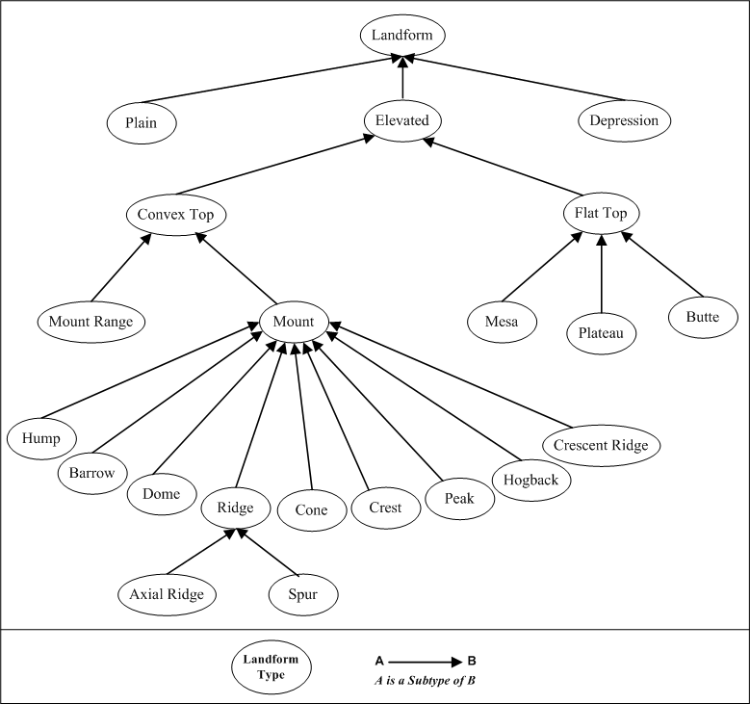
Another Eminence Taxonomy
Source: Granö, 1927

Slide 8
EnvO

Slide 9
EnvO

Slide 10
EnvO
Are buttes and plateaus not elevations?
Are volcanoes often not also elevations?

Slide 11
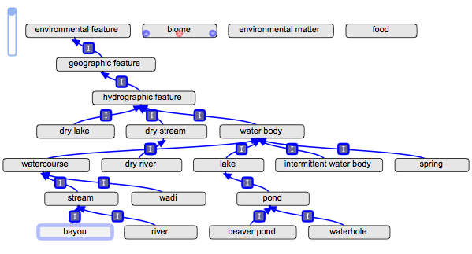
EnvO

Slide 12
EnvO

Slide 13
WordNet
Entity
Physical Entity
Object, Physical Object
Geological Formation, Formation
NATURAL ELEVATION, ELEVATION
(HAS PART: slope, incline, side)

Slide 14
WordNet
Entity
Physical Entity
Object, Physical Object
Geological Formation, Formation
NATURAL ELEVATION, ELEVATION
What if a volcano has a crater and not a peak?
Can a hill not have a peak or summit?
(HAS PART: slope, incline, side)

Slide 15
WordNet
Entity
Physical Entity
Object, Physical Object
Geological Formation, Formation
NATURAL ELEVATION, ELEVATION
(HAS PART: slope, incline, side)

Slide 16
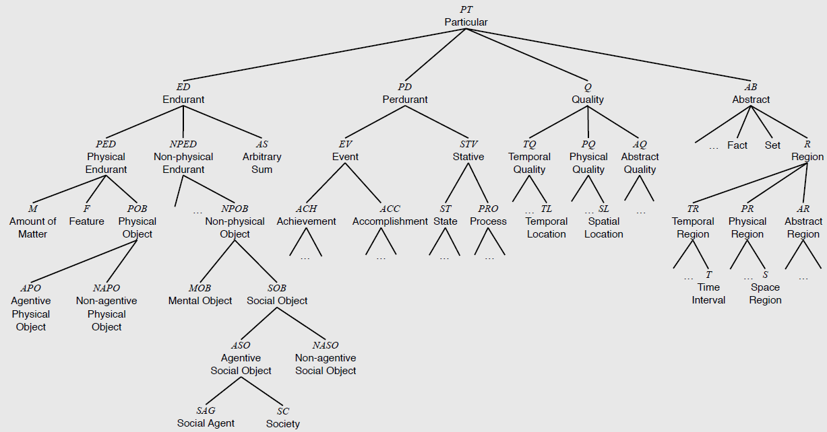
DOLCE

Slide 17
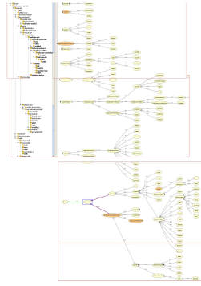
DOLCE Landscape (Boyan Broderic)

Slide 18
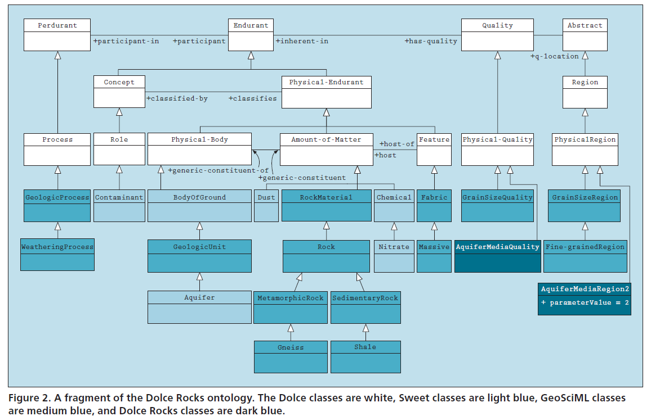
Boyan Broderic, Florian Probst 2009. Cross Disciplinary E-Science by Integrating Geoscience Ontologies with Dolce, IEEE Intelligent Systems

Slide 19
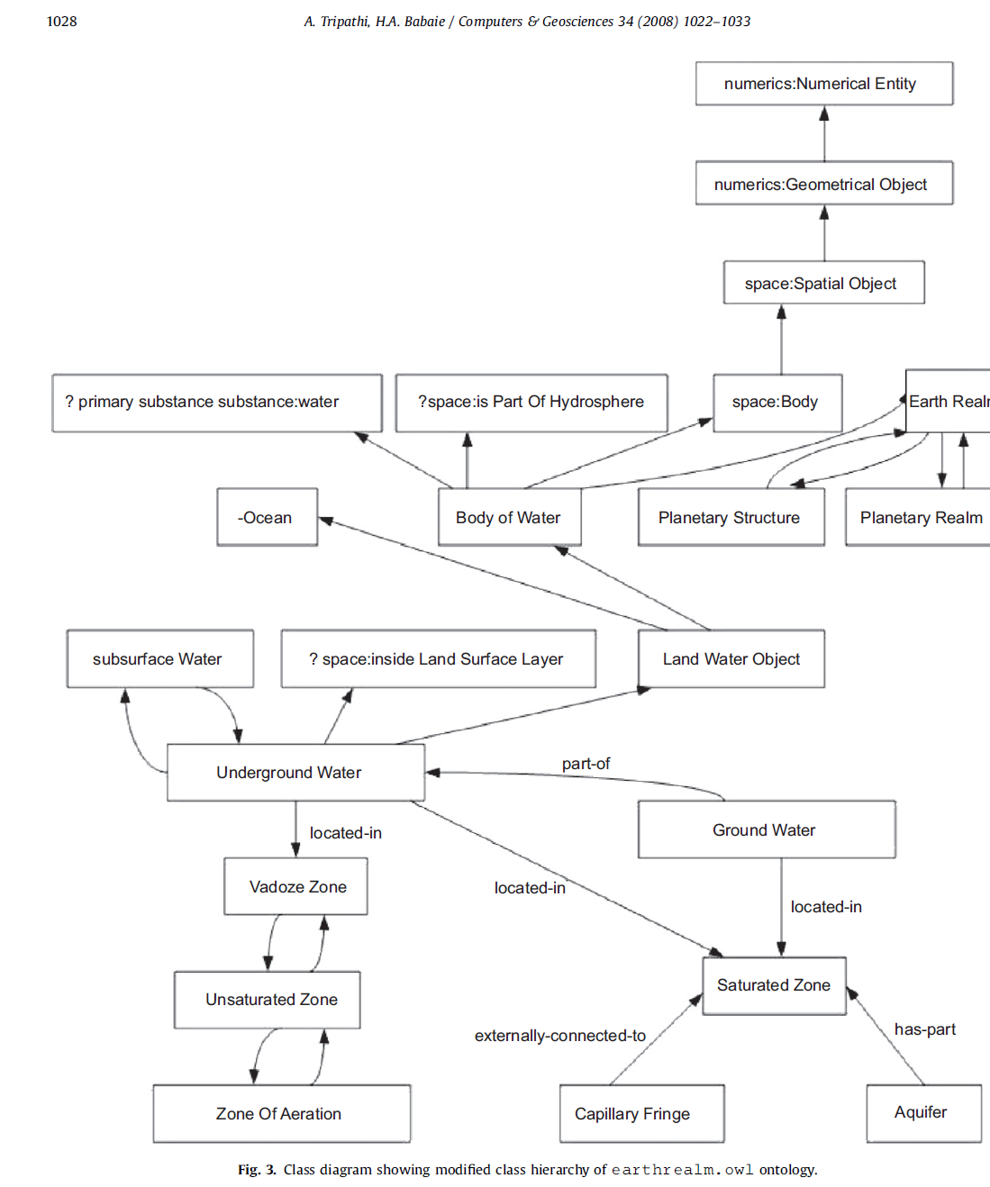

Slide 20
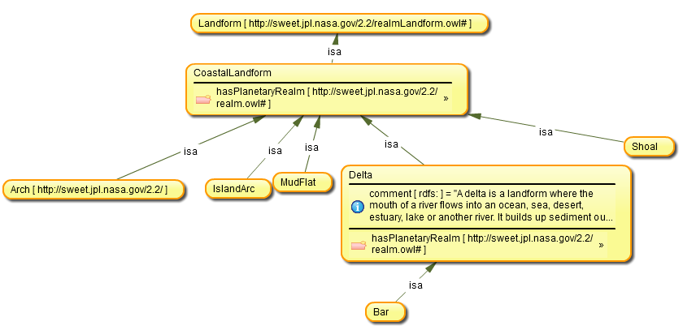
SWEET?

Slide 21
Different perspectives
Physiographic description (landscape scale)
Landscape segmentation
Geomorphological
Functional (ESRI data models)

Slide 22
Why Landscape Ontology?
MY interest in and background in geology and physical geography
Data modeling issues (Field? Object?)
Form or Process? (form vs. how it was formed)
Sufficient semantic incompatibility of different landscape terminologies
No unifying theory of the landscape and its components are cognized and conceptualized
Spatial cognition approach

Slide 23
Where we stand…
“So, my view of natural landscape is that landforms and waterbodies have particular characteristics that humans are able to observe, such as size, shape, material, and then within any language, the culture has, over the centuries and millenia, picked out certain distinctions that that become categorial (or categorical). Some distinctions lead to different terms, such as "mesa". Some distinctions lead to compound terms with an adjective. Some distinctions are ignored in one language and have different nouns in another language.”
--David Mark, email communication (2010)

Slide 24
Realist Ontology of the Landscape?
A realist ontology of landforms is likely to be very shallow because of cultural and linguistic variations in landscape perception
Pluralistic view of landform ontologies is unavoidable
HOWEVER, there still are certain commonalities which can be the basis of an upper-level landform/landdscape ontology
But it does not include object level concepts such as mountain, hill, butte, river etc.
Use spatial cognition as a framework for identifying unifying concepts across language and cultures
Consider issues of geographic scale (granularity)

Slide 25
Realist Ontology of the Landscape
ONE giant ‘object’ – EARTH
Form of the earth surface can be approximated as a discrete approximation to a single-valued field of elevations
Land cover material (rock, sand, dirt, water, clay, wood,)
Observable physical characteristics (location, shape, size, elevation, gradient, depth, color, material)
Surface can have local superficialities features (e.g., protuberance, peak, ridgeline, fault, layer, hollow, depression, cliff, incline, slope break, edge)
Secondary anthropogenic entities (e.g. trees, roads, buildings) are also attached to that earth surface

