Slide 1
Surface Networks
Doug Foxvog, UMBC/NIST
Dave Kolas, Raytheon BBN Technologies
David Mark, SUNY Buffalo
Daniel Mekonnen, Algebraix Data Corporation
Anand Padmanabhan, UIUC
Boleslo E Romero, UCSB
Gaurav Sinha, Ohio University
E. Lynn Usery, U.S. Geological Survey
GeoVoCamp, Reston, VA
11/2102

Slide 2
Cayley-Maxwell Theory of Surface Networks
Classes describe elements of surfaces (e.g. topography)
Many named surface features have classes which are subjective and/or context dependent:
Mountains vs hills
There are objective elements of surfaces that can be a set of building blocks for these.

Slide 3
Theory vs. Practice
Practical specialization of pattern:
Real world surface does not meet requirements of the theoretical model (i.e., is not continuously differentiable)
This means that certain geographic features are not able to be modeled
Specialization allows for ‘extra’ critical points and lines
This creates better links to features in other domains
Catchments
Streams

Slide 4
General Theory vs. Application
Three ontologies so far:
Surface Networks in general
Geographic terrain surfaces
Links out to GeoSPARQL
Multi-Surface Applications

Slide 5
Class Hierarchy

Slide 6
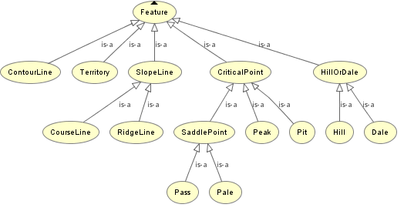
Class Hierarchy - Terrain

Slide 7
Relationships - Terrain
boundedBy
hasPart_directly
part of_directly
partOf_directly
upperEnd
lowerEnd
upperEnd
lowerEnd

Slide 8
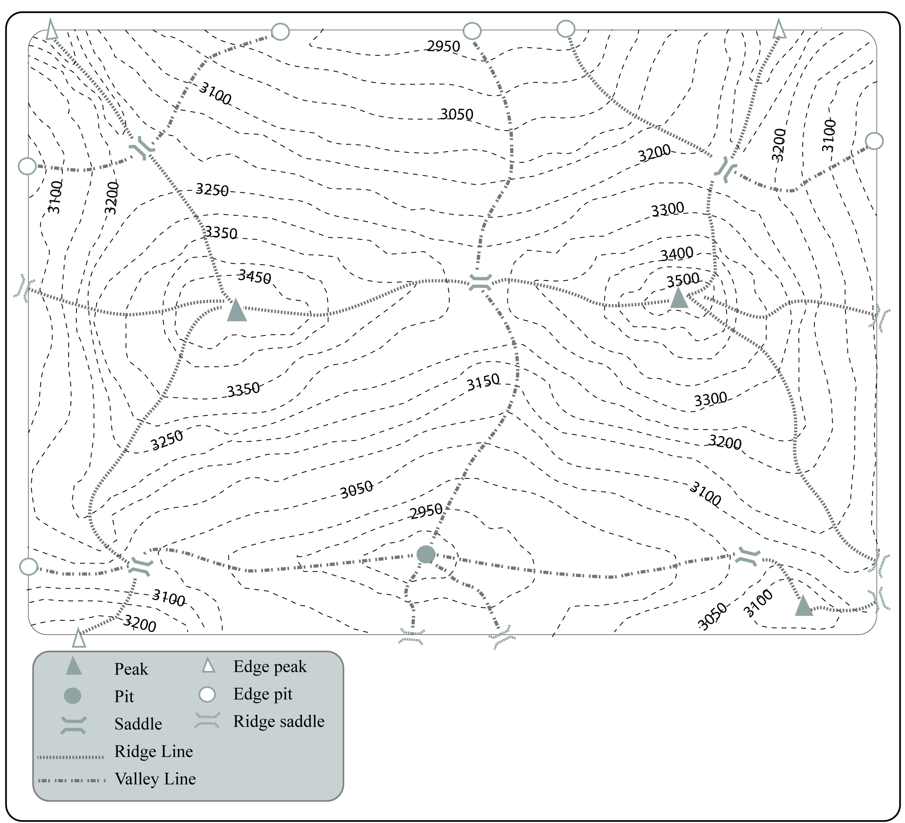

Slide 9
OWL Ontology
Created and will be made available
Namespaces? Locations?

Slide 10
Future Work
Datasets
Generate example surface network data from USGS 30m Digital Elevation Model
Publish this data within the ontology as RDF
Scale this process up via CyberGIS project
USGS publishes data results
Publication

