Slide 1
Semantic Tools for Buildings Spatial Ontology Community of Practice (SOCOP) Workshop GeoVoCamp
Networking and Information Technology Research and Development (NITRD)
at the US National Science Foundation (NSF)
November 18 – 19, 2013
Presented by Deborah MacPherson, CannonDesign

Slide 2
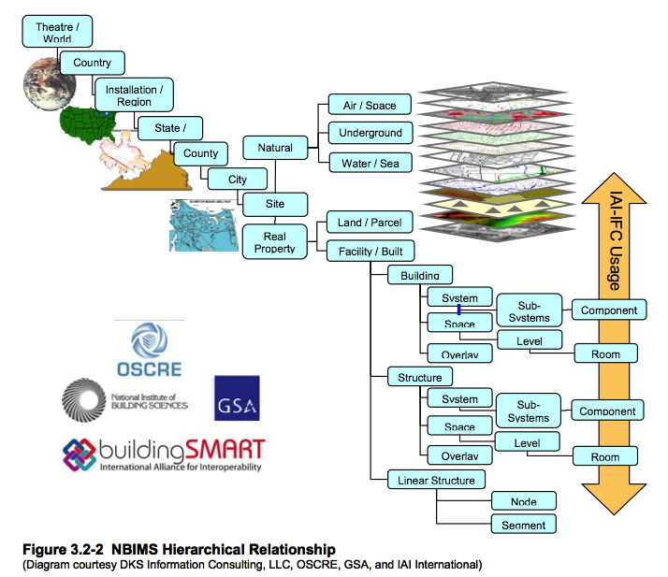
Building Information Modeling (BIM) Taxonomy

Slide 3
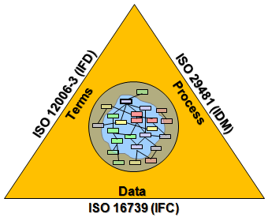
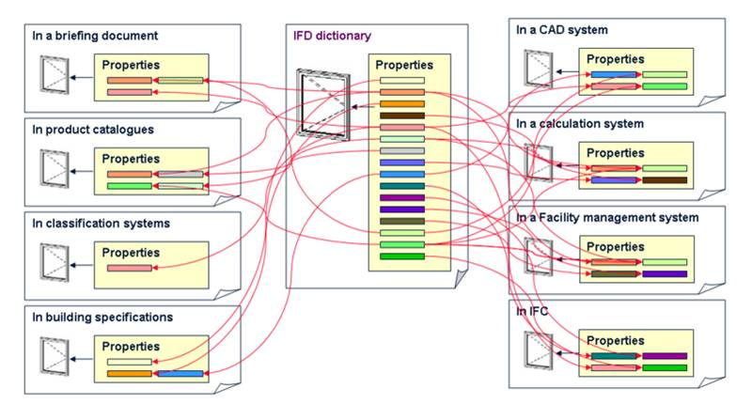
buildingSMART Data Dictionary
A mechanism that allows for creation of multilingual dictionaries or ontologies.
A reference library intended to support improved interoperability in the building and construction industry.
ISO 12006-3: 2007 (Building construction: Organization of information about construction works, Part 3: Framework for object-oriented information)
Previously called International Framework for Dictionaries (IFD)
http://www.ifd-library.org

Slide 4
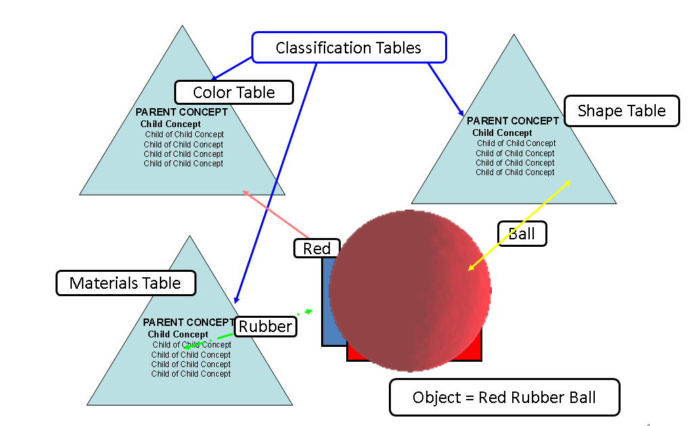
OmniClass – Faceted Classification

Slide 5
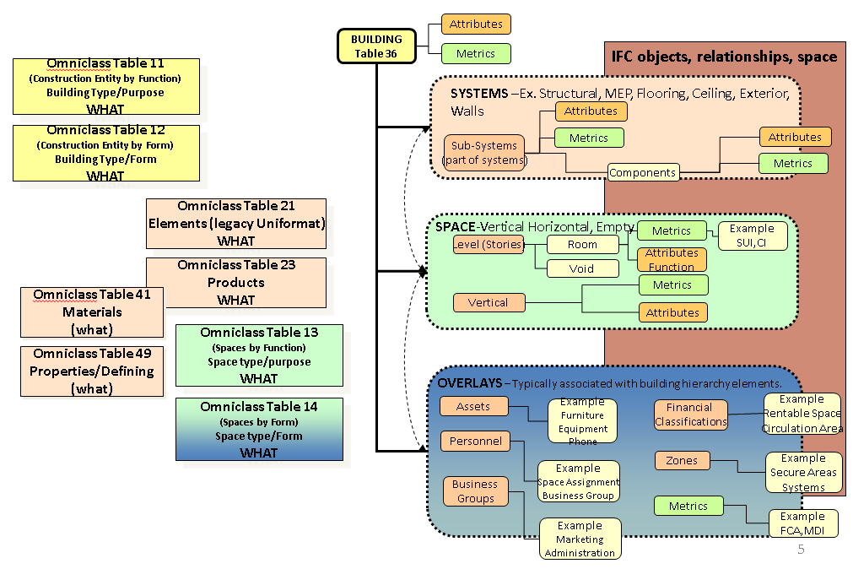
OmniClass – Putting the I in BIM

Slide 6
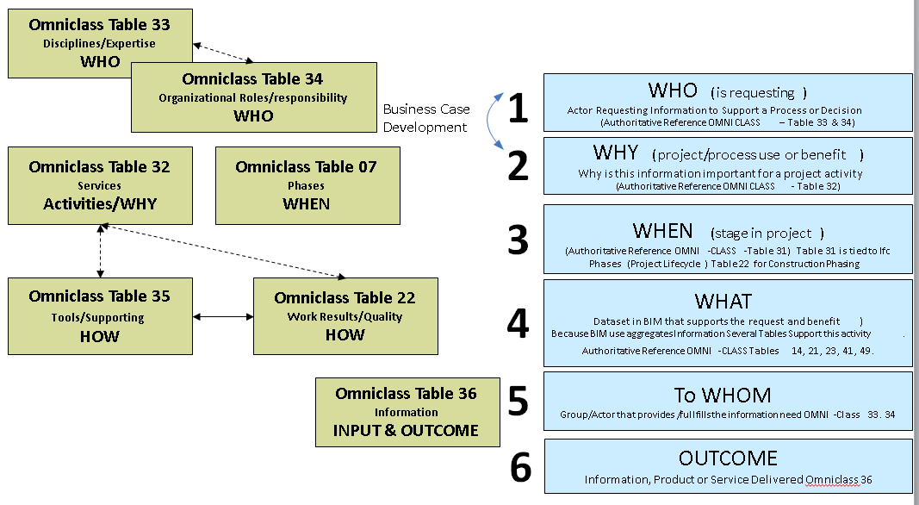
OmniClass – Business Process

Slide 7
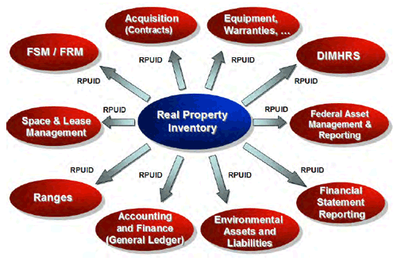
Real Property Unique ID

Slide 8
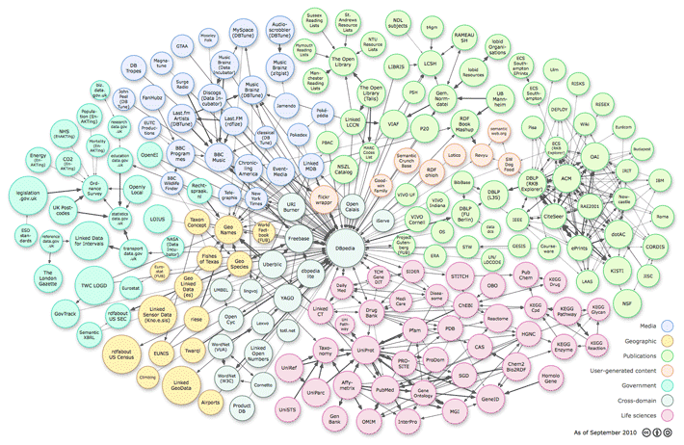
Why Geo? Why Now?
CityGML LOD4
Linked Open Data

