Slide 1
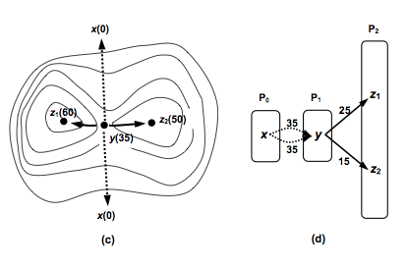
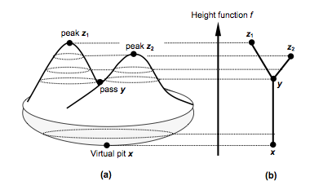
Surface Water - how water sits in(on?) terrain (Based on 2012’s Surface Networks and the Ontology of Topography)
David M Mark
University at Buffalo
Gaurav Sinha
Ohio University

Slide 2
Surface Water - how water sits in(on?) terrain
The basic principle is this:
In landscapes with moderate to high relief, the configuration of the topography controls where water flows or pools

Slide 3
Surface Water - how water sits in(on?) terrain
This should provide a theoretically-sounds basis for semantic interdependence of hydrographic and topographic ‘layers’
Also perhaps a basis for inferring hydrographic features from topographic information

Slide 4
“Wisdom Sits in Places”
Water sits in voids!(depressions, basins, course-lines)

Slide 5
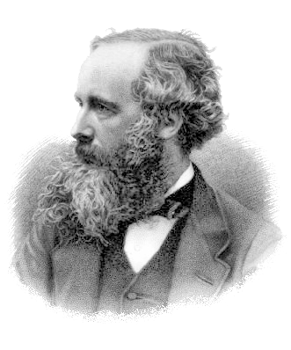
Origin Stories…
Reech, M., 1858, Proprieté générale des surfaces fermées, Journal de l'Ecole Polytechnique
Cayley, Arthur, 1859, On contour lines and slope lines. Philosophical Magazine Series 4, Volume 18, Issue 120
Maxwell, James Clerk, 1870. On hills and dales. Philosophical Magazine Series 4, Volume 40, Issue 269

Slide 6
Surface Network
Source: Rana and Morley, 2002, Figure 2.1, p. 21

Slide 7
Contour Enclosure Tree
Source: Rana and Morley, 2
002, Figure 2.1, p. 21

Slide 8
These are Graphs on the SAME NODES!

Slide 9
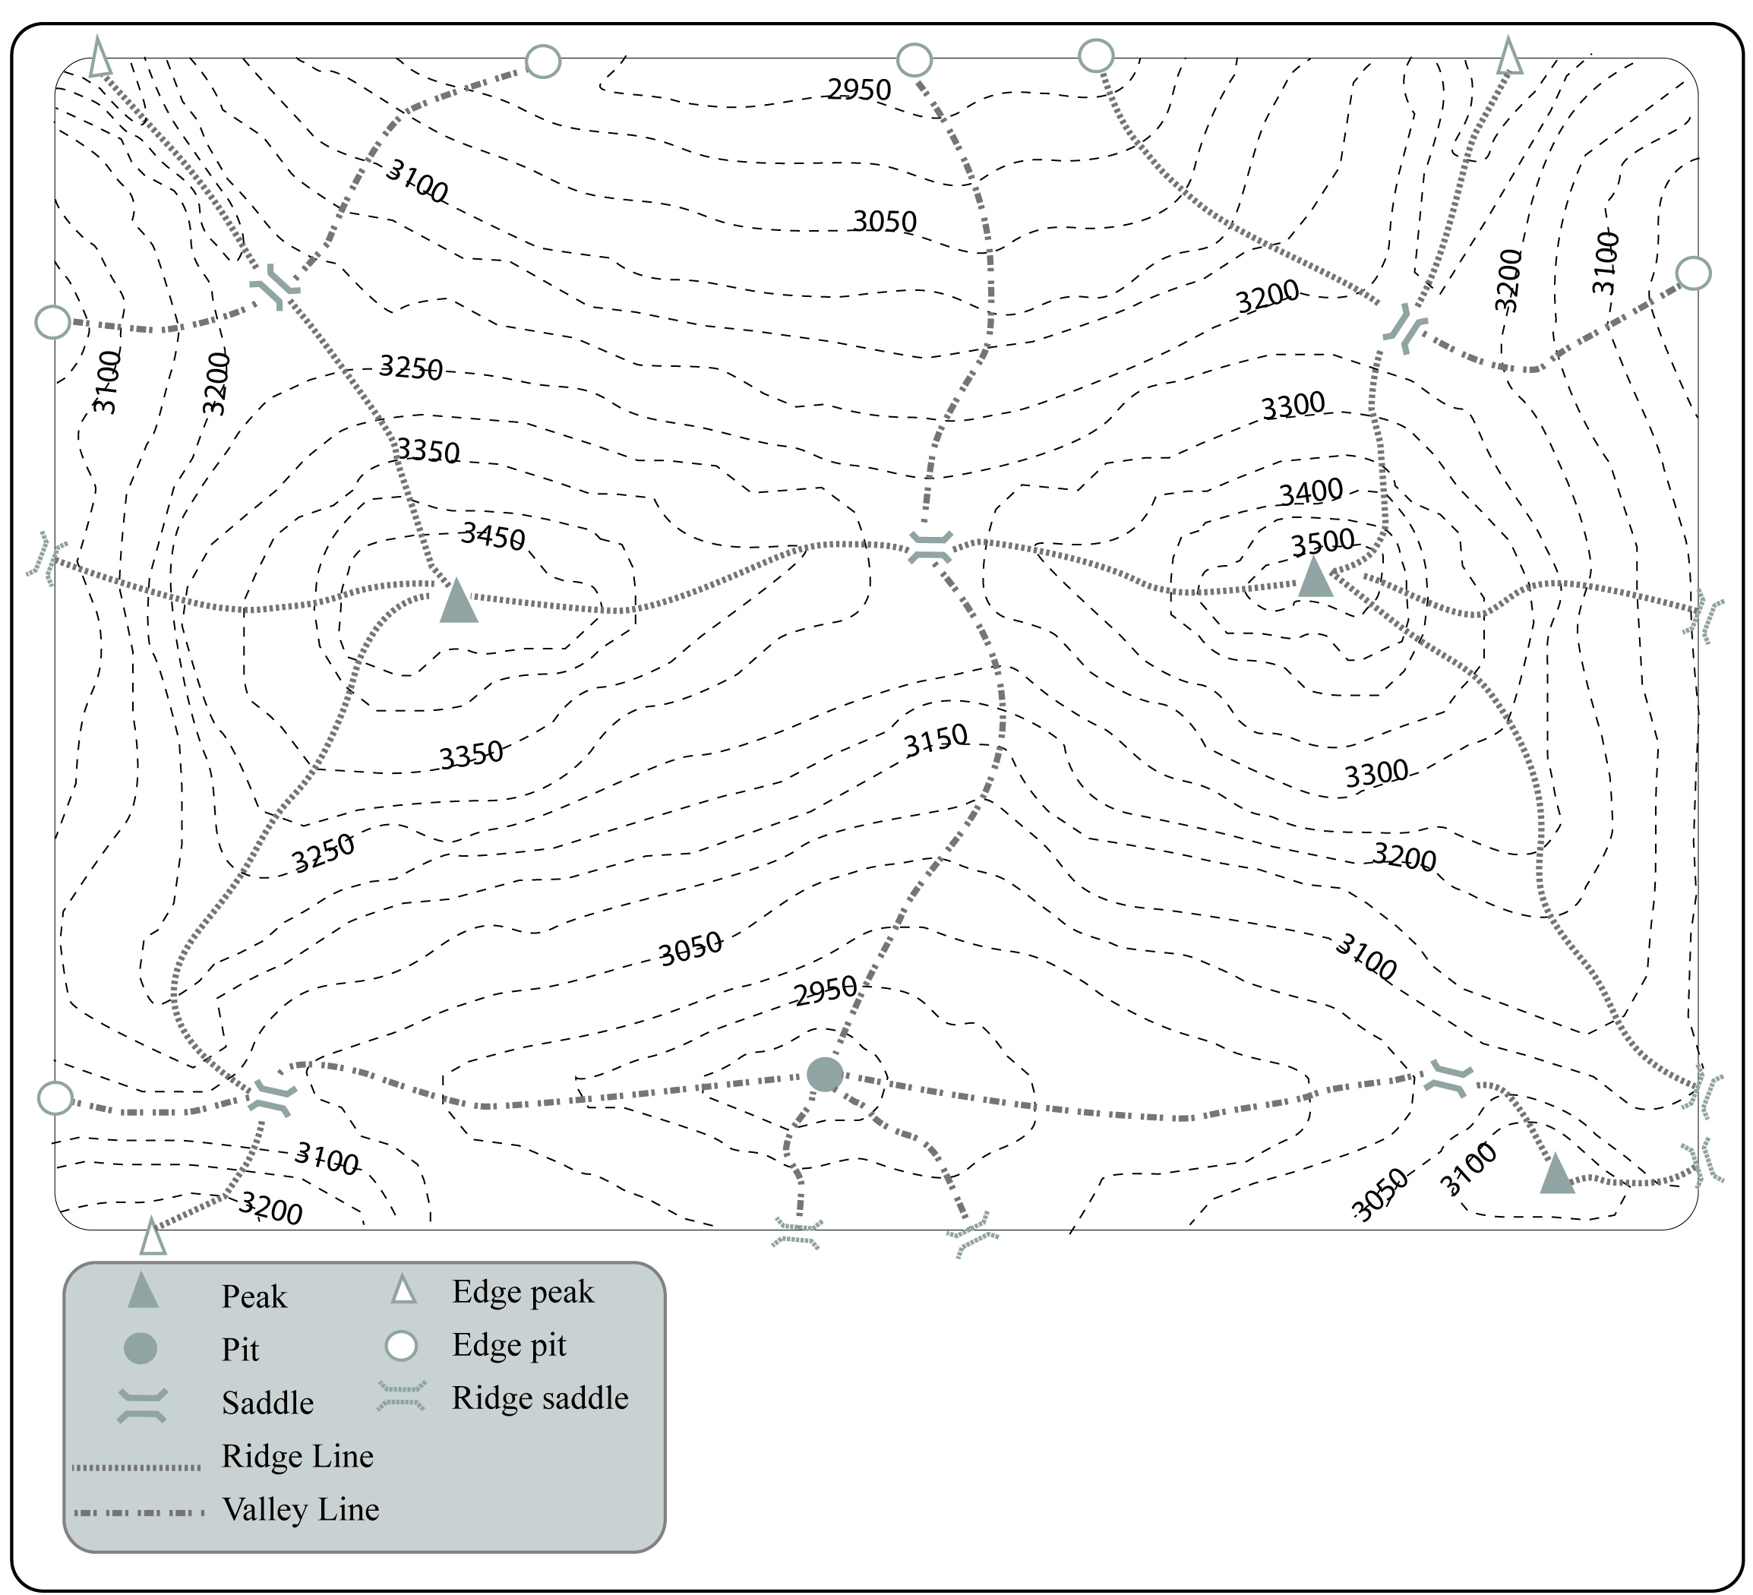

Slide 11
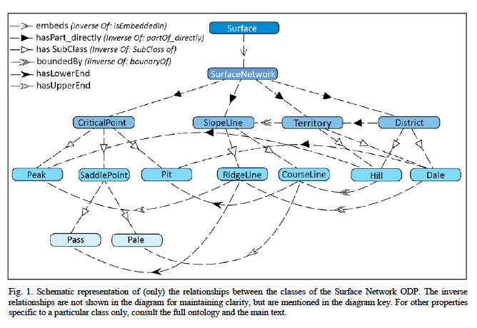

Slide 12
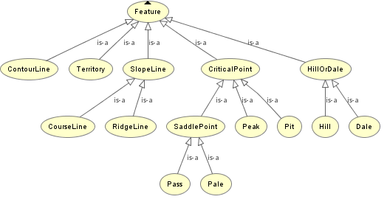
Class Hierarchy – Terrain
During the workshop last year, for a while we included contours, but they did not make the final version

Slide 13
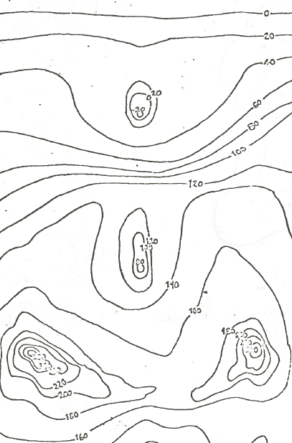

Slide 14
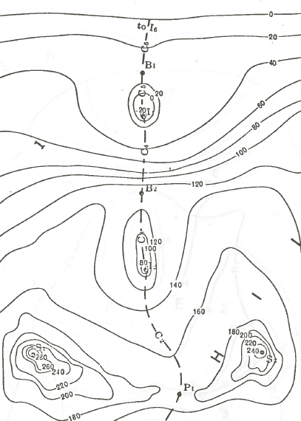

Slide 15
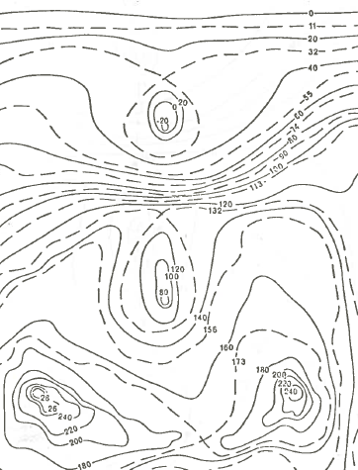

Slide 16
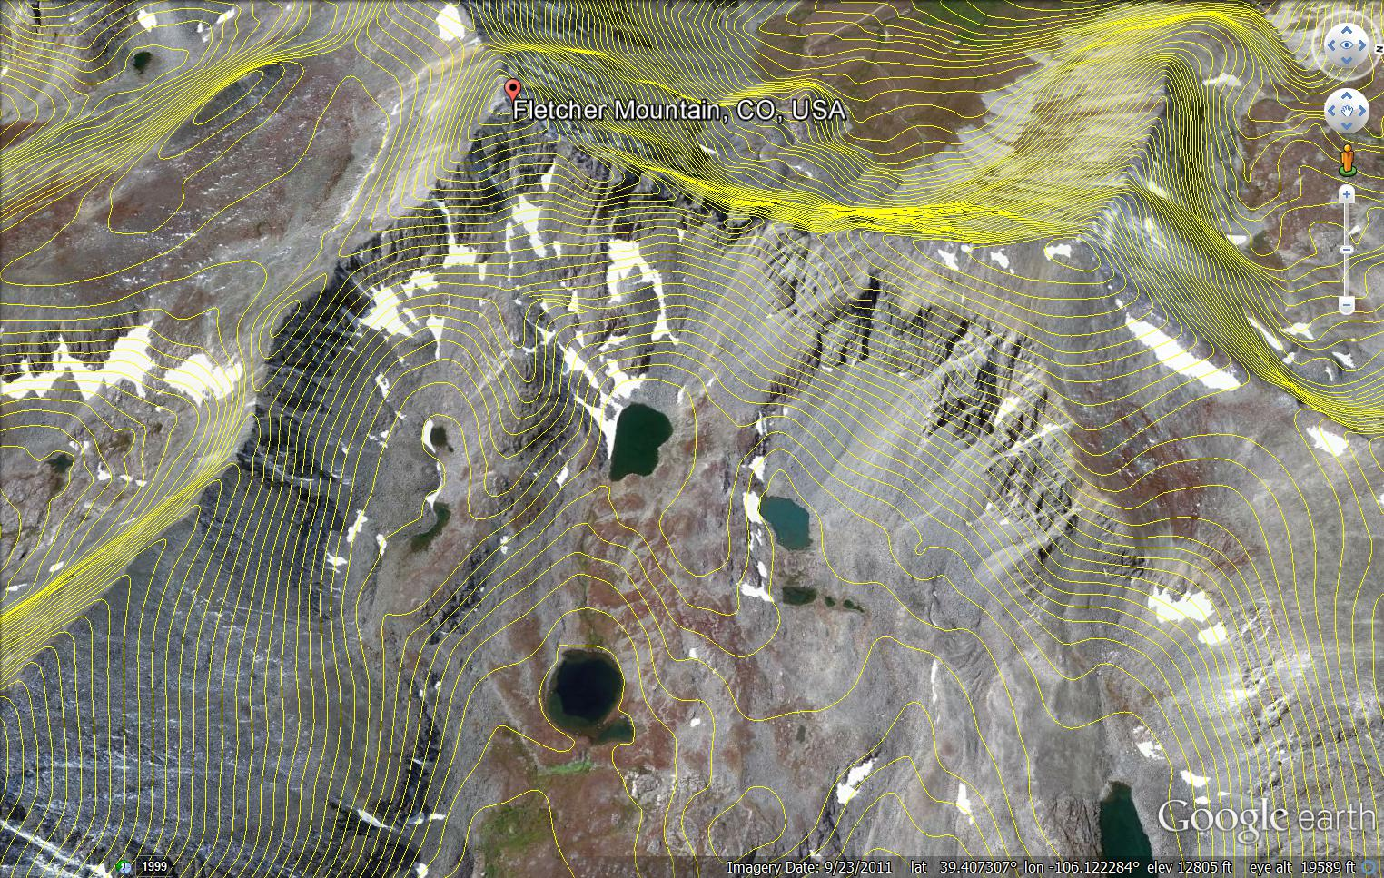

Slide 18
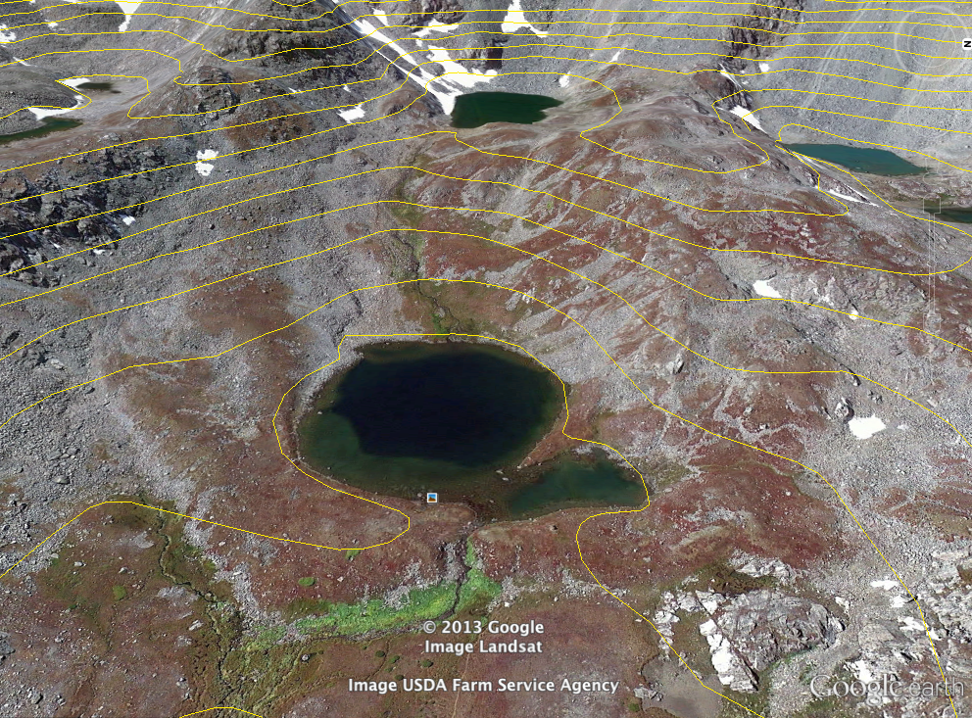

Slide 19
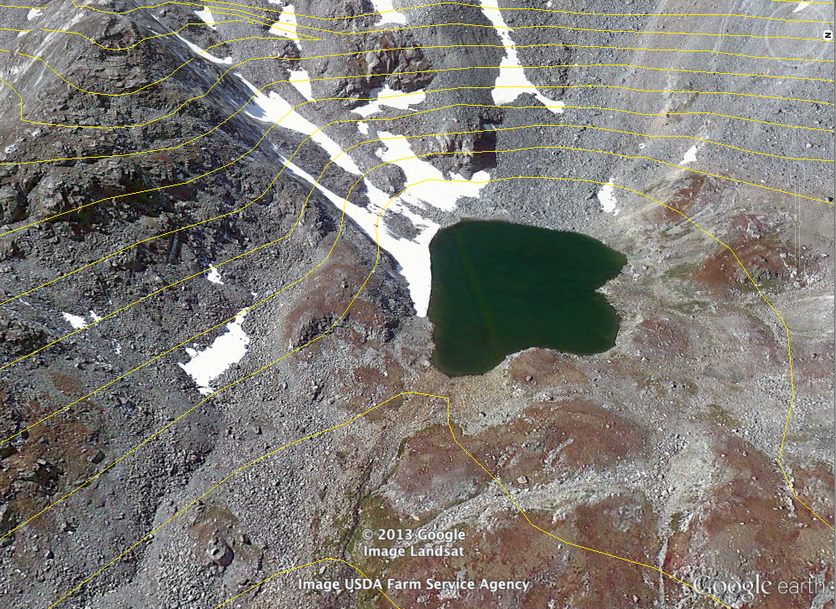

Slide 20
Ontology: What exactly is the “lake”?
Is a lake a large body of water?
SDTS: Lake: “Any standing body of inland water”
Or is it a (natural) basin that can hold a large amount of water?
Or is in a large area covered by water?
If the water goes away, is the lake dry, or does the lake cease to exist?

Slide 21
Ontology: What exactly is the “river”?
Is a river a large stream of water?
SDTS: Watercourse: “A way or course through which water may or does flow”
If the water goes away, is the river dry, or does the river cease to exist?

Slide 22
Ontology Summary: “Lakes” and “rivers”
Is a river a large stream of water?
SDTS appears to be inconsistent here
Watercourse: “A way or course through which water may or does flow”
Lake: “Any standing body of inland water”
The lake is the water, but the river is the place (course-line)

Slide 23
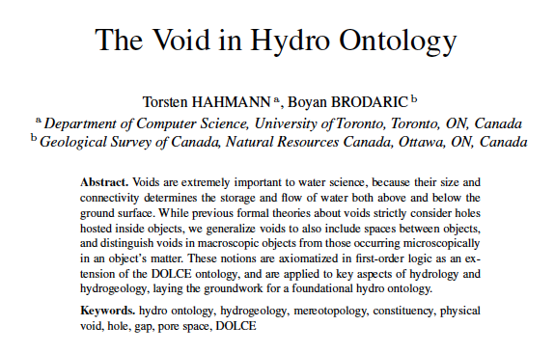
Water and Voids

Slide 24
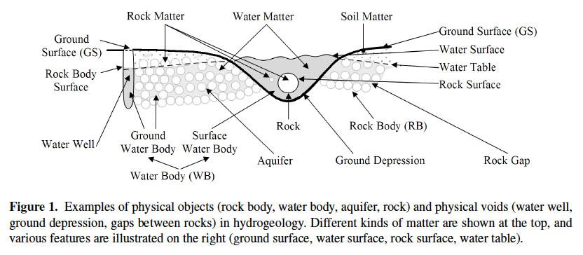
Water and Voids

Slide 25
Water and Voids

Slide 26
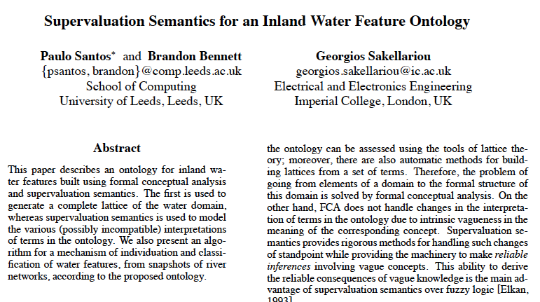

Slide 27
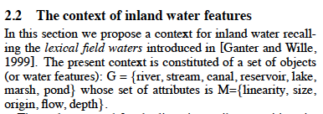
Santos, Bennett, & Sakellariou

Slide 28
Hayes on Lakes
Hayes, P. (1985b) Naive Physics I: Ontology of Liquids. in: J. Hobbs and R. Moore (Eds.), Formal Theories of the Commonsense World. Norwood, NJ: Ablex, pp. 71-108

Slide 29
Consider a Lake
“Consider now a lake.
This is a contained-space defined by geographical constraints. Lake Leman, for example, is the space contained between the Jura Mountains, Lausanne, the Dent d'Oche, Thonon, and the Rochers de Naye, below the 400 meter contour (more or less).
Its container is the surface of the earth under it, i.e. the lake bed.”

Slide 30
Consider a Lake
“I think the only way to describe lakes, rivers and ponds in the present framework is to say that they are contained-spaces which are full of water:
that is, the space ends at the surface of the water.
To be in the lake is then, reasonably, to be immersed in water, while to be on the lake is to be immediately above the water and supported by the lake (cf. on the table), which seems reasonable.
Thus a lake is full by definition.”

Slide 31
“It might seem that we have essentially resuscitated our original ontology of pieces-of-water under a dilferent name. But not so. For with this ontology, Lake Leman is a fixed object in geographical space whereas in the pieces-of-water ontology, it would be constantly changing, since the Rhone flows in one end and out the other; it would be a phenomenon, not an object.”

Slide 32
Two objections by Hayes
“One can make several objections. I will consider two.”
“If the Rhone were to dry up and Lake Leman drain away, we would say the Lake had gone, but the space would still be there: so 'Lake Leman' must refer to the water, not the space. No. Because a lake, on our account, is a space full of water, and its top is the surface of the water. Thus, as the lake drained away, we would have its space shrinking and when all the water had gone, so would have the lake. Notice in this connection the distinction between a lake (or a river) and the lake valley (river bed). The latter is a container, the former a contained space.”

Slide 33
Two objections by Hayes
2. Since Lake Leman (for example) is, on our account, merely a space, how can it support a boat? Perhaps the water supports the boat.
But we want to avoid saying that any particular piece of water supports the boat.
But, on the other hand, the water in my bath (say) does not support the boat in any way, and we want this to be quite clear.
The only way to handle this for now, is to say that, in fact, the lake supports the boat: that is, the space supports it.
But it only does so because it is full of water, so that an empty space would not support a boat. Thus, boats float on lakes and ponds because lakes and ponds are full of water.

Slide 34
Future Ontology Work: Unity and Identity Criteria
Does the body of water that is the lake have unity?
Does the body of water that is the lake have identity?
Does the body of water that is the river have unity?
Does the body of water that is the river have identity?
Does the basin that contains the lake have unity?
Does the basin that contains the lake have identity?
Does the longitudinal depression that contains the river have unity?
Does the longitudinal depression that contains the river have identity?

Slide 35
Thanks!
David M Mark
dmark@buffalo.edu
Gaurav Sinha
sinhag@ohio.edu

Slide 36
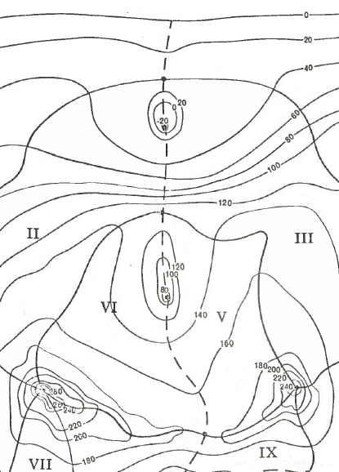

Slide 37
