Slide 1
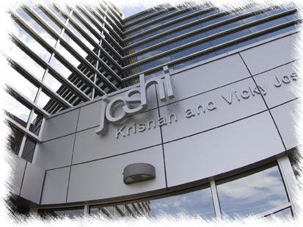
Semantic Provenance: Trusted Biomedical Data Integration
Spatial Semantics for Better Interoperability and Analysis:
Challenges And Experiences In Building Semantically Rich Applications In Web 3.0
(Keynote at the 3rd Annual Spatial Ontology Community of Practice Workshop (SOCoP), USGS Reston, VA, December 03, 2010)
Amit Sheth
LexisNexis Ohio Eminent Scholar
Ohio Center of Excellence in Knowledge-enabled Computing – Kno.e.sis
Wright State University, Dayton, OH
http://knoesis.org
Thanks: Cory Henson, Prateek Jain
& Kno.e.sis Team. Ack: NSF and other
Funding sources.
Notes:
Knoesis center recently declared a center of excellence by Ohio governor: http://bit.ly/coe-k

Slide 2
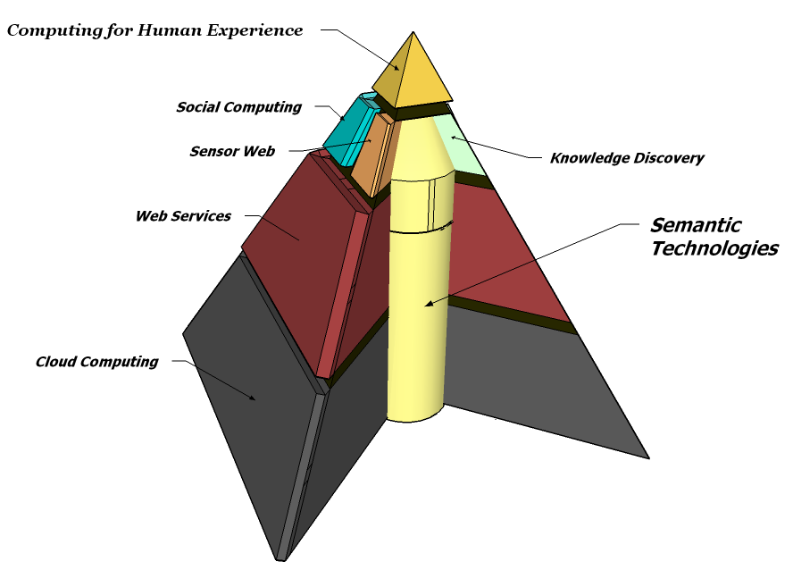
Semantics as core enabler, enhancer @ Kno.e.sis
15 faculty
45+ PhD students & post-docs
Excellent Industry collaborations (MSFT, GOOG, IBM, Yahoo!, HP)
Well funded
Multidisciplinary
Exceptional Graduates

Slide 3
Web (and associated computing) evolving
Enhanced Experience,
Tech assimilated in life
Computing for Human Experience
http://bit.ly/HumanExperience
Web as an oracle / assistant / partner
- “ask the Web”: using semantics to leverage text + data + services
Situations,
Events
2007
Semantic Technology Used
Objects
Web ofpeople, Sensor Web
- social networks, user-created casual content
- 40 billion sensors
Patterns
Web 3.0
Web 2.0
Web 1.0
Web of resources
- data, service, data, mashups
- 4 billion mobilecomputing
Keywords
Web of databases
- dynamically generated pages
- web query interfaces
1997
Web of pages
- text, manually created links
- extensive navigation
Notes:
We see a change of paradigm on the Web. Researchers once had to extensively navigate through pages to obtain the answer to a question.
We are getting closer to the time where one can pose a question to the Web and have the solution computed by integrated sources.
Some key areas of work include:
How to integrate pages, databases, services and human contributions on the Web
How to detect and propagate changes, control authorship and trust
How to ask questions and visualize the results
How to automatically perform knowlege discovery over this global knowledge base

Slide 4
Variety & Growth of Data
Variety/Heterogeneity
Many intelligent applications that involve fusion and integrated analysis of wide variety of data
Web pages/documents, databases, Sensor Data, Social/Community/Collective Data (Wikipedia), Real-time/Mobile/device/IoT data, Spatial Information, Background Knowledge (incl. Web of Data/Linked Open Data), Models/Ontologies…
Exponential growth for each data: e.g. Mobile Data
2009: 1 Exabyte (EB)
2010 US alone: 40+ EB.
Estimate of 2016-17 (Worldwide): 1 Zettabyte (ZB) or 1000 Exabytes.
(Managing Growth & Profits in the Yottabytes Era, Chetan Sharma Consulting, 2009).

Slide 5
A large class of Web 3.0 applications…
utilize larger amount of historical and recent/real-time data of various types from multiple sources (lot of data has spatial property)
not only search, but analysis of or insight from data – that is applications are more “intelligent”
This calls for semantics: spatial, temporal, thematic components; background knowledge
This talk: spatial semantics as a key component in building many Web 3.0 applications

Slide 6
A Challenging Example Query
What schools in Ohio should now be closed due to inclement weather?
Need domain ontologies and rules to describe type of inclement weather and severity.
Integration of technologies needed to answer query
Spatial Aggregation
Semantic Sensor Web
Machine Perception
Linked Sensor Data
Analysis of Streaming Real-Time Data
6

Slide 7
Technology 1 Spatial Aggregation
What schools are in Ohio?
What weather sensors are near each of the school?
7
Notes:
Knoesis center recently declared a center of excellence by Ohio governor

Slide 8
Spatial Aggregation
Utilizes partonomy in order to aggregate spatial regions
To query over spatial regions at different levels of granularity
Data represents “low-level” districts (school in district)
Query represents “high-level” state (school in state)
8

Slide 9
Increased Availability of Spatial Info
9

Slide 10
Accessing Can Be Difficult
10

Slide 11
Must Ask for Information the “Right” Way
11

Slide 12
Why is This Issue Relevant?
Spatial data becoming more significant day by day.
Crucial for multitude of applications:
Social Networks like Twitter, Facebook and Foursquare.
GPS
Military
Location Aware Services: Four Square Check-In
weather data…
Spatial Data availability on Web continuously increasing.
Twitter Feeds, Facebook posts.
Naïve users contribute and correct spatial data too which can lead to discrepancies in data representation.
E.g. Geonames, Open Street Maps
12

Slide 13
What We Want
Automatically align conceptual mismatches
User’s Query
Spatial Information of Interest
Semantic Operators
13
Notes:
A mechanism to improve access to spatial information by allowing users

Slide 14
What is the Problem?
Existing approaches only analyze spatial information and queries at the lexical and syntactic level.
Mismatches are common between how a query is expressed and how information of interest is represented.
Question: “Find schools in NJ”.
Answer: Sorry, no answers found!
Reason: Only counties are in states.
Natural language introduces much ambiguity for semantic relationships between entities in a query.
Find Schools in Greene County.
14

Slide 15
What Needs to be Done?
Reduce users’ burden of having to know how information of interest is represented and structured to enable access by broad population.
Resolve mismatches between a query and information of interest due to differences in granularity to improve recall of relevant information.
Resolve ambiguous relationships between entities based on natural language to reduce the amount of wrong information retrieved.
15

Slide 16
Existing Mechanism for Querying RDF
SPARQL
Regular Expression Based Querying Approaches
16

Slide 17
Common Query Testing All Approaches
“Find Schools Located in the State of Ohio”
17

Slide 18
In a Perfect Scenario
School
parent feature
Ohio
18

Slide 19
In a Not so Perfect Scenario
School
parent feature
County
parent feature
Ohio
19

Slide 20
And Finally..
School
parent feature
County
parent feature
Ohio
Exchange students
School
parent feature
Indiana
20

Slide 21
Proposed Approach
Define operators to ease writing of expressive queries by implicit usage of semantic relations between query terms and hence remove the burden of expressing named relations in a query.
Define transformation rules for operators based on work by Winston’s taxonomy of part-whole relations.
Rule based approach allows applicability in different domains with appropriate modifications.
Partonomical Relationship Based Query Rewriting System (PARQ) implements this approach.
21

Slide 22
Meta Rules for Winston’s Categories
Transitivity
(a φ-part of b) (b φ-part of c) (a φ-part of c)
Dayton place-part of Ohio
Ohio place-part of US
Dayton place-part of US
Overlap
(a place-part of b) (a place-part of b) (b overlaps c)
Sri Lank place-part of Indian Ocean
Sri Lank place-part of Bay of Bengal
Indian Ocean overlaps with Bay of Bengal
Spatial Inclusion
(a place-part of b) (a place-part of b) (b overlaps c)
White House instance of Building
Barack is in
the White House
Barack is
In the building
22

Slide 23
Slight and Severe Mismatch
SELECT ?school
WHERE {
?state geo:featureClass geo:A ?schools geo:featureClass geo:S
?state geo:name "Ohio“
?schools geo:parentFeature ?state
}
Query Re-Writer
SELECT ?school
WHERE {
?state geo:featureClass geo:A ?schools geo:featureClass geo:S
?state geo:name "Ohio“
?school geo:parentFeature ?county
?county geo:parentFeature ?state
}
23

Slide 24
Where Do We Stand With All Mechanisms..
 | Ease of Writing | Expressivity | Works in all scenarios | Schema agnostic
SPARQL | X | √ | X | X
PSPARQL | √ | √ | X | √
Our Approach (PARQ) | √ | √ | √ | √
24

Slide 25
Evaluation
Performed on publicly available datasets (Geonames and British Ordnance Survey Ontology)
Utilized 120 questions from National Geographic Bee and 46 questions from trivia related to British Administrative Geography
Questions serialized into SPARQL Queries by 4 human respondents unfamiliar with ontology
Performance of PARQ compared with PSPARQL and SPARQL
25

Slide 26
Sample Queries
“In which English county, also known as "The Jurassic Coast" because of the many fossils to be found there, will you find the village of Beer Hackett?”
“The Gobi Desert is the main physical feature in the southern half of a country also known as the homeland of Genghis Khan. Name this country.”
26

Slide 27
PARQ - vs - SPARQL
 | System | # of Queries Answered | Precision | Recall
Respondent1 | PARQ | 82 | 100% | 68.3%
 | SPARQL | 25 | 100% | 20.83%
Respondent2 | PARQ | 93 | 100% | 77.5%
 | SPARQL | 26 | 100% | 21.6%
Respondent3 | PARQ | 61 | 100% | 50.83%
 | SPARQL | 19 | 100% | 15.83%
Respondent4 | PARQ | 103 | 100% | 85.83%
 | SPARQL | 33 | 100% | 27.5%
27

Slide 28
PARQ - vs - PSPARQL
System | Precision | Recall | Execution time/query in seconds
PARQ | 100% | 86.7% | 0.3976
PSPARQL | 6.414% | 86.7% | 37.59
Comparison for National Geographic Bee over Geonames
System | Precision | Recall | Execution time/query in seconds
PARQ | 100% | 89.13% | 0.099
PSPARQL | 65.079% | 89.13% | 2.79
Comparison for British Admin. Trivia over Ordnance Survey Dataset
28

Slide 29
Spatial Aggregation Conclusion
Query engines expect users to know the dataset structure and pose well formed queries
Query engines ignore semantic relations between query terms
Need to exploit semantic relations between concepts for processing queries
Need to provide systems with behind the scenes rewrite of queries to remove burden of knowing structure of data
29

Slide 30
Technology 2
Semantic Sensor Web (SSW)
What is inclement weather?
What sensors in Ohio are capable of detecting inclement weather?
What sensors are near schools in Ohio?
What observations are these sensors generating NOW?
Are these observations providing evidence for inclement weather?
30
Notes:
Knoesis center recently declared a center of excellence by Ohio governor

Slide 31
Semantic Sensor Web
Utilizes ontologies to represent and analyze heterogeneous sensor data
Sensor-observation ontology
Spatial ontology
Temporal ontology
Domain ontologies (i.e., weather ontology)
Generates abstractions (that matter to human decision making) over sensor data
Analysis of data to detect and represent interesting features (i.e., objects, events, situations)

Slide 32
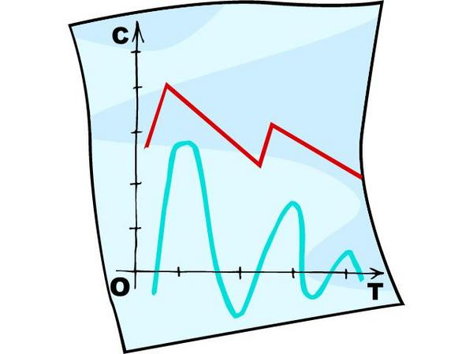
Semantic Sensor Web
Utilizes semantic technologies to bridge the divide between the “real-world” and the Web (critical to Cyber-Physical systems)
Environment
Sensor
Observation
Physical Space (“real-world”)
Information Space (Web)
Perception
Event ID/Understanding,
Situation Awareness
Sensor Data

Slide 33
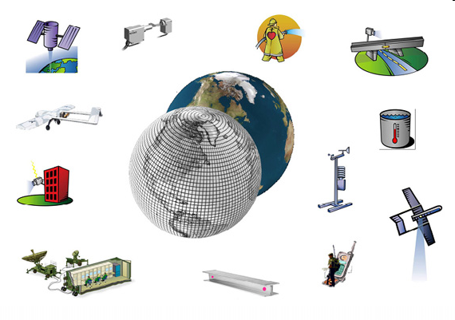
Sensors are now ubiquitous, and constantly generating observations about our world

Slide 34
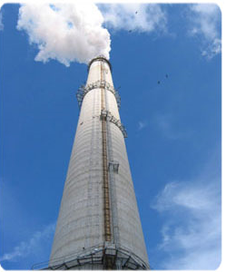
However, these systems are often stovepiped,
with strong tie between sensor network and application

Slide 35
We want to set this data free

Slide 36
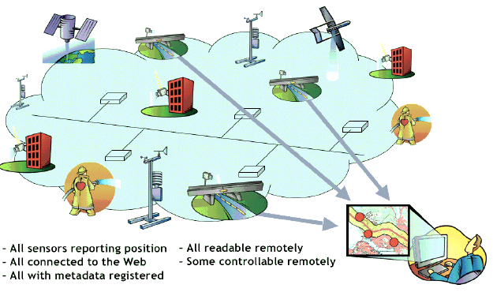
With freedom comes new responsibilities ….
Notes:
Making sense of data from many sources in many form is challenging

Slide 37
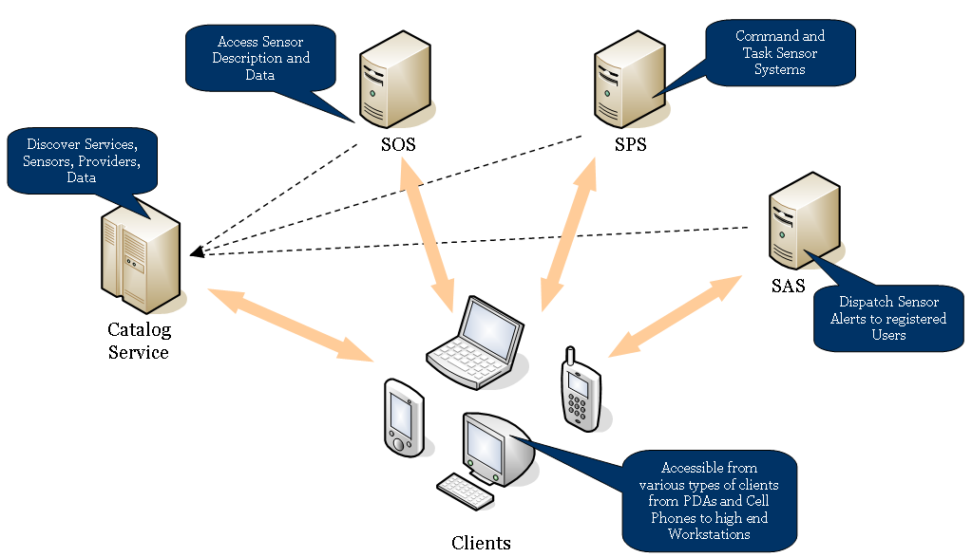
1) How to discover, access and search the data?
Web Services
- OGC Sensor Web Enablement (SWE)

Slide 38
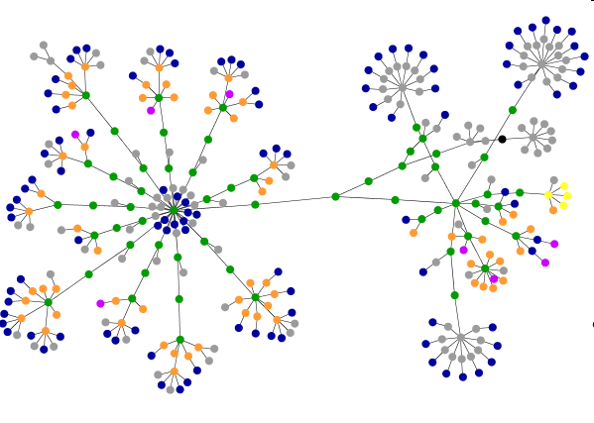
2) How to integrate this data together
when it comes from many different sources?
Shared knowledge models, or Ontologies
- syntactic models – XML (SWE)
- semantic models – OWL/RDF (W3C SSN-XG)

Slide 39
The SSN-XG Deliverables
Ontology for semantically describing sensors
Illustrate the relationship to OGC Sensor Web Enablement standards
Semantic annotation of OGC Sensor Web Enablement standards

Slide 40
3) Make streaming numerical sensor data meaningful to web applications and naïve users?
Symbols more meaningful than numbers
- analysis and reasoning (understanding through perception)

Slide 41
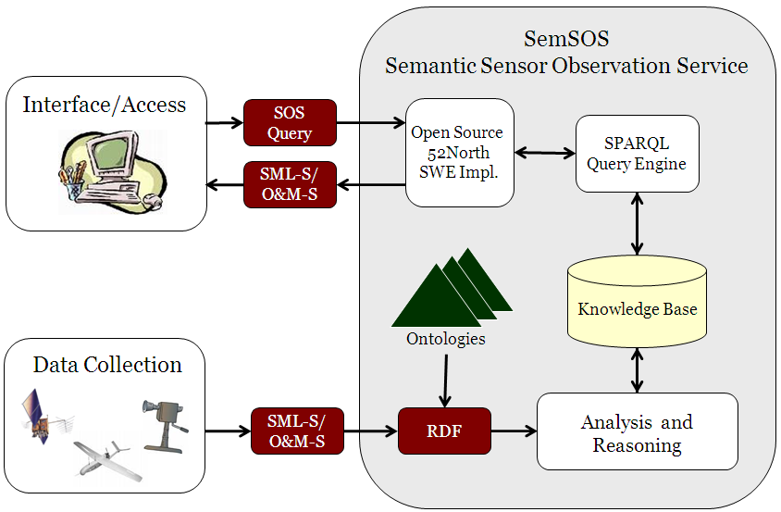
Overall Architecture

Slide 42
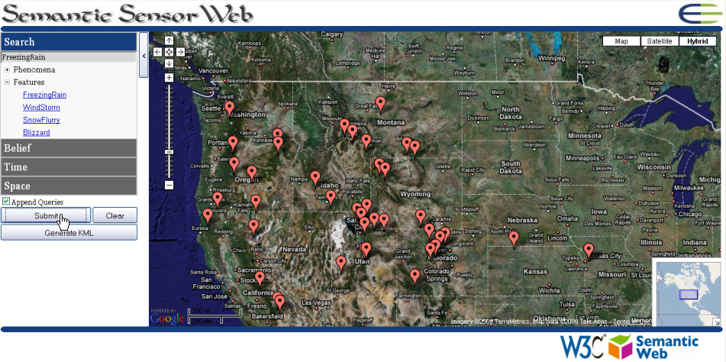
SSW demo with Mesowest data
http://knoesis.org/projects/sensorweb/demos/semsos_mesowest/ssos_demo.htm

Slide 43
Technology 3
Active Machine Perception
Are these observations providing evidence for inclement weather?
43
Notes:
Knoesis center recently declared a center of excellence by Ohio governor

Slide 44
Machine Perception
Task of extracting meaning from sensor data
Perception is the act of choosing from alternative explanations for a set of observations (Intellego Perception)
Perception is a active, cyclical process of explaining observations by actively seeking – or focusing on – additional information (Active Perception)
Active Perception cycle is driven by prior knowledge
44

Slide 45
Goal to Obtain
Awareness of the Situation
Web
observe
perceive
“Real-World”
45

Slide 46
Formal Theory of Machine Perception
Specification
Implementation
Evaluation
Ontology of Perception: A Semantic Web Approach to Enhance Machine Perception (Technical Report, Sept. 2010)
46

Slide 47
Enable Situation Awareness on Web
Must utilize abstractions capable of representing observations and perceptions generated by either people or machines.
Web
observe
perceive
“Real-World”
47

Slide 48
Observation of Qualities
Both people and machines are capable of observing qualities, such as redness.
observes
Observer
Quality
Formally described in a sensor/observation ontology
48
Notes:
Observer - agent that executes an observation process.
Observation Process – process of detecting qualities from stimuli, consisting of the following steps: (1) choose an observable quality, (2) find stimuli that are causally linked to the observable quality, (3) detect the stimuli, and (4) generate observation values. Observation values (or percepts) are symbols that represent the observed qualities in the physical world.
Observation – action by an observer of executing the observation process

Slide 49
Perception of Entities
Both people and machines are also capable of perceiving entities, such as apples
perceives
Perceiver
Entity
* Formally described in a perception ontology
49
Notes:
Perceiver - agent that executes a perception process
Perception Process – process of detecting entities from observed qualities (abductive inference). Note that the perception process actually infers concepts (symbols) that represent entities in the physical world.
Perception – action by a perceiver of executing the perception process

Slide 50
Background Knowledge
Ability to perceive is afforded through the use of background knowledge. For example, knowledge that apples are red helps to infer an apple from an observed quality of redness.
Quality
inheres in
Entity
Formally described in a domain ontology
50
Notes:
Quality – property in the physical world that may be observed (i.e., accessible to the senses through stimuli); qualities inhere in entities.
Entity – object, event, or situation in the physical world (not directly accessible to the senses and must be inferred* from observations of qualities and background knowledge). *Actually, concepts (symbols) are inferred that represent entities in the physical world.
Background knowledge – set of relations between qualities and entities known to a perceiver

Slide 51
Perception Cycle
The ability to perceive efficiently is afforded through the cyclical exchange of information between observers and perceivers.
Observer
sends
percept
sends
focus
Perceiver
Traditionally called the Perception Cycle (or Active Perception)
51
Notes:
Perception Cycle - a process that relates observers and perceivers; the observer communicates percepts to the perceiver, representing qualities that have been observed, and the perceiver communicates focus to the observer, representing qualities that should be observed.
Percept – is a symbol that represents an observed quality (also sometimes called observation value).
Focus – guides the observer towards only those qualities necessary for effective perception (in the form of a quality type).
* Evaluation – in our experiments, we have shown that focus can reduce the number of observations necessary for perception by up to 50%.

Slide 52
Integrated Perception Cycle
Integrated together, we have an abstract model – capable of situation awareness – relating observers, perceivers, and background knowledge.
observes
Observer
Quality
sends
percept
sends
focus
inheres in
perceives
Perceiver
Entity
52
Notes:
Integration of the three ontologies discussed above:
sensor/observation ontology relating observers (or sensors) to observable qualities,
perception ontology relating perceivers to perceivable (inferable) entities, and
domain ontology relating qualities and entities in the physical world

Slide 53
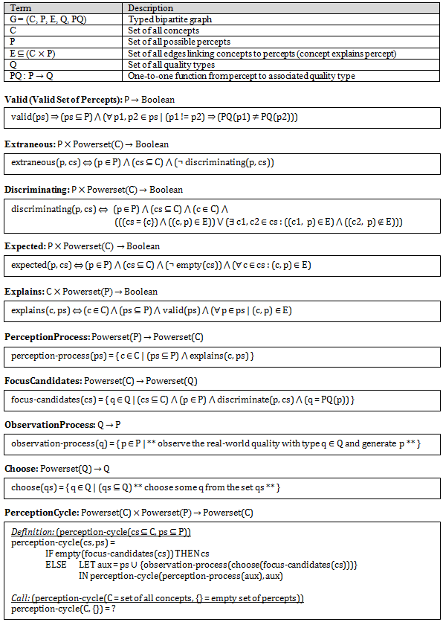
Specification of Perception Cycle
(in set theory)
53

Slide 54
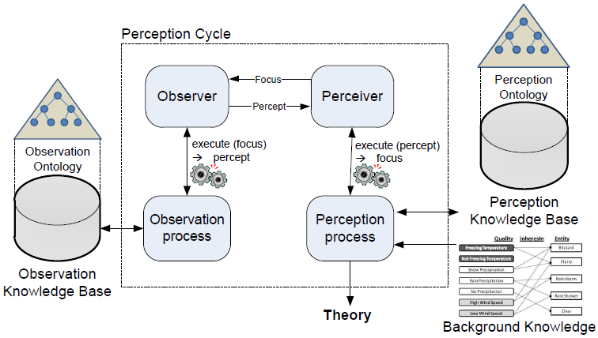
Implementation of Perception Cycle
54

Slide 55
Evaluation of Perception Cycle
We demonstrated 50% savings in resource requirements by utilizing background knowledge within the Perception Cycle
55
Notes:
The top figure shows the results of executing the perception cycle for the 516 weather stations within a radius of 400 miles of the blizzard in Utah, and for each ordering of quality types. The horizontal axis represents the different orderings of observable qualities; p represents precipitation, w represents wind speed, and t represents temperature.
The bottom figure shows the percentages of percepts generated during the perception cycle for different sets of observers (at different distances from the known blizzard) and for different orderings of quality types.

Slide 56
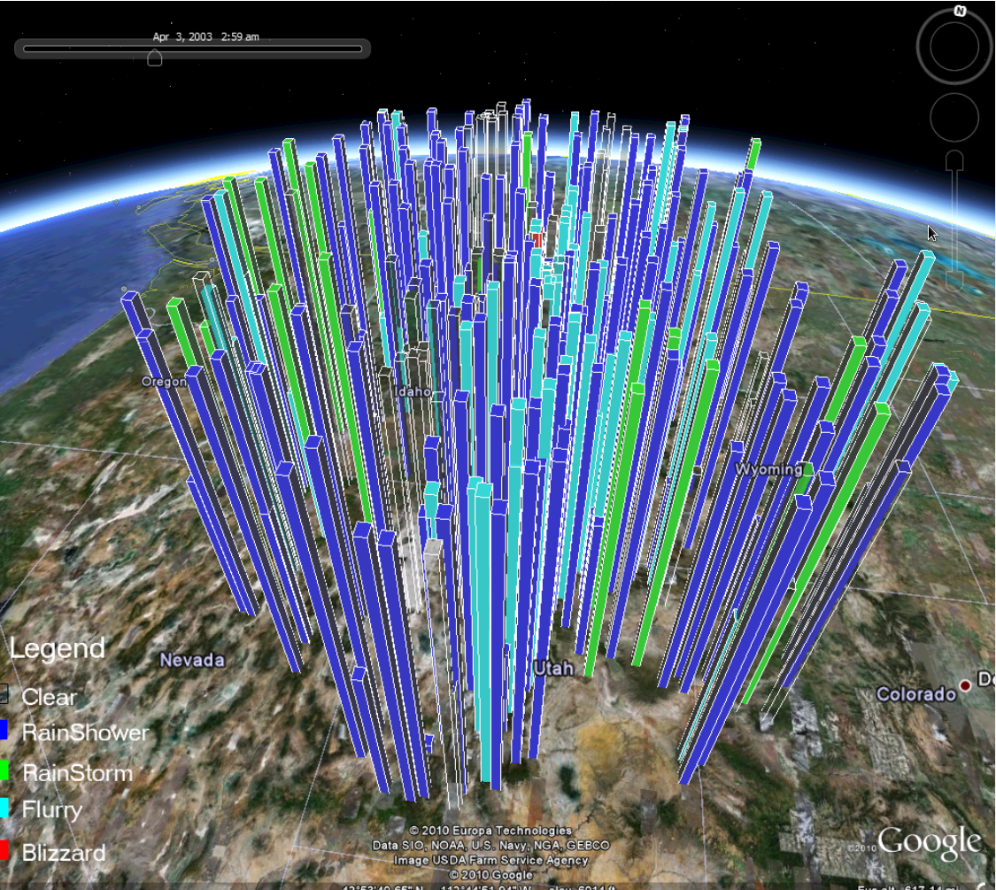
Trusted Perception Cycle Demo
http://www.youtube.com/watch?v=lTxzghCjGgU
http://knoesis.org/projects/sensorweb/demos/trusted_perception_cycle/

Slide 57
Technology 4
Linked Sensor Data
What schools are in Ohio?
What inclement weather necessitates school closings?
What sensors in Ohio are capable of detecting inclement weather?
What sensors are near schools in Ohio?
What observations are these sensors generating NOW?
57
Notes:
Knoesis center recently declared a center of excellence by Ohio governor

Slide 58
Linked Sensor Data
Knowledge/representations from SSW are accessible on LOD
LinkedSensorData
Descriptions of ~20,000 weather stations
Weather stations linked to featured defined in Geonames.org
LinkedObservationData
Description of storm related observations
~1.7 billion triples, ~170 million weather observations
Updated in real-time with current observations and abstractions
58

Slide 59
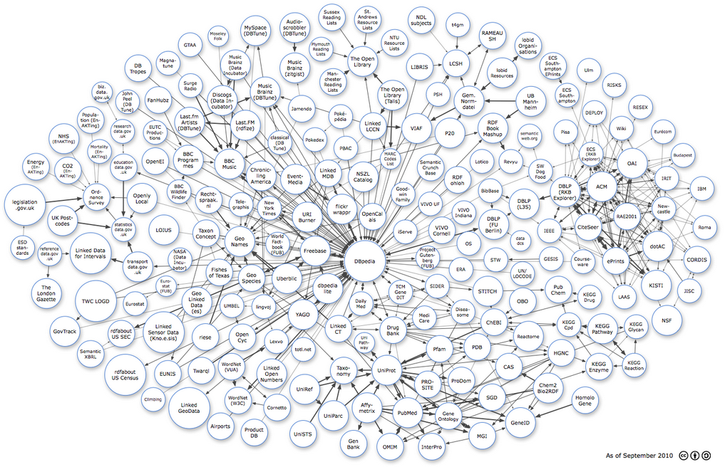
Linked Open Data
Community-led effort to create openly accessible, and interlinked, semantic (RDF) data on the Web
59

Slide 60
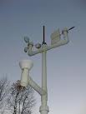
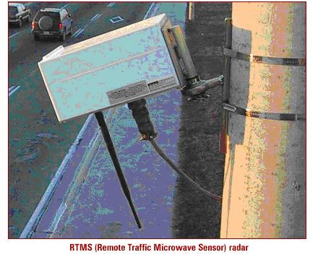
What is Linked Sensor Data
Weather Sensors
Sensor Dataset
GPS Sensors
Satellite Sensors
Camera Sensors
60

Slide 61
Sensors Dataset (LinkedSensorData)*
RDF descriptions of ~20,000 weather stations in the United States.
Observation dataset linked to sensors descriptions.
Sensors link to locations in
Geonames (in LOD)
that are nearby.
weather station
61
*First Initiative for exposing Sensor Data on LOD

Slide 62
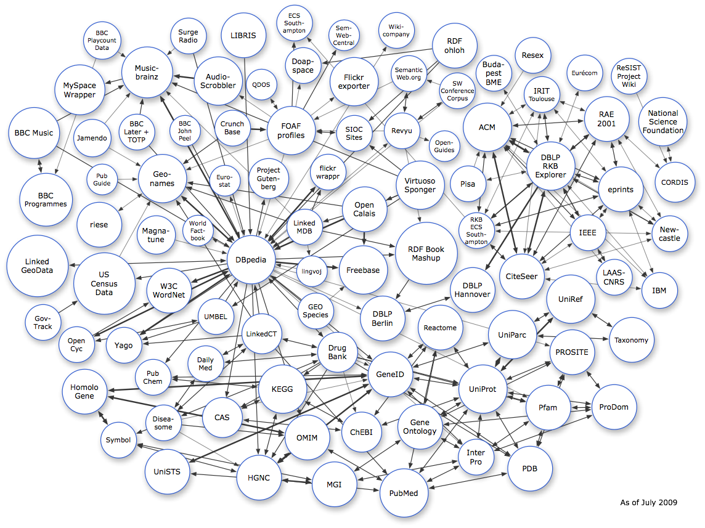
What is Linked Sensor Data
Recommended best practice for exposing, sharing, and connecting pieces of data, information, and knowledge on the Web using URIs and RDF
GeoNames Dataset
RDF – language for representing data on the Web
locatedNear
Sensor Dataset
Publicly Accessible
62

Slide 63
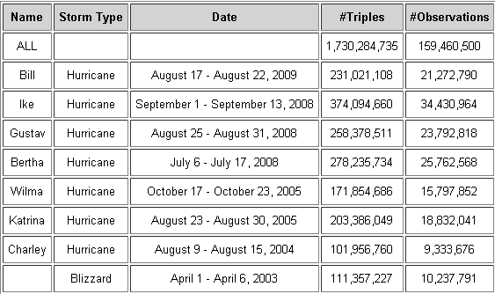
Observations Dataset (LinkedObservationData) – Static Datasets
RDF descriptions of hurricane and blizzard observations in the United States.
The data originated at MesoWest (University of Utah)
Observation types: temperature, visibility, precipitation, pressure, wind speed, humidity, etc.
63
Notes:
63

Slide 64
Linked Datasets
Observation
KB
Sensor KB
Location KB
(Geonames)
procedure
location
Example
72⁰F
procedure
Thermometer
location
Dayton Airport
~2 billion triples
MesoWest
Dynamic + Archive
20,000+ systems
MesoWest
~Static
230,000+ locations
Geonames
~Static
64
Notes:
64

Slide 65
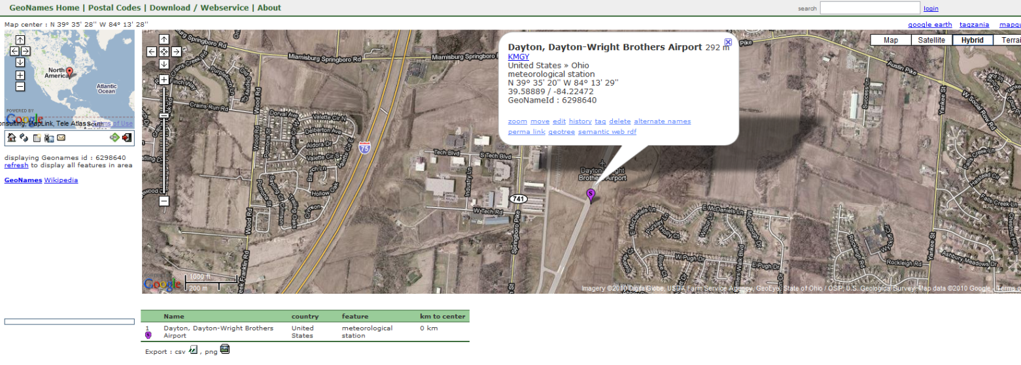
Sensor Discovery Application
Weather Station ID
Current Observations from MesoWest
Weather Station Coordinates
Weather Station Phenomena
MesoWest – Project under Department of Meteorology, University of UTAH
GeoNames – Geographic dataset
65
Notes:
Get all sensors using well known location names – Problem to be solve

Slide 66
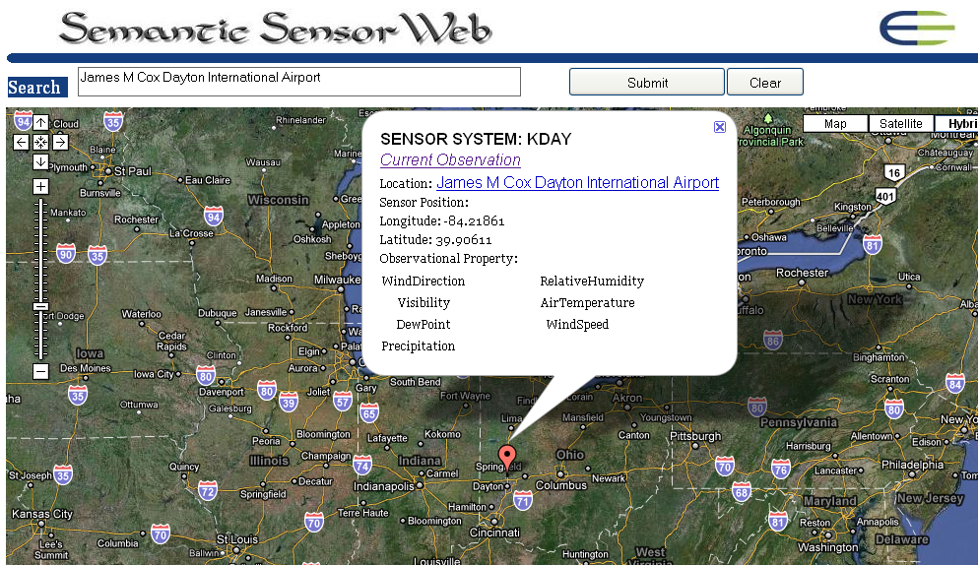
Sensor Discovery on Linked Data Demo
http://knoesis.org/projects/sensorweb/demos/sensor_discovery_on_lod/sample.htm

Slide 67
Technology 5
Analysis of Streaming Real-Time Data
What observations are these sensors generating NOW?
67
Notes:
Knoesis center recently declared a center of excellence by Ohio governor

Slide 68
Analysis of Streaming Real-Time Data
Conversion from raw data to semantically annotated data in real-time
Analysis of data to generate abstractions in real-time

Slide 69
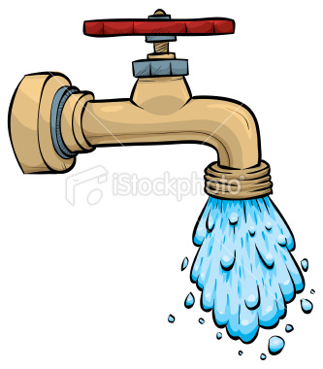
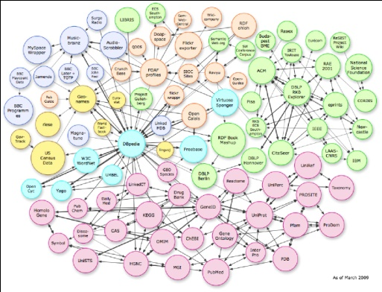
Real Time Streaming Sensor Data
Semantic Analysis using Ontology for Event Detection
Storing Abstractions (Events) obtained after reasoning on the LOD

Slide 70
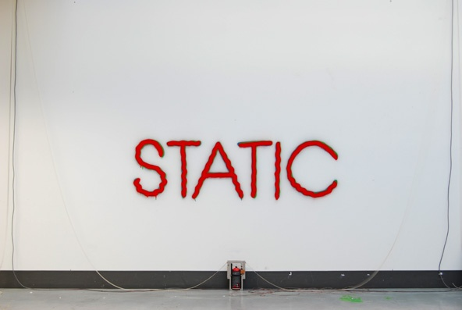
Linked Open Data
Mostly
70
Notes:
LOD Cloud is a way of sharing, exposing, and connecting pieces of data, information and knowledge on the Semantic Web using URI’s and RDF
Comprises of geographic, biological datasets etc

Slide 71
Huge Volumes!!

Slide 72
Too Much Data
(Data grows faster than storage!!)
72
Notes:
Linked Data explodes

Slide 73
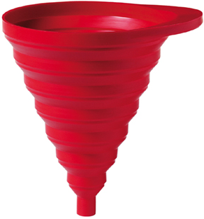
Solution
Huge amounts of Sensor Data!!
Abstractions over data (Events)
Observations relevant to events
73

Slide 74
Workflow Architecture for Managing Streaming Sensor Data

Slide 75
Answering the Challenge Query
75
Notes:
Knoesis center recently declared a center of excellence by Ohio governor

Slide 76
The Query
What schools in Ohio should now be closed due to inclement weather?
needs to be divided into sub-queries that can be answered using technologies previously described
76

Slide 77
What Schools Are in Ohio?
Need partonomical spatial relations
What counties are contained in Ohio?
What districts are contained in a county?
What schools are contained in a district?
Geonames.org contains these partonomical spatial relations
Spatial aggregation executes the partonomical inference to convert the general query into sub-queries that can be answered
Uses: spatial aggregation and LOD
77

Slide 78
What is Inclement Weather?
Need domain ontology that describes characteristics of inclemental weather
Example
Icy Roads => freezing temperature & precipitation (rain or snow)
Uses: SSW
78

Slide 79
What Inclement Weather Necessitates School Closings?
Need school policy information on rules for closing (e.g., for icy road conditions)
Data.gov on LOD contains large amount of such policy information
Uses: LOD
79

Slide 80
What Sensors in Ohio Are Capable of Detecting Inclement Weather?
Need ontological descriptions of sensors and weather in order to match sensor capabilities to weather characteristics
Temperature sensor → freezing temperature
Rain gauge sensor → precipitation
LinkedSensorData has descriptions of ~20,000 weather stations on LOD
Uses: SSW and LOD
80

Slide 81
Sensors Near Schools in Ohio?
Spatial analysis: match school locations (in Ohio) to sensor locations that are nearby
Sensor descriptions in LinkedSensorData contain links to nearby features (such as schools)
Uses: SSW and LOD
81

Slide 82
What Observations are These Sensors Generating NOW?
Need to semantically annotate raw streaming observations in real-time
Need to make these current/real-time annotations accessible by placing them on LOD (i.e., LinkedObservationData)
Uses: SSW, LOD, Streaming Data
82

Slide 83
Are These Observations Providing Evidence for Inclement Weather?
Analysis of observation data using background knowledge
Generation of abstractions that are easier to understand
Uses: SSW, Perception
83

Slide 84
http://knoesis.org
84

Slide 85
References
Spatial Aggregation References (http://knoesis.org/research/semweb/projects/stt/)
Prateek Jain, Peter Z. Yeh, KunalVerma, Cory Henson and AmitSheth, SPARQL Query Re-writing for Spatial Datasets Using Partonomy Based Transformation Rules, 3rd Intl. Conference on Geospatial Semantics (GeoS 2009), Mexico City, Mexico, December 3-4, 2009.
Alkhateeb, F., Baget, J.-F., Euzenat, J.: Extending SPARQL with regular expression patterns (for querying RDF). Web Semantics 7, 2009.
Semantic Sensor Web References (http://wiki.knoesis.org/index.php/SSW)
Cory Henson, Josh Pschorr,Amit Sheth, Krishnaprasad Thirunarayan, SemSOS: Semantic Sensor Observation Service, in Proceedings of the 2009 International Symposium on Collaborative Technologies and Systems (CTS 2009), Baltimore, MD, May 18-22, 2009.
Cory Henson, Holger Neuhaus, Amit Sheth, Krishnaprasad Thirunarayan, Rajkumar Buyya, An Ontological Representation of Time Series Observations on the Semantic Sensor Web, in Proceedings of 1st International Workshop on the Semantic Sensor Web 2009.
Michael Compton, Cory Henson, Laurent Lefort, Holger Neuhaus, A Survey of the Semantic Specification of Sensors, 2nd International Workshop on Semantic Sensor Networks, 25-29 October 2009, Washington DC.
Machine Active Perception References
Cory Henson, Krishnaprasad Thirunarayan, Pramod Anatharam, Amit Sheth, Making Sense of Sensor Data through a Semantics Driven Perception Cycle, Kno.e.sis Center Technical Report, 2010.
Krishnaprasad Thirunarayan, Cory Henson, Amit Sheth, Situation Awareness via Abductive Reasoning for Semantic Sensor Data: A Preliminary Report, In: Proceedings of 2009 International Symposium on Collaborative Technologies and Systems (CTS 2009), pp. 111-118, May 18-22, 2009.
Linked Sensor Data References (http://wiki.knoesis.org/index.php/LinkedSensorData)
Harshal Patni, Cory Henson, Amit Sheth, Linked Sensor Data, In: Proceedings of 2010 International Symposium on Collaborative Technologies and Systems (CTS 2010), Chicago, IL, May 17-21, 2010.
Harshal Patni, Satya S. Sahoo, Cory Henson and Amit Sheth, Provenance Aware Linked Sensor Data, 2nd Workshop on Trust and Privacy on the Social and Semantic Web, Co-located with ESWC, Heraklion Greece, 30th May - 03 June 2010
Joshua Pschorr, Cory Henson, Harshal Patni, Amit P. Sheth, Sensor Discovery on Linked Data, Kno.e.sis Center Technical Report, 2010

