Slide 1
Semantic Mediation & OWS 8
Glenn Guempel
gguempel@usgs.gov
703-648-4541

Slide 2
OWS 8 Semantic Mediation
Purpose:
investigate, evaluate, and demonstrate through OGC new and/or existing services the benefit of semantic mediation approaches (e.g. ontologies, mappings, SPARQL) to query and use data, based on different data models, which are available via OGC Web Feature Services

Slide 3
OGC OWS-8 Activity Threads & Subthreads

Slide 4
OWS 8 Semantic Mediation
Objective
Advancement of semantic mediation approaches to deal with differences in heterogeneous data models
Use of Semantic Web technologies (e.g. ontology's, RDF, SKOS)
Enable machines to share specifications of concepts and thus be able to interpret, harmonize and convert information consistently
Proposed Architecture should support multiple models, without the need to provide one-to-one mappings among the models participating in the system

Slide 5
OWS-8 Semantic Mediation
Sponsors: NGA, USGS, UK Defence Science & Technology Laboratory

Slide 6
Specific Tasks
Development of:
RDF based Rosetta Mediation Model (RMM)-
OGC Mediation Component that allows a client to query multiple data sources
RDF Ontology representing components of the NGA Data Model and USGS Data
Mappings from the NGA Data Model ontology to RMM and Mappings from the USGS Data Model ontology to RMM
Delivery of:
Service implementations shall be made available to demonstrate the process and results of this effort.
Information Models, Encodings and Mappings as cited above.
The Semantic Mediation task shall be documented in an Engineering Report .

Slide 7
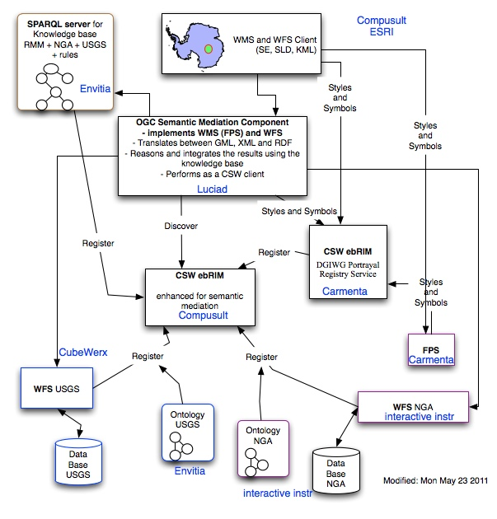
CCI Architecture

Slide 8
OWS-8 Significant Results
Successful harmonization of heterogeneous geospatial datasets through the use of Semantic Web technologies.
Implemented a prototype “Semantic Mediation Service” that wraps a WFS into a user preferred Feature Model
Implemented a knowledge base SPARQL service.
Developed Rossetta Mediation Models for mapping between USGS and NGA data models.
Enhanced the open source ShapeChange UML conversion tool to support automated creation of RDF /OWL , Codelists (SKOS), KML (XSLT), GML (XML Schemas), Codelists (GML), Constraints (Schematron)
Complex Schematron assertions can be derived automatically from application schemas in UML to support; XML based on different encoding rules (GML, ISO/TS 19139), OCL constraints and from other information in the UML model.
Identified the need to stand up several new OGC standards working groups to support SPARQL, Semantic Mediator Service and Mapping Table generation.

Slide 9
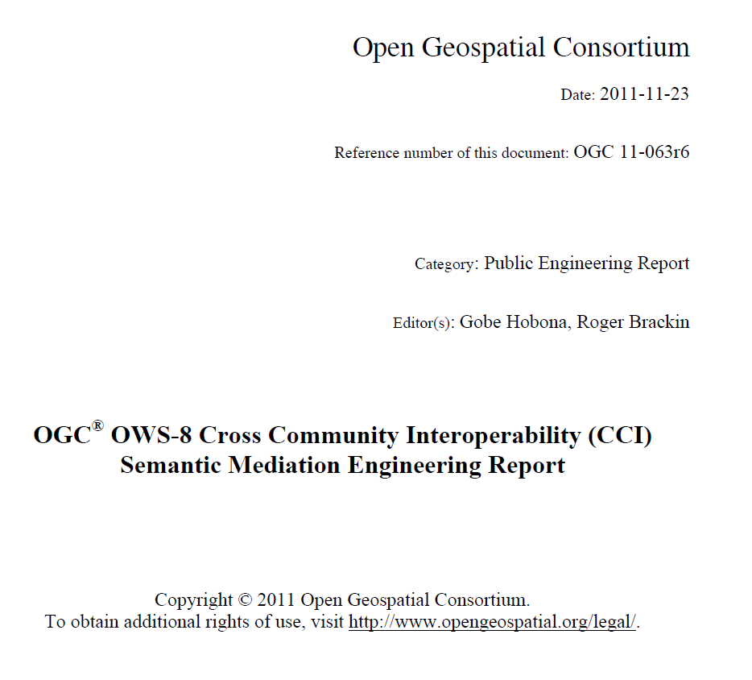
OGC Public Engineering Report is Available http://www.opengeospatial.org/standards/pe

Slide 10
OWS-9 Building on OWS-8
Expanding semantic mediation to include conflation
Additional sources of data including more complex data and unstructured data
Keeping track of provenance of data (trusted source, etc.)
Further investigation into encoding mappings
Potential of RIF for encoding mappings
Proposed standards development for: SPARQL server, Semantic mediation service
Investigate how catalog deals with expressing SPARQL server capabilities
Advance technologies to support single point of entry to NGA and USGS gazetteer data

Slide 11
OWS-9 Preliminary Schedule
Date | Milestone
Aug/Sep 2011 | Concept development
Oct & Nov 2011 | Call for sponsors and sponsor meeting
January 2012 | RFQ Issued; responses due February 2012
April 2012 | Kickoff meeting
Dec 2012 | Demonstrations and final deliverables

Slide 12
Thank You

Slide 13
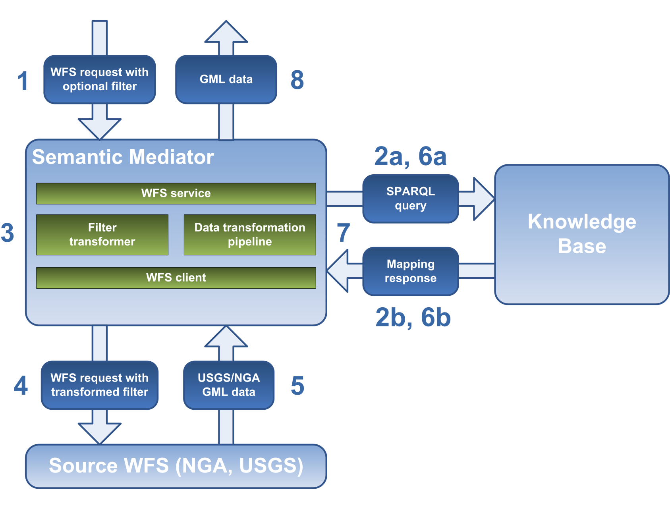
Semantic Mediator: Architecture
Notes:
Internally, the semantic mediator relies on a Knowledge Base server to provide the transformation semantics needed to transform a data model to and from the RMM-s data model. To transform a request from a client into a valid response, several steps have to be taken.
In a first step, the semantic mediator receives a WFS request from a client. This request is defined in terms of the target data model of the semantic mediator.
Since this request is not directly compatible with the data model of the Source WFS server, it will first have to be converted to a valid request before it is sent to the Source WFS.
To do this, the semantic mediator generates a SPARQL request which it sends to the knowledge base. At this point it needs to know which source feature types match the requested target feature type.
The response of the Knowledge base is parsed and used to create a new request for the Source WFS. The Source WFS will then respond to the request in its native data model.
Again, the Knowledge Base server has to be consulted to transform the received source feature type into valid target feature types for the client. The semantic transformations of the knowledge base are interpreted and applied to the source feature types returned by the Source WFS server.
This generates one or more valid target feature types which are then returned to the client.

