Slide 1
How Semantic Technology Can Improve the NextGen Air Transportation System Information Sharing Environment
4th Annual Spatial Ontology Community of Practice Workshop: Geo-Spatial Ontologies and Semantics - Current and Future Practices
U. S. Geological Survey (USGS) National Center
Reston, VA
Friday, December 2, 2011

Slide 2







Inter-Agency Information Sharing Challenges
Weather Community
Integrated Surveillance
Community
UAS
Community
Flight and Flow
Community
Safety
Community
Airport Operations
Community
Airline Operations
Community
Other
Communities
Services
conform
Weather
Flight Track
publish
Standards
SAR
Time
Data
AXIM
WXXM
FIXM
KML
GML
Classification
Live
Other Services
WCS
WFS
WMS
ebXML
UDDI
Geospatial Coverage
Recorded
Other Standards
Temporal Coverage
Simulated
State/Local Government
Commercial Entities
International Partners

Slide 3
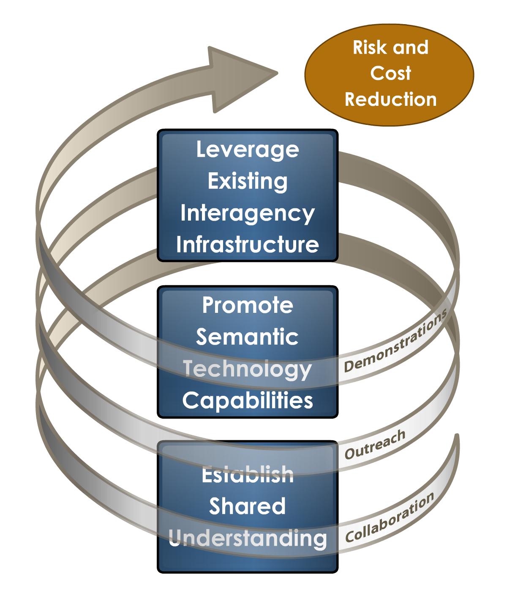
NCOD Approach to Inter- Agency Information Sharing
Utilization of a process for shared understanding development that is based upon interagency participation and definition of information elements in domains.
Adoption of a technology capabilities stack that validates and illustrates how technologies like Service Oriented Architecture (SOA) and Semantic Web technologies can enable the information sharing vision of NextGen.
Creation of an interagency infrastructure that federates the NextGen member agency and industry’s existing Research and Development (R&D) environments to validate the interoperability of information exchanges and the technology stack in a near-realistic environment.

Slide 4
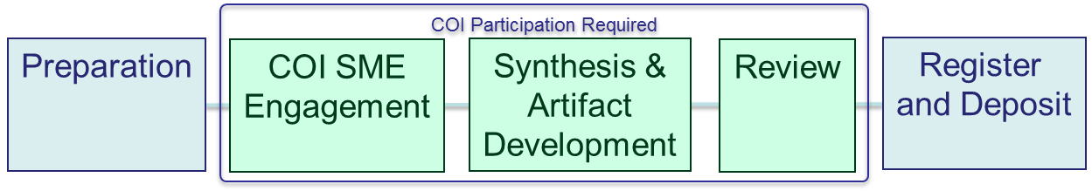
Process for Inter-Agency Shared Understanding
Key Deliverables
  COI Ontology
  Business Context (DoDAF Artifacts)
  Other Artifacts
Completed Engagements
  Weather
  Integrated Surveillance
  Unmanned Aircraft System
Consistent with DoD Net-Centric Data Strategy
COI Ontology (RDF/OWL)
Transformation Rules (XSLT)
Business Process Analysis
(OV-2)
Message Schema (XSD)
Information Exchange Description
(OV-3)
Service Description (WSDL)
Operational Activity Model
(OV-5b)
Architectural Impact Report
Requirements Document
(SV-4)
Business Rules Service Constraints
Systems Communications Description
(SV-2)

Slide 5
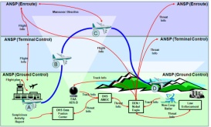
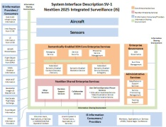
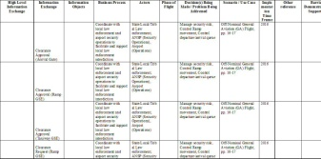
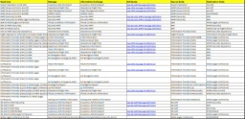

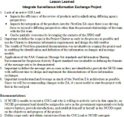
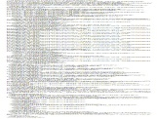
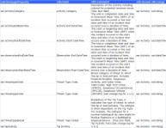
Example Deliverables
To-Be OV-5a
To-Be OV-1
To-Be OV-2
Business Process
Model
To-Be OV-5
Deliverable Cover Sheet
Integrated Surveillance
Information Exchange Project
To-Be SV-1
(Layered)
To-Be SV-1
Information Exchange
Evaluation Matrix
To-Be SV-4
To-Be OV-3/SV-6
To-Be SV-5
Lessons
Learned
XML
Vocabulary /
Ontology

Slide 6
Semantic Metadata Catalog and Portal
SOA Registry Scope
Governed within an Agency
Focused on discoverability of published services
Supports only flat, non-semantic data
Focused on governance
Semantic Metadata Catalog and Portal Extended Capabilities
Utilizes existing SOA Registry capabilities
Addresses cross-agency information exchanges
Facilitates collaboration
Focuses on discoverability of defined information exchanges
Takes full advantage of Semantic Relationships defined in ontologies
Bottom Line:
Utilizes semantic discovery capabilities
Yields a more targeted result set
Provides an intelligent search beyond simple keywords

Slide 7



Semantic Metadata Catalog and Portal Architecture
Weather Community
Service
Registration
and Discovery
Semantic Metadata Catalog and Portal
JPDO User Interface Layer
Semantic Processing Layer
Semantic Metadata Catalog
Existing SOA Registry
Integrated Surveillance Community
Service
Registration
and Discovery
Semantic Metadata Portal
NextGen Ontology Community
Integration Layer
Web Services Layer
Integration
of
Federated
Registry
Ontology Portal
UDDI
Artifact Catalog
ebXML
External Systems
GIIEP
SWIM
Access
Color Key:
Semantic
External
Future

Slide 8
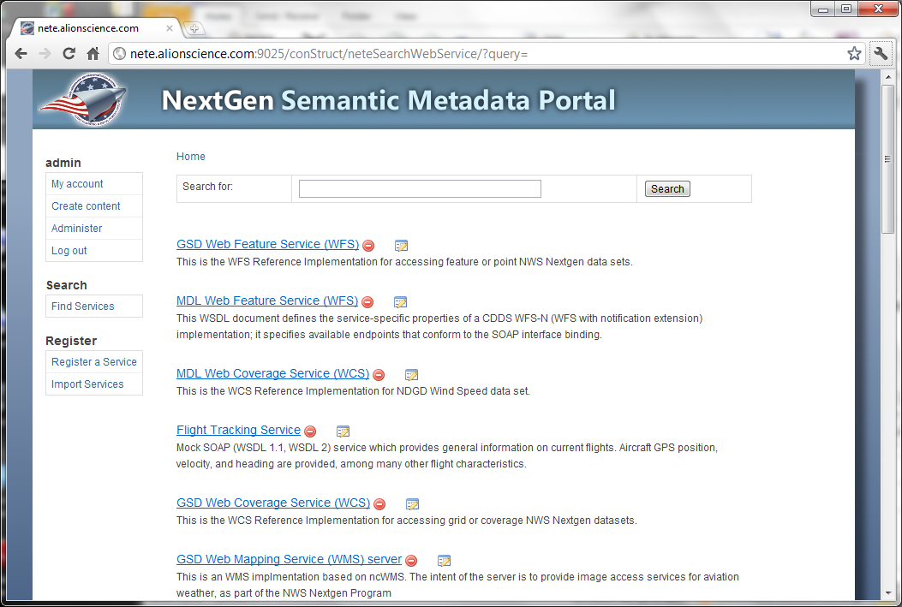
Demo: Semantic Metadata Catalog and Portal

Slide 9
Demo: NextGen Ontology Portal
Purpose:
  To be a collaborative web application through which users can publish, access, search, browse, map, and update ontologies and their terms.
  Reference Implementation only
Supports:
  COI participants (e.g., ontologists, SMEs, and enterprise architects), developers and managers.
National Center for Biomedical Ontology BioPortal | Marine Metadata Interoperability Ontology Registry and Repository
Air Force Vocabulary OneSource | Open Biomedical Ontologies Foundry
Example Portals

Slide 10
Questions

