Slide 1
USGS Needs and Advancements in Semantics of Geospatial Data and CyberGIS
E. Lynn Usery and Dalia Varanka
usery@usgs.gov
dvaranka@usgs.gov
http://cegis.usgs.gov

Slide 2
Objectives
I will focus on the need to process and support our large datasets and intensive computation and the need for semantics of geospatial data to address scientific and everyday problems with CyberGIS.
Accomplishments
Parallel version of mapIMG
Implementation in CyberGIS project
Advances in semantics that in the future will be implemented as a part of CyberGIS.

Slide 3
Outline
USGS CyberGIS Needs
Data Issues
Background – The National Map
Computation
Intelligence
USGS CyberGIS Research
Grid/parallel computing
Social Media
Ontology and Semantics for Geospatial Data
CEGIS Topographic Semantics and CyberGIS Vision

Slide 4
Data ISSUES
Volume – multiple nationwide datasets at high resolution
Structure – variety of structures, vector and raster, many different formats
Semantics – various attribution and relation schemes, some feature-based, some layers
Integration of multiple datasets – for maximum utility all datasets should be able to be integrated to produce new data and information

Slide 5
Dataset | Geometry/ Format | Attribution/ Scaling | URL
National Hydrography Dataset (NHD) | Vector | Discrete/nominal | http://viewer.nationalmap.gov/viewer/nhd.html?p=nhd
National Transportation Dataset | Vector; tables | Discrete/nominal | http://viewer.nationalmap.gov/viewer/ http://gisdata.usgs.net/website/MRLC/viewer.htm
National Boundaries Dataset | Vector | Discrete/nominal | http://viewer.nationalmap.gov/viewer/
National Structures Dataset | Vector | Discrete/nominal | http://viewer.nationalmap.gov/viewer/
Geographic Names Information System (GNIS) | Vector | Discrete/nominal | http://geonames.usgs.gov/domestic/download_data.htm
National Elevation Dataset (NED) | Raster | Continuous/ratio | http://viewer.nationalmap.gov/viewer/ http://seamless.usgs.gov/website/seamless/viewer.htm
National Digital Orthophotos | Raster | Continuous/ interval | http://www.ndop.gov/data.html; http://viewer.nationalmap.gov/viewer/ http://gisdata.usgs.net/website/MRLC/viewer.htm
National Land Cover Dataset (NLCD) | Raster | Discrete/nominal | http://viewer.nationalmap.gov/viewer/ http://gisdata.usgs.net/website/MRLC/viewer.htm
Global Land Cover Dataset | Raster | Discrete/nominal | http://landcover.usgs.gov/landcoverdata.php
LiDAR | Point | Continuous/ratio | http://viewer.nationalmap.gov/viewer/
Satellite images | Raster | Continuous/interval | http://edcsns17.cr.usgs.gov/NewEarthExplorer/; http://glovis.usgs.gov/
Hazards (Earthquakes, Volcanoes) | Graphics | Multiple forms | http://earthquake.usgs.gov/hazards/; http://volcanoes.usgs.gov/activity/status.php
Minerals | Vector; text | Discrete/nominal | http://mrdata.usgs.gov/; http://tin.er.usgs.gov/mrds/ http://tin.er.usgs.gov/geochem/; http://crustal.usgs.gov/geophysics/index.html
Energy | Vector; databases | Multiple forms | http://energy.usgs.gov/search.html
Landscapes and Coasts | Reports | Discrete/nominal | http://geochange.er.usgs.gov/info/holdings.html
Astrogeology | Databases | Discrete/nominal | http://astrogeology.usgs.gov/DataAndInformation/
Geologic Map Database | Vector; maps; text | Discrete/nominal | http://ngmdb.usgs.gov/
Geologic Data Digital Data Series | Maps; tables | Discrete/nominal | http://pubs.usgs.gov/dds/dds-060/
National Water Information System | Graphics; tables | Continuous/ratio | http://wdr.water.usgs.gov/nwisgmap/
Floods and High Flow | Graphics; tables | Continuous/ratio | http://waterwatch.usgs.gov/new/index.php?id=ww
Drought | Graphics; tables | Continuous/ratio | http://waterwatch.usgs.gov/new/index.php?id=ww
Monthly Stream Flow | Graphics; tables | Continuous/ratio | http://waterwatch.usgs.gov/new/index.php?id=ww
Ground Water | Vector; tables; | Continuous/ratio | http://waterdata.usgs.gov/nwis/gw/; http://groundwaterwatch.usgs.gov/
Water Quality | Graphics | Continuous/ratio | http://waterdata.usgs.gov/nwis/qw/; http://waterwatch.usgs.gov/wqwatch/
National Biological Information Infra- structure (NBII) | Graphics; vector; geodatabases | Multiple forms | http://www.nbii.gov/portal/server.pt/community/nbii_home/236
Vegetation Characterization | Vector; databases | Multiple forms | http://biology.usgs.gov/npsveg/
Wildlife | Vector; text;video | Multiple forms | http://www.nwhc.usgs.gov/
Invasive Species | Vector; databases; graphics, image | Multiple forms | http://www.nbii.gov/portal/server.pt/community/invasive_species/221

Slide 6
The National Map – http://nationalmap.gov/
The National Map is a collaborative effort to improve and deliver topographic information for the nation
The goal of The National Map is to become the nation’s source for trusted, nationally consistent, integrated and current topographic information available online for a broad-range of uses

Slide 7
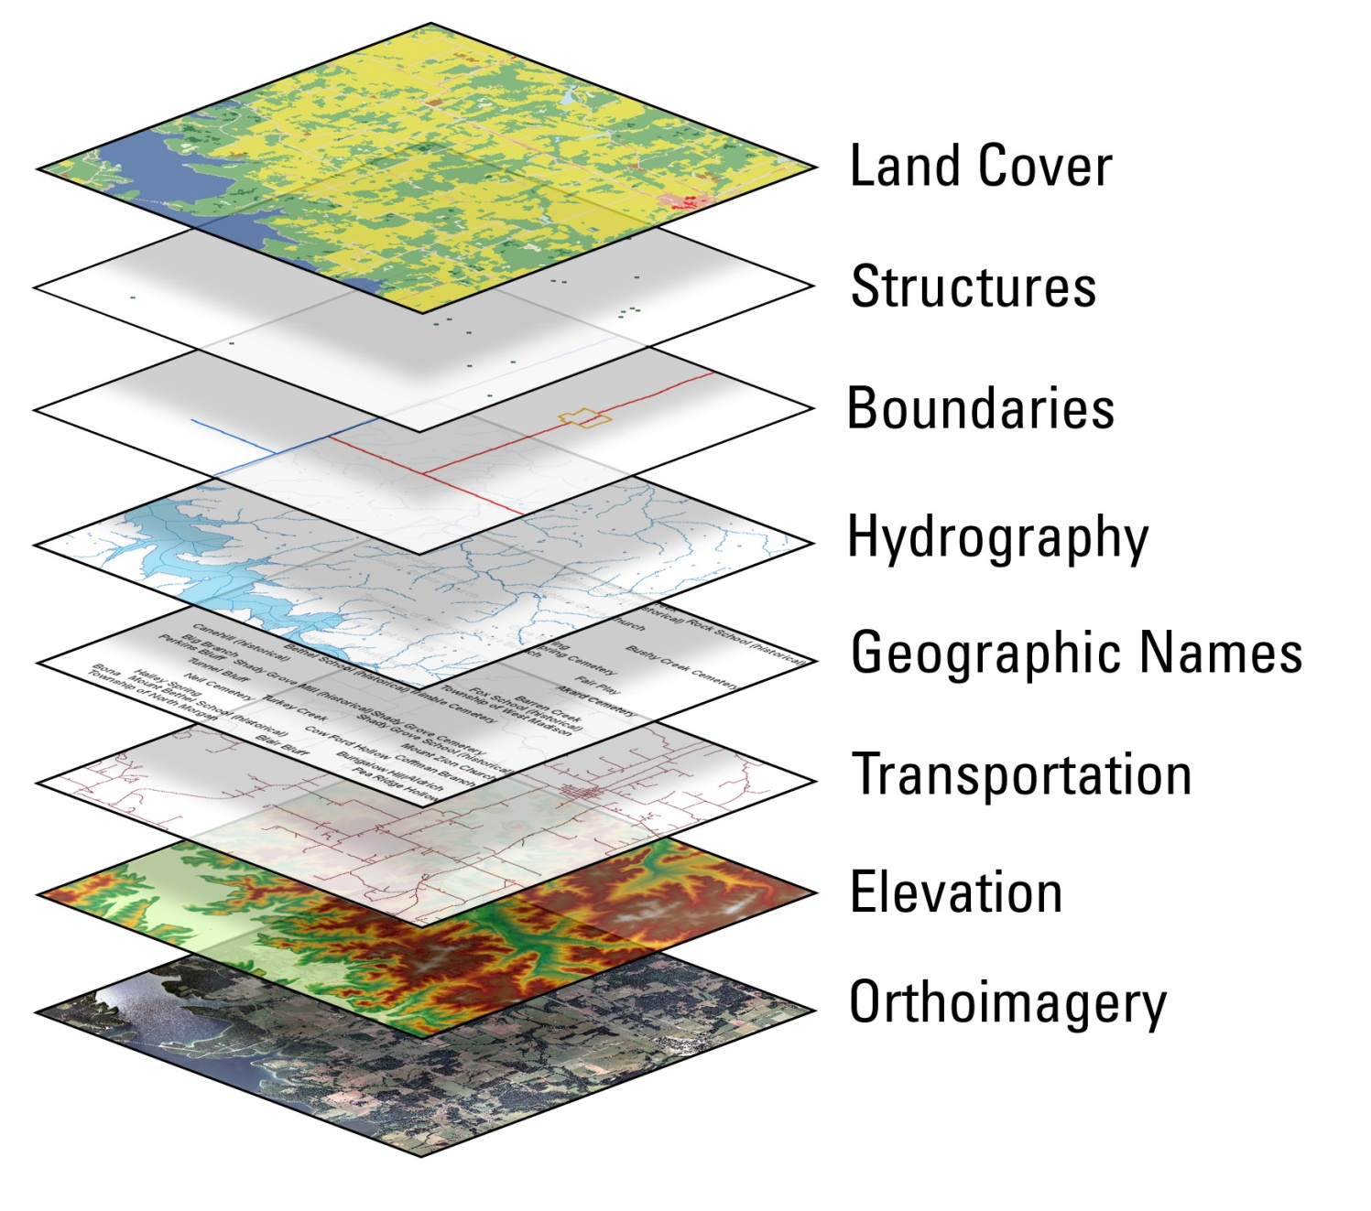
The 8 Layers of The National Map

Slide 8
Datasets of The National Map
National Land Cover Dataset (1992, 2000, 2006)
National Elevation Dataset (1,1/3,1/9 arc-sec)
National Digital Orthophoto Dataset (multiple dates, multiple resolutions, 1m, 1/3 m urban areas)
National Hydrography Dataset (NHD) (Medium, High, Local resolution)
Geographic Names Information System (GNIS)
National Structures Dataset
National Boundaries Dataset (US, state, county, minor civil divisions, governmental units)
National Transportation Dataset (TIGER and others)

Slide 9
Products of The National Map
Data display through The National Map viewer
http://viewer.nationalmap.gov/viewer/
Palanterra, joint development – NGA, ESRI, USGS
Display user selected TNM data
Data download of 8 layers Mashups with other data using KML

Slide 10
Products of The National Map
US Topo – New 1:24,000-scale topographic maps in GeoPDF; Complete U.S. coverage 2009-2011; available now for free download from USGS Map Store, beginning revision on 3-year cycle – Produce over 100 maps per day
http://nationalmap.gov/ustopo/index.html
Digital, georeferenced versions of all previous topographic maps for a specified 7.5-minute area; recent release of 90,000; > 180,000 total
http://nationalmap.gov/historical/

Slide 11
Computation
Complex calculations, e.g., map projection formulas
Must be applied to entire nationwide datasets which include multiple terrabytes to petabytes of data
Data query and search
By location
By feature or objects
http://viewer.nationalmap.gov/viewer/

Slide 12
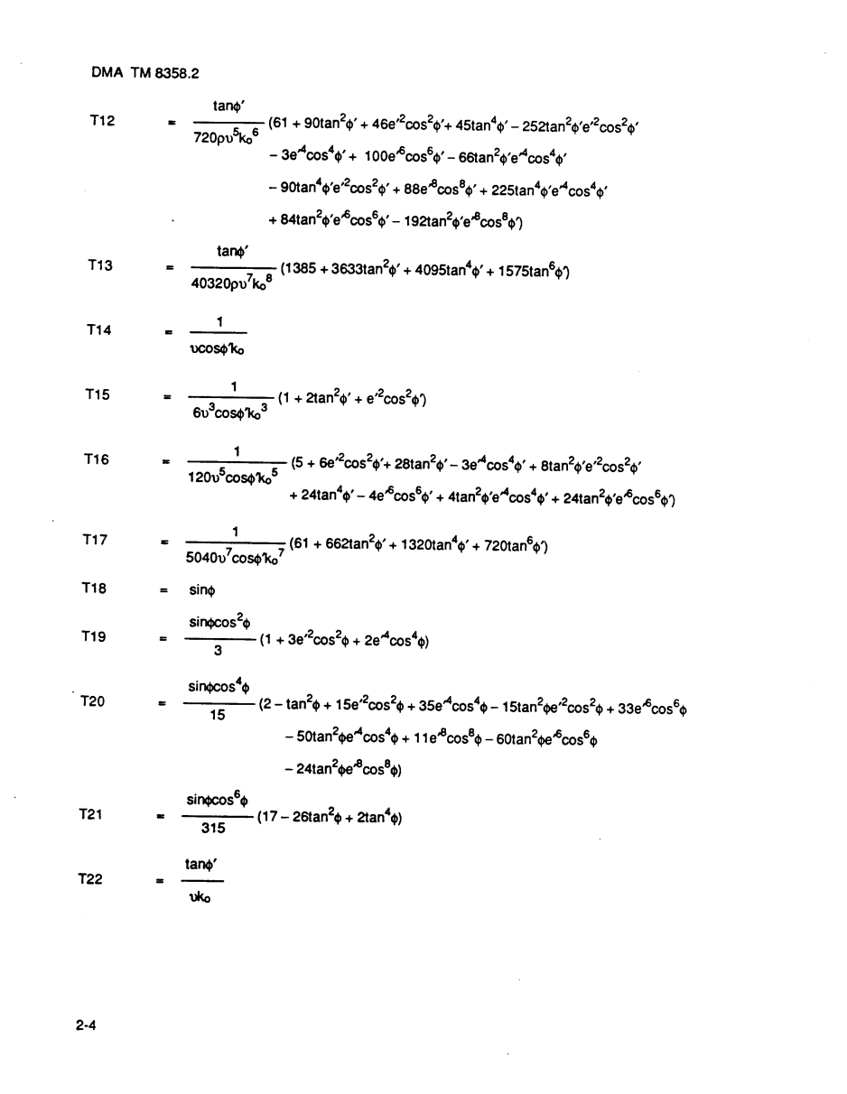
Example Map Projection Computation – UTM Coordinates

Slide 13
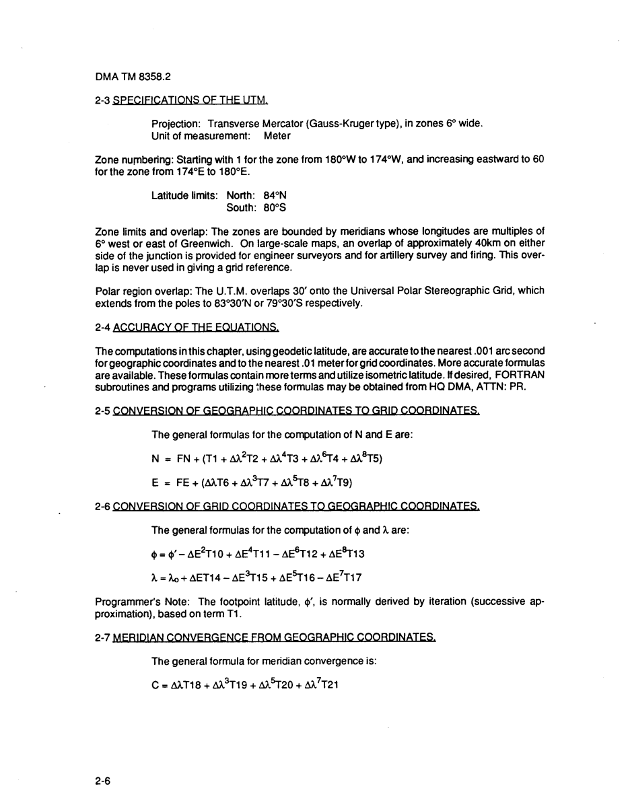
Example Map Projection Computation – UTM Coordinates

Slide 14
Example Map Projection Computation – UTM Coordinates

Slide 15
Intelligence
Ontology and Semantics
Ontology of features, attributes, and relationships: currently being developed.
Topographic vocabulary – available
Semantic Web triple format: Conversion for selected test areas is in progress.
Examples of Topographic Vocabulary and URIs for individual features

Slide 16
USGS CyberGIS Research – CEGIS
Grid/parallel computing
Internal project to move operations for The National Map to parallel/grid platform
Map projection of large datasets – mapIMG
Implemented in CyberGIS
Pre-processing for NHD generalization
Conversion of data to RDF

Slide 17
USGS CyberGIS Research – CEGIS
Social Media
Examining contributions of VGI to The National Map
Examining use of Twitter, Facebook, Flickr in research and production of geospatial data
Ontology and the Semantic Web
Taxonomy, ontology for The National Map
Conversion of vector and raster data to RDF
Implementation of a SPARQL Endpoint on USGS server for querying RDF data of The National Map
http://usgs-ybother.srv.mst.edu:8890/sparql

Slide 18
Ontology for The National Map

Slide 19
Feature Domains
Events
Divisions
Built-up areas
Ecological regime
Surface water
Terrain
Domains derived from ground surveys incorporated in DLG standards

Slide 20
Events
Security |  | Historical site
Hazard | Hazard zone | Military history | Archeological site
Earthquake | Incident | Historical marker | Cliff dwelling
Flood | Fire | Tree | Ruins
Area to be submerged | Restricted area

Slide 21
Divisions
Civil Units |  | Boundaries
Cadastral | Nation | Fenceline
Parcel | Territory | Hedge
Public Land Survey System | Tribal reservation | Place
Land grant | State | Region
Homestead entry | County | Locale
Survey line | Census | Boundary line
Principle meridian | State | Boundary point
Baseline | County | Hydrologic unit
Survey point | Census county division
Point monument | Block group | Shipping
Survey corner | Block | Lane
Government unit | Tract | Traffic separation scheme area
Municipality | Special use zone | Pilot water
City | Time zone | Roundabout
Town | Nature reserve | Inshore trafic zone
Villiage |  | Exclusive Economic Zone

Slide 22
Built-up
Transportation and warehousing | 60
Entertainment and Recreation | 26
Utilities | 16
Resource Extraction | 13
Structure | 12
Agriculture and Fishing | 11
Military | 10
Communication | 7
Waste Management | 7
Real Estate | 6
Place of Worship | 6
Manufacturing | 4
Institutions | 3
Burial Grounds | 3
Disturbed Surface | 3
Trade | 3

Slide 23
Ecological Regime
Tundra
Desert
Grassland
Scrub
Forest
Pasture
Cultivated Cropland
Transition area
Nature reserve

Slide 24
Natural/Artificial
Reach
hasPart: Bottom
Channel
Pond
Basin
Natural |  |  |  | Artificial
Marine/Estuarine |  | Freshwater |  | Impounded | Diked | Channel | Flow Control
Cove |  | Watercourse | Waterbody | Reservoir | Levee | Siphon | Weir
Foreshore |  | Stream | Lake | Fish ladder | Embankment | Aqueduct | Lock
Flat |  | hasPart: Mouth | Ice cap (regional) |  | hasPart: Revetment | Canal | hasPart:Lock chamber
Ice field (regional) |  | hasPart: Source | Snow field (regional) |  | Dam | Flume | hasPart: Stram
Marine | Estuarine | hasPart: Streambed | Sastrugi (regional) |  | Masonry shore | Turning basin | Spillway
Ocean | Estuary | hasPart: Streambanks |  |  |  |  | Jetty
Sea | Bay | hasPart: Crossing |  |  |  |  | Breakwater
Gulf | Inlet | hasPart: Ford |  |  |  |  | Water intake
Submerged Stream |  | River |  |  |  |  | Pump
Shore |  | Creek
hasPart: Shingle |  | Brook
Shoreline |  | Arroyo
Beach |  | Rapids
Ice floe (regional) |  | Bend
Polyna (regional) |  | Falls
 |  | Cascade
 |  | Waterfall
 |  | Innundation area
 |  | Spring
 |  | Mud pot
 |  | Geyser
 |  | Slope spring
 |  | Ice berg (regional)
 |  | hasPart: Iceberg tongue
 |  | Glacier (regional)
 |  | Crevasse (regional)
Wetland
Marsh
Swamp
Bog
Surface Water

Slide 25
Terrain includes 58 USGS landform features
Aeolian | Delta | Island cluster | Quicksand
Arch | Dish | Isthmus | Reef
Bar | Divide | Karst | Ridge
Basin | Drainage basin | Lava | Ridge line
Beach | Dunes | Lava | Salt pan
Bench | Fault | Mineral pile | Shaft
Cape | Floodplain | Moraine | Sink
Catchment | Fracture | Mount | Solution chimneys
Cave | Fumarole | Mountain Range | Summit
Chimney | Gap | Peak | Talus
Cirque | Glacial | Peneplain | Terrace
Cliff | Ground surface | Peninsula | Valley
Coast | Hill | Pinnacle | Volcano
Crater | Incline | Plain
Crater | Island | Plateau

Slide 26
Topographic Vocabulary
Examples from:
Events
Divisions
Builtup
Ecological regime
Surface water
Terrain
Available from Ontology Project Webpage:
http://cegis.usgs.gov/ontology.html

Slide 27
Example of converted data and query of USGS SPARQL Endpoint

Slide 28
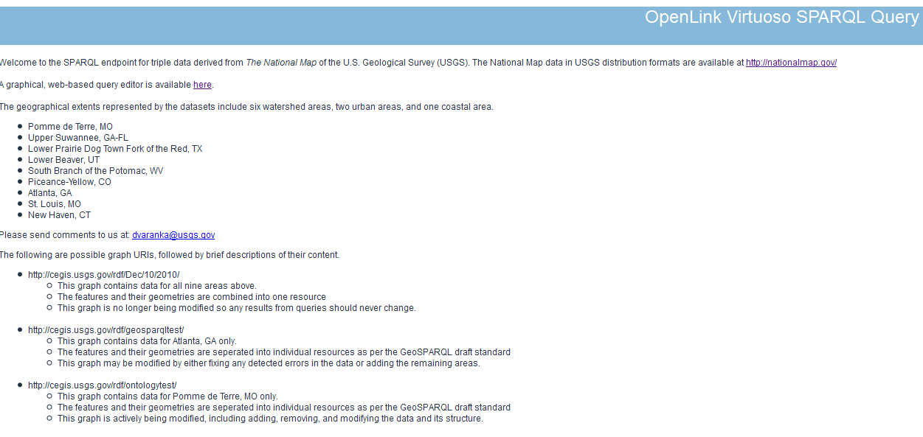
http://usgs-ybother.srv.mst.edu:8890/sparql

Slide 29
Query – Find the tributaries of West Hunter Creek
Default Graph URI
http://cegis.usgs.gov/rdf/ontologytest/
PREFIX ogc: <http://www.opengis.net/rdf#>
PREFIX fid: <http://cegis.usgs.gov/rdf/nhd/featureID#>
SELECT ?feature ?type
WHERE {
fid:_102217454 ogc:hasGeometry ?geo1.
?geo1 ogc:touches ?geo2.
?feature ogc:hasGeometry ?geo2.
?feature a ?type }

Slide 30
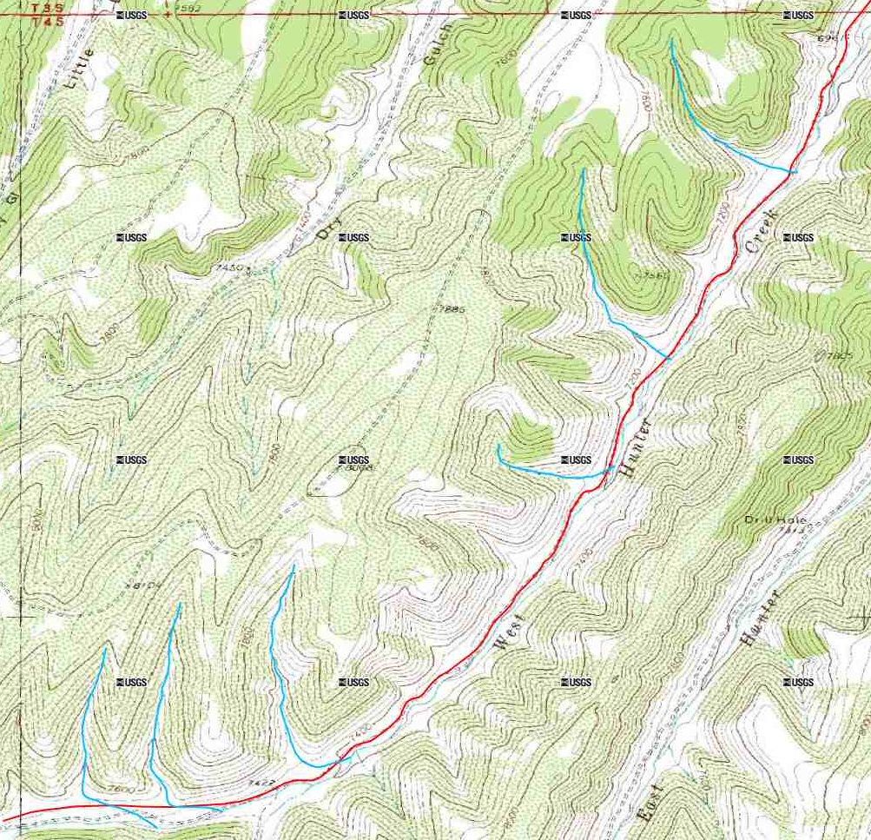
Query Result
http://cegis.usgs.gov/rdf/nhd/featureID#_102216432
http://cegis.usgs.gov/rdf/nhd/featureID#_102216448
http://cegis.usgs.gov/rdf/nhd/featureID#_102216340
http://cegis.usgs.gov/rdf/nhd/featureID#_102216320
http://cegis.usgs.gov/rdf/nhd/featureID#_102217454
http://cegis.usgs.gov/rdf/nhd/featureID#_102216276
http://cegis.usgs.gov/rdf/nhd/featureID#_102216358

Slide 31
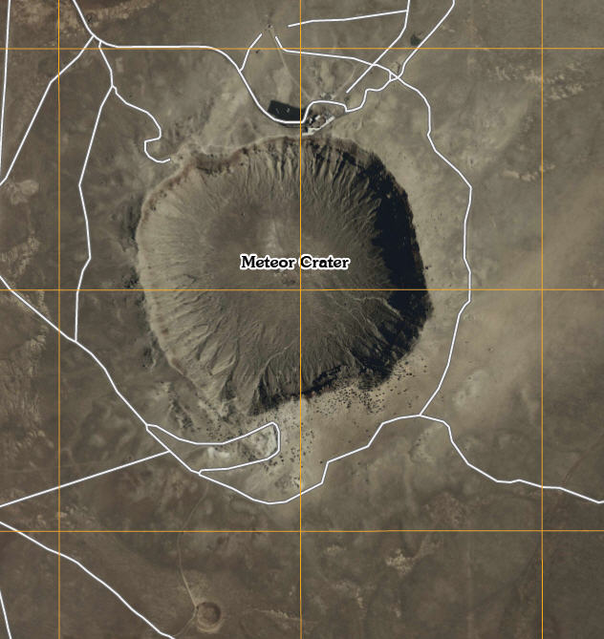
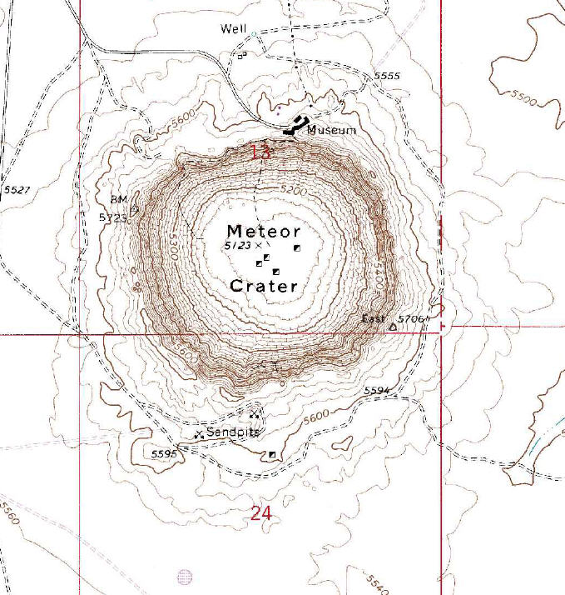
Meteor Crater Example Feature from Raster Data

Slide 32
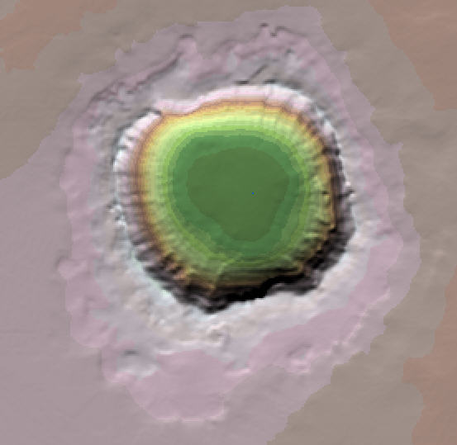
Meteor Crater – Shaded Relief Image

Slide 33
Meteor Crater Attributes and Relationships
Feature Crater
Definition Circular-shaped depression at the summit of a volcanic cone or
one on the surface of the land caused by the impact of a meteorite;
a manmade depression caused by an explosion (caldera, lua).
Instance Meteor Crater
GNIS ID 7945
Attributes
Location UTM E 497,959.94 m N 3,876,020.68 m Zone 12
PLSS T 19 N, R 12 1/2 E, Section 13 and 24
MBR Max E 498,536.79 m Min E 497,317.62 m
Max N 3,876,632.29 m Min N 3,875,479.58
Elevation High 5,723 ft
Low 5,123 ft
Depth 600 ft
Shape Circular
Inner Diameter 0.50 mi (0.833 km)
Outer Diameter 0.75 mi (1.25 km)
Rim width 0.125 mi (0.2 km)
Contour at outer perimeter 5,600 ft
Contour at inner perimeter 5,180 ft
Relationships
Surrounded by roads
Adjacent to Museum Museum Name: Meteor Crater Museum
Near sand pits
Near well
Benchmarks on crater BM 5723 BM East 5706
Table 2

Slide 34
Example of Meteor Crater in RDF/OWL

Slide 35
Major challenges for geospatial semantics and CyberGIS
Semantic spatial data model
Coordinates on the Semantic Web in RDF
Geospatial feature ontologies
Ontology-driven geospatial operators
Moving multi-GB to TB of data to grid/cloud
Implementing spatial operators on Semantic Web and in grid/cloud environment
Interfacing Semantic Web and grid/cloud capabilities

Slide 36
CEGIS Vision for Topographic Semantics and CyberGIS

Slide 37
The National Map becomes an intelligent topographic knowledge-base capable of responding to wide ranging public needs for geographic information.
Knowledgeable about geographic features as they exist in the world, not just their cartographic representations.
Accumulation of process knowledge about how these features interact, and how they change with time.
Capable of responding to a range of different queries as might be posed by users seeking geographic information.
Capable of delivering not just current information but information on past states and histories of features.
Capable of making projections on future states.
Aware of the quality of its information and capable of communicating variation in quality and uncertainty to users.

Slide 38
Research Needs
Geographic feature ontologies (hydrography, transportation, structures, boundaries, land cover, terrain, and image)
Geographic feature data models based on these ontologies, and an associated gazetteer replacing the Geographic Names Information System (GNIS)
Ontology-driven generalization, data integration, user-interfaces, map generation
Ontology-driven data models for quality aware features supporting time, change, and semantics-driven transaction
CyberGIS environment to make this research tractable and implementable

Slide 40
USGS Needs and Advancements in Semantics of Geospatial Data and CyberGIS
Questions?
E. Lynn Usery
Dalia Varanka
usery@usgs.gov
dvaranka@usgs.gov
http://cegis.usgs.gov

